Slide 1

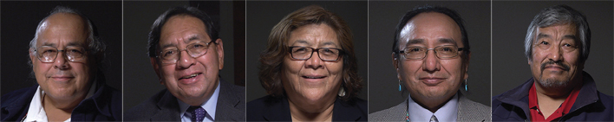
National Indian Health
Outreach & Education
2014 Elders & Seniors Initiative

Slide 2
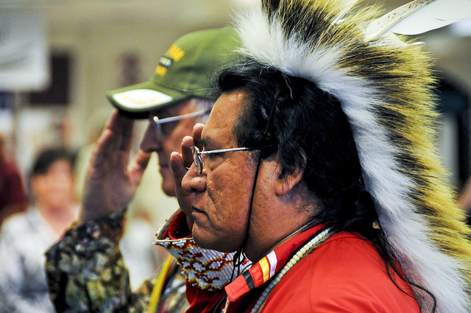
Learn More About
Affordable Care Act as Law
Strengthen Indian Health
Five Fast Facts about Medicare and the Affordable Care Act (ACA)
NIHOE Elders Projects & Toolkit
Notes:
During the today’s presentation we will cover core information about:
Affordable Care Act as law
Strengthen Indian Health
Five Fast Facts about Medicare and the Affordable Care Act
The National Indian Health Outreach & Education Initiative (NIHOE) Elders projects and toolkit

Slide 3
The Health Care Law
On March 23, 2010, President Obama signed into law the Patient Protection and Affordable Care Act (ACA)
More than 32 million people in this country who would otherwise not have health insurance now have access to health coverage
The ACA protects the rights of all Americans, including American Indians and Alaska Natives (AI/AN), to access affordable health care
Notes:
President Obama signed the Patient Protection and Affordable Care Act into law more than four years ago. The law is more commonly known as the “Affordable Care Act” or “ACA.”
Through the Affordable Care Act, more than 32 million individuals in this country, who would otherwise not have health insurance, now have access to health coverage. The new law has specific and unique benefits to tribal communities and people in a number of ways.
The ACA provides new opportunities for access to affordable or free health care coverage through the Health Insurance Marketplace and the expansion of Medicaid in some states. For American Indian and Alaska Native Elders who have Medicare, the Affordable Care Act strengthens their coverage and allows Elders to take charge of their own health.

Slide 4
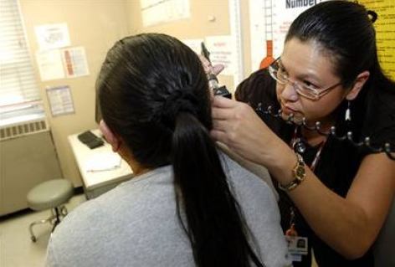
Health Care and Federal Trust Responsibility
The government’s historical and unique legal relationship with tribes is based on treaties, laws, and Supreme Court decisions
Health reform offers new opportunities to access health insurance to AI/AN citizens and employees
Indian Health Service offers health care to AI/AN citizens on or near Indian reservations and in some Urban Indian communities
Notes:
The Affordable Care Act marks a continued commitment to the historical and unique legal relationship with Tribes. Health care reform reaffirms the federal commitment to provide health care based on hundreds of treaties and numerous laws and Supreme Court decisions. The law supports, strengthens, and recognizes the entire Indian Health Service delivery system as the primary health system for American Indians and Alaska Natives, all the while providing new opportunities to access affordable or free health insurance through a variety of programs.

Slide 5

Health Care Law Benefits for Indian Country
Permanent reauthorization of the Indian Health Care Improvement Act
Strengthens the Indian Health Service delivery system
Increases affordability to health insurance coverage
Notes:
There are a number of provisions specific for American Indians and Alaska Natives under the law.
For instance, the law permanently reauthorizes the Indian Health Care Improvement Act (IHCIA), to maintain the Indian Health Service for future generations.
In addition to permanent reauthorization, health reform strengthens the entire Indian Health Service delivery system, workforce, and care. The law provides new opportunities for IHS, tribal, and urban Indian health facilities to collect additional revenues, offer more services, and serve their patients more effectively. The ACA also builds a pipeline for new health care professionals. This means more nurses, physicians and psychologists in Indian Country. It also means more culturally competent and efficient care when you visit the IHS clinic in your community.
The law also established the Health Insurance Marketplace to help control the cost of health insurance and allow individuals to have access to affordable coverage. Every health insurance plan in the Marketplace meets the Minimal Essential Coverage required in the law. In the Marketplace, consumers can compare insurance options based on price, benefits, quality, and other important features.

Slide 6
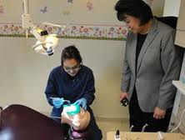
Strengthening Indian Health
Expanded Authority for IHS Service IHCIA prescribes the duties and responsibilities, which allows IHS to modernize its health care delivery systems and permit tribal governments to make technical changes in the future
Greater Workforce by increasing clinician recruitment and retention in IHS, Tribal, and urban facilities.
Increased revenue through third-party payments to I/T/Us that support both direct care and contract health care services.
Notes:
As I just briefly mentioned the IHS has new opportunities as health care delivery system.
First, IHS has new authorities to expand services. The reauthorization of the IHCIA, which prescribes the duties, responsibilities, and authorities of the Indian Health Service, allows IHS to modernize its health care delivery systems and permit tribal governments to make technical changes in the future.
Some of these new opportunities include:
New and expanded programs for mental and behavioral health treatment and prevention;
Long-term care services, including home health care, assisted living, and community-based care;
Dialysis services;
Funding of patient travel costs; and
Facilitated care for Indian veterans
Second, IHS can increase providers and nurses. The ACA can improve your local facilities by utilizing provisions of the law to expand your health care workforce through new resources that boost the number of doctors, nurses, and health care providers in American Indian and Alaska Native communities. The Health Resources and Services Administration (HRSA) designated all Indian Health Service, Tribal, and urban Indian health programs as National Health Service Corps (NHSC) sites, so vacancies can be filled in your clinics.
Lastly, IHS can increase revenue through third party billing. Medicare, Medicaid, the Children’s Health Insurance Program (CHIP), and private insurance covered populations increase payments to IHS to support both direct care and Preferred/Purchased Care services. This frees up IHS funds for expanded services. When private or government insurance money, otherwise known as third party billing, is added to the Indian health system, it helps to improve services for all American Indians and Alaska Natives. Third party billing adds new money because Tribal facilities can collect reimbursements from private insurance directly. More opportunities to bill outside the IHS system helps facilities and areas stretch the all-important Purchased/Referred Care dollars.
All this means that IHS is here to stay and is likely continue to get better as more and more American Indians and Alaska Natives are covered.

Slide 7
What if I have Medicare?
Medicare isn’t part of the Health Insurance Marketplace, so you don’t need to do anything.
If you have Medicare, you meet the Minimal Essential Coverage requirement. This means you are considered covered under the law!
  If you have Medicare Part A (Hospital Insurance) – You are covered!
  If you have both Medicare Part A and B – You are covered!
  If you only have Medicare Part B (Medical Insurance) – You are not covered!
  It is against the law for someone who knows you have Medicare to sell you a Marketplace plan.
Notes:
Medicare isn’t a part of the Health Insurance Marketplace. If you have Medicare, you are considered covered, and do not need to do anything in the Marketplace.
The Marketplace won’t affect your Medicare choices or benefits. No matter how you get Medicare, whether through Original Medicare or a Medicare Advantage Plan (like an HMO or PPO), you won’t have to make any changes.
Also, the Marketplace does not offer Medicare supplemental, also known as Medigap, insurance or Part D drug plans.
If you have Part A or Part A and B, you are considered covered.
If you only have Part B, you are not considered covered, and may have to pay a tax penalty for not having essential coverage. Visit www.healthcare.gov to view your coverage options through the Health Insurance Marketplace.

Slide 8
Five Fast Facts about Medicare and the Affordable Care Act (ACA)
The Affordable Care Act:
Offers improved Medicare prescription drug coverage.
Assures free annual wellness checkups and screenings
Provides new protections against elder abuse, neglect, and financial misuse.
Prevents insurance companies from denying coverage for preexisting conditions.
Makes affordable long-term care possible, including home health care, assisted living, and community-based care.
Notes:
The Affordable Care Act :
Offers improved Medicare prescription drug coverage.
Assures free annual wellness checkups and screenings
Provides new protections against elder abuse, neglect, and financial misuse.
Prevents insurance companies from denying coverage for preexisting conditions.
Makes affordable long-term care possible, including home health care, assisted living, and community-based care.

Slide 9
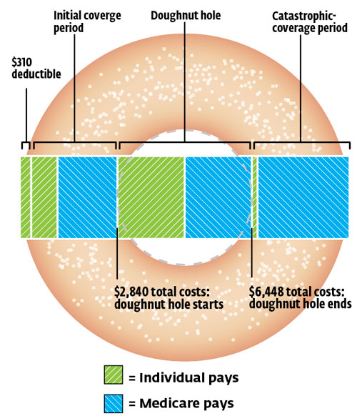
Save Money on Brand-Name Prescription Drugs
1. You get cheaper prescription drugs:
  If you’re in the “donut hole,” you’ll get a 50% discount when buying Part D-covered brand-name prescription drugs.
  The discount is applied automatically at the pharmacy. You don’t have to do anything extra to get the discount.
  What is the “donut hole”? It’s the Medicare Rx Drug Plan coverage gap, meaning there’s a temporary limit on what the drug plan will cover.
  The coverage gap or “donut hole” will be completely closed by 2020.
Notes:
You get cheaper prescription drugs.
If you’re in the donut hole, you receive a 50 percent discount when buying brand-name prescription automatically when you fill your prescription—you don’t have to do anything to get it.

Slide 10
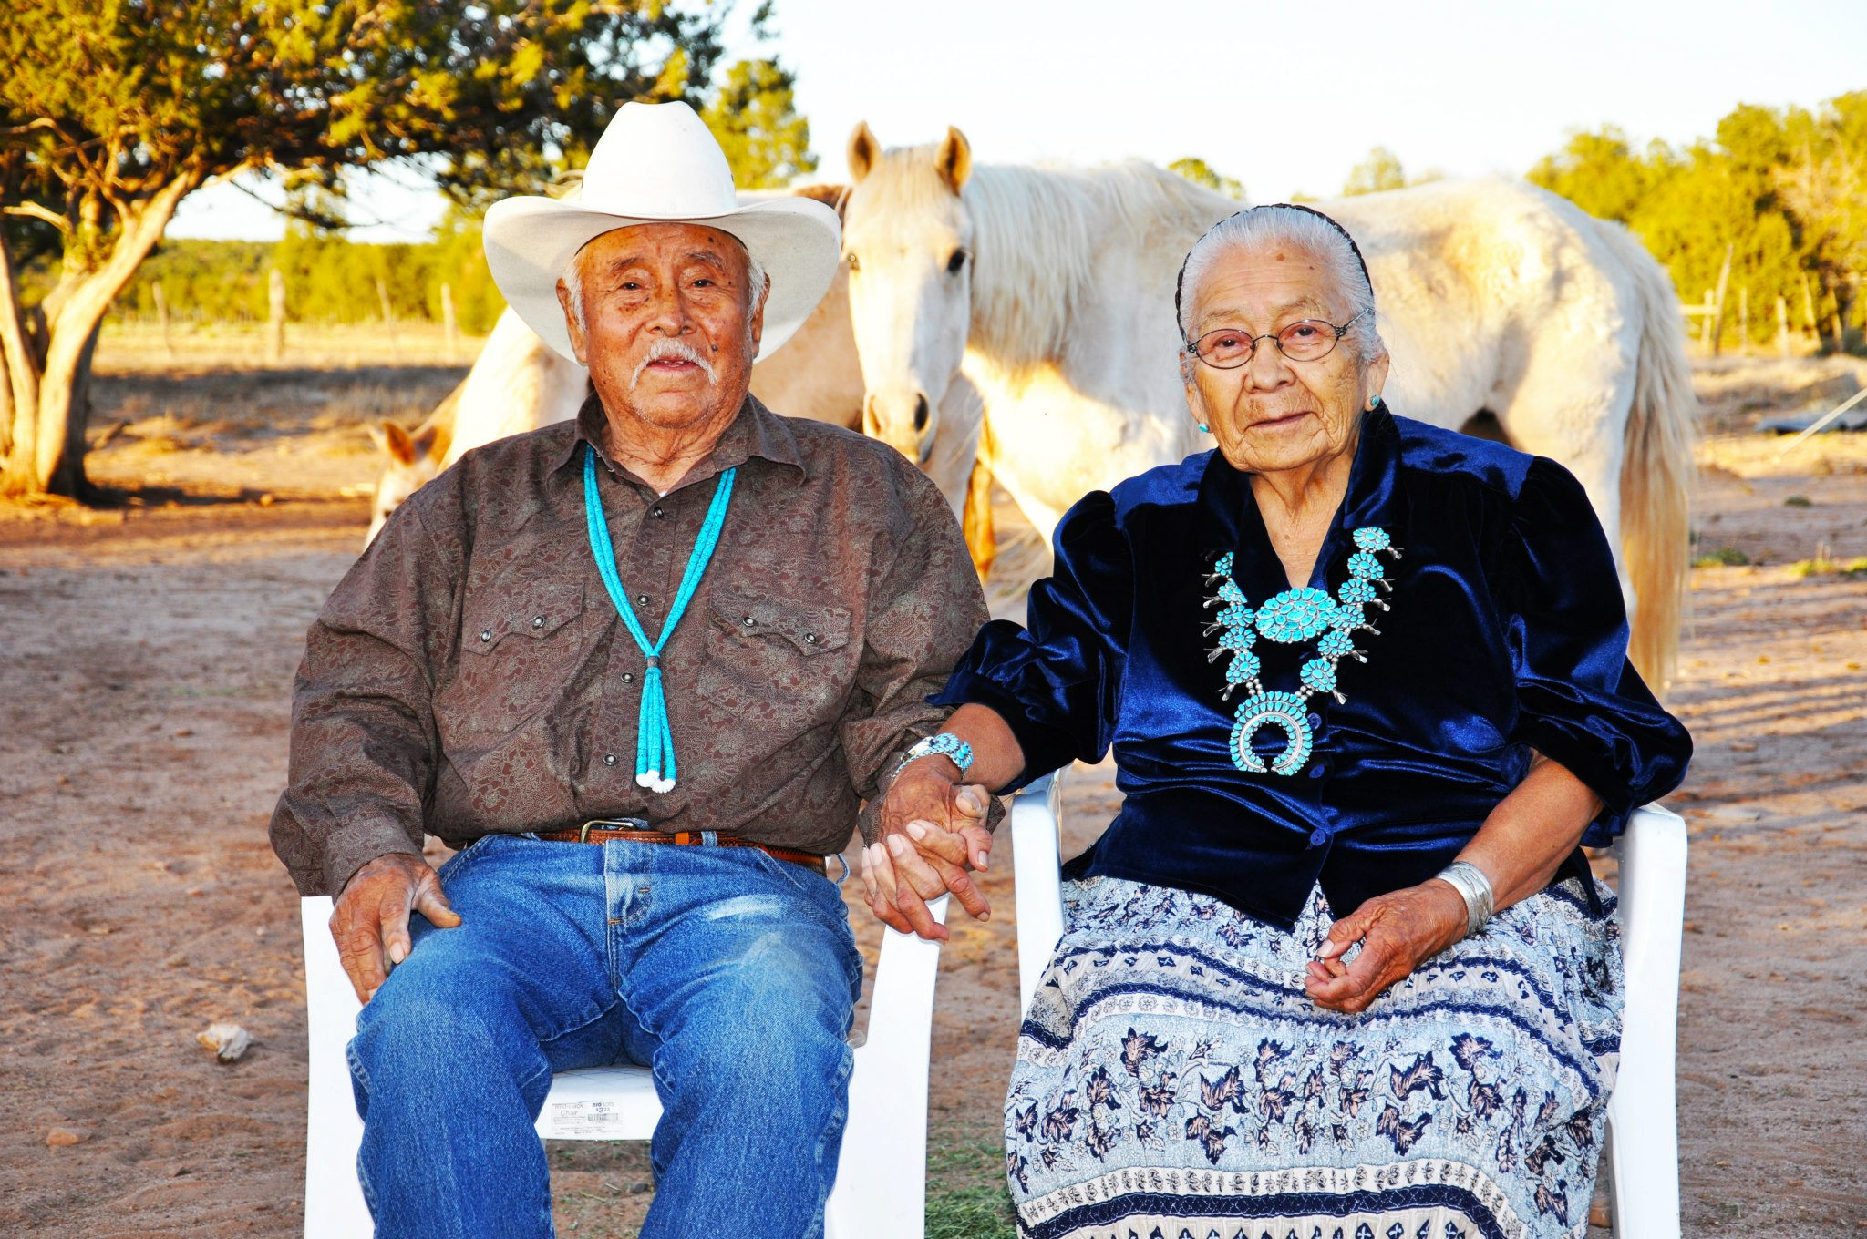
Free Preventative Services
You get free preventive services:
  Free annual wellness exams, so you and your doctor can map out a plan to keep you healthy.
  Free screenings, such as mammograms, colonoscopies, diabetes, high blood pressure, and high cholesterol.
  Free flu, pneumonia, and Hepatitis B shots.
  Free nutrition therapy to help people manage diabetes or kidney disease
Notes:
You get free preventive services.
Medicare now covers certain preventive services and free wellness checks.

Slide 11
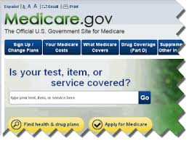
Protecting Your Care
3. Provides new protections against elder abuse, neglect, and financial misuse:
  Grant opportunities for workers that provide long-term care to ensure Elders’ safety.
  Tough new rules and sentences on criminals who commit health care fraud.
  Nationwide background checks for employees working with Elders.
Notes:
The law fights fraud, strengthens Medicare, and protects federal funding.
The Affordable Care Act builds efforts to combat fraud and abuse. These efforts are saving billions of dollars in money that was being stolen from people with Medicare.

Slide 12
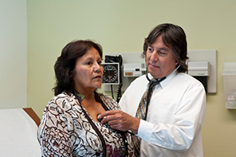
Coverage for Preexisting Conditions
4. Prevents insurance companies from denying coverage for preexisting conditions:
  You cannot be refused coverage for having asthma, diabetes, cancer, or other preexisting conditions.
  You will have to still pay deductibles and co-pay, as your plan outlines.
Photo courtesy of the Indian Health Service

Slide 13
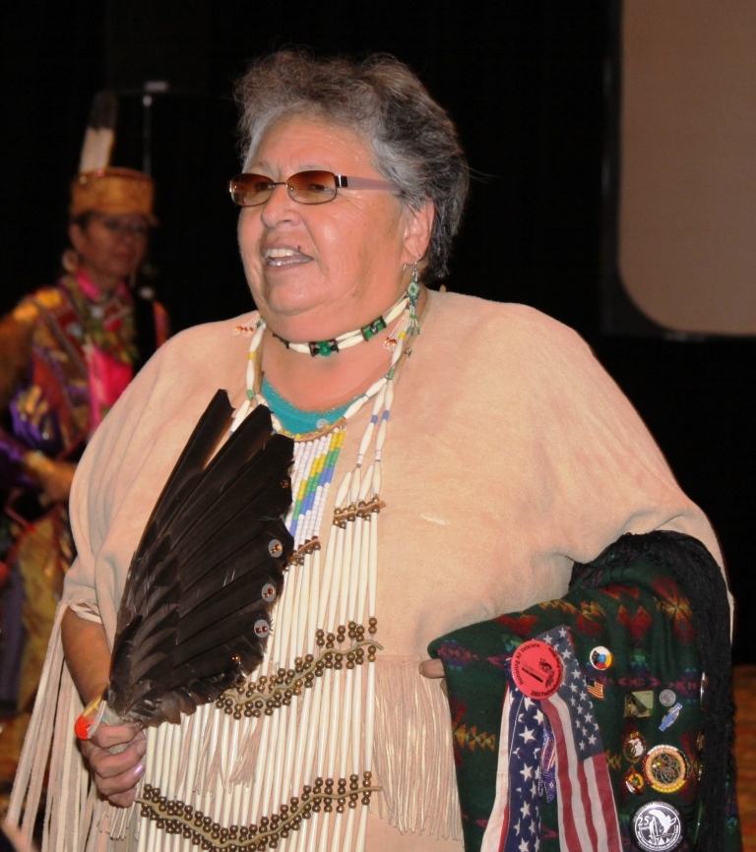
Protecting Medicare
5. Makes affordable long-term care possible, including home health care, assisted living, and community-based care:
  Funding available for states to strengthen access to long-term care for elders in their homes or communities.

Slide 14
Sign up for Medicare
Apply online at Social Security Administration’s website: www.ssa.gov.
Visit your local Social Security office.
Call Social Security at 1-800-772-1213. TTY users should call 1-800-325-0778

Slide 15
Tribal Elders ACA Toolkit
The ACA AI/AN Elders Toolkit includes:
A PowerPoint presentation on the ACA and Medicare.
A 60-second Public Service Announcement (PSA) on the Fast Five Facts of how the ACA strengthens Medicare.
A tri-fold brochure outlining the Fast Five Facts and providing more information on the ACA and how it affects AI/AN elders.
Posters on the Fast Five Facts.
An ACA-theme meal placemat with the Fast Five Facts and a special ACA word search on the reverse side.
A bingo game with ACA terms as the call sheet.

Slide 16

Elders Public Service Announcement
Notes:
As a part of the National Indian Health Outreach and Education initiative, funded by the Indian Health Service, NIHB produced a 60-second Public Service Announcement on how the ACA strengthens Medicare for American Indian and Alaska Native elders.
The PSA was shot on location during the National Congress of American Indian’s Annual Convention in Tulsa, OK in October 2013.
The folks in the PSA may be familiar, as they are prominent leaders in Indian Country, and who are staunch advocates for quality health care for all tribal peoples.
You’ll see:
Frank Ettawageshik, Executive Director of the United Tribes of Michigan
Arlen Melendez, Chairman of the Reno-Sparks Indian Colony
Cecilia Fire Thunder, former President of the Oglala Lakota Nation
Rex Lee Jim, Vice President of the Navajo Nation
Mike Williams, Tribal Councilman of the Akiak Native Community
All stating the Fast Five Facts of Medicare and the ACA.

Slide 17
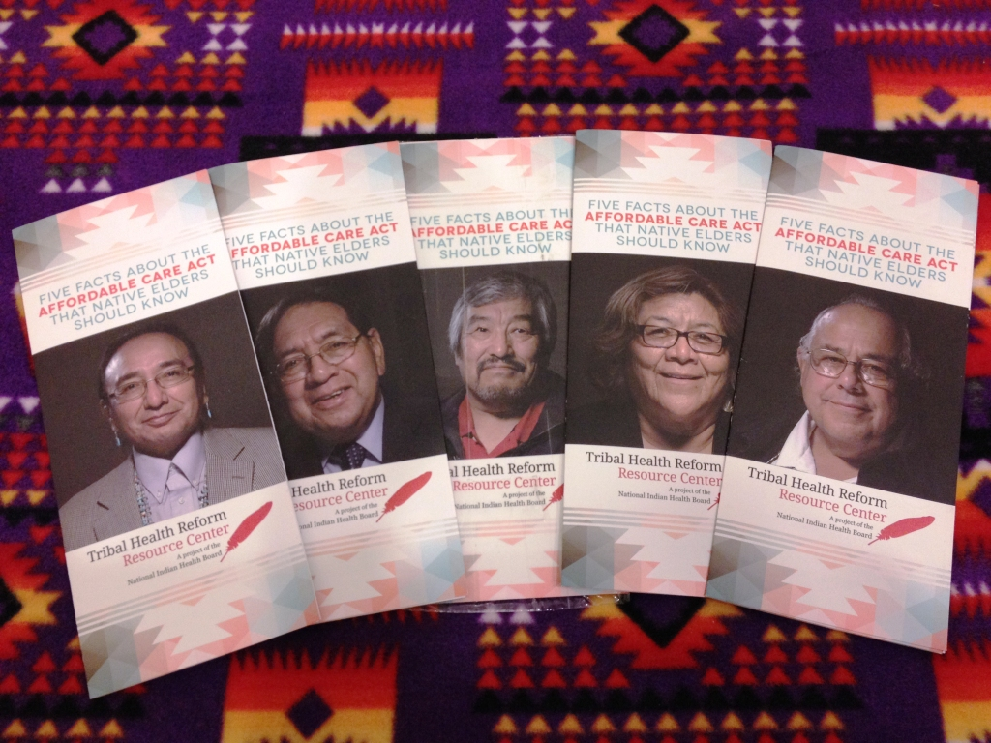
Elders Outreach Materials
Brochures

Slide 18
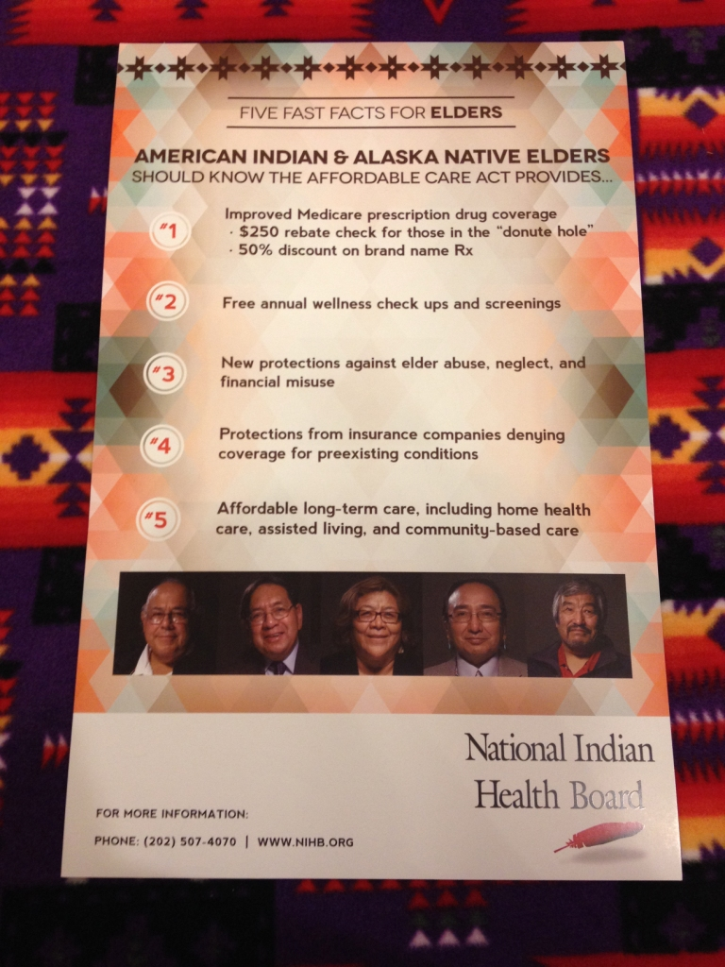
Elders Outreach Materials
Posters

Slide 19
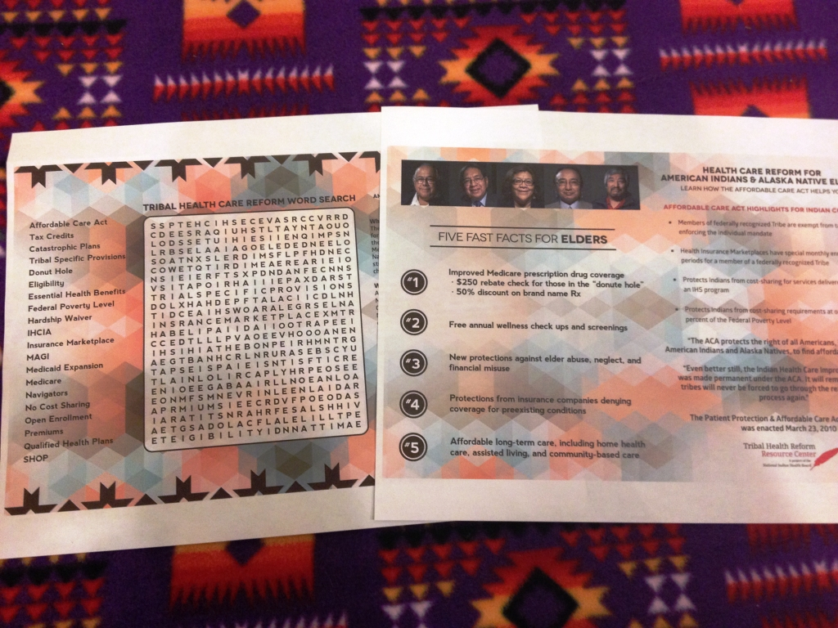
Elders Outreach Materials
Activity Placemat

Slide 20
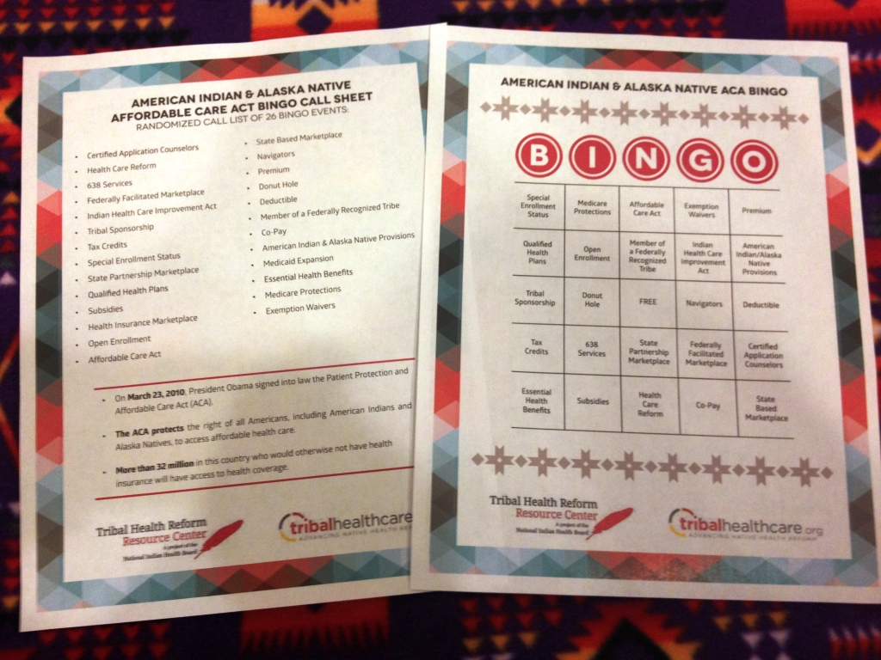
Elders Outreach Materials
Bingo Game

Slide 21
Where and How to Use the Toolkit
Tribal senior citizen centers, chapter houses, community centers, assisted living centers and nursing care centers.
PowerPoint presentation, PSA, and brochure can be used by staff at these centers to educate elders on the ACA and Medicare.
Posters may be printed and displayed at the centers or given out to the community.
Placemat and bingo game are activities for a meal or luncheon gathering to put a fun spin on learning about the Affordable Care Act.

Slide 22
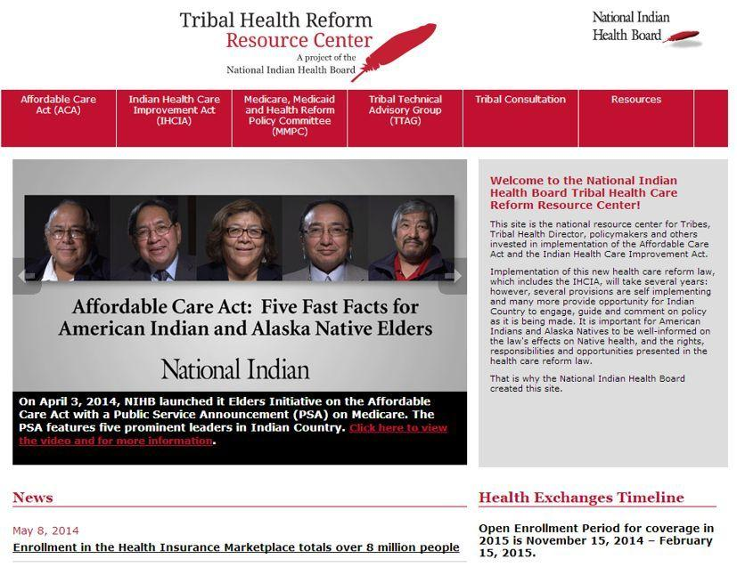
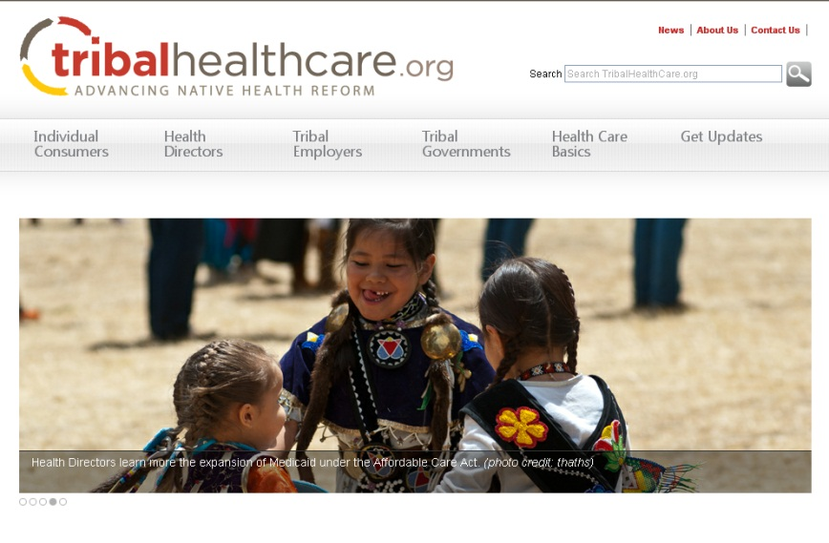
Your Tribal Health Reform Resources
These two websites have two purposes:
Provide consumer-oriented education materials
Provide training tools for American Indians and Alaska Natives on ACA & IHCIA
Notes:
NIHB’s Tribal Health Reform Resource Center website is updated weekly with the most recent information on the Health Insurance Marketplace, Medicaid Expansion, Indian exemptions, and general ACA news. We are also created an event calendar, so please send us your event information and we’ll make sure it gets posted on the website.
www.tribalhealthcare.org was launched in May 2012 and offers resources about insurance, health care, and laws for various consumer groups. The site serves as a portal for stakeholders to receive updates on implemented provisions, education materials, health care reform and e-resources that clearly explain health reform changes and its impact for Tribal communities.
www.ihs.gov

Slide 23
Order Your Tribal Elders
ACA Toolkit Today
Contact NIHB at 202-507-4070 or visit www.nihb.org/tribalhealthreform to order your Tribal Elders Affordable Care Act Toolkit today!

