Slide 1

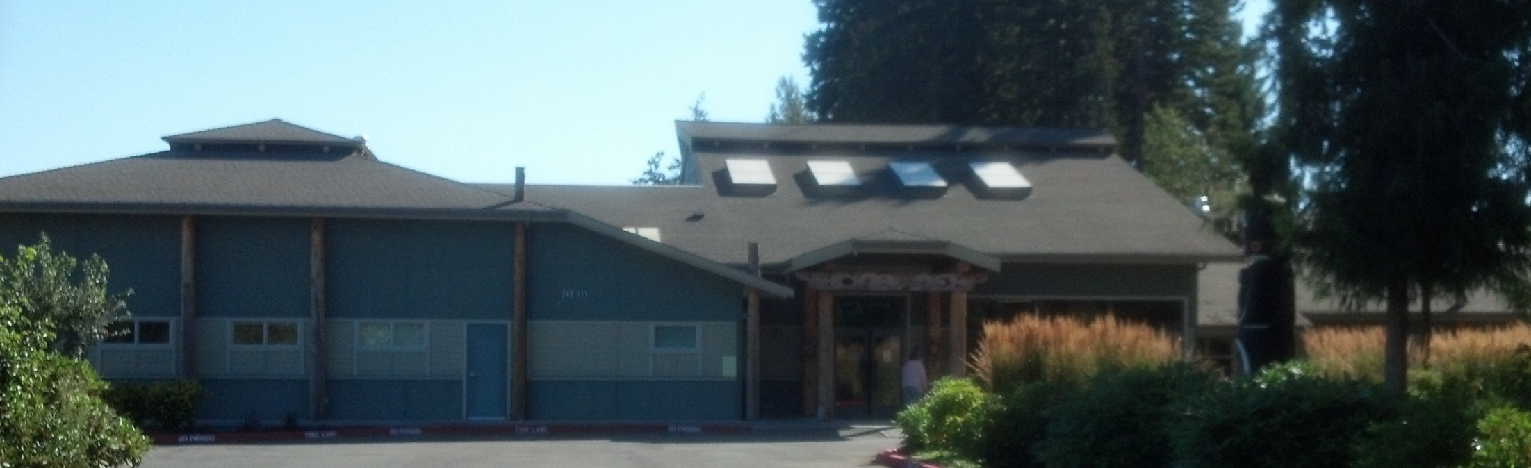

Health Department Updates
September 2012

Slide 2
Elwha Klallam Health and
Emergency Preparedness Fair
August 24, 2012

Slide 3
176 Participants and 22 Vendors
Awesome!

Slide 4
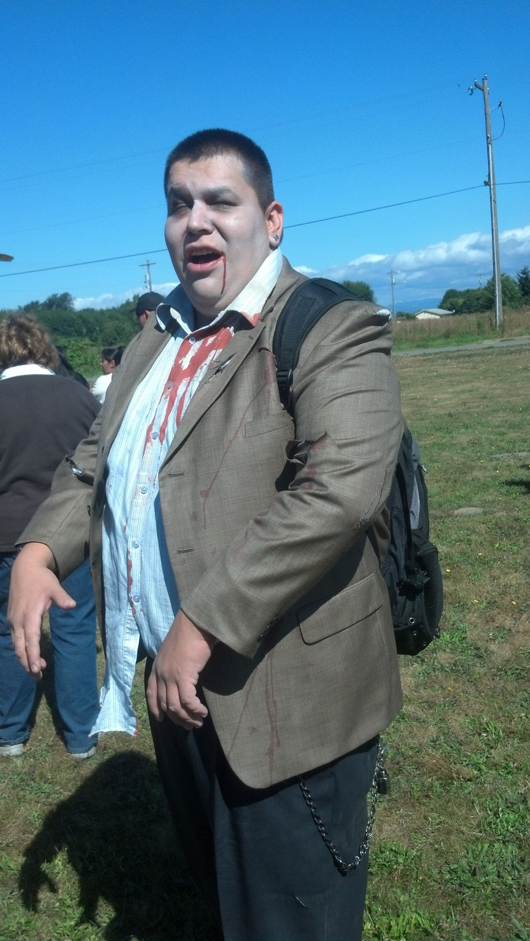
Zombies wearing sport coats?
We called in reinforcements!

Slide 5
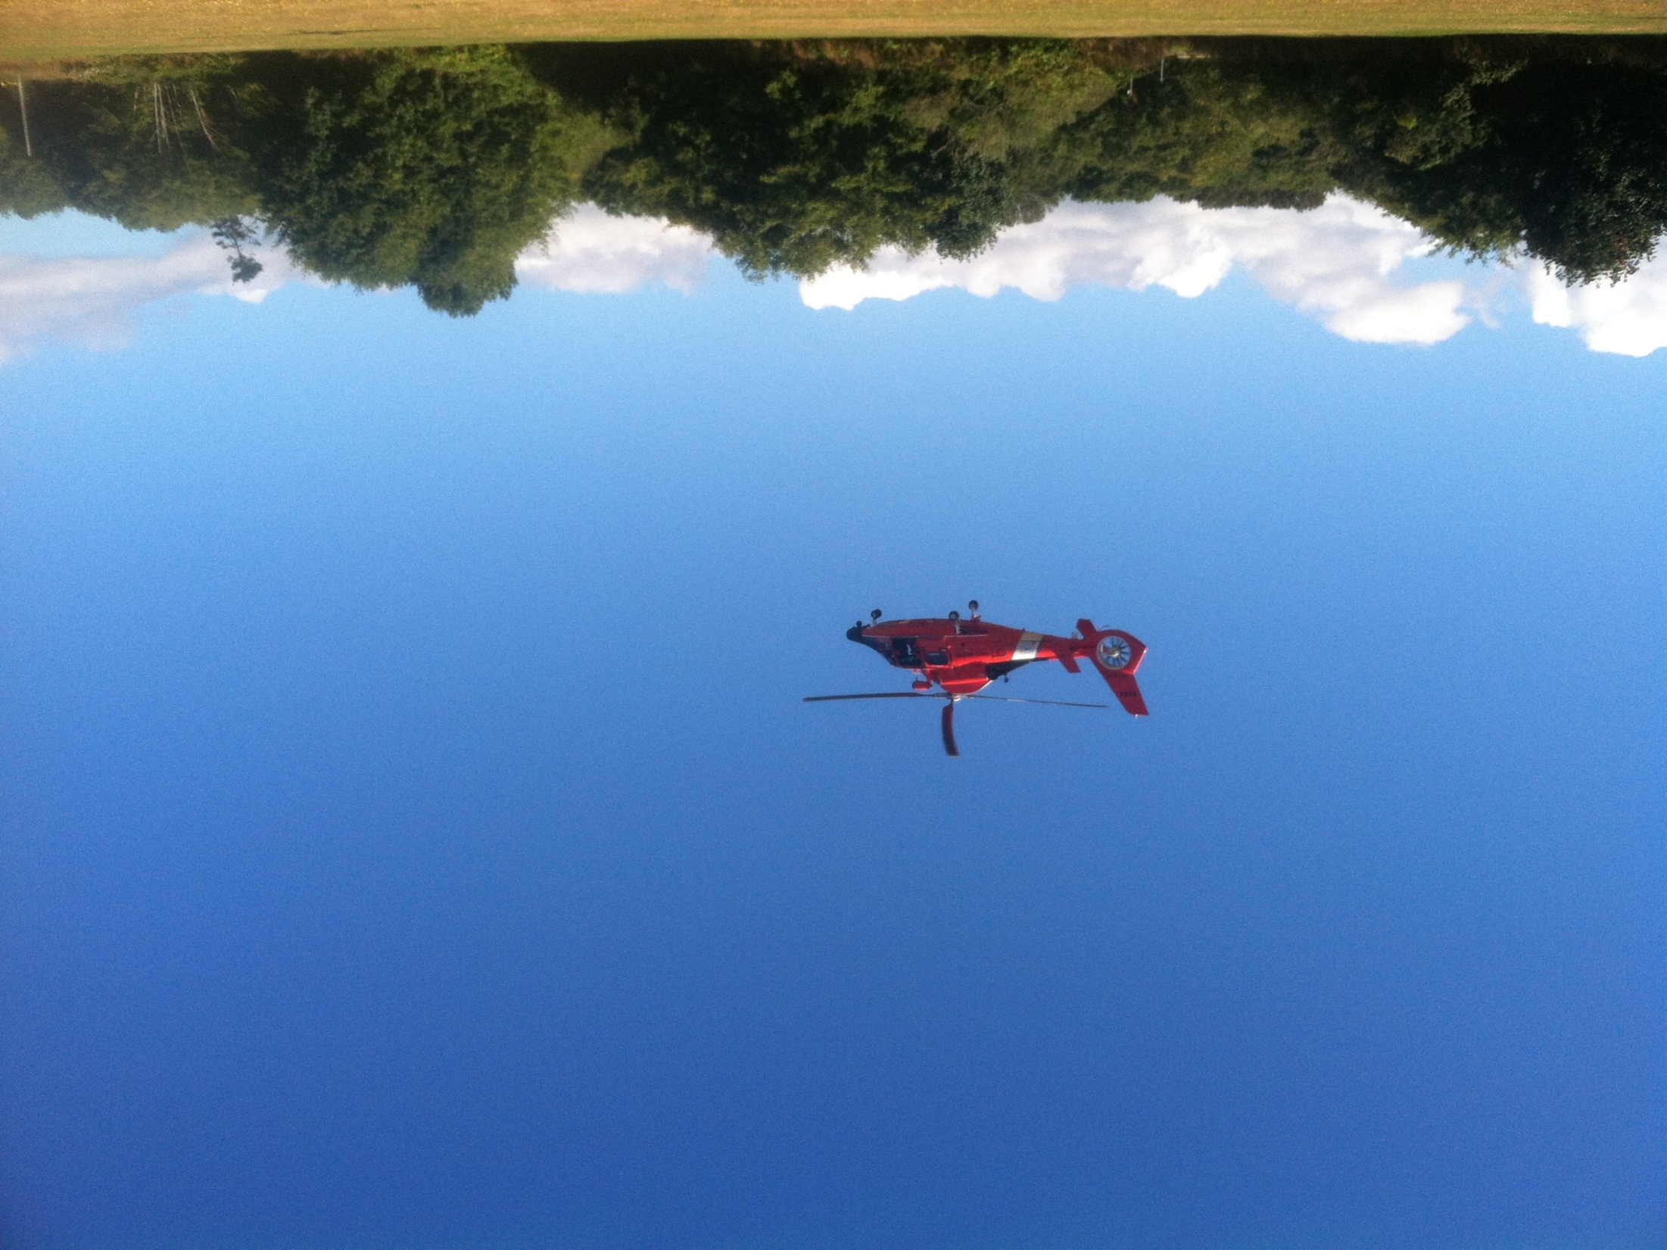

Slide 6
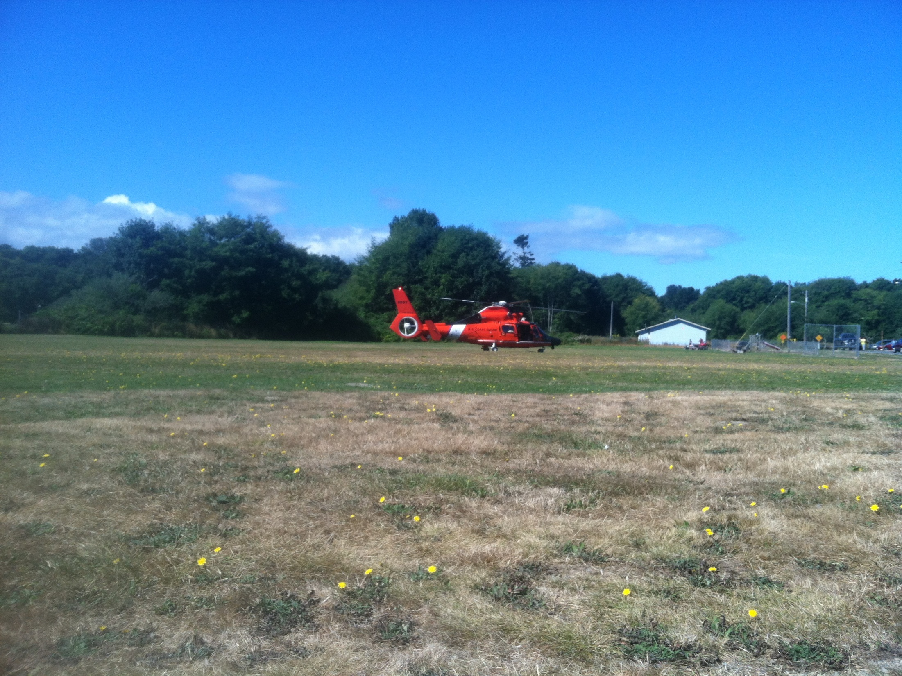

Slide 7
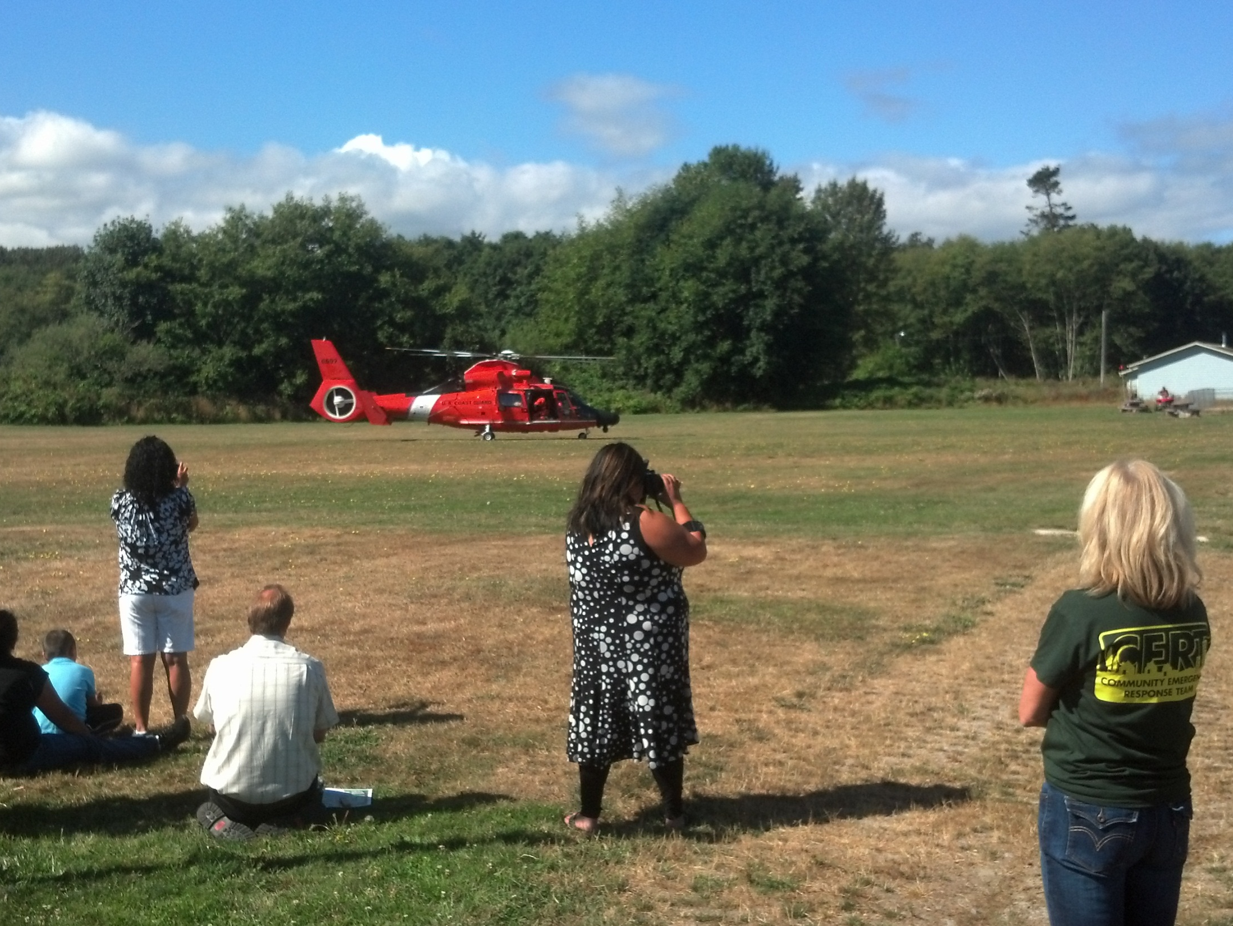

Slide 8
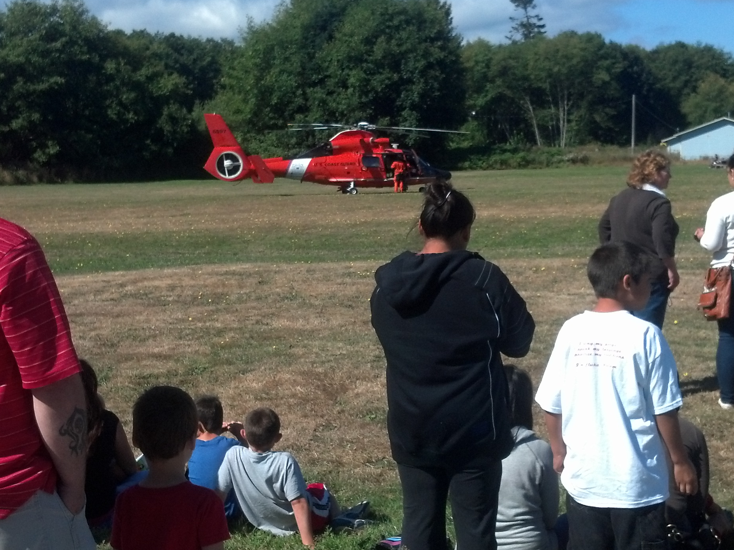

Slide 9
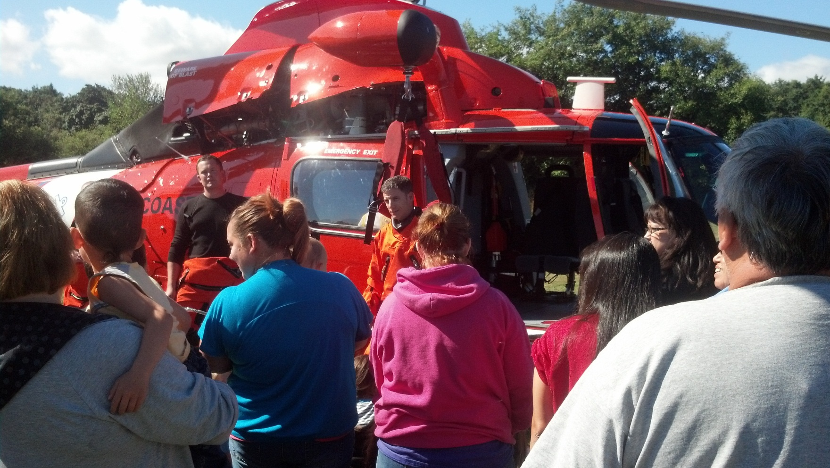
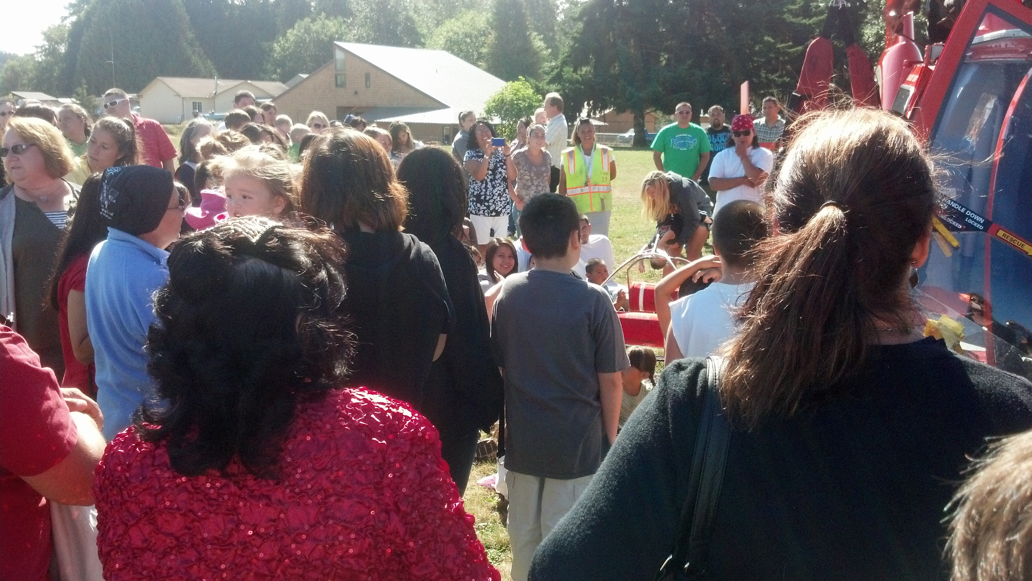

Slide 10
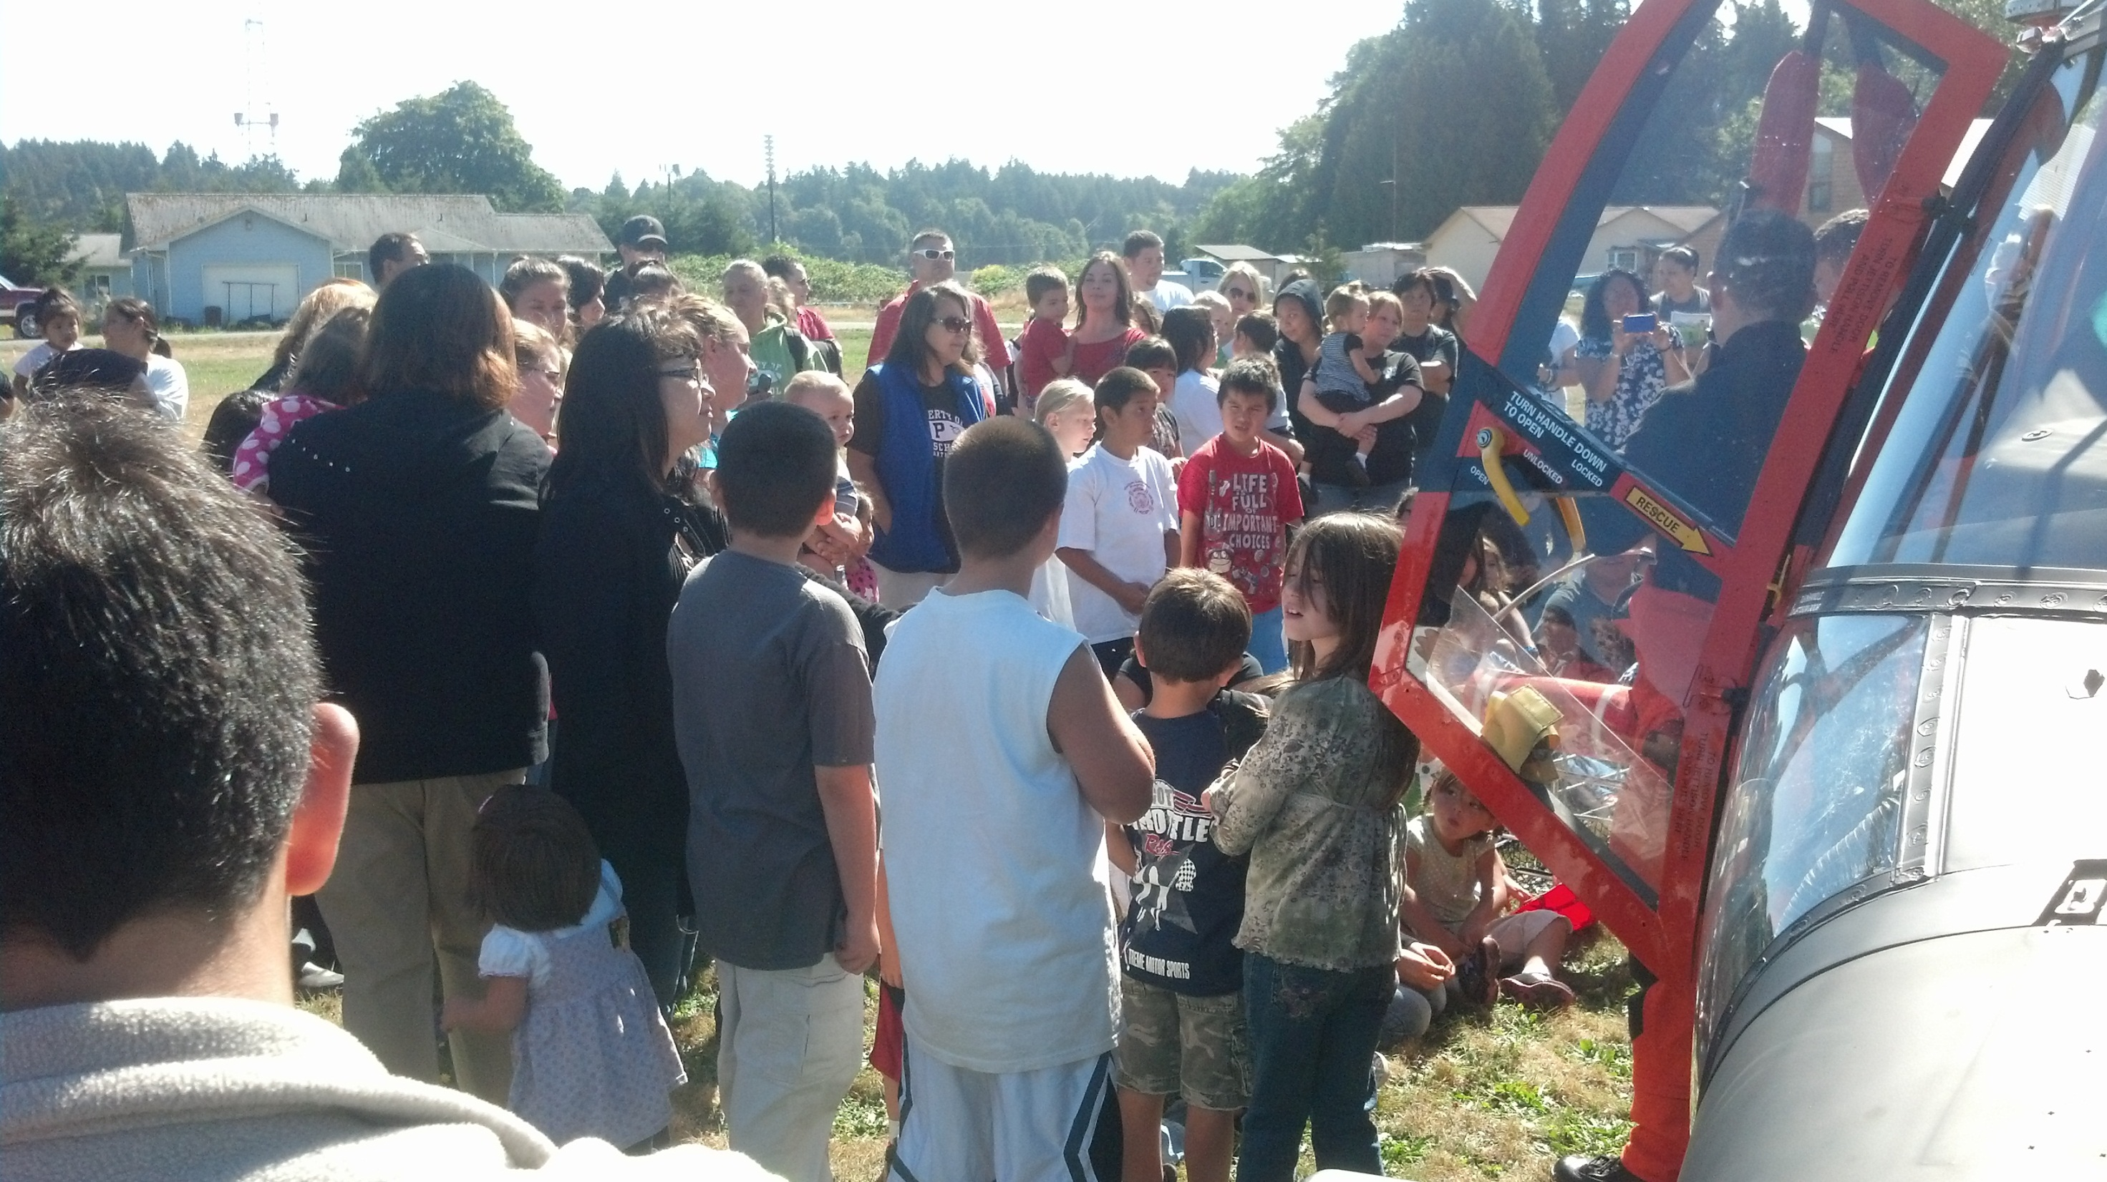

Slide 11
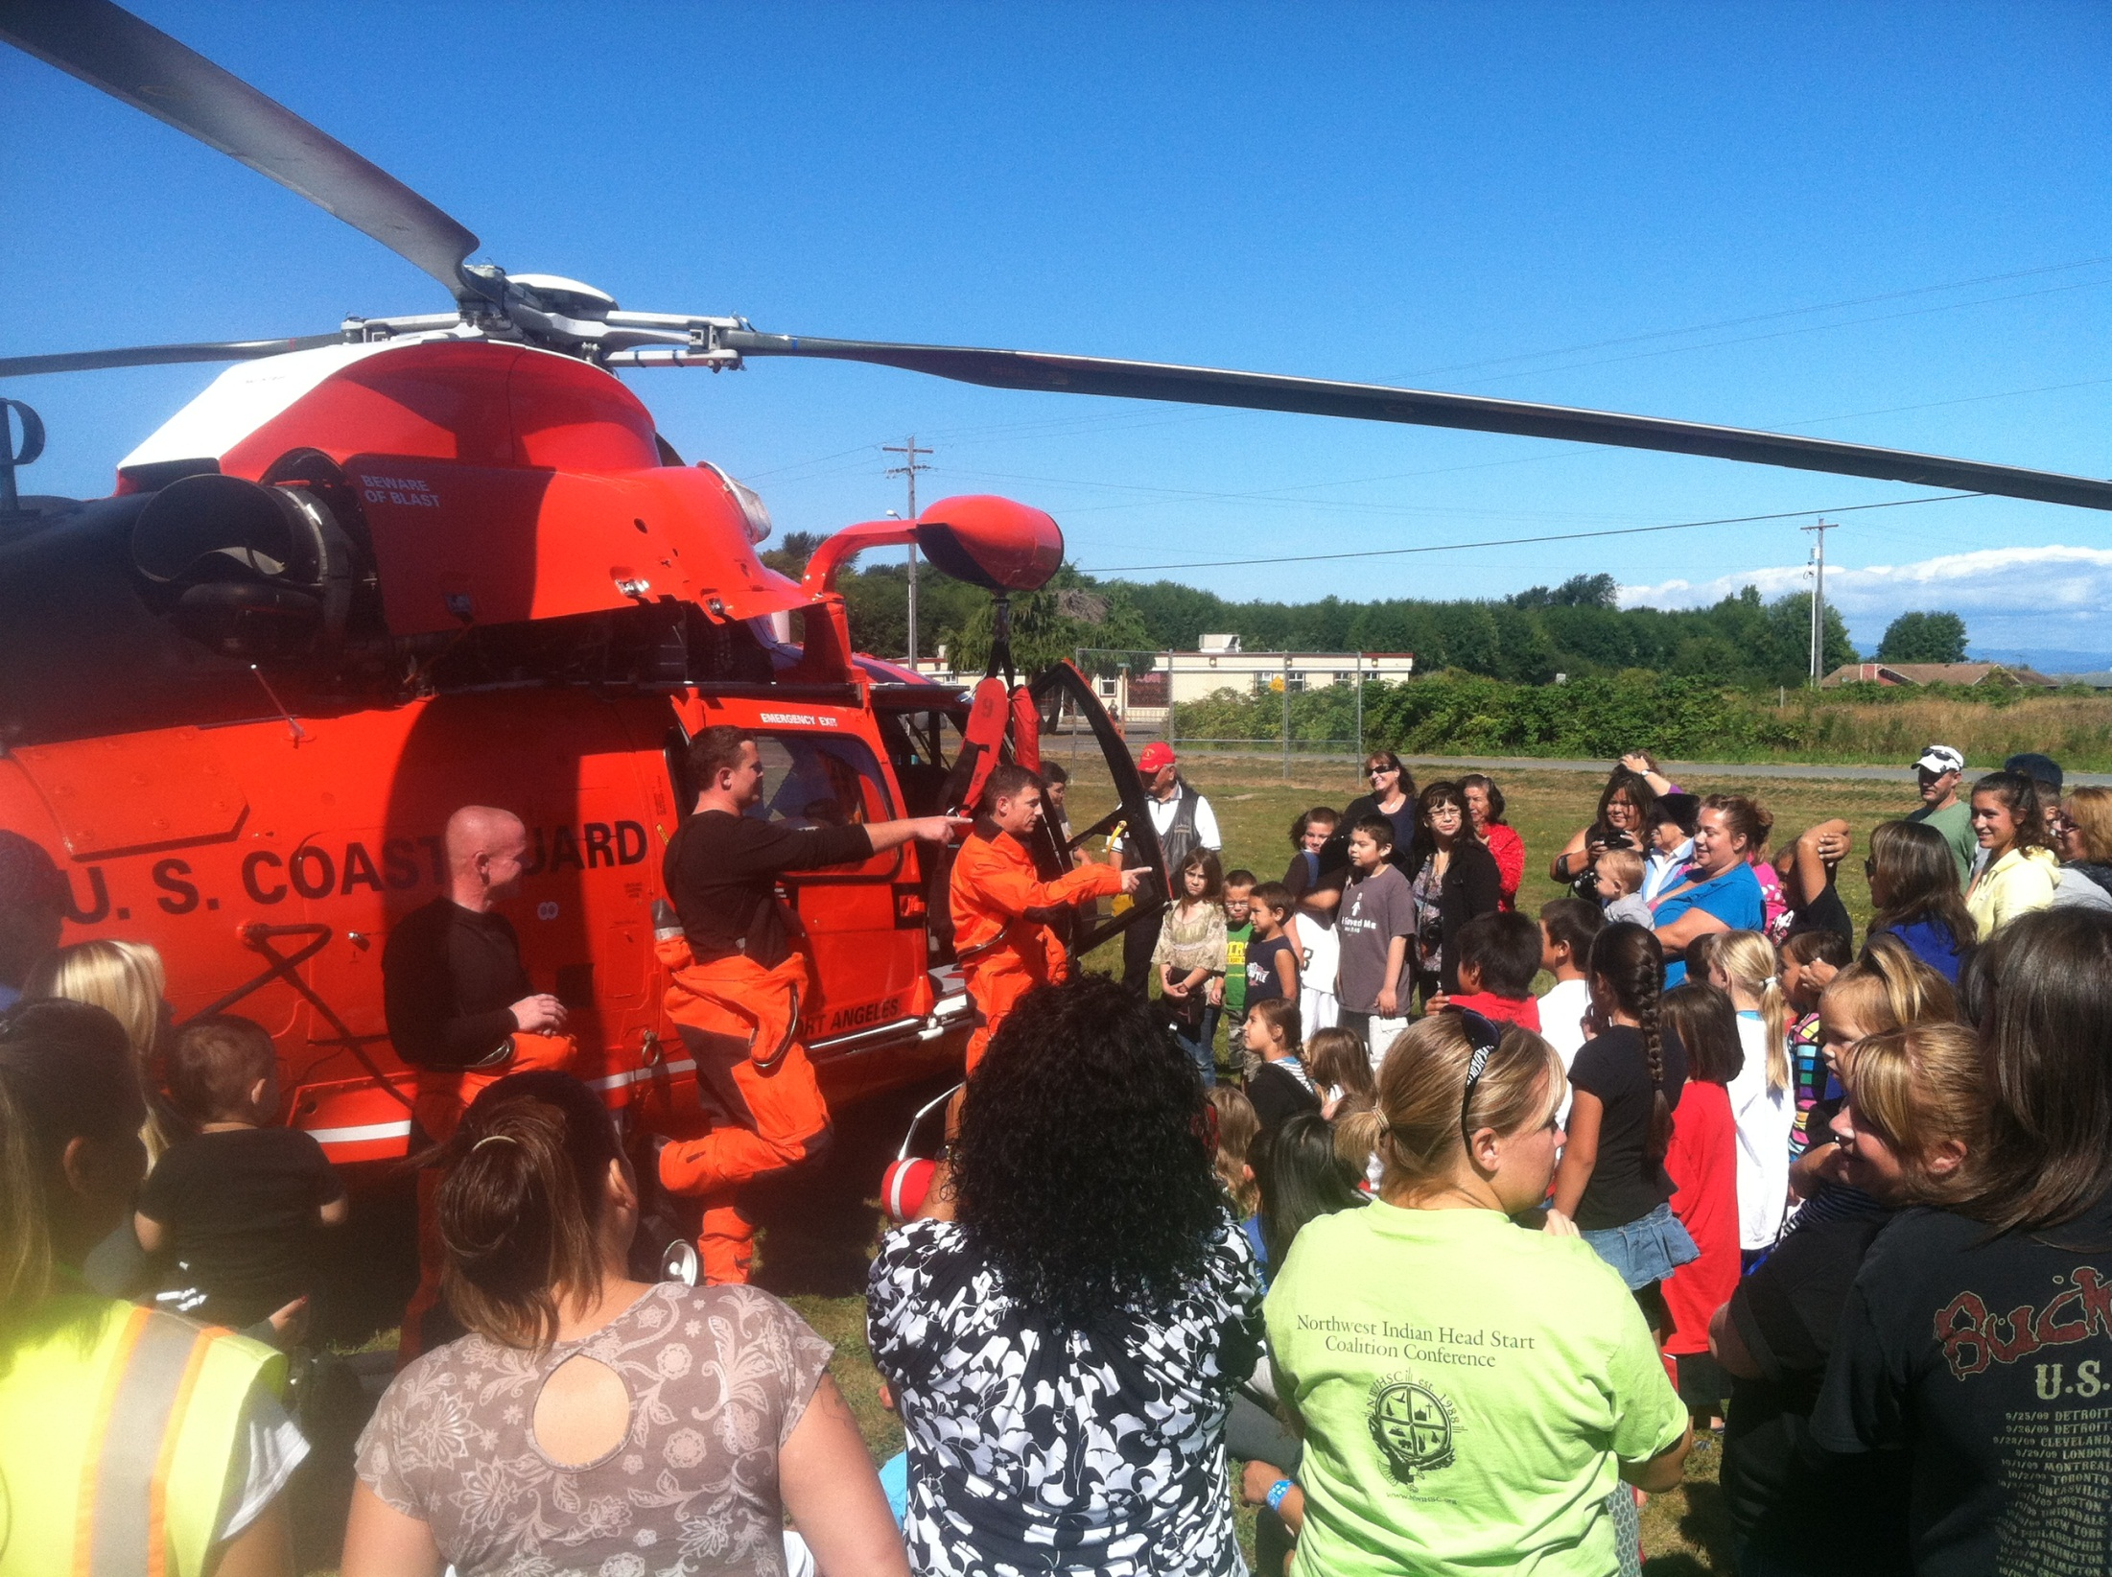

Slide 12
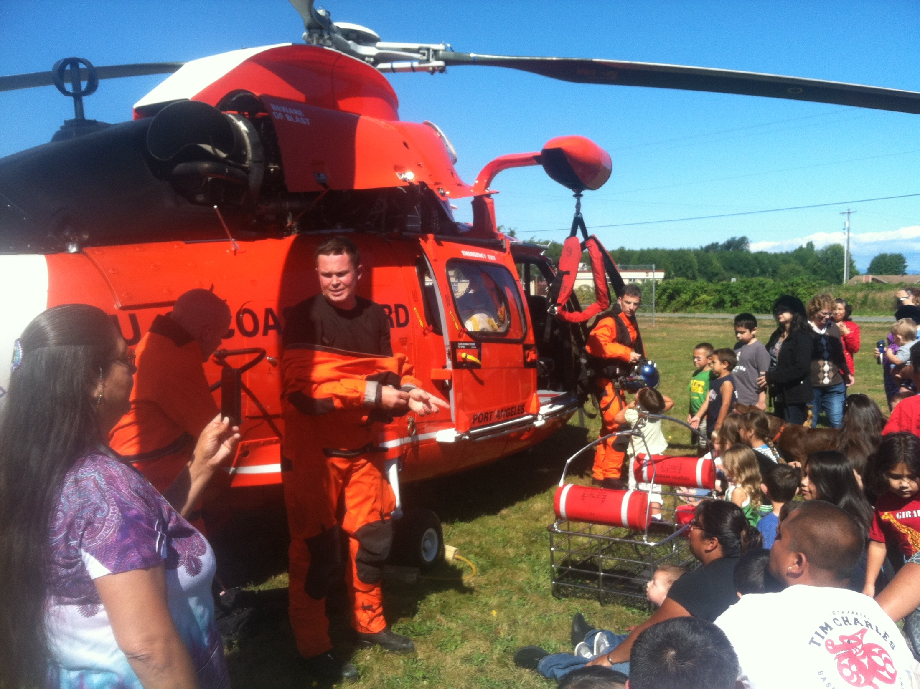

Slide 13
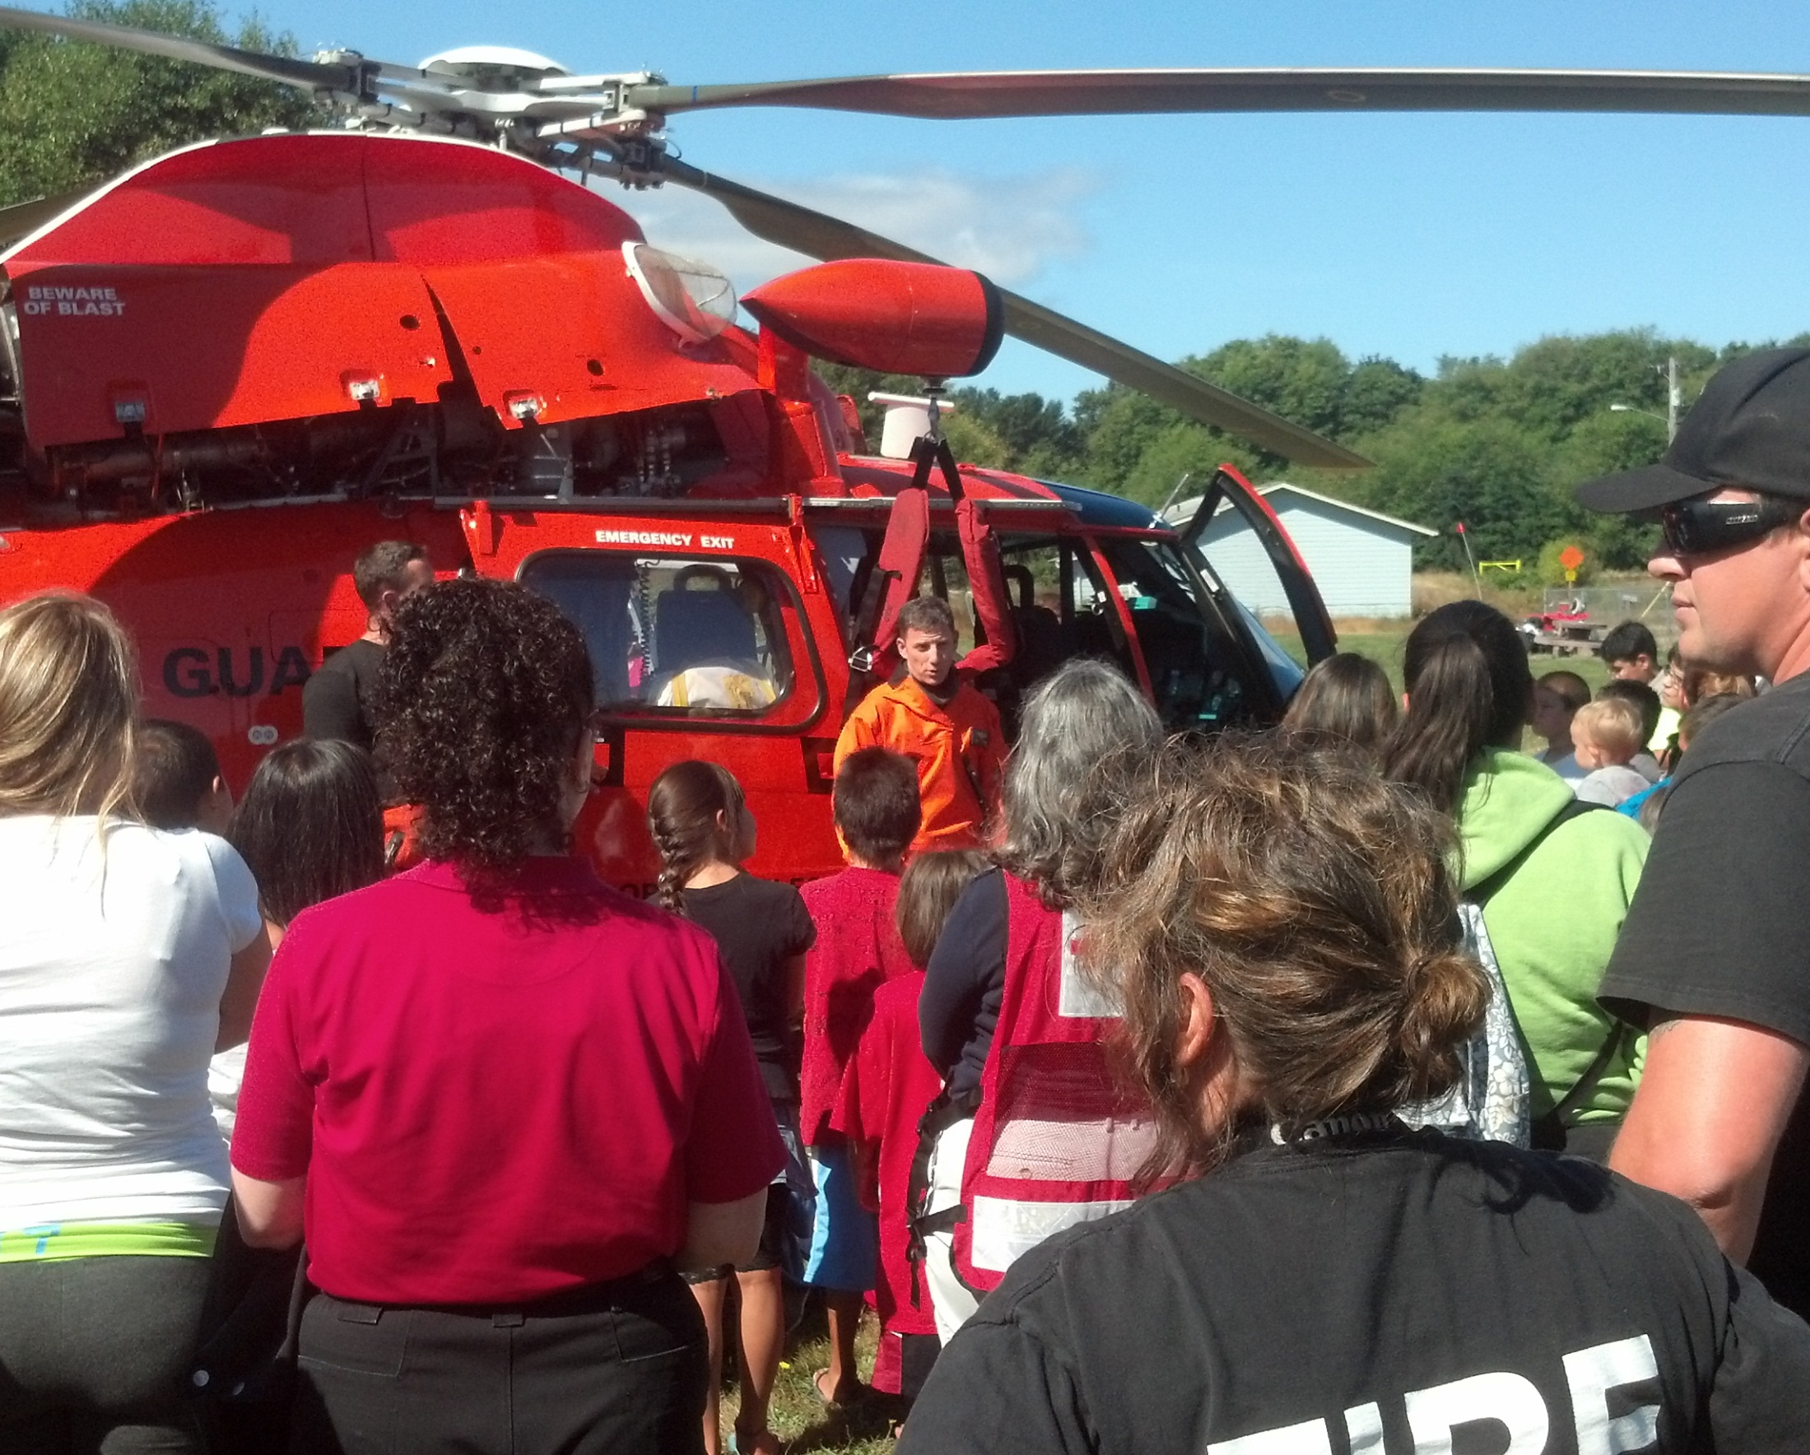

Slide 14
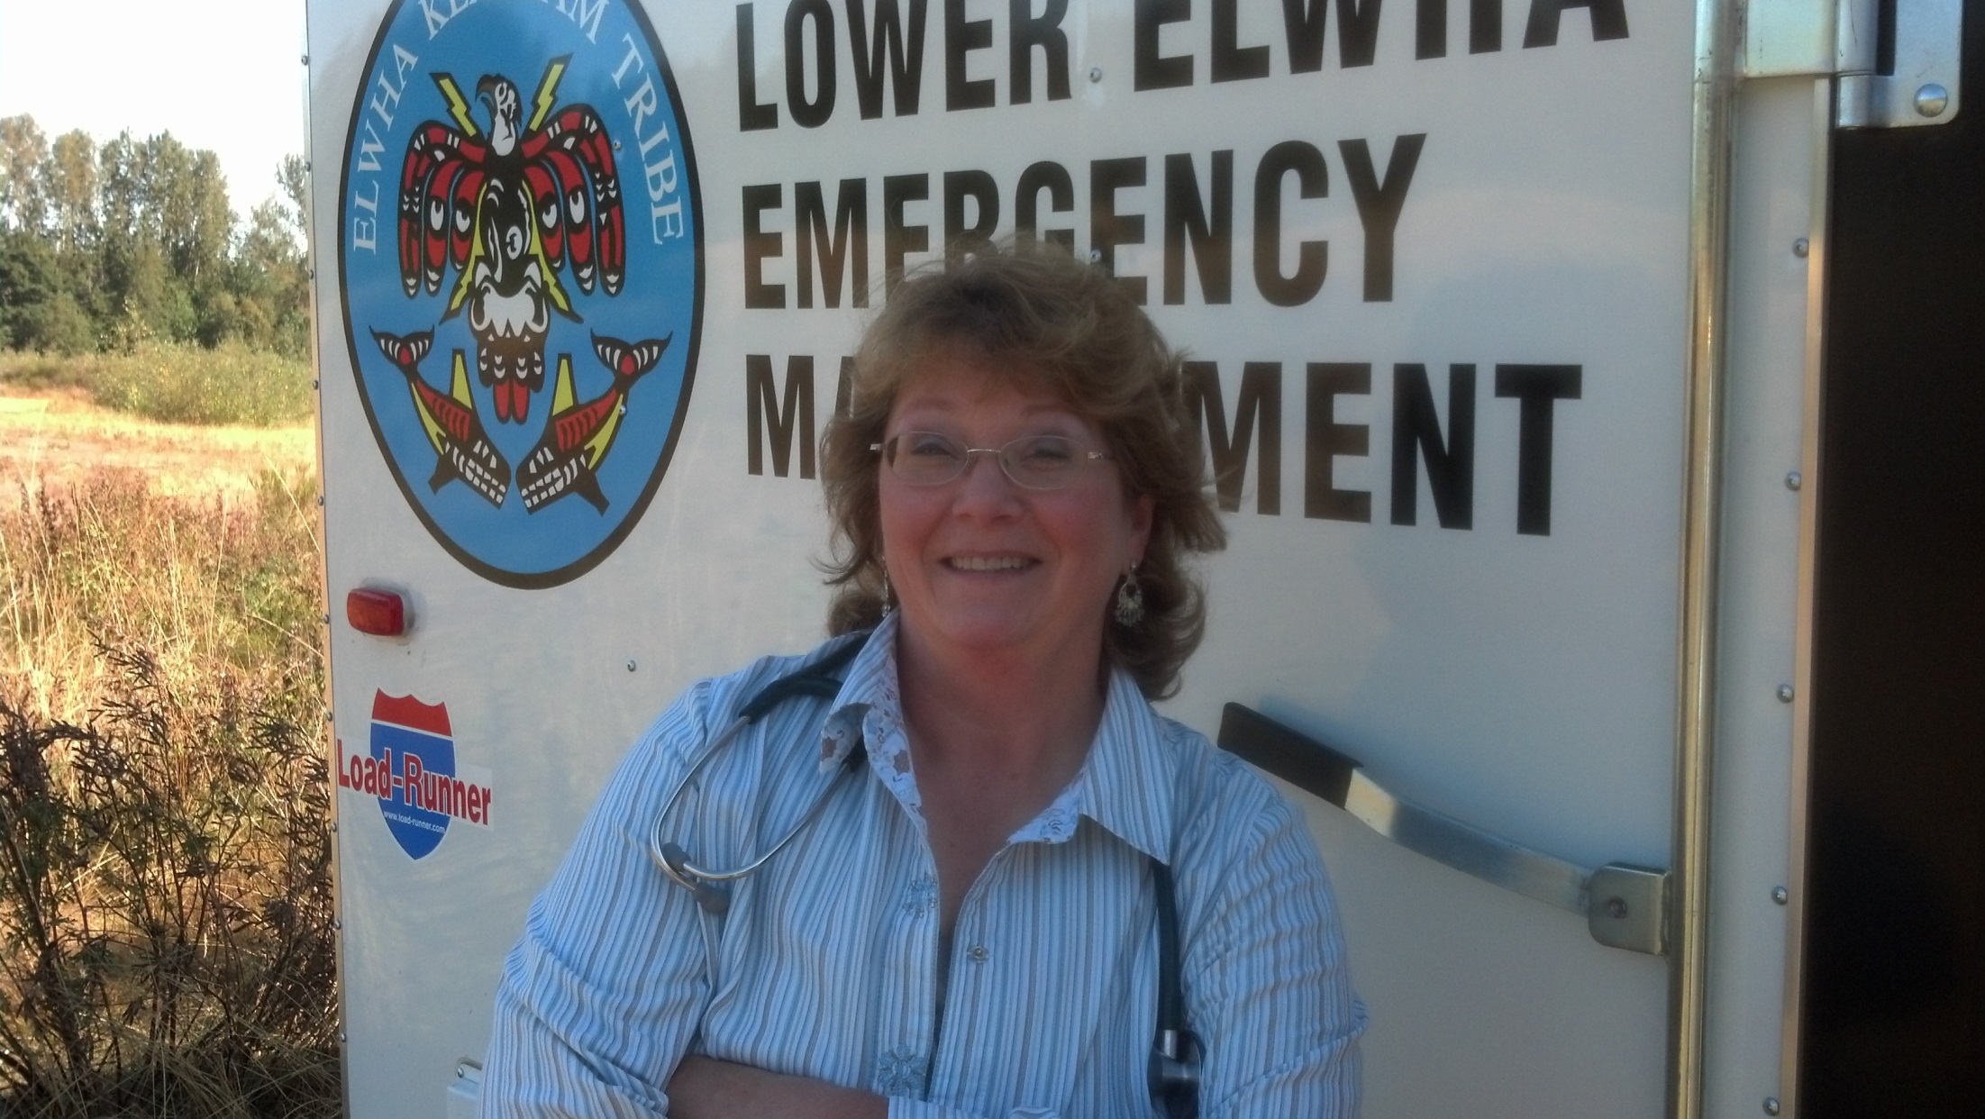
Director of Emergency Management
Hollie Kaufman, ARNP

Slide 15

Our Comprehensive Emergency
Management Plan is updated

Slide 16
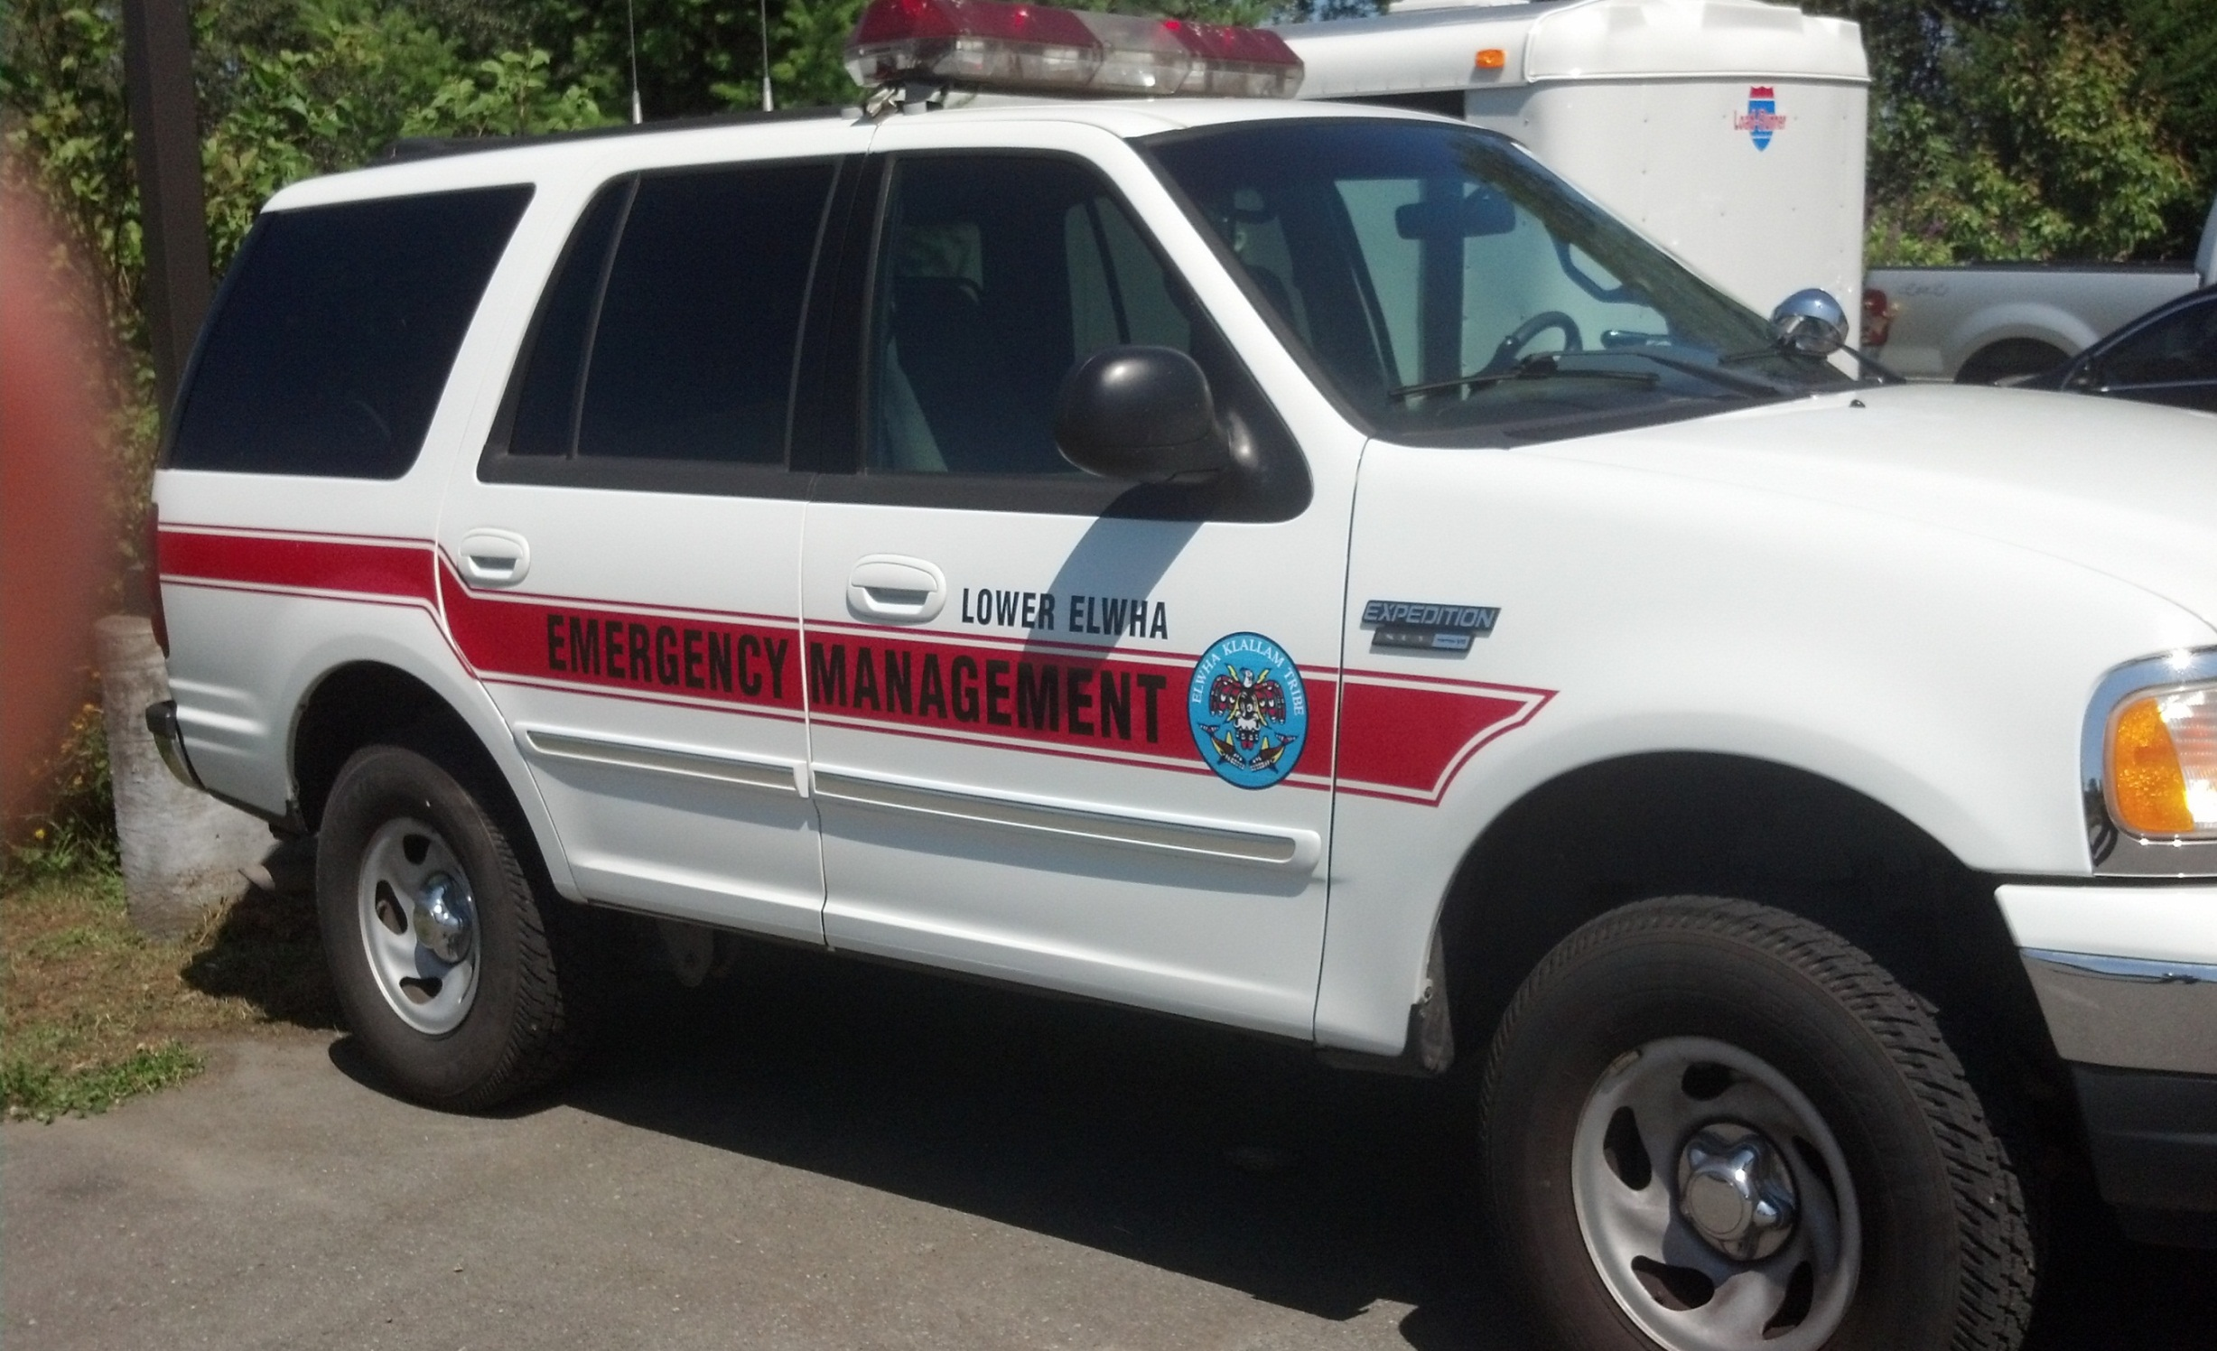
We have Vehicles and Equipment
Hollie’s “E” mobile

Slide 17
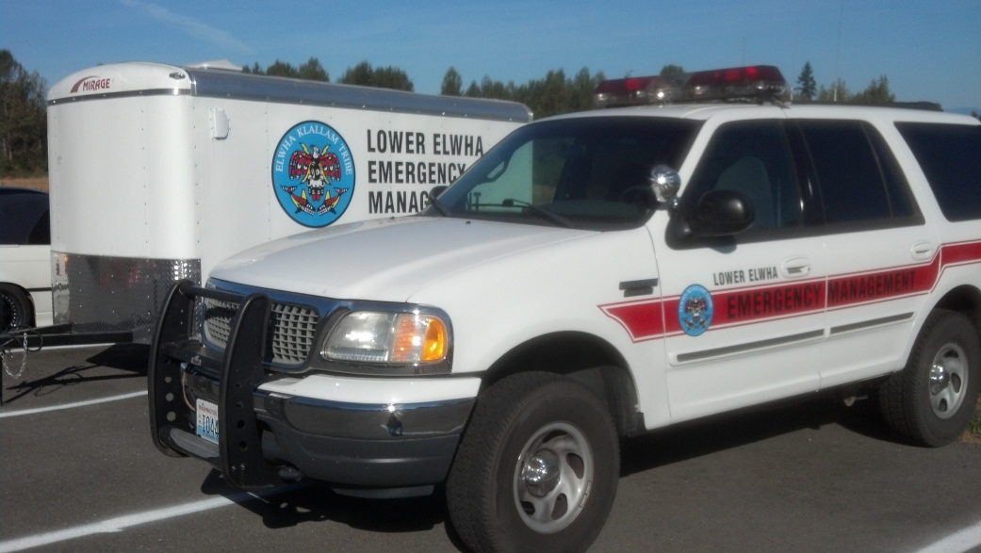
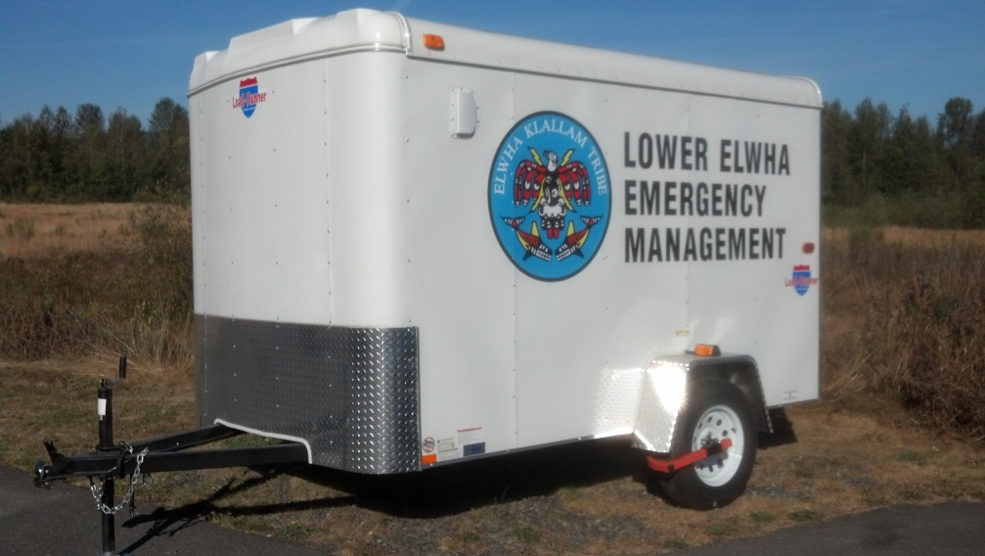
Supply Trailers
Emergency
Vehicle &
Trailer #1
Emergency
Trailer #2

Slide 18


There is still a lot of work to do and…
…we need you on the team!

Slide 19
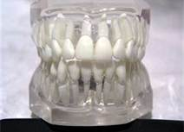
Dental Exhibits

Slide 20
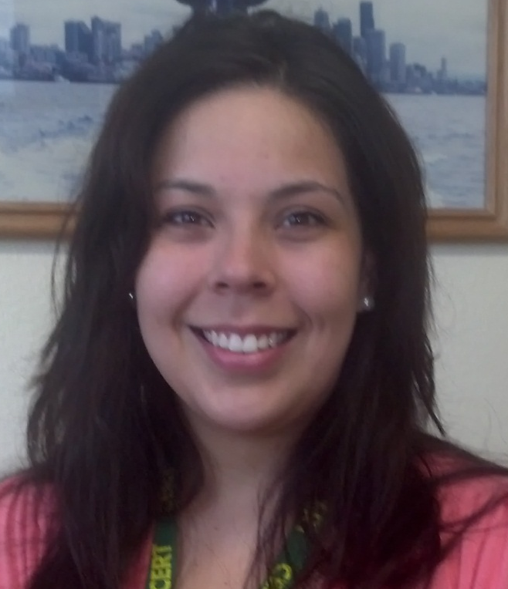
Teeth are meant
to last
a lifetime

Slide 21
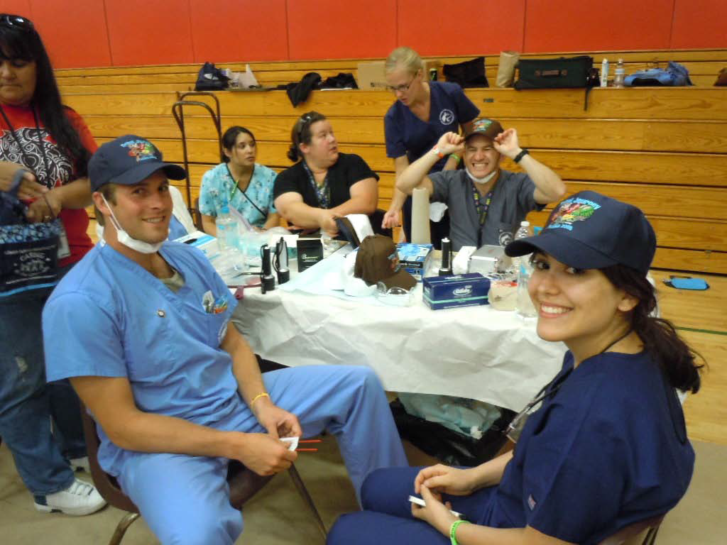
Tracey, Marcy, and Summer team
with UW Dental Students

Slide 22
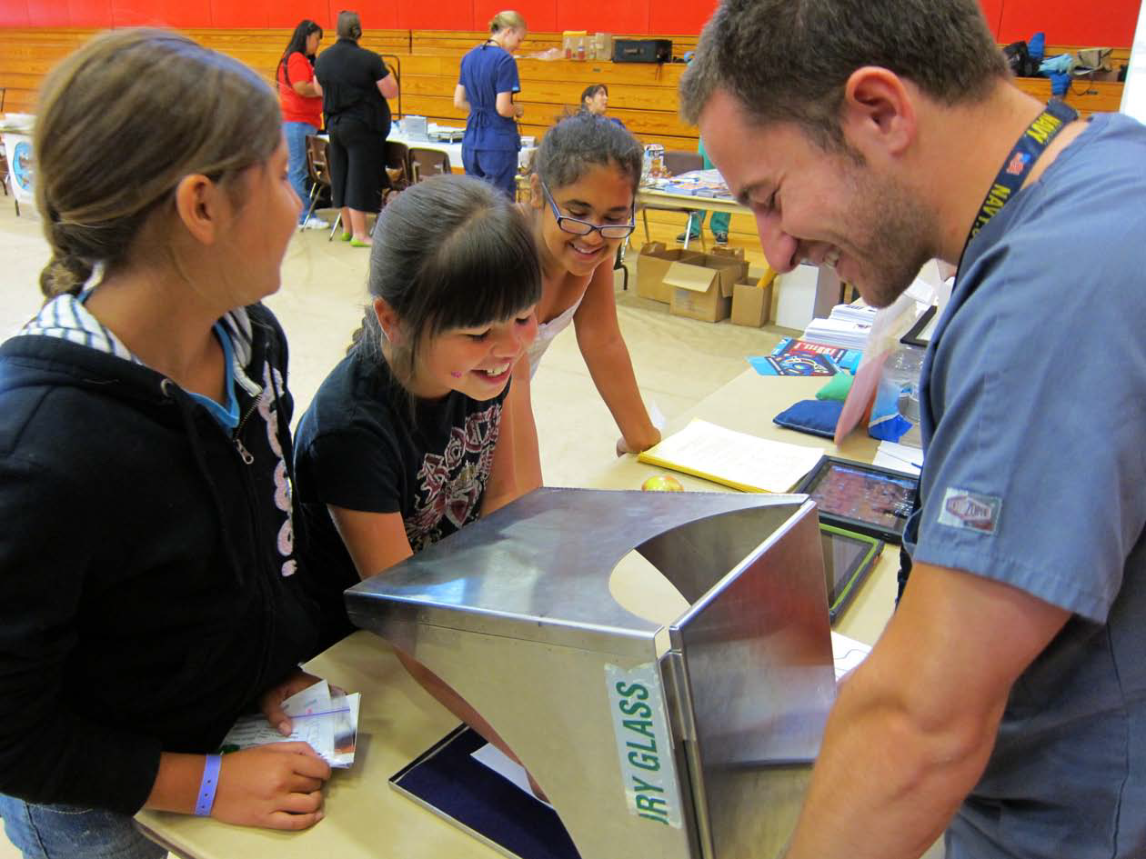
The Maze
Getting our kids interested

Slide 23
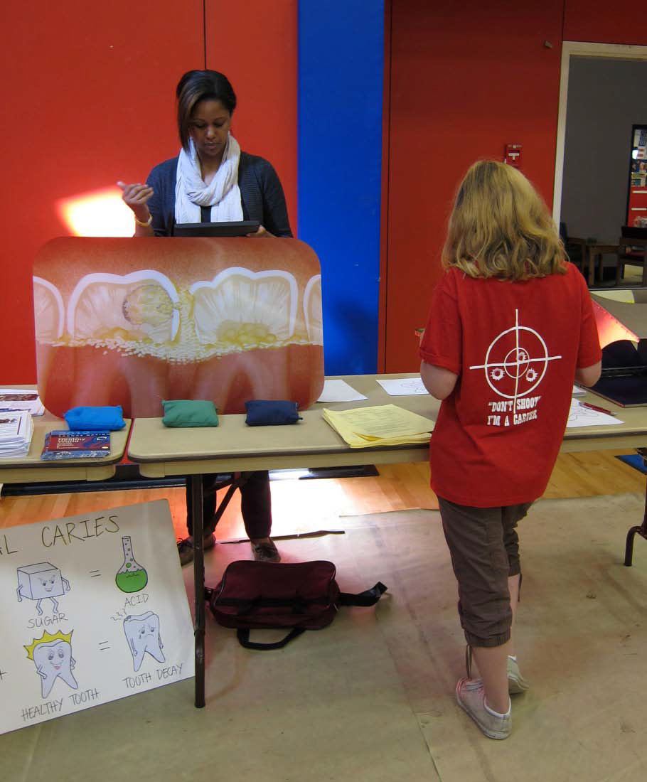
Cavities form before your
eyes

Slide 24
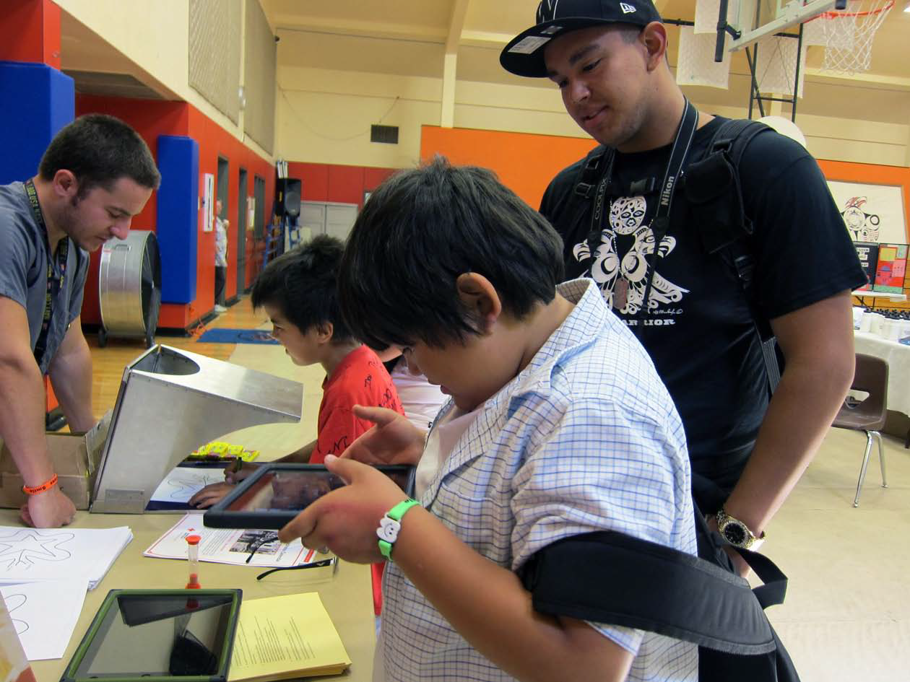
“Save
your Teeth” iPad game

Slide 25
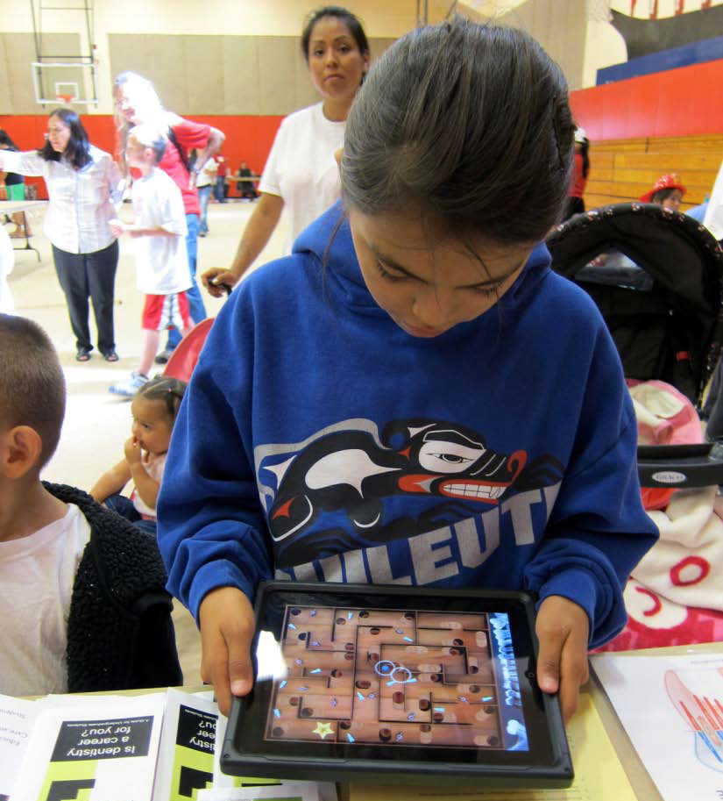

Slide 26
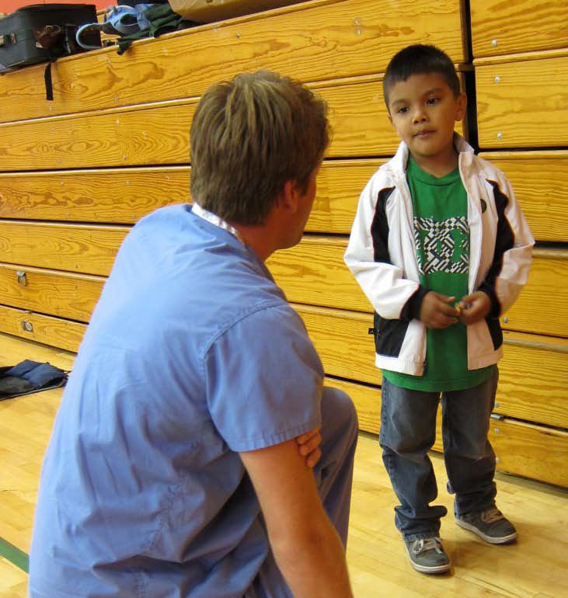

Slide 27
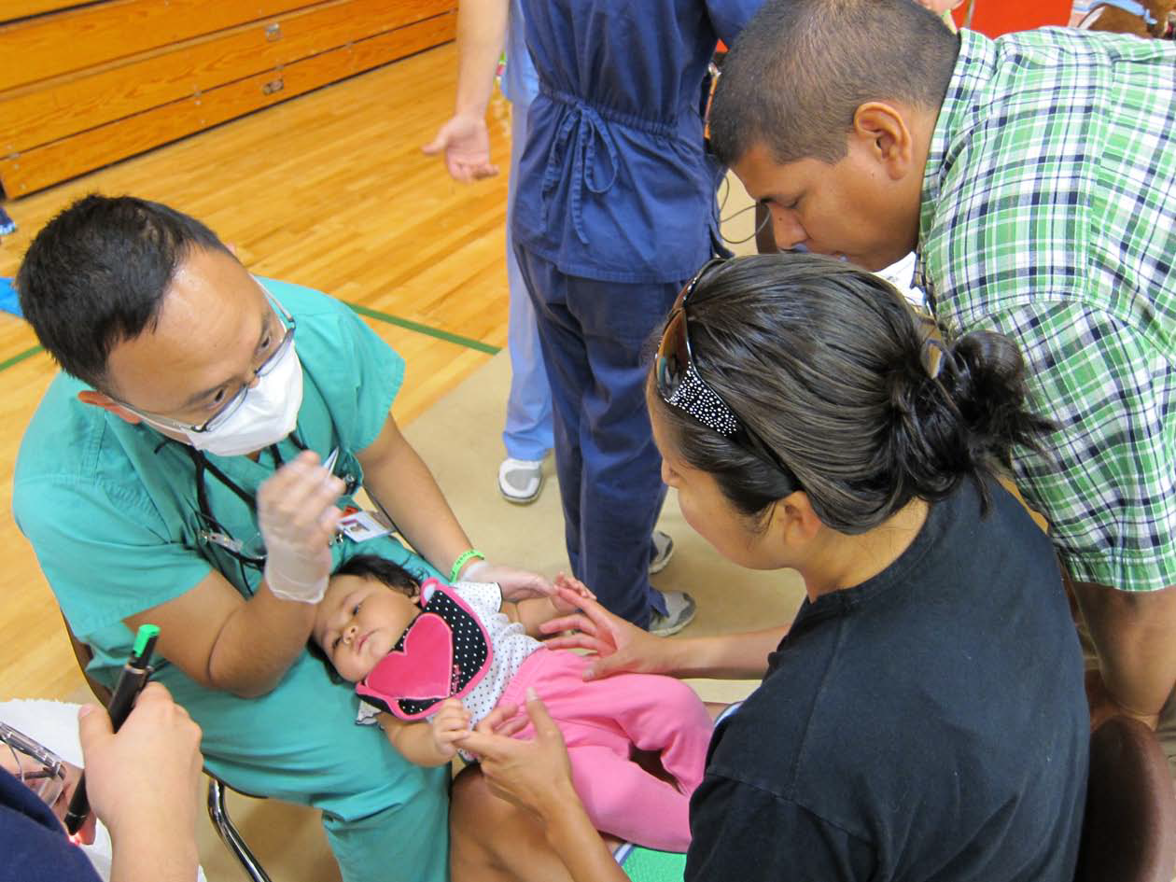
Dental Screening Exam

Slide 28
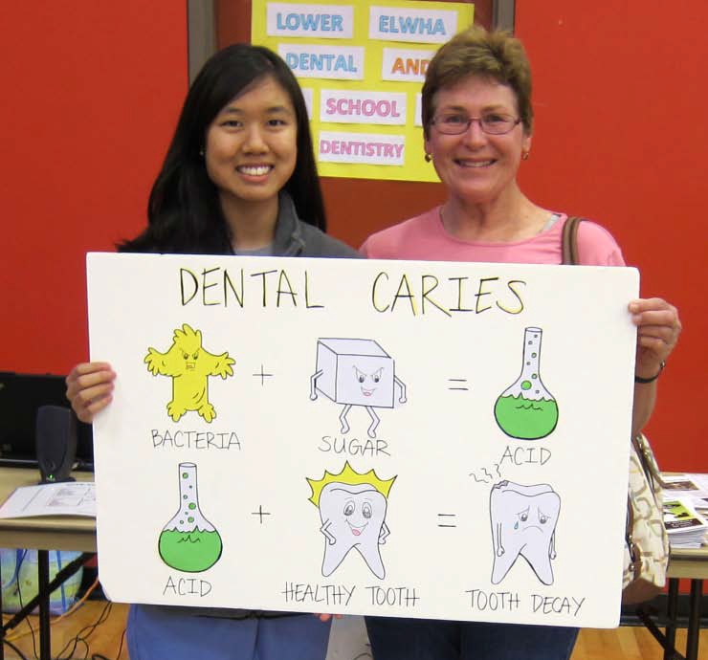

Slide 29
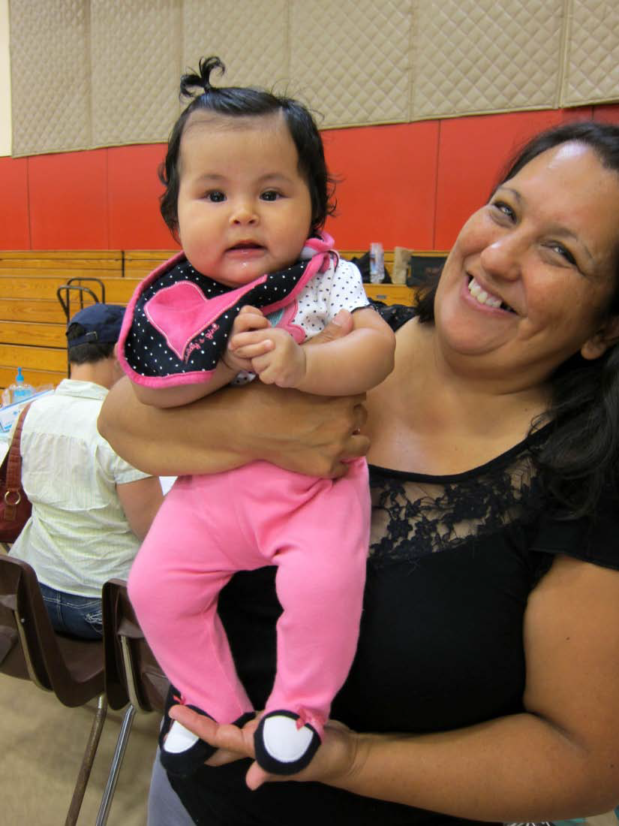
Yep!
She’s
our
cutie
pie

