Slide 1
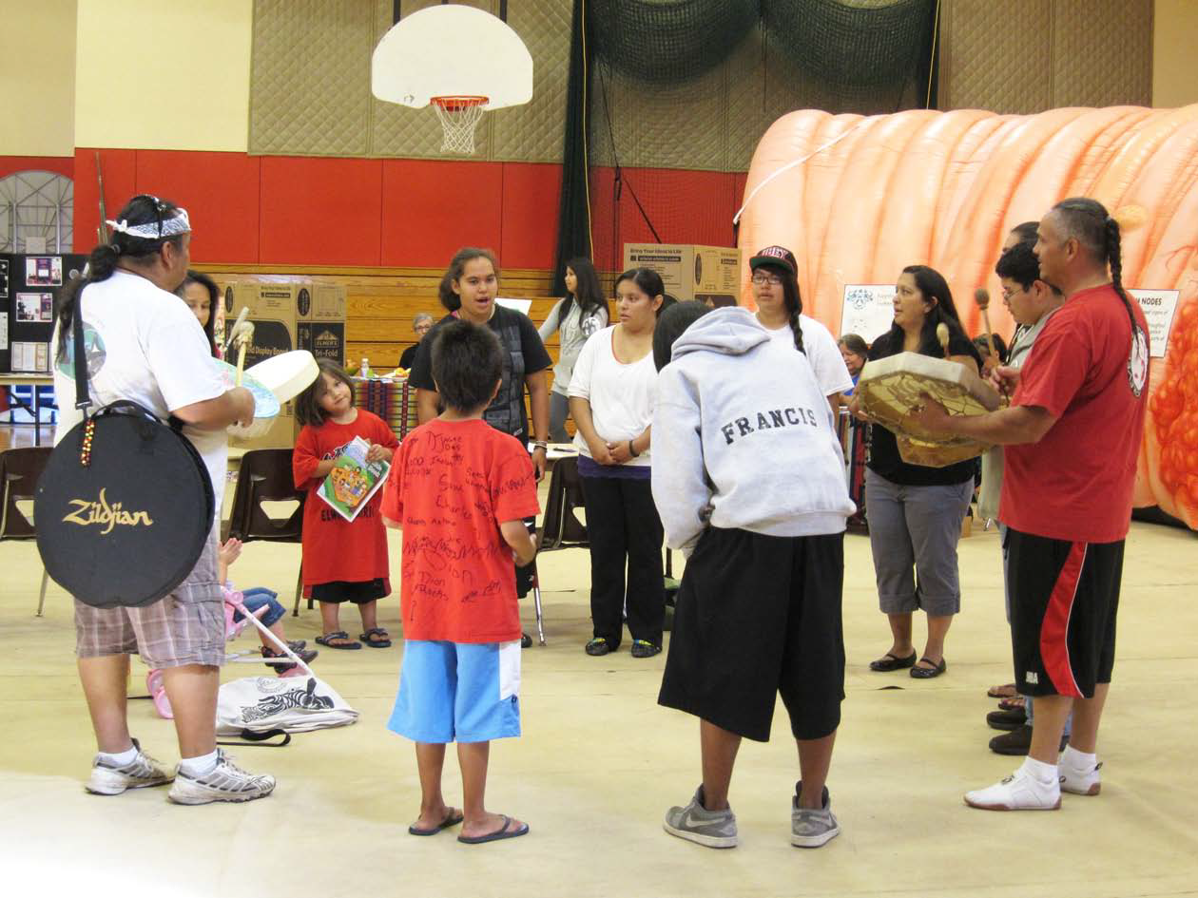
Drum Circle

Slide 2
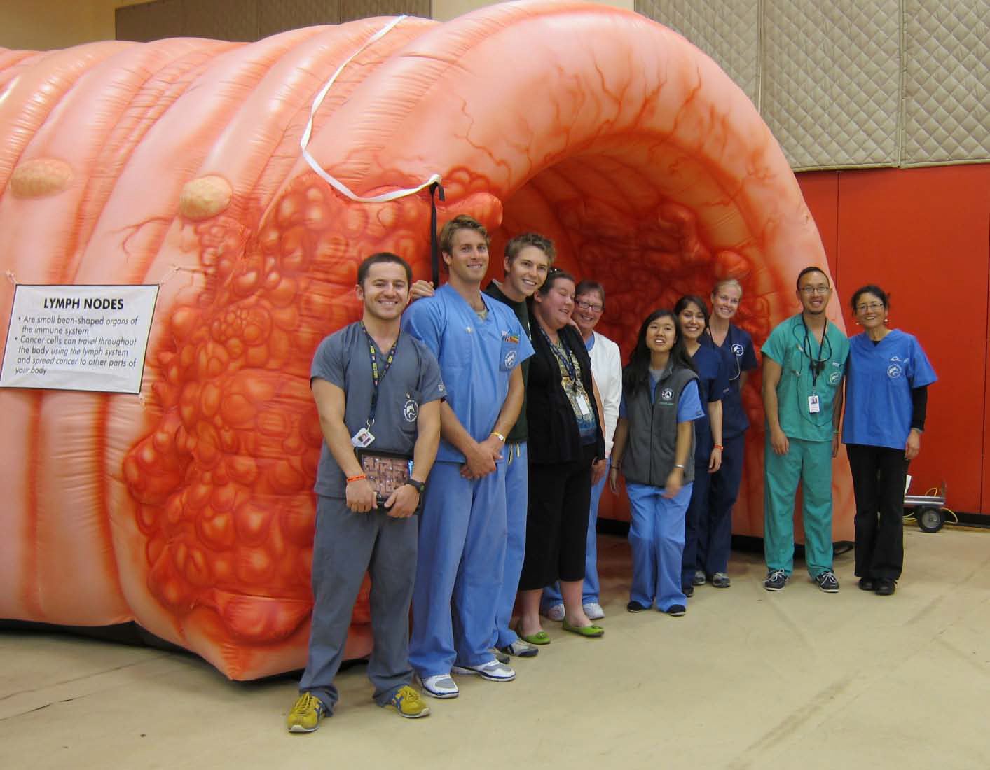
A Colon up close ☺

Slide 3
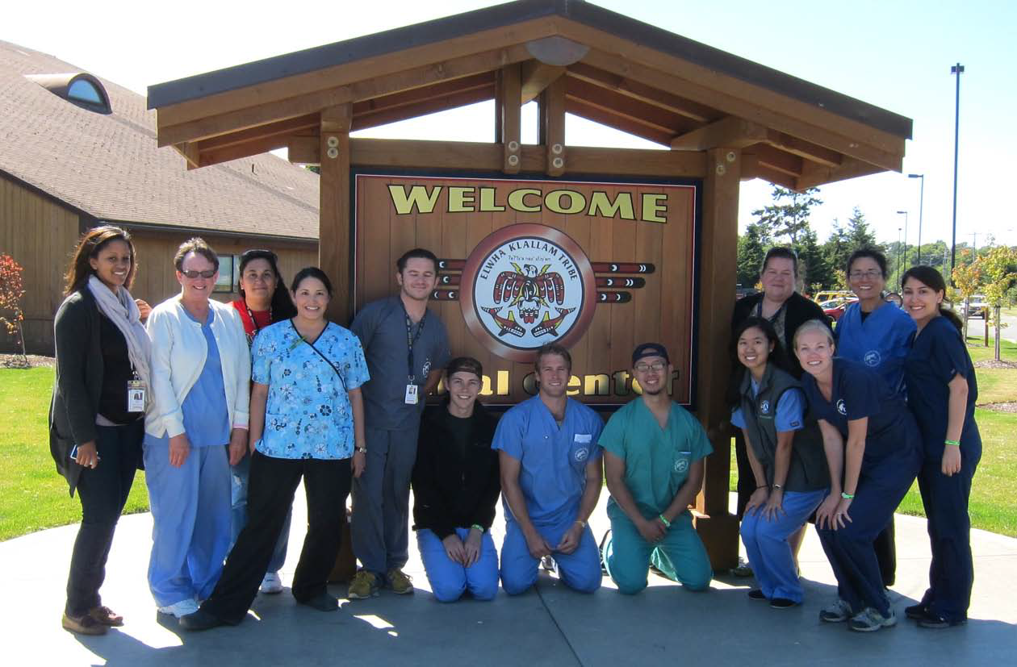

Slide 4
Many thanks to
Roberta and Hollie
who were our point people for the 2012
Elwha Klallam Health and
Emergency Preparedness Fair
August 24, 2012

Slide 5

Traditional
Foods
Garden

Slide 6
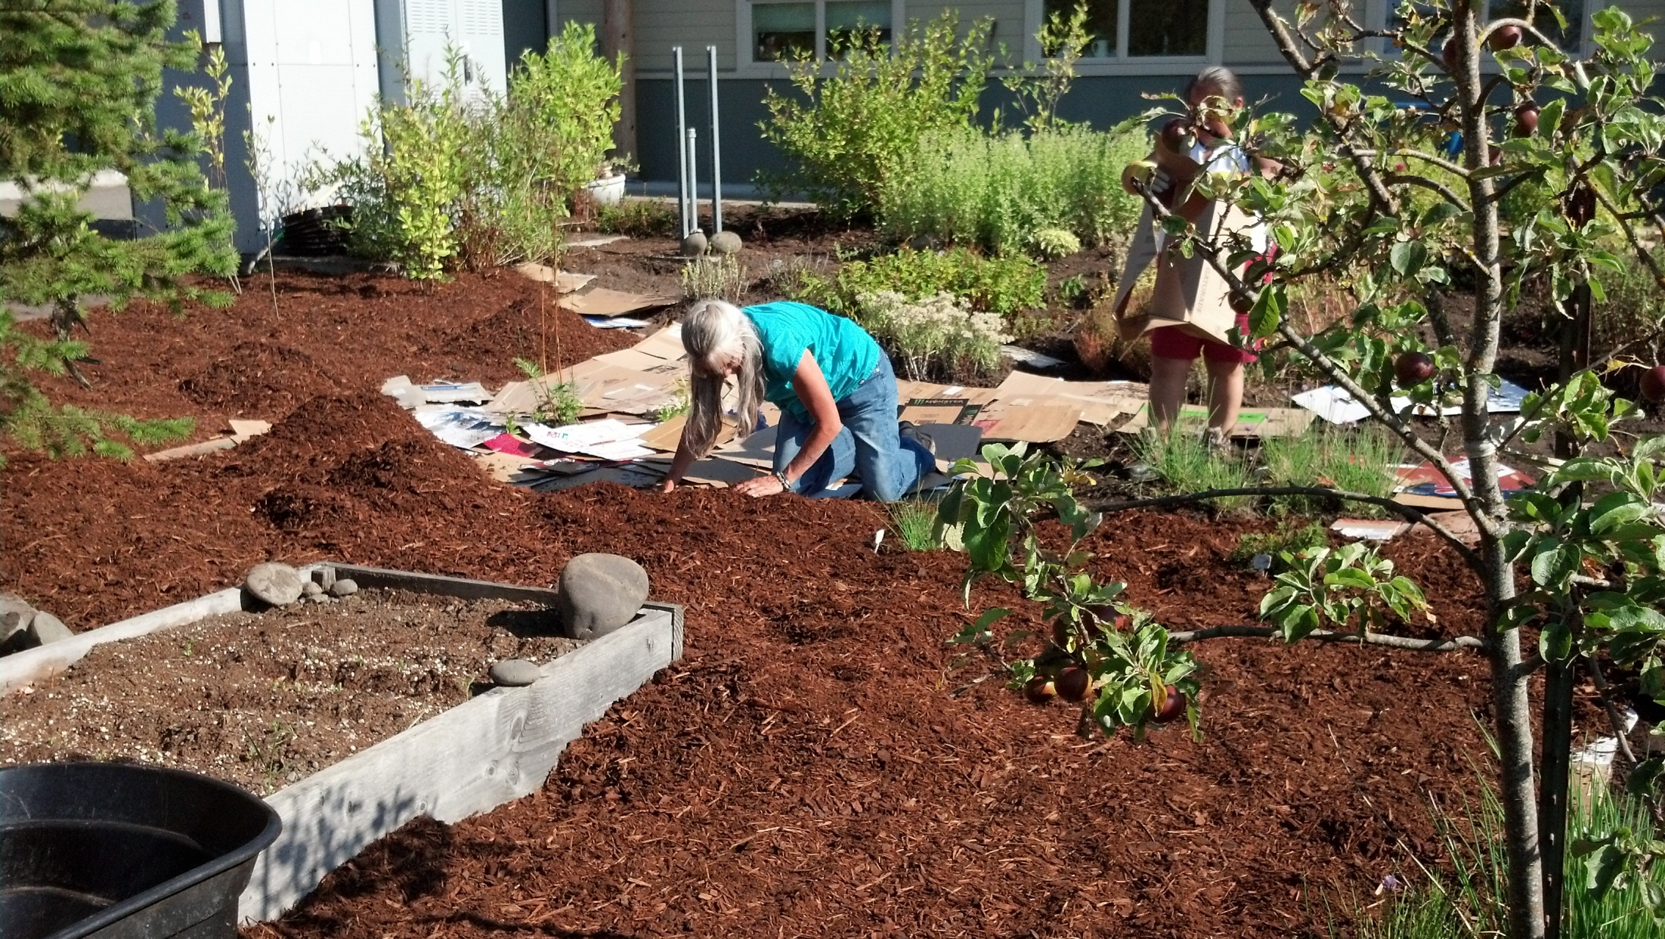

Slide 7
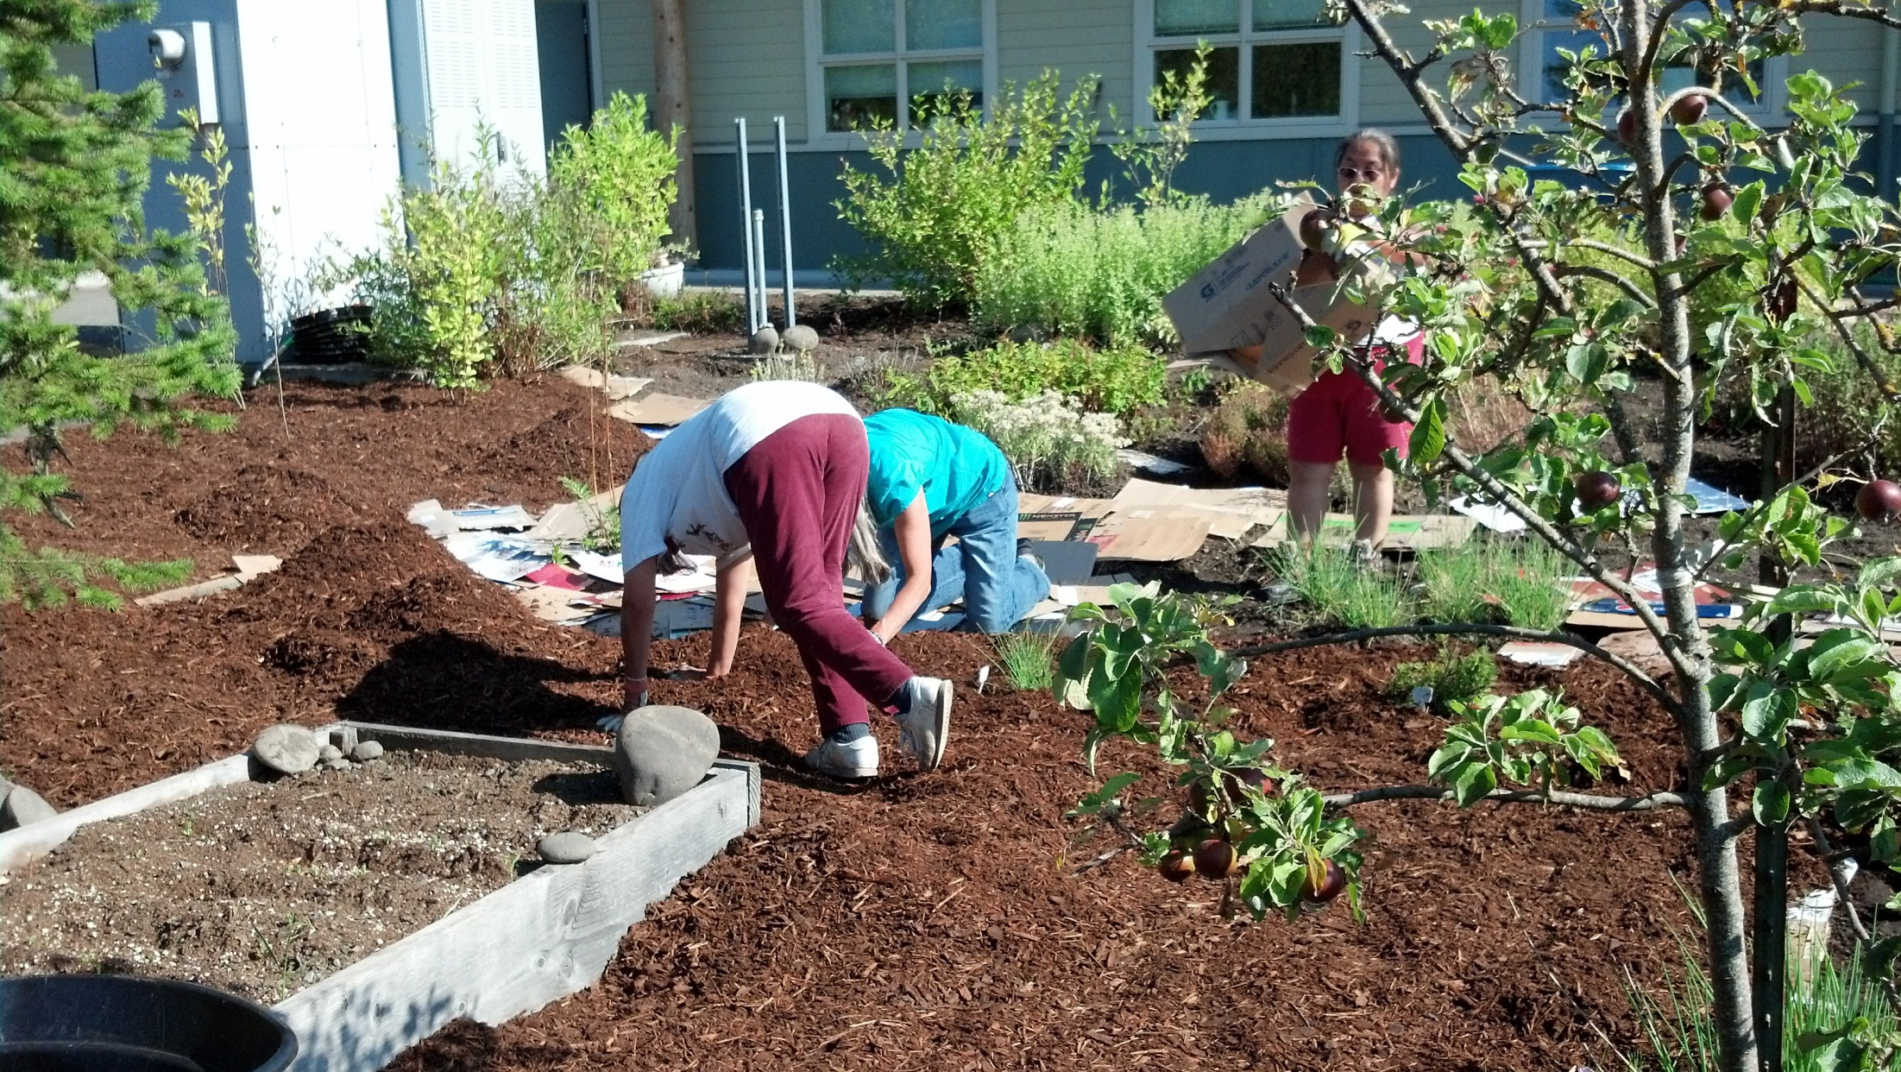

Slide 8
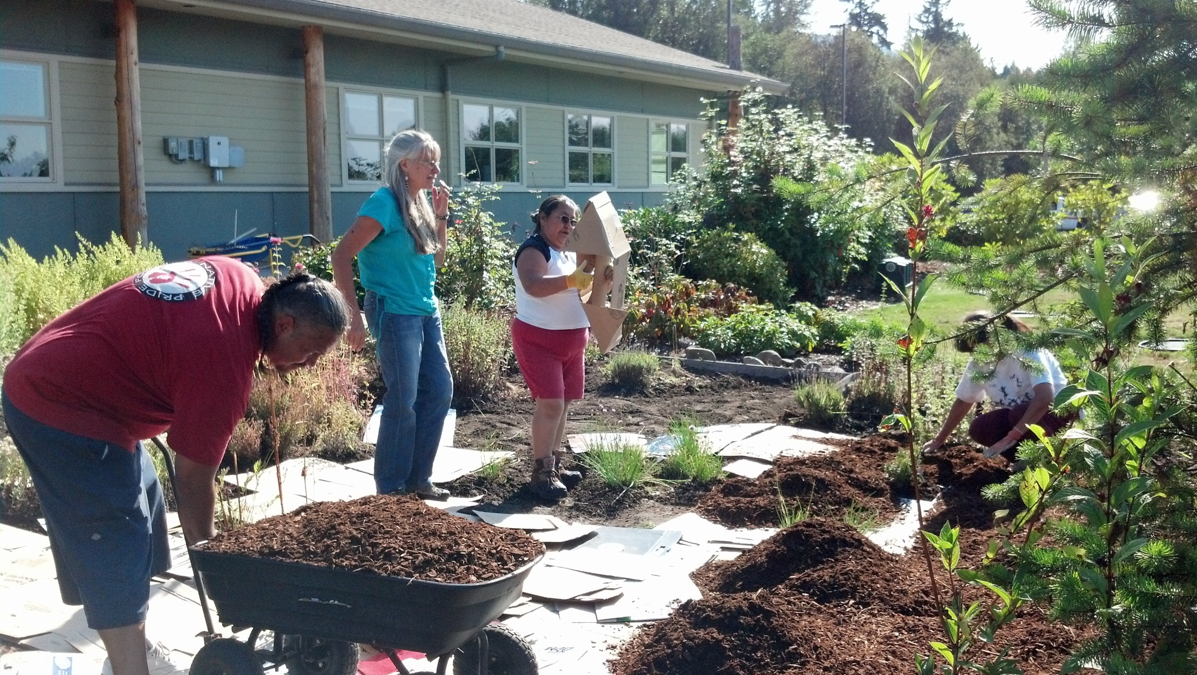

Slide 9
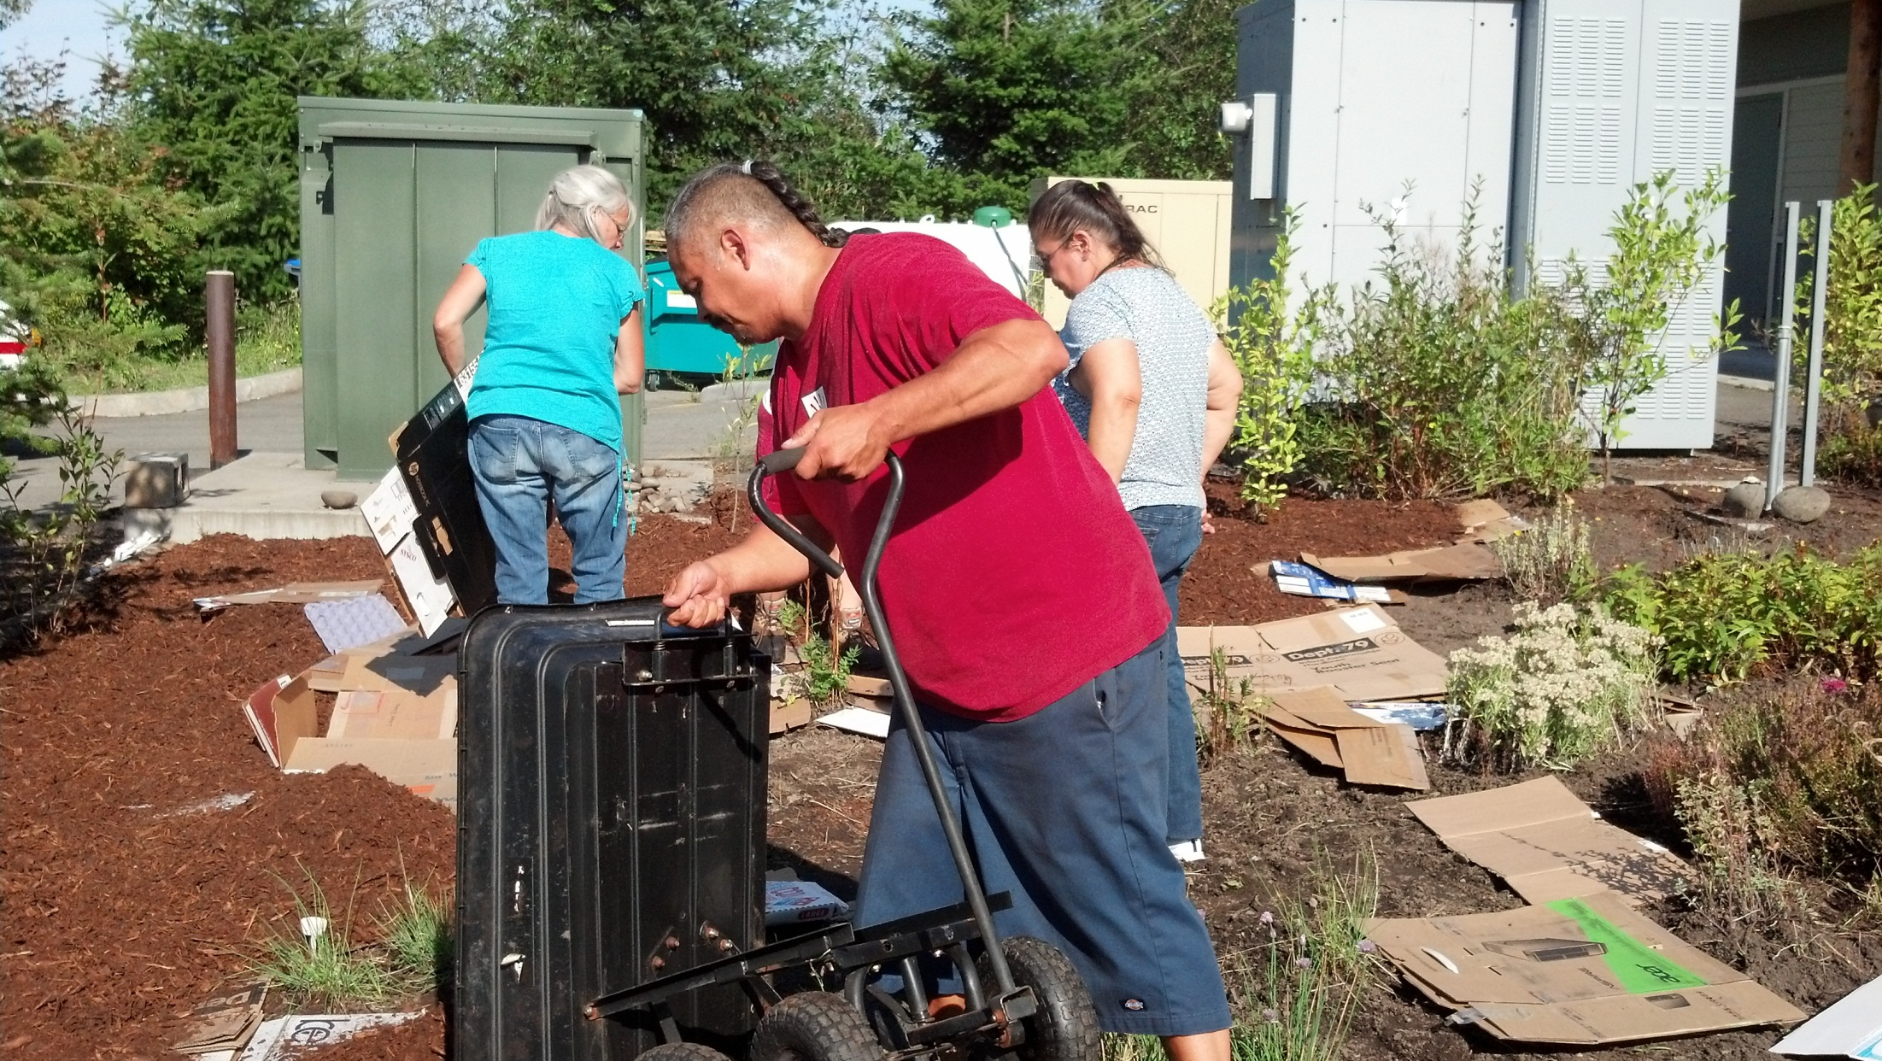

Slide 10
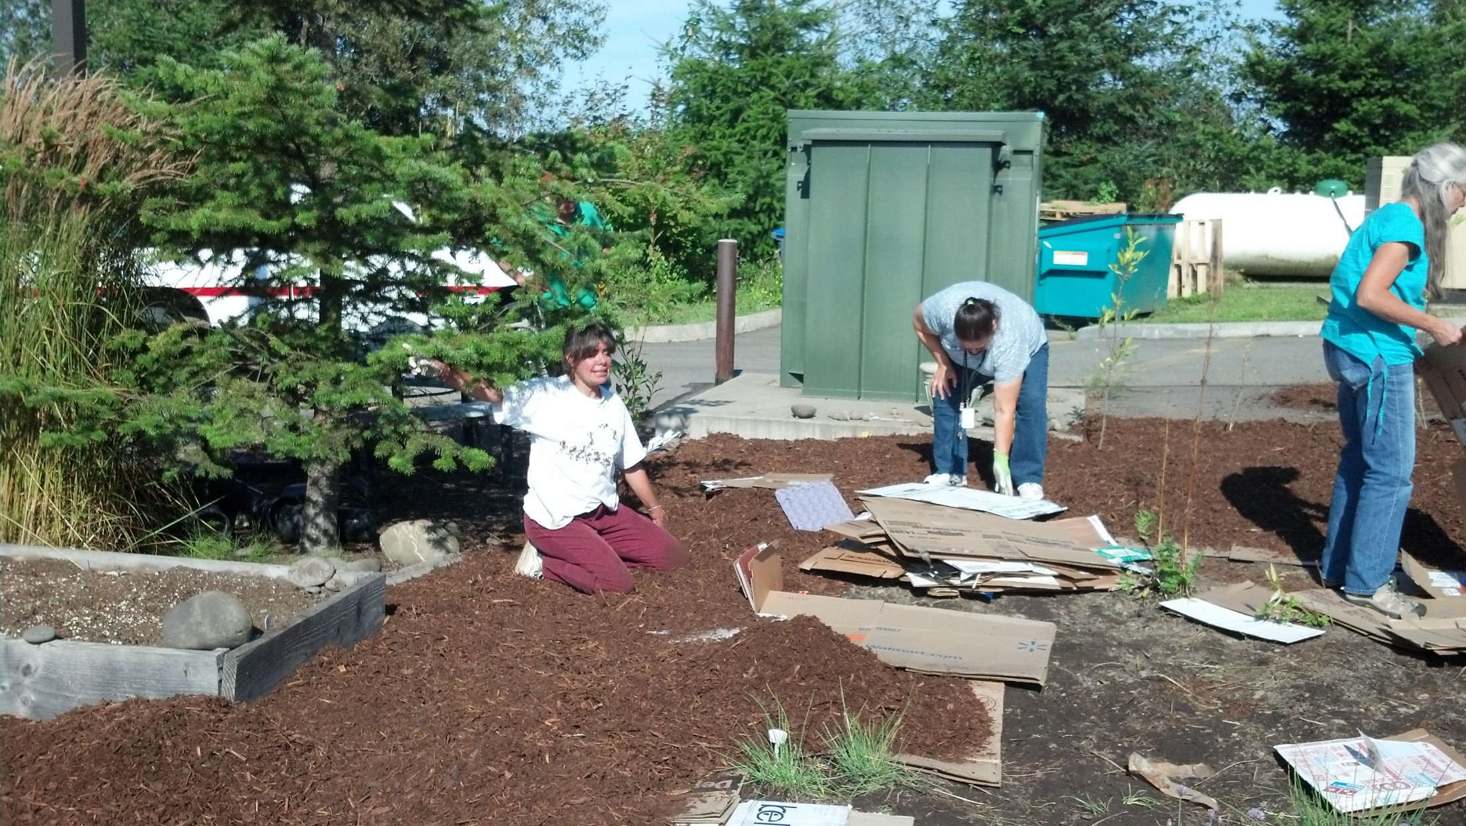

Slide 11
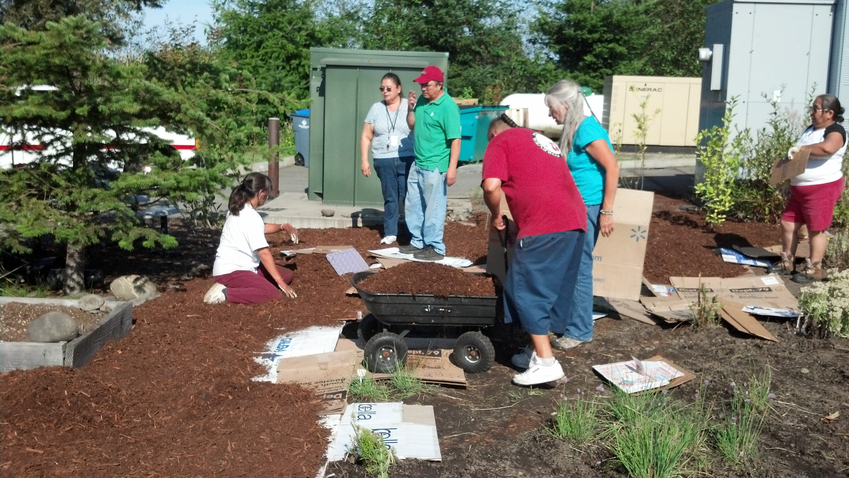

Slide 12
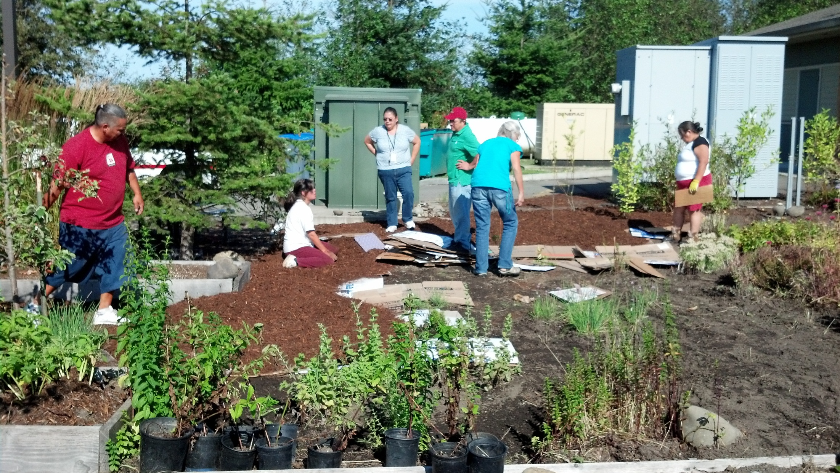
OK Ellen, I promise not to do “Snow Angels” in the mulch ever again.

Slide 13
Green is
Good!

Slide 14

It’s Time
for a
Change

Slide 15
Something’s
Going…

Slide 16
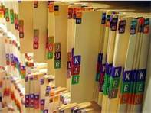
…Like Endless Paper

Slide 17
Something’s
Coming…

Slide 18

…Like New Technology

Slide 19

E
H
R

Slide 20
Electronic
Health
Records

Slide 21
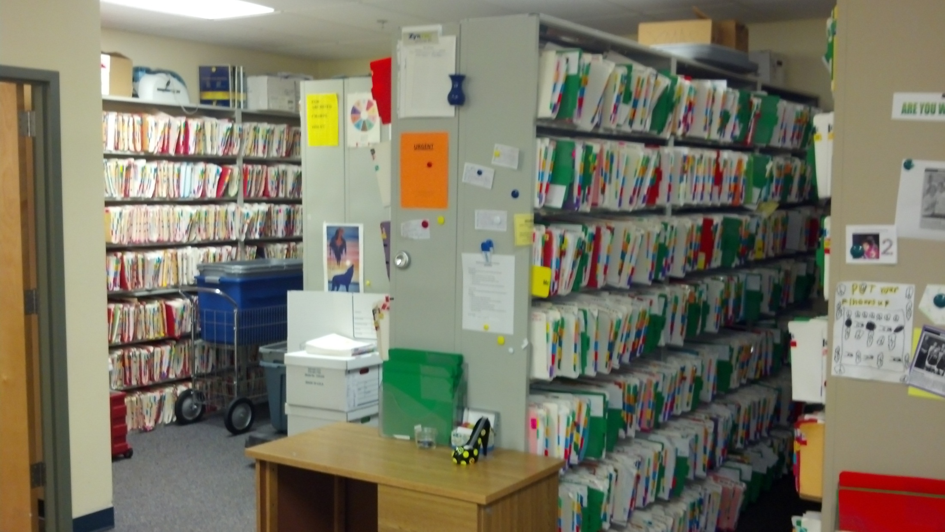
Parting is such sweet…sweetness

Slide 22
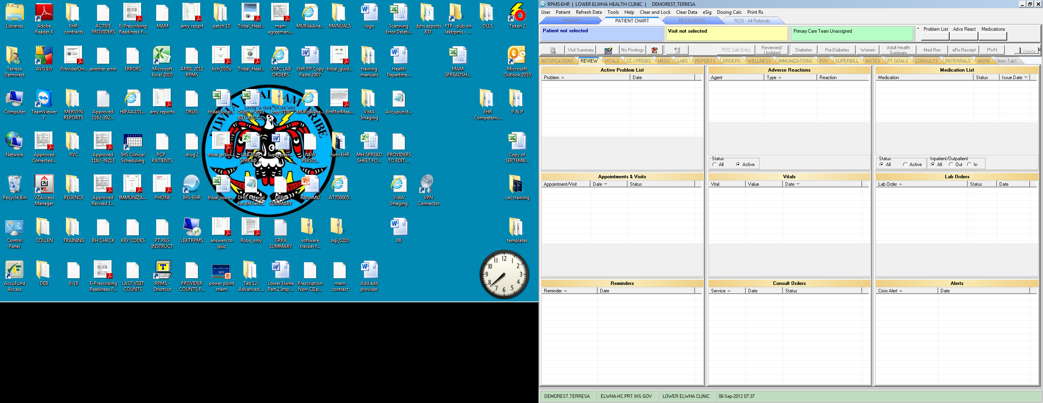
The look of screens to come
“Cool!”

Slide 23
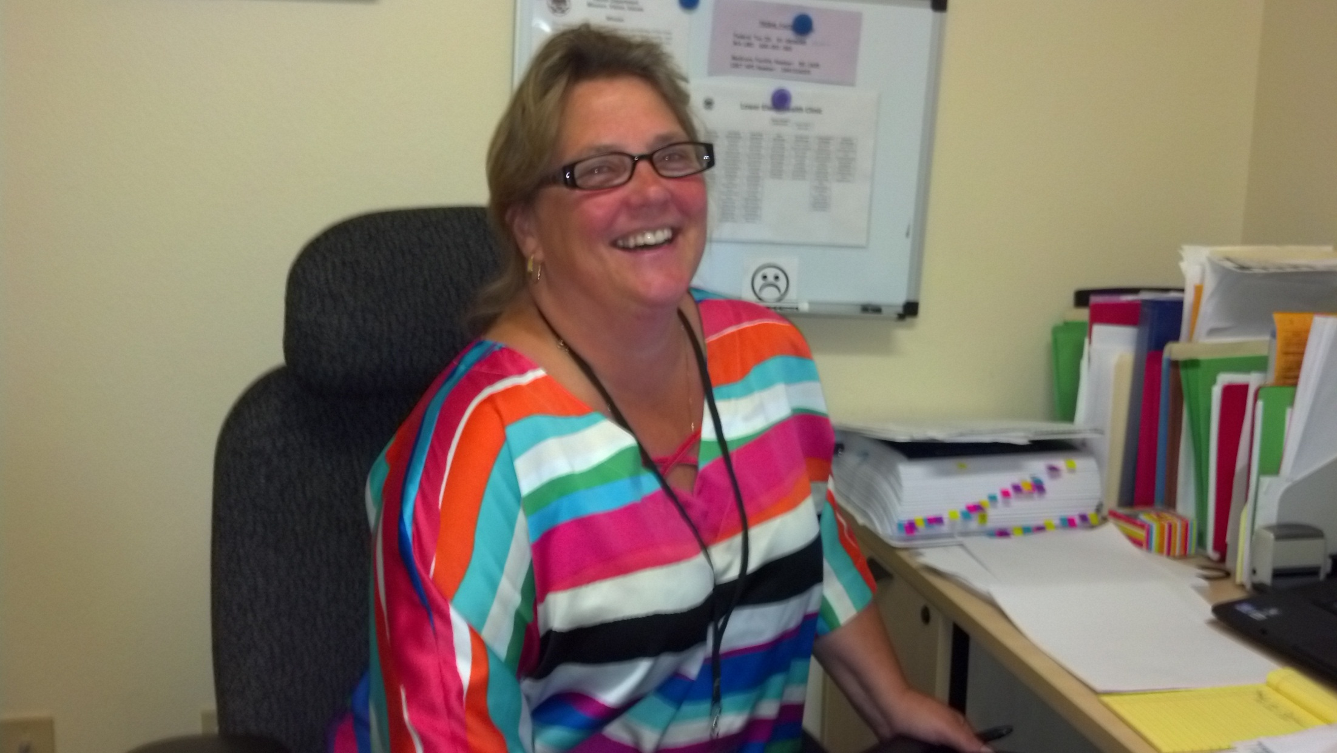
Terri is leading the way
“We can do it!”

Slide 24
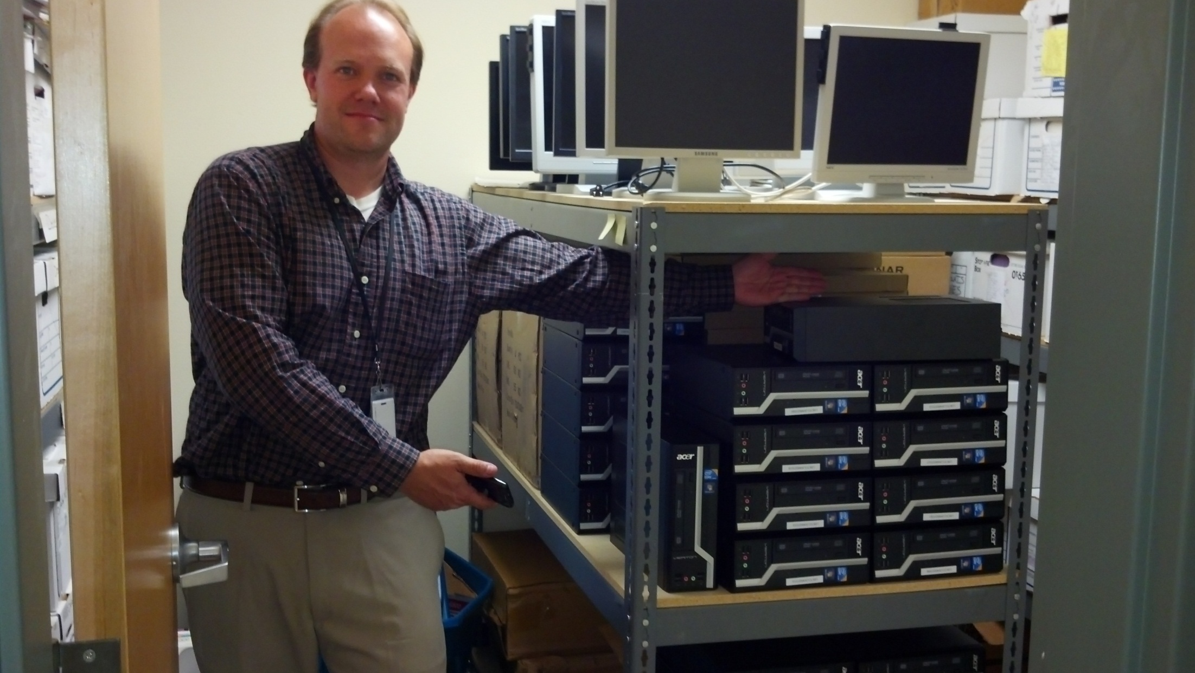
Ken says, “We have the tools!”

Slide 25
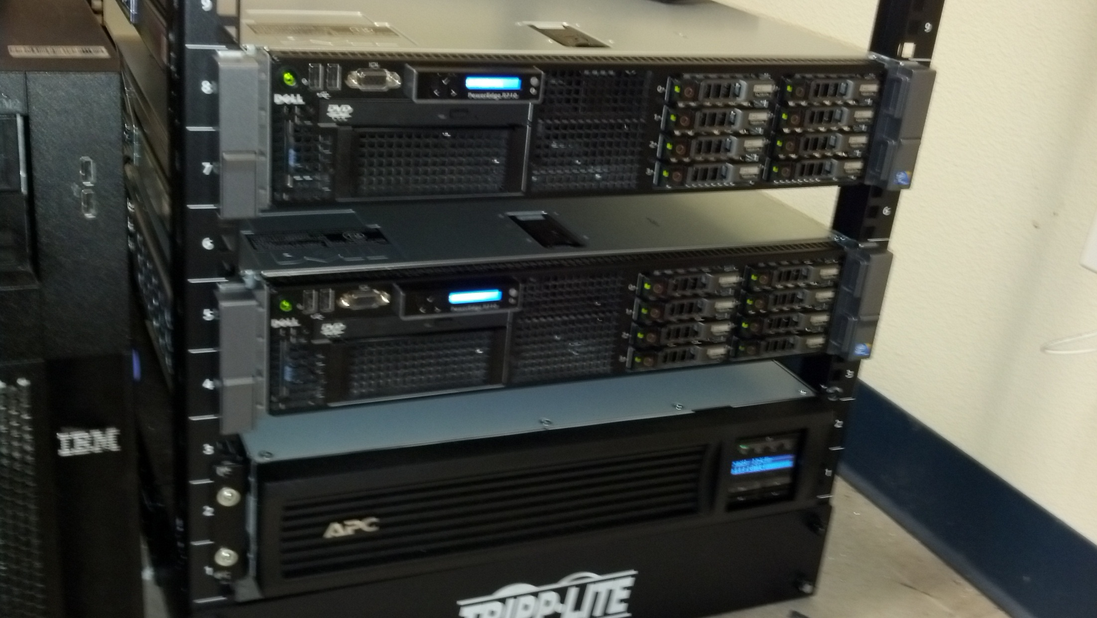
New Servers are Installed

Slide 26
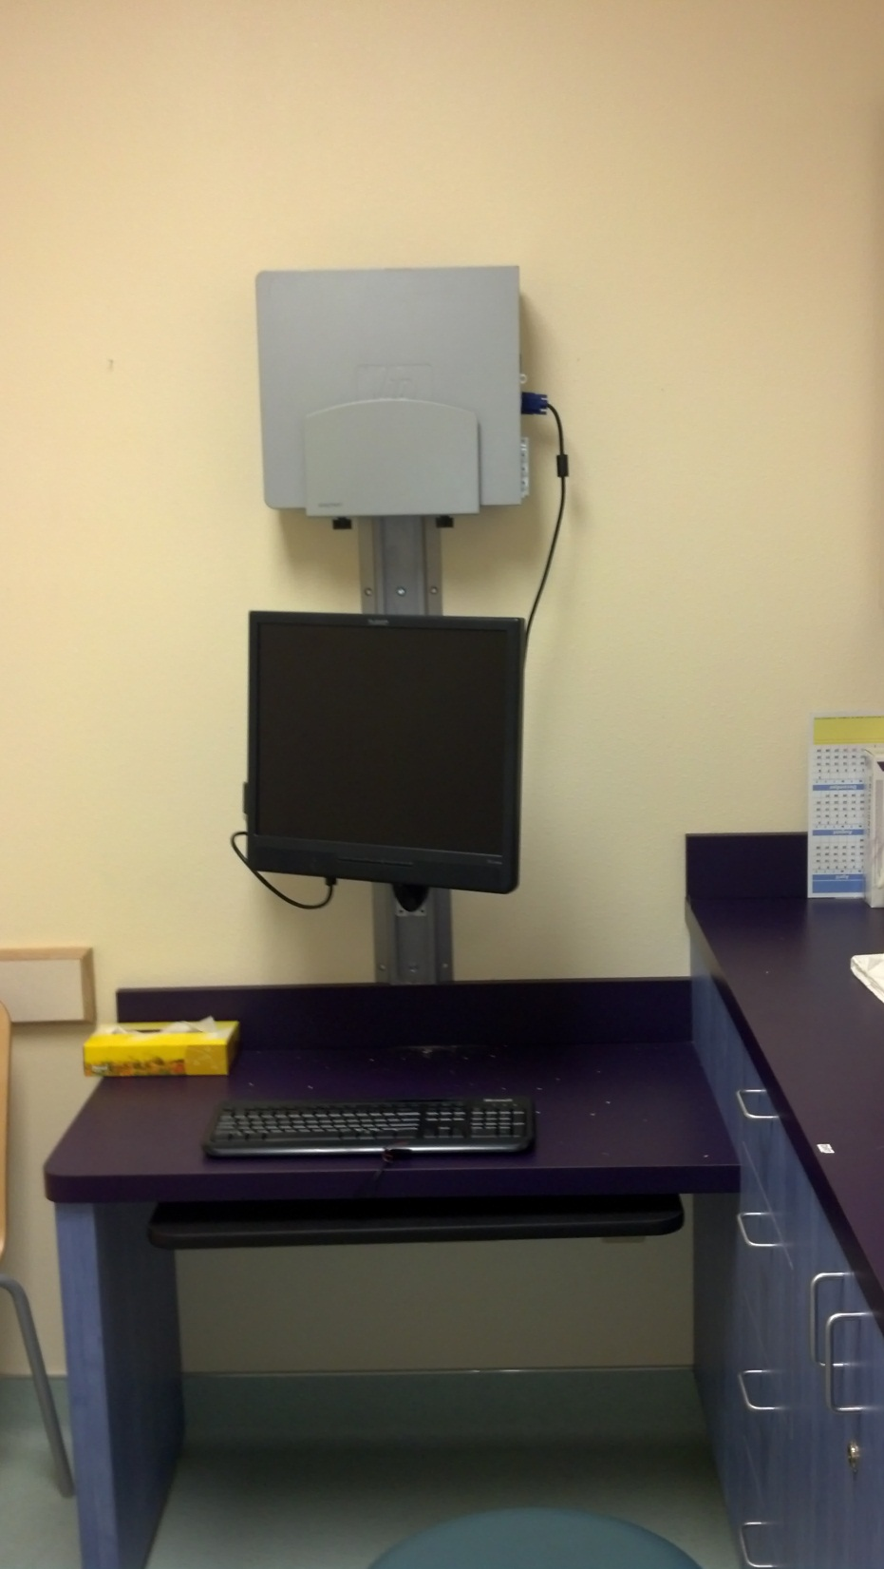
Exam
Rooms
New
Look

Slide 27
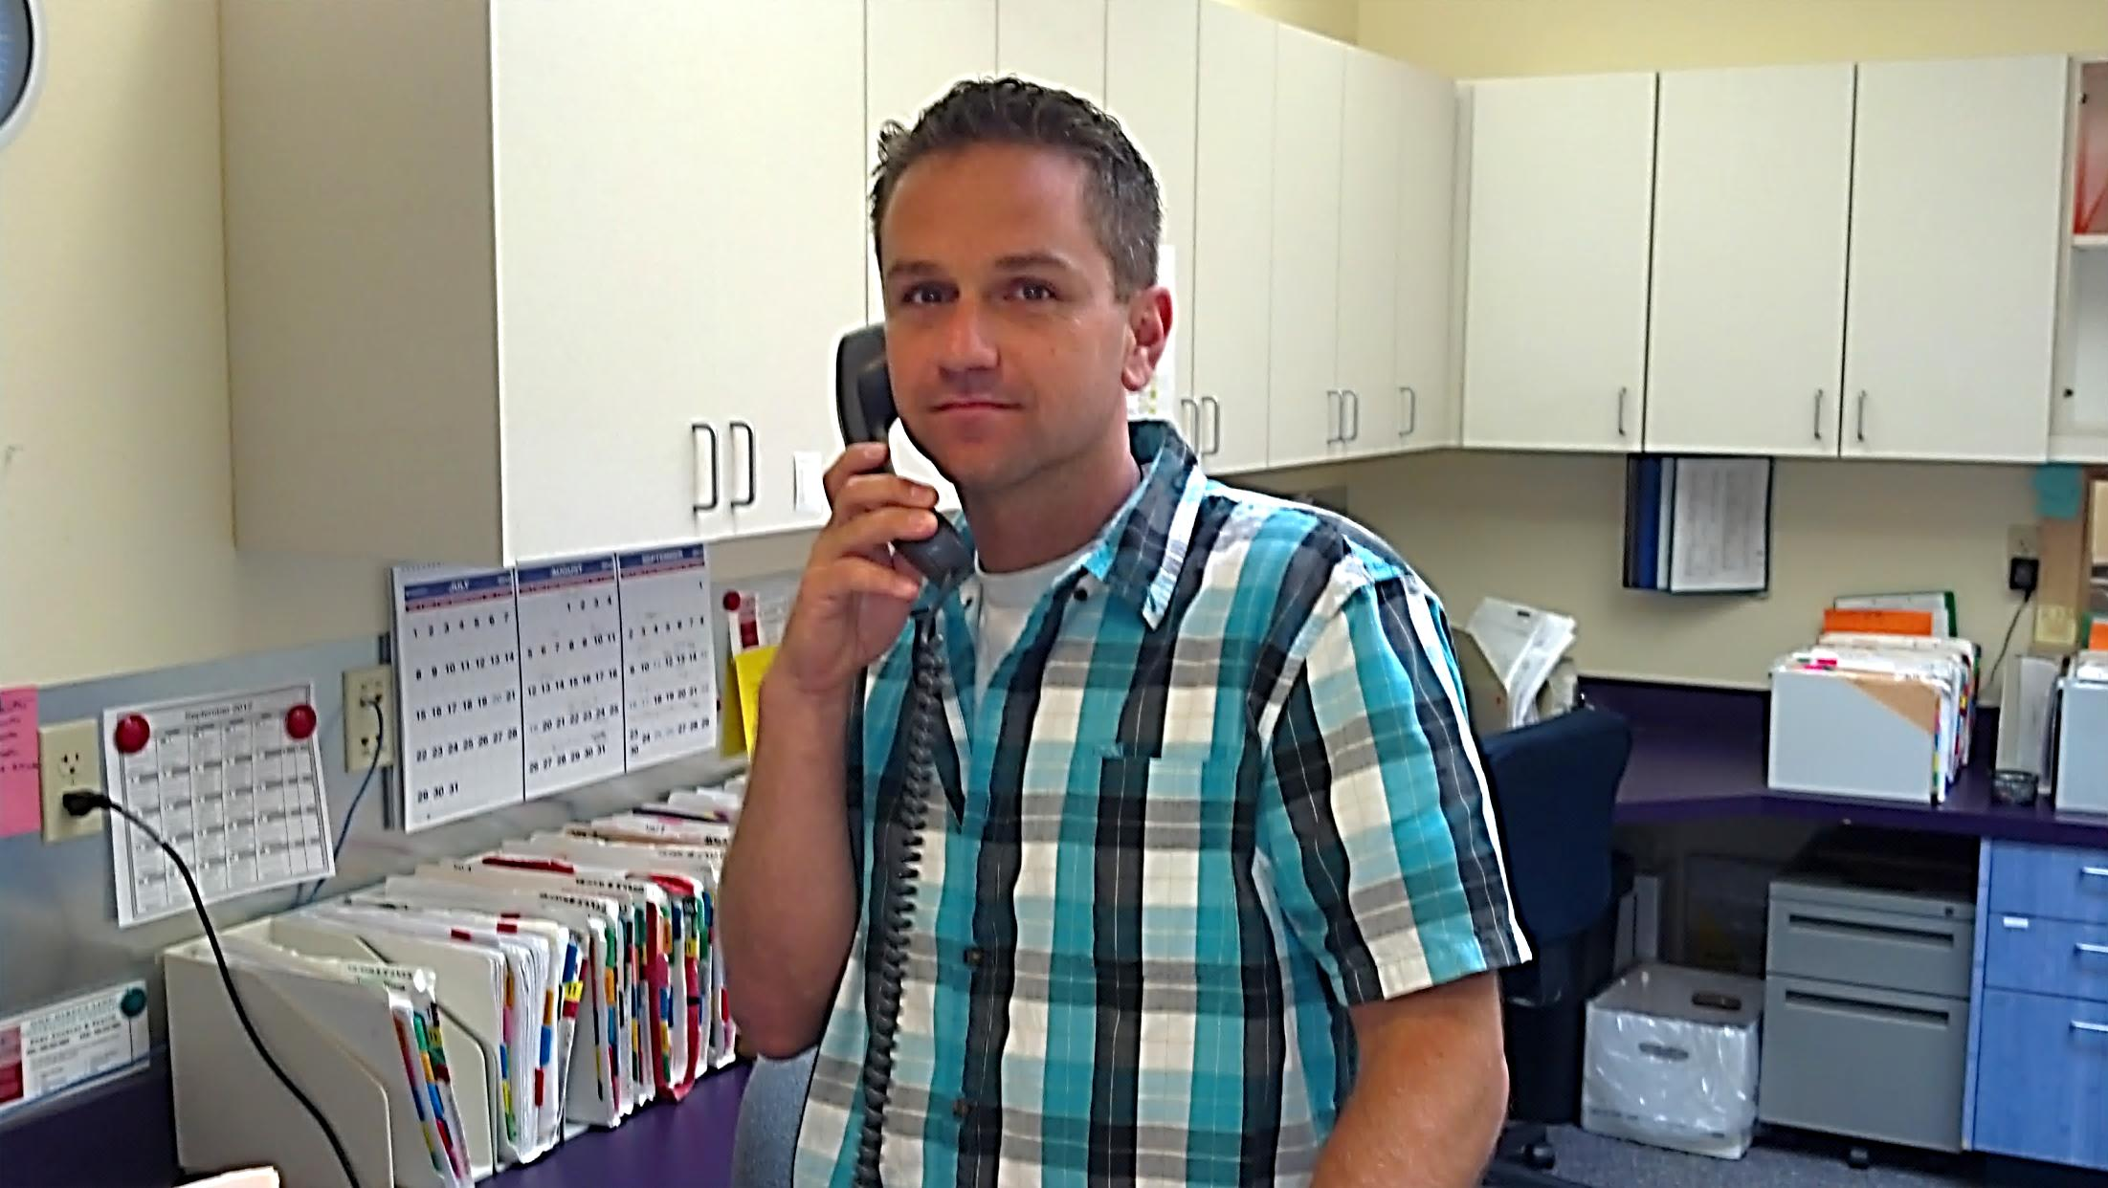
JD says, “I’ll be a C.A.C.”
Clinical Applications Coordinator

Slide 28
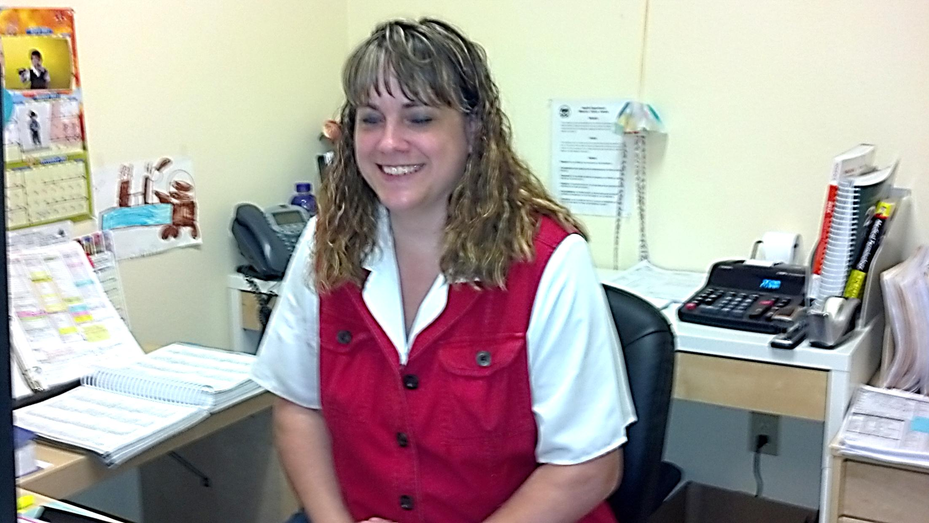
Tawny, “I’m making a Wish”
“October 1st, We rock!”

Slide 29
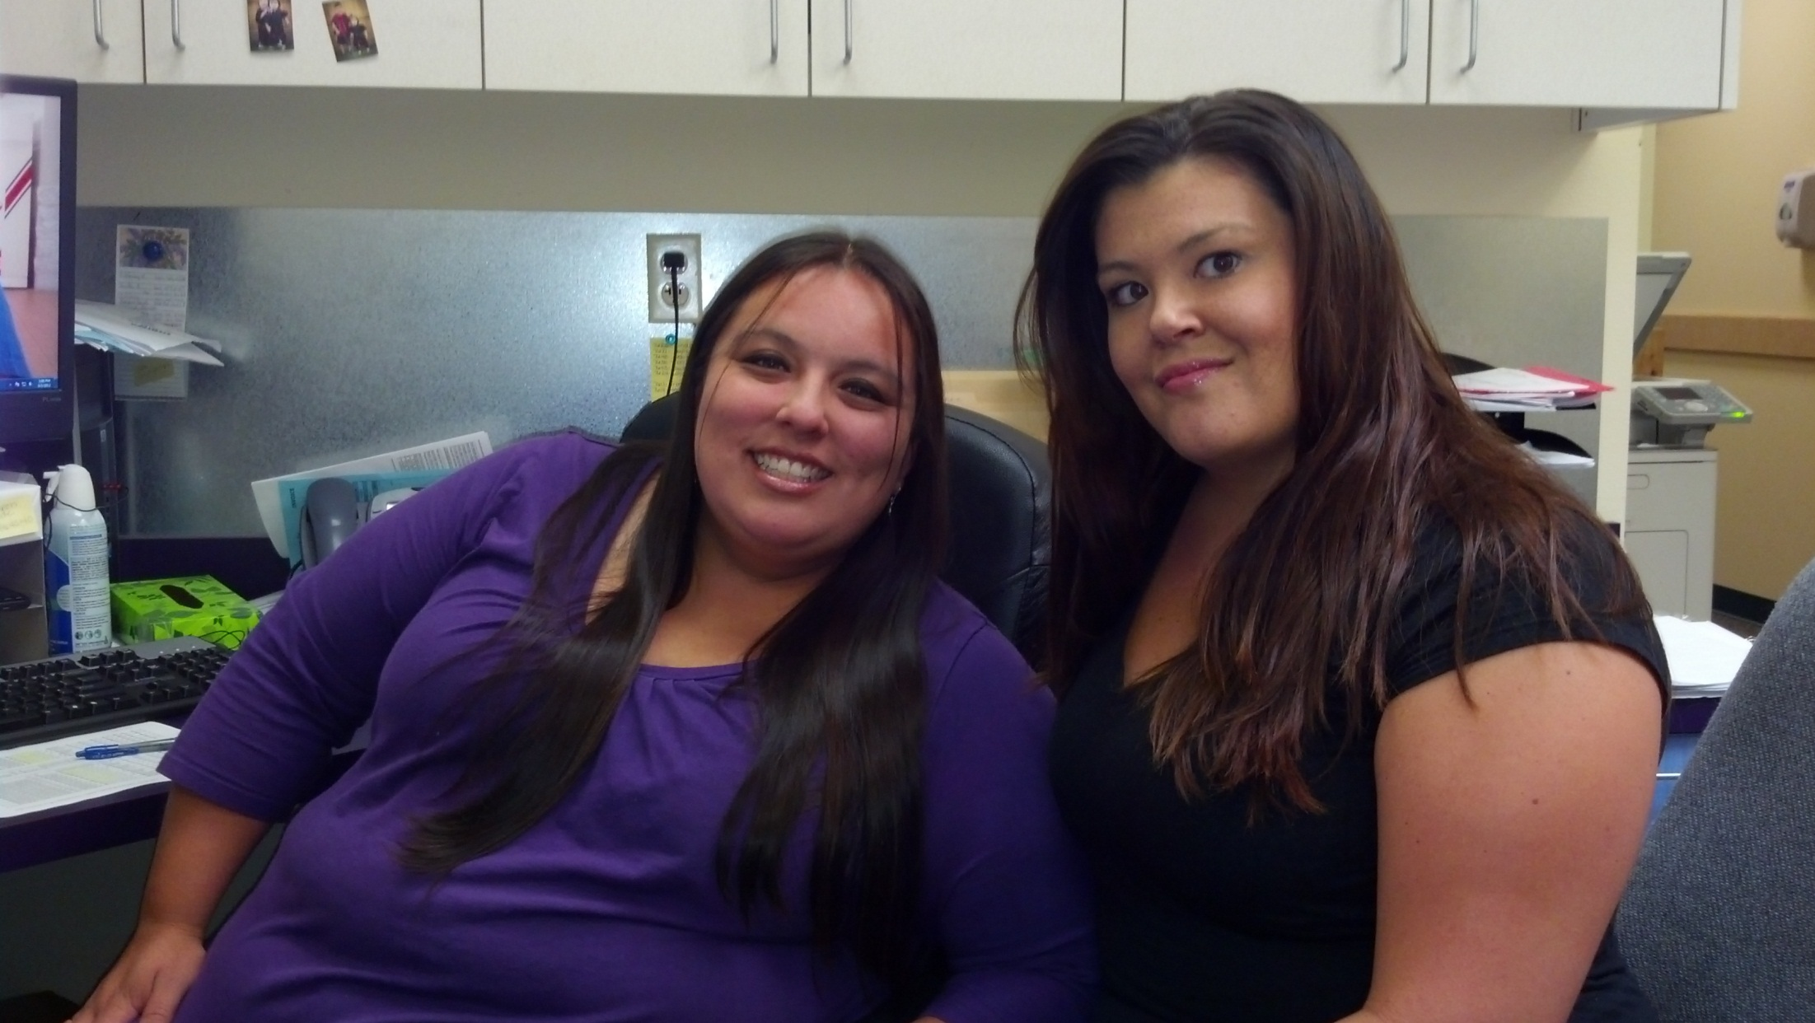
Julie, Rosie, and Brenda* take Billing
to new heights.
*Sorry we missed
you Brenda

Slide 30
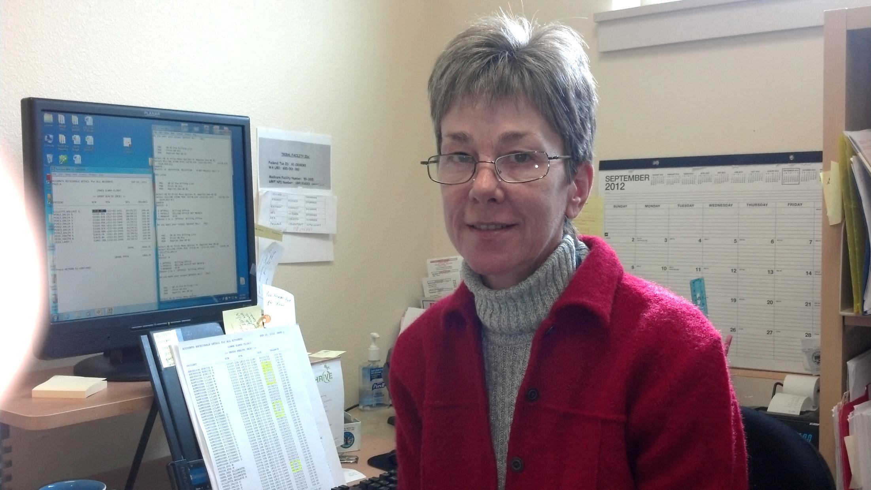
Deb is our billing
Anchorwoman

Slide 31
EHR
is here

Slide 32
And
We’re
Ready

Slide 33
More News
Deb Palmer is now our Financial Coordinator
Matt Eastman-Pittam is our Acting CD Manager
Leanna Ray-Colby joins the Management Team
Stephanie Holcomb joins us as our newest MA
Acupuncture and Massage have both returned!
We completed 100 patient satisfaction
surveys last month:
➢➢➢50 each for Medical and Dental

Slide 34
More News (cont.)
The Quality Improvement Team
now meets monthly
The Health and Safety Team is also going to
hold monthly meetings
Customer Service Training is scheduled for
September 20th →50 participants
We estimate to end this fiscal year
well in the black!!!!!!
Yeah!

Slide 35
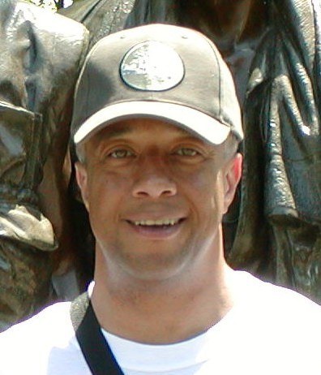
Thank
You
To all who helped make
our Health and
Emergency Preparedness
Fair a success.
Mervyn Chambers, MNPL
Health Services Director

Slide 36
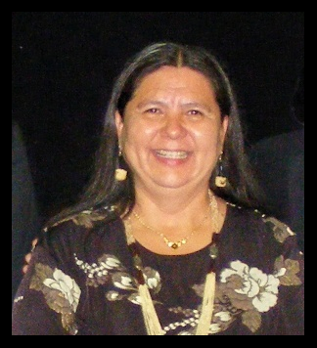
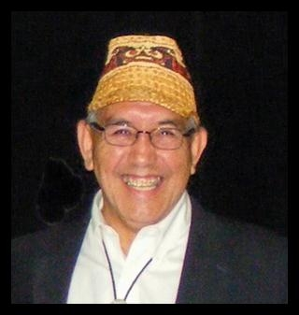
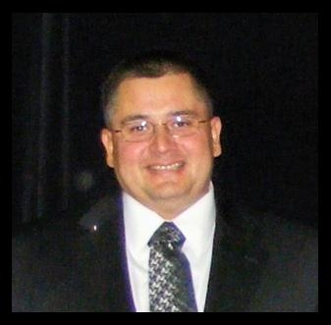
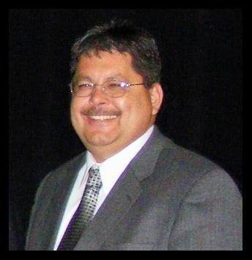
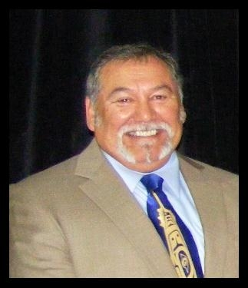
Tribal Leadership
Council
Frances G. Charles
Tribal Chairwoman
Russell N. Hepfer
Vice-Chairman
Ed Johnson
Secretary/Treasurer
Anthony Charles
Councilman
Joseph A. Turrey
Councilman

Slide 37
Acknowledgements
To recognize individuals and organizations who helped make this Fair possible:
The Lower Elwha Klallam Tribal Council: Frances Charles-Chairwoman, Russell Hepfer-Vice Chairman, Ed Johnson -Secretary/Treasurer, Anthony Charles-Councilman, Joseph Turrey-Councilman
Sonya Tetnowski -Chief Executive Officer - Lower Elwha Klallam Tribe
Roberta Kimberly and Hollie Kaufman, Lower Elwha Health Department (LEHC) Staff and co-chairs of the 2012 Health and Emergency Preparedness Fair Organizing Committee
Bea Gandara and Students - University of Washington School of Dentistry:
U.S. Coast Guard
Clallam County Fire Department
Jamye Wisecup - Program Coordinator for the Clallam County Emergency Management
Gina Yarbrough - Tribal Emergency Preparedness Coordinator, State of Washington, Department of Health
Eric Vinson - Northwest Portland Area Indian Health Board: (Colon Exhibit)
VENDORS
Doneal Putnam - Massage Therapy, U of WA Dental School - Beatrice Yandara, Beatrice Arakawa - LEKT Domestic Violence Program, Mitch Brown - LEKT Klallam Counseling, Dave Myers - LEKT Klallam Counseling, Lois Lato - Certified Hearing Company, Amy Ward - LEKT Registered Dietician, Kelli Holloway - DSHS, Gina Yarbrough - DOH - Olympia, Ellen Patrie - Puget Sound Blood Center, Nancy Adams - Breast and Cervical Health Program, Sue Hynes - My Nurse Foot Care, Jerry Charles - LEKT Veterans Program, Susan Clements - Sequim Cancer Care, Michelle Kelley - Red Cross, Steve Stigler - Acupuncture, Arlene Wheeler - LEKT Culture Program, Ellen Charles - LEHC, Fire District 2, US Coast Guard, Emergency Response Team, Medical Reserve Corp,
VOLUNTEERS
Jason Wheeler- LEKT Recreation, George Charles - LEKT Recreation, Mitchell Boyd- LEKT Recreation, Garnet Charles - LEKT Custodial, Janet Frances - LEKT Elder Volunteer, Charlene Charles - LEHC, Lorinda Robideau - LEHC, Arlene Wheeler and LEKT Dance Group For Singing, Chris Thomas – Zombie, Kevin Kaufman, Cert Team Members

Slide 38
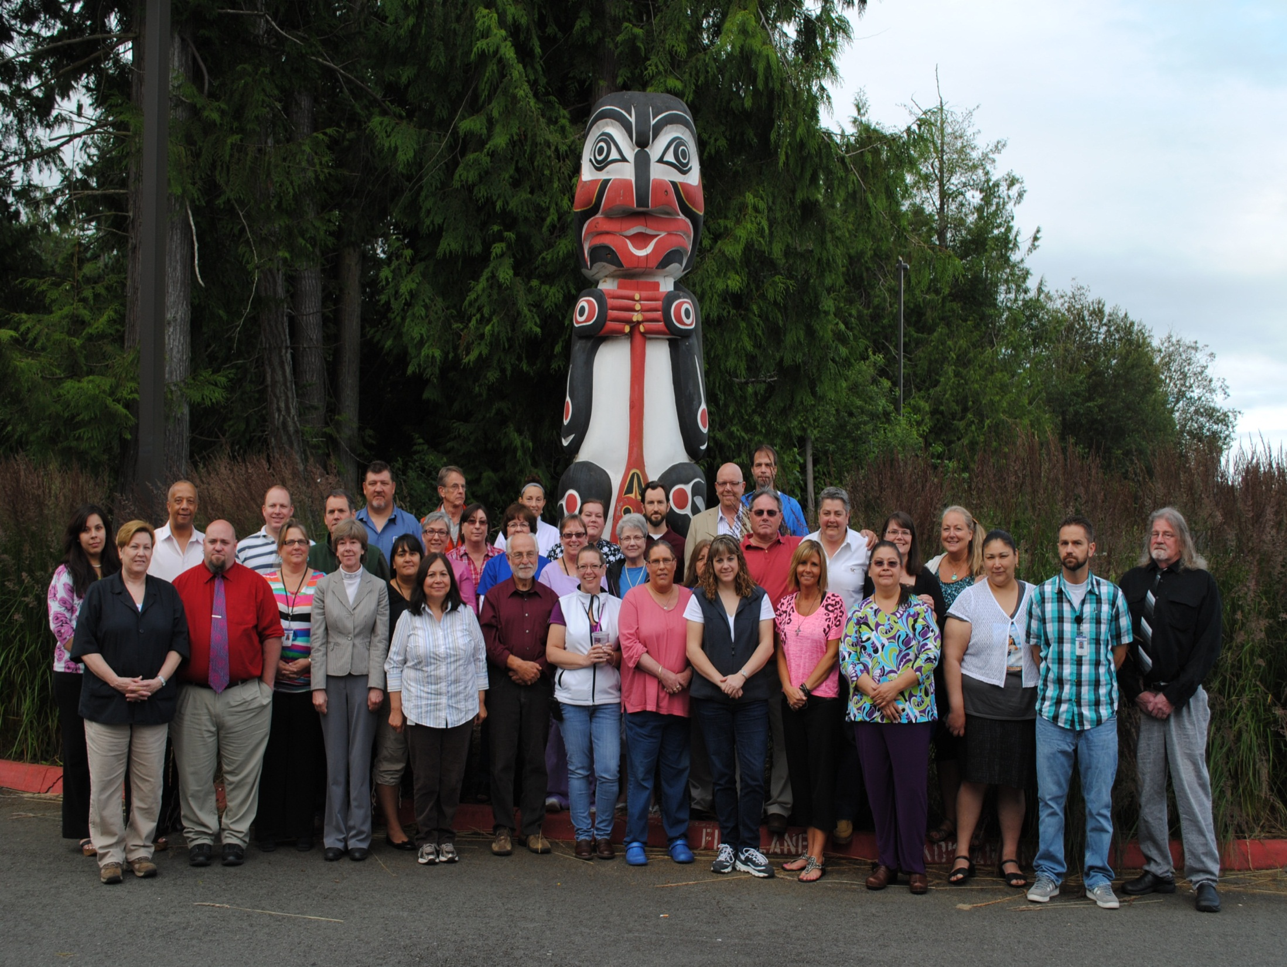
Elwha Klallam Health Department

