Slide 1
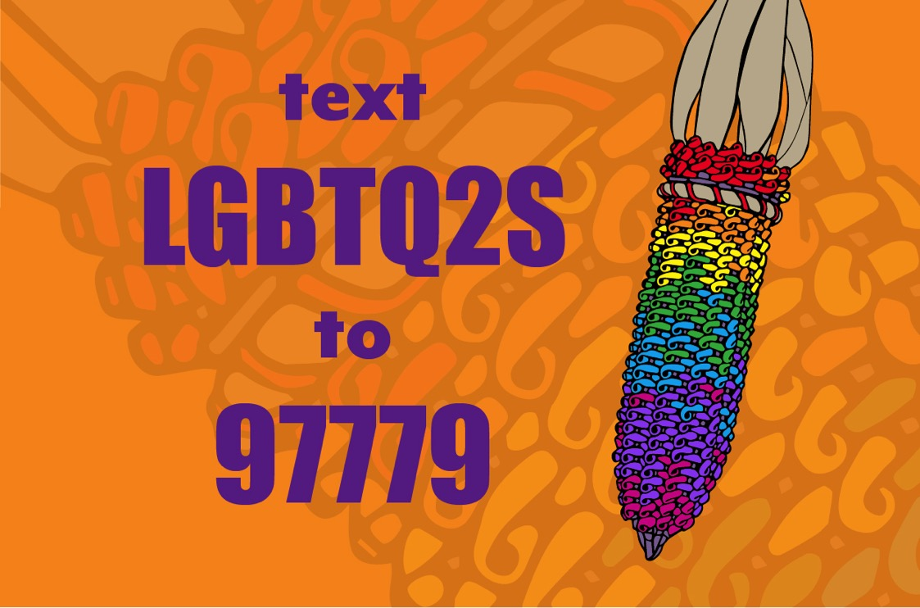

Slide 2
Caring for the person first Two Spirit and LGBTQ Health
Morgan Thomas

Slide 3
Acknowledgements
The original inhabitants of this place, the Sdohobsh (Snohomish) people and their successors the Tulalip Tribes, who since time immemorial have hunted, fished, gathered, and taken care of these lands.
Providers, staff, and tribal leadership in the PNW
Alessandra Angelino and Seattle Children’s Hospital for the creation of Celebrating our Magic Toolkit
This project was funded in part with resources from the Minority HIV/AIDS Fund.
Indian Health Service –Rick Haverkate
Boxcar Assembly – Courtney Hermann and Kerribeth Elliott
Notes:
I want to first acknowledge the traditional owners of the land we are on today, as well as the land of the Coast Salish peoples where most of my work towards this project has taken place.
I also want to thank my mentors, providers, and staff from tribal clinics and communities in the PNW for their partnership and willingness to work with me on this project.
My mentors at SCH for their support of the project.
A very important thank you to NPAIHB and esp Morgan Thomas and Jessica Leston who were integral in the development and completion of this project. Thank you for your dedication!
Also thanks to Rick and the IHS, and my advisors at IWRI.

Slide 4
How can we access the documentary?
Online
http://www.npaihb.org/2slgbtq/#film

Slide 5
Specific aims:
1) Deliver culturally grounded resources for people who identify as Two Spirit or LGBTQ, their healthcare providers, and their allies.
Posters
Rack Cards
Pamphlets

Slide 6
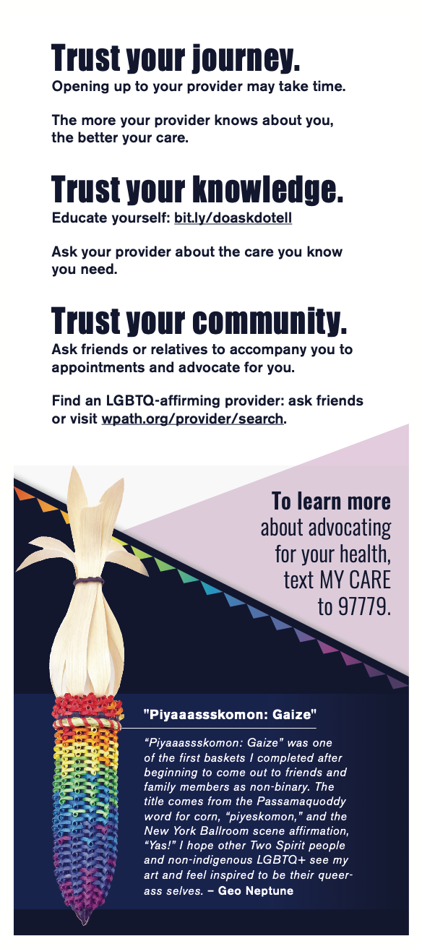

Slide 8
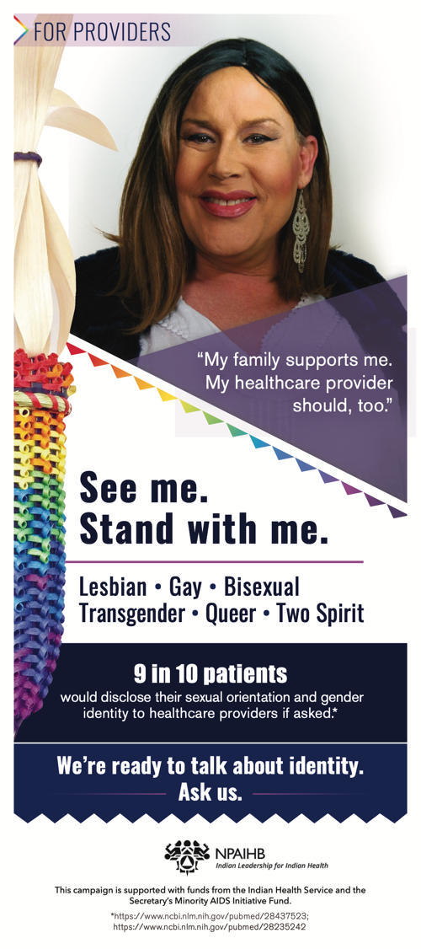
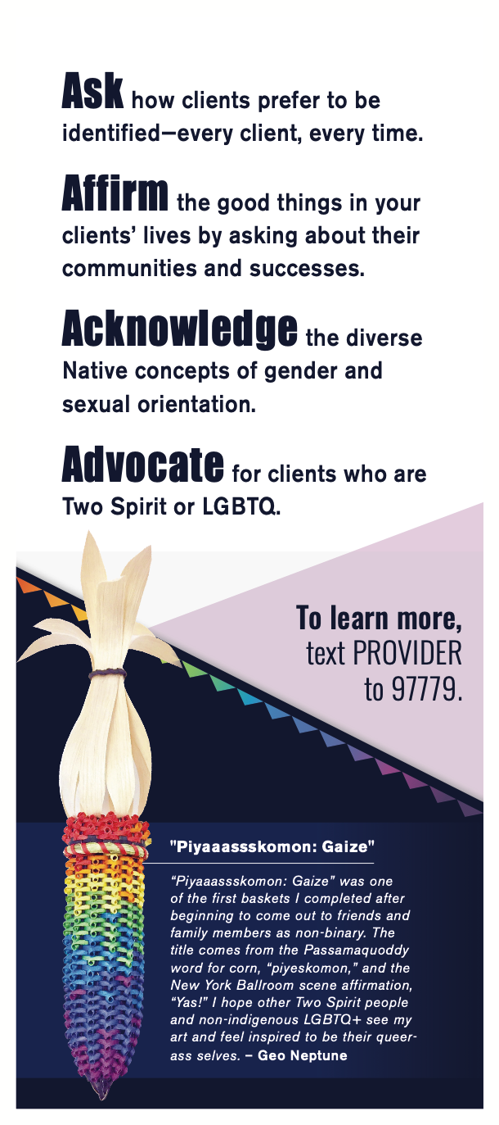

Slide 10
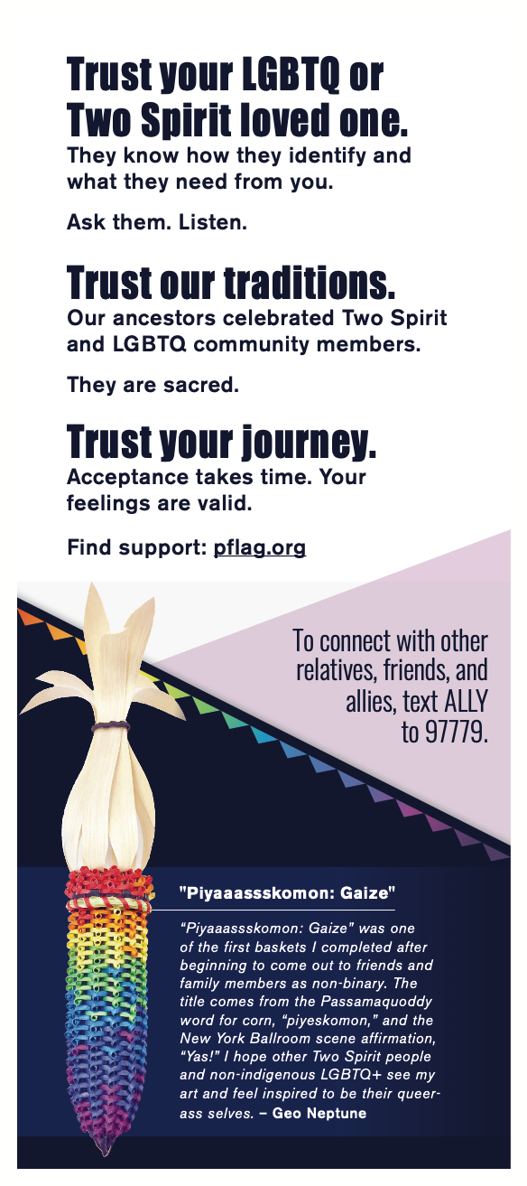

Slide 12
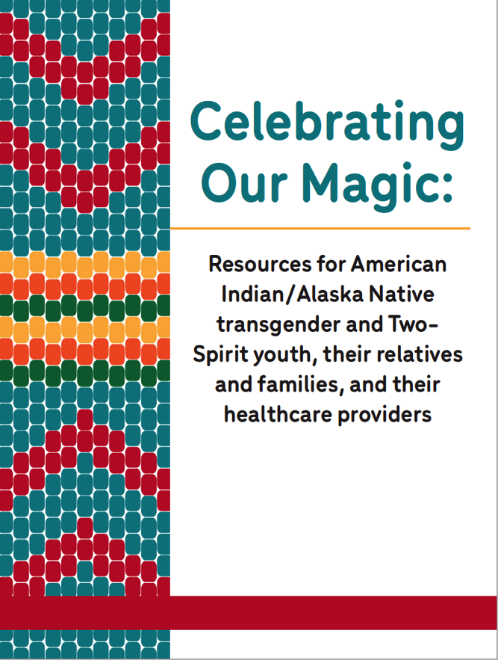
Specific aims:
Deliver culturally-grounded resources to youth exploring their gender identity and/or choosing to medically transition
Provide resources and support for families
Increase health provider awareness of aspects unique to AI/AN transgender and Two-Spirit youth
Notes:
Over the last six months Alessandra Angelino has been engaging in community based work and conversations to develop a Toolkit for Native youth who identify as transgender and Two-Spirit, as well as their families and the health providers who care for them.
CBPR; feedback; iterative process
While the majority of discussions, community expert engagement, community advisory board meetings, and focus group discussions have taken place physically in WA state, I have been in contact with individuals across the US to develop this resource.
We know that AI/AN youth disproportionately face barriers accessing healthcare. AI/AN youth experience higher rates of mental health issues and suicidality compared to non-AI/AN peers, and those who identify as transgender face even higher risk [1, 2]. Lack of access to information and culturally-specific resources are significant barriers to healthcare in this population. Education, awareness, and support from families and health providers can reduce these barriers and may lead to improved mental and physical health outcomes, as well as supportive communities [3, 4].
The primary objective of this project was to create a culturally-specific and sustainable Toolkit for AI/AN transgender and Two-Spirit youth, their relatives, and their health providers across the United States.
The specific aims of the Toolkit are to (1) deliver culturally-grounded resources to youth exploring their gender identity and/or choosing to medically transition, (2) provide resources and support for families, and (3) increase health provider awareness of aspects unique to AI/AN transgender and Two-Spirit youth.

Slide 13
Coming soon…
Trans and Gender Affirming Care ECHO
March – August 2020
Two Spirit & LGBTQ Podcast
April – September 2020
Kids Book for Two Spirit and trans youth
August 2020
Community Readiness Assessment
In Process

Slide 15
www.npaihb.org/2SLGBTQ

Slide 16
Discussion
What other resources or initiatives does your community need?
What resources or advocacy initiatives are ongoing in your community, that may be helpful for other communities?

Slide 17
Morgan Thomas mthomas@npaihb.org

