Slide 1
2020 Decennial Census
NPAIHB Quarterly Board Meeting
October 23, 2019
160 Days until Census Day
(April 1, 2020)

Slide 2
Census Trivia
When was the first Census conducted?
First Census conducted in 1790
When did AIANs become part of the Census count?
American Indians living in the general population were identified for the first time in 1860
American Indians living on reservations were identified for the first time in 1900
What percentage of census takers (enumerators) are over the age of 50?
50%
What year were AIANs granted the right to vote?
American Indians were granted the right to vote in 1924
When day is “Census Day”?
April 1, 2020

Slide 3
1790-1840 | American Indians excluded.
1860 | American Indians considered assimilated are counted.
1870 | Census Schedule lists “Indian" as a choice in the column heading for "Color."
1880 | Census and Commissioner of Indian Affairs collaborated to count both taxed and non-taxed American Indians.
1890 | Both taxed and non-taxed American Indians are counted and results were reported.
1890-1950 Census takers use observation to determine if a person is American Indian.
1930 | In response to Meriam Report the Census does a more thorough account of American Indians by: 1) use of a general schedule 2) enumerating Indians the same time as the rest of the population and 3) using trained census employees.
1940 | American Indians included in total U.S. census count.
1950 | Supplemental Schedule for BIA is included and maps that designated reservation boundaries are used.
1960 | Respondents self-report their race.
1960-1970 Self-identification begins to replace observation to identify race.
1970 | Race was once again obtained on the basis of observation by enumerators in rural areas of the country, including most reservations.
1980 | The Census Bureau begins to actively seek AIAN input into the census process and Alaskan Natives were mentioned separately for the first time. The count of the AIAN population was the highest to date with a 72 percent increase over the 1970 census count.
1990 | Tribal Governments Program developed to work with federally recognized tribal governments. The Census AIAN Advisory Committee is created.
2000 | “Tribal Governments Program” changed to the “American Indian and Alaskan Native (AIAN) Program” and the program is expanded to include all AIAN people. Tribal Governments Liaison Program extended to state-recognized tribes.
2010 | A Partnership Specialist (Tribal) position is created to work with Tribal Officials.

Slide 4


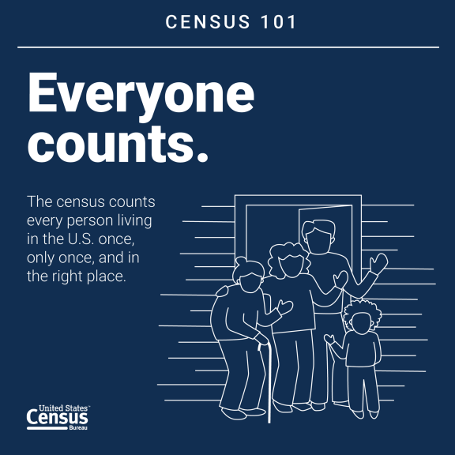
Why Do We Take the Census?
U.S. Constitution, Article 1, Section 2 mandates an apportionment of representatives among the states for the House of Representatives every 10 years.
By law, the U.S. Census Bureau must deliver a report of population counts to the President of the United States within 9 months of Census Day – on or before December 31, 2020.

Slide 5
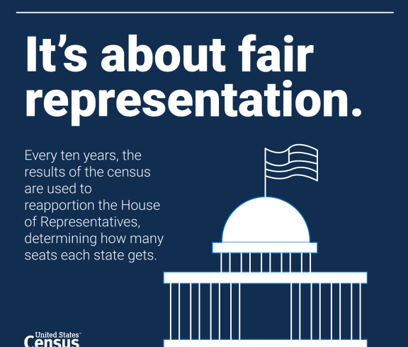
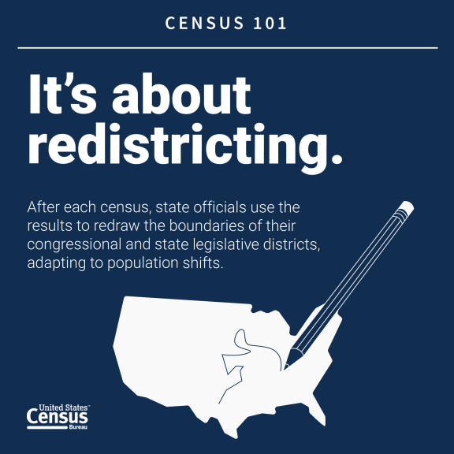
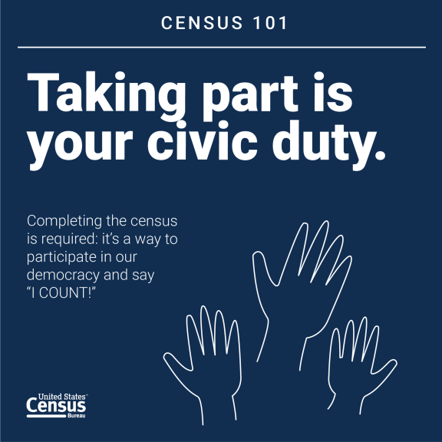
2020 Census: Counting Everyone Once, Only Once, and in the Right Place
With accurate census data, Tribe’s and Tribal organizations can make stronger decisions to better serve your communities.
Data is the most accurate when people participate.
How can we do this together?

Slide 6
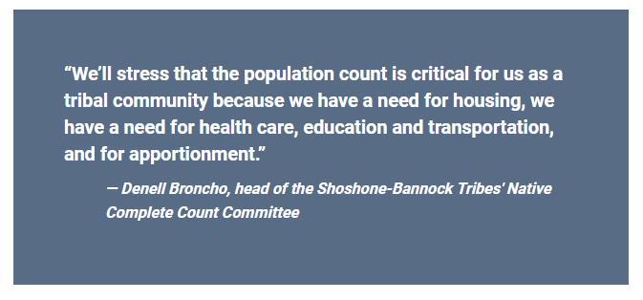

Slide 7
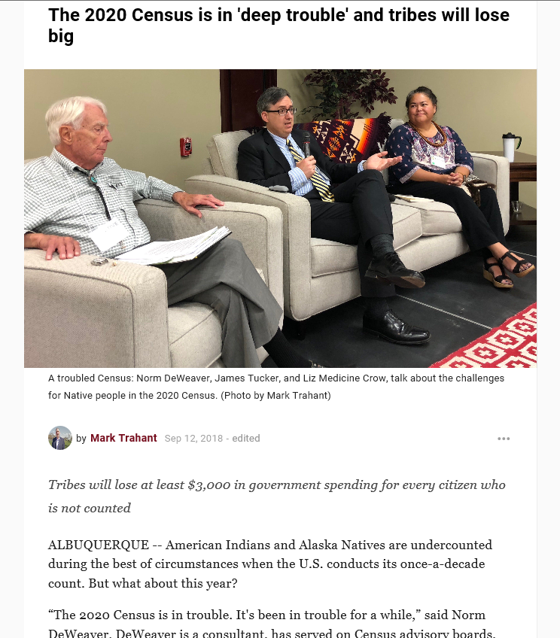
What is at Stake?
Distribution of more than $675 billion annually in federal funds.
Redistricting of state legislative districts.
Forecasting future transportation needs.
Determining areas eligible for housing assistance and rehabilitation loans.
Assisting tribal, federal and state and local governments in planning, and implementing programs and services in:
Education (School lunch program, Head Start/Early Head Start)
Health (Medicaid, Medicare, Indian Health Services)
Social Services (Workforce Development, Youth and Elders Programs)
Housing (Indian Housing Block Grants)

Slide 8

Community Partnership and Engagement Program
Increase participation in the 2020 Census for those who are less likely to respond or are often missed.
EDUCATE people about the Decennial 2020 Census and foster cooperation with Tribes and stakeholders.
ENCOURAGE tribal and community partners to motivate people to self-respond.
ENGAGE tribal, urban and grass roots organizations to reach out to hard to count groups and those who aren’t motivated to respond to the national campaign.

Slide 9

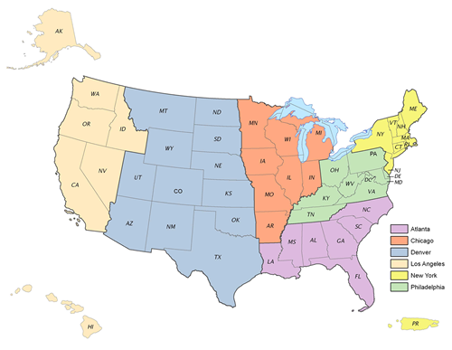
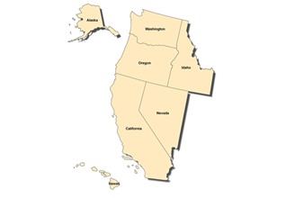
Area Census Offices (ACO) - 2nd Wave July-Sept 2019
Washington: 5 (Seattle, Tacoma, Olympia, Everett, Spokane)
Oregon: 3 (Salem, Springfield, Portland)
Idaho: 1 (Boise)
LARCC – 7 States
*Region with largest Tribal Nations (401)
*TPS in majority of states

Slide 10
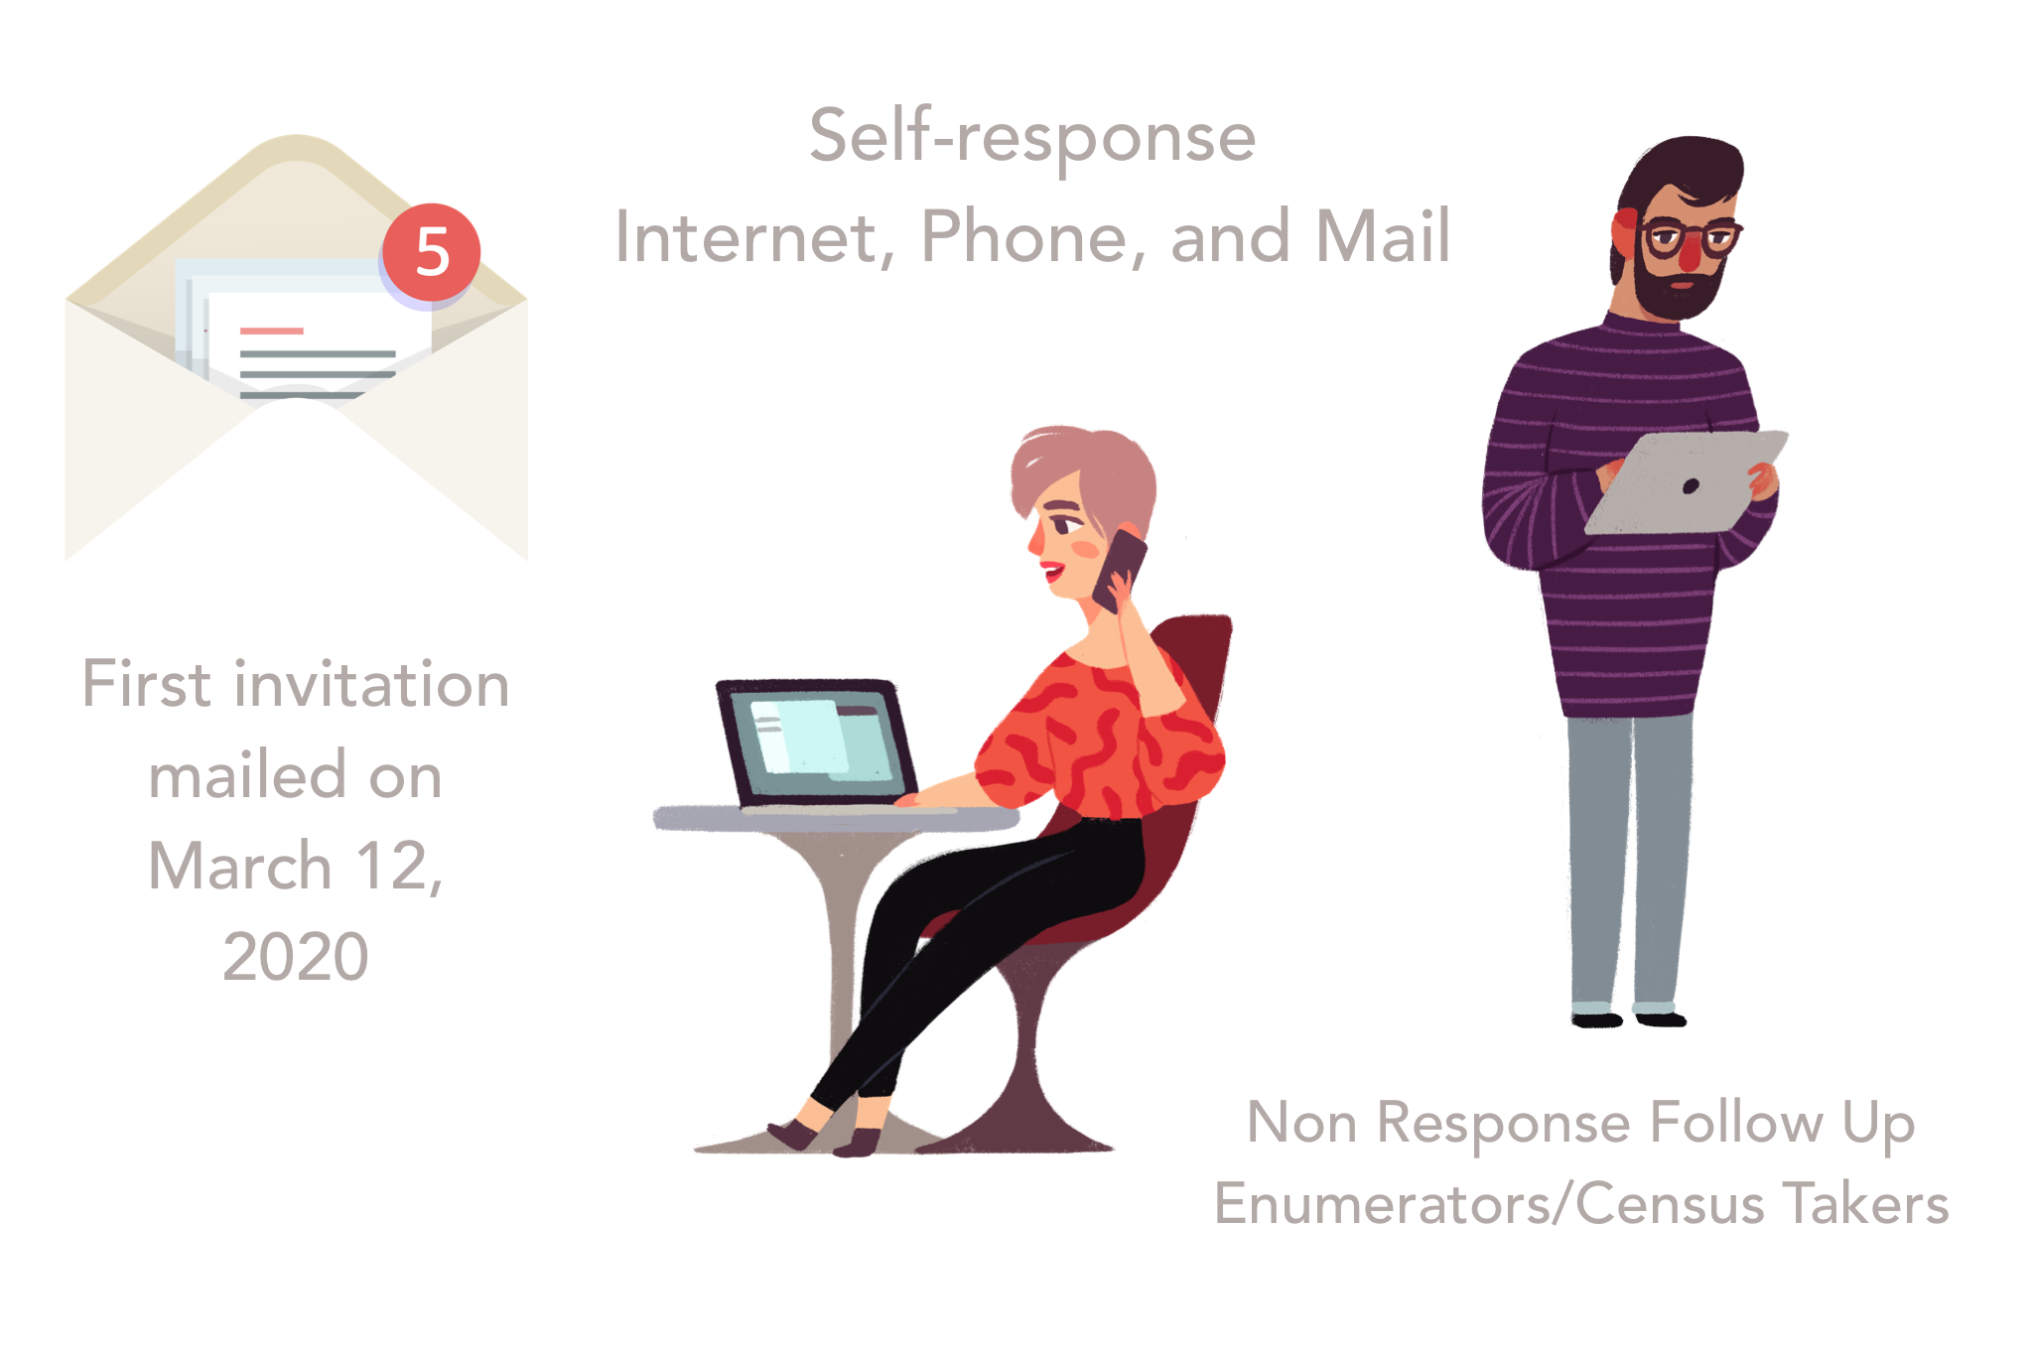
2020 Census vs 2010 Census
We mail to physical addresses not PO Boxes
Easier.
More efficient.
Confidential.
Safe.
Last day to self-respond July 31, 2020
Last day of NRFU July 24, 2020

Slide 11

The Census is Confidential and Required by Law
The Census Bureau is required to keep information confidential. All responses provided on the 2020 Census question are or to a Census Bureau employee are confidential and protected under Title 13 of the U.S. Code.
We will never share a respondents personal information with other government agencies.
Results from the census are reported in statistical format only.
Records are confidential for 72 years by law (Title 44, U.S. Code).
All Census Bureau employees swear a lifetime oath to protect respondent information.
Penalty for wrongful disclosure is up to 5 years imprisonment and/or a fine of $250,000

Slide 12
2020 Census Timeline
Fall 2018 | Recruitment begins for early census operations.
Fall 2019 | Recruitment begins for peak operations in 2020.
August – October 2019 | In-field address canvassing where needed.
March – July 2020 | Internet Self-Response.
March – July 2020 | In-person or follow-up interviews.
March – September 2020 | Census Questionnaire Assistance via telephone.
April 1, 2020 | Census Day – Respondents will be able to respond via internet, telephone or paper questionnaire.
December 2020 | U.S. Census Bureau delivers population counts to President for apportionment.
March 2021 | U.S. Census Bureau delivers redistricting data to states.

Slide 13
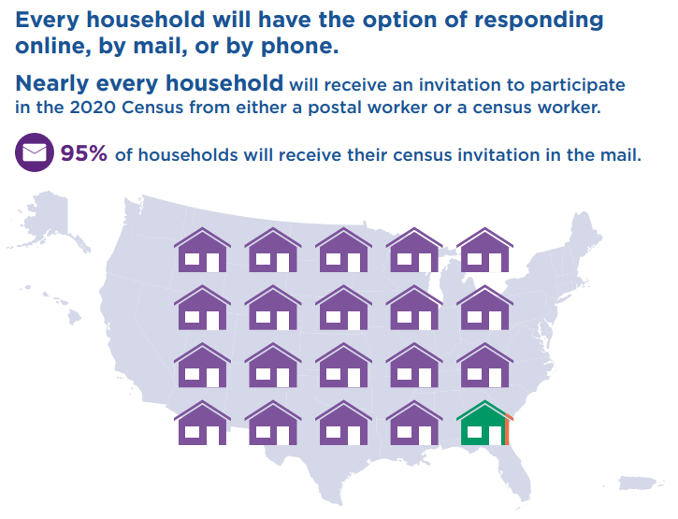
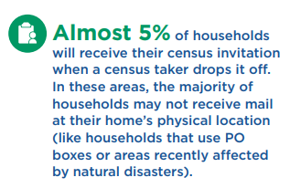
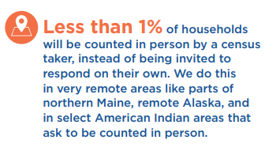

Slide 14
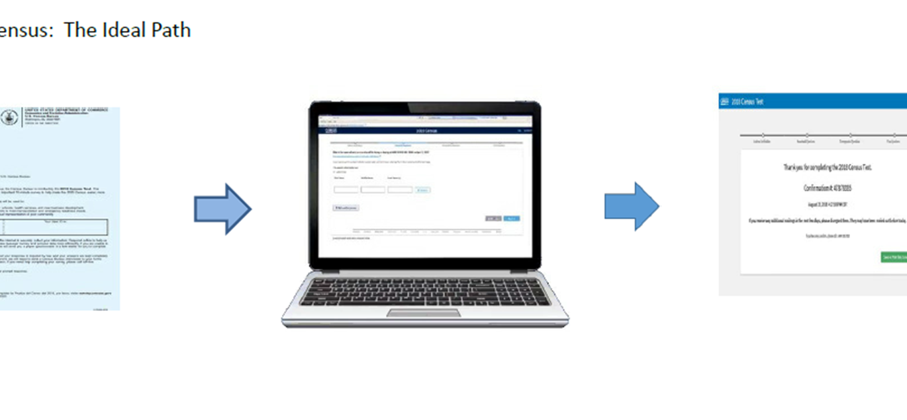

Slide 15
Hard to Count Populations (HTC)
American Indian/Alaska Natives — at risk of being undercounted (4.9% undercount in 2010)
Young children and Elders (0-5 years – 4.6% undercount in 2010)
Renters
Low income persons, low of internet access
Persons experiencing homelessness/transient — Housing insecurity, seasonal fishing communities
Persons who distrust the government
Persons with mental or physical disabilities
Persons who do not live in traditional housing

Slide 16
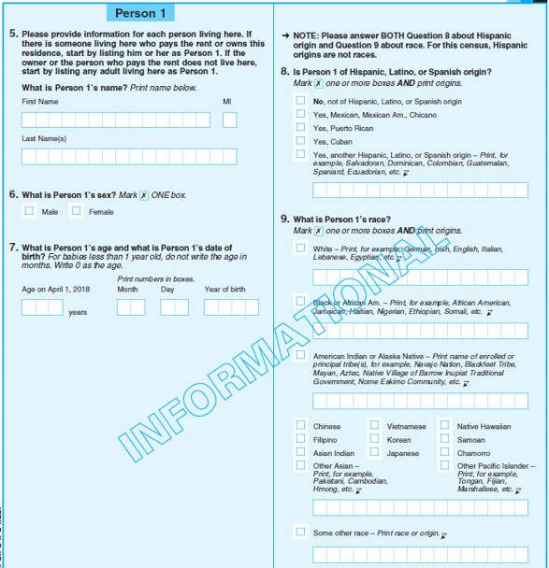
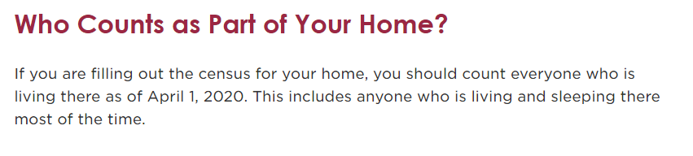
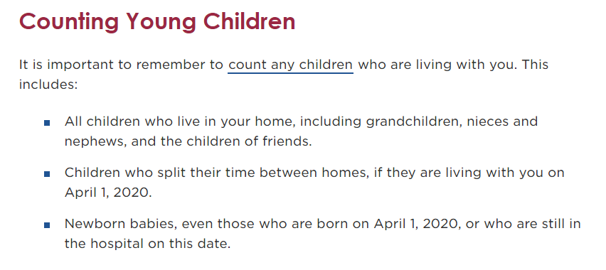
Further residency guidance can be found at 2020Census.gov

Slide 17
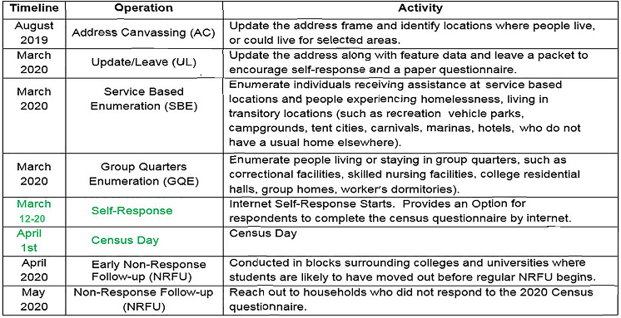

Slide 18
Update Leave (March 2020) Ex. Warm Springs, Shoshone Bannock, Quinault
Optimize and allow household Self-Response through delivery of 2020 Census Questionnaire to every Housing Unit (HU)
Package will include:
  Paper Questionnaire (will have preprinted questionnaire ID and can be mailed)
  A letter (Will provide instructions on three methods to respond to Census)
    First method is to respond online using Uniform Resource Locator (URL) and Questionnaire ID printed on the enclosed Questionnaire.
    Second method is complete and mail back the Questionnaire in the postage-paid envelope provided.
    Third method is to respond via telephone by calling the Census Questionnaire Assistance (CQA) Center
  Census Questionnaire Assistance Insert
  Frequently Asked Questions Insert
  Return Envelope

Slide 19
Group Quarters and Service Based Enumeration (March 2020)
A Group Quarter (GQ) is a place where people who are not related live or stay in a group living arrangement that is owned or managed by an entity or organization providing housing and/or services for the residents.
Types of Group Quarters include:
College Residence Halls, Group Homes, Prisons, Nursing Homes, Residential Treatment Centers
Service-Based Enumeration (SBE) is a subset of GQ, where individuals who are experiencing home-lessness are receive services. We target places where people who maybe experiencing homeless are receiving services so we can provide them opportunities to be counted.
These locations include: Mobile Food Vans , Soup Kitchens, Transitional and Emergency Shelters (with Sleeping Facilities) — for people experiencing homelessness.
Targeted Non-Sheltered Outdoor Locations (TNSOLs) — places where people experiencing homelessness live without paying to stay. Ex. Parks, Wooded Areas, Parkway Benches, Alleys, Restaurants, 24-hour Laundromats, Walmart, Casinos, etc.

Slide 20
The Role of Community Partners – We need you.
Community partners who actively work within Hard to Count (HTC) Population can assist the Census workers to gain access to these targeted populations in order to accurately count them, by doing the following:
Participate in the ongoing conversation and Census related activities about the 2020 Census.
Participate on your Tribal CCCC or local CCC. If not formed, encourage creating one!
Respond to Census workers when they reach out for assistance and partnership building.
Share resources about the 2020 Census with your network of providers.
Preset the population experiencing homelessness by letting them know that Census workers will be conducting enumerations beginning on April 1, 2020.
Encourage their participation in the 2020 Census. Frame your conversation in terms of the benefits of participating in the Census.
Help Census workers to identify Hidden Housing and new Group Quarters in your community.
Be an active champion for the work being done by the Census Bureau.
Invite us to your events, conferences and gatherings.

Slide 21
What we will ask.
Age and Date of Birth
Address
Hispanic or Latino origin
Race/Ethnicity
Relationship (includes same sex)
Gender
Tenure (Owner/Renter)
Household (count everyone at address)

Slide 22
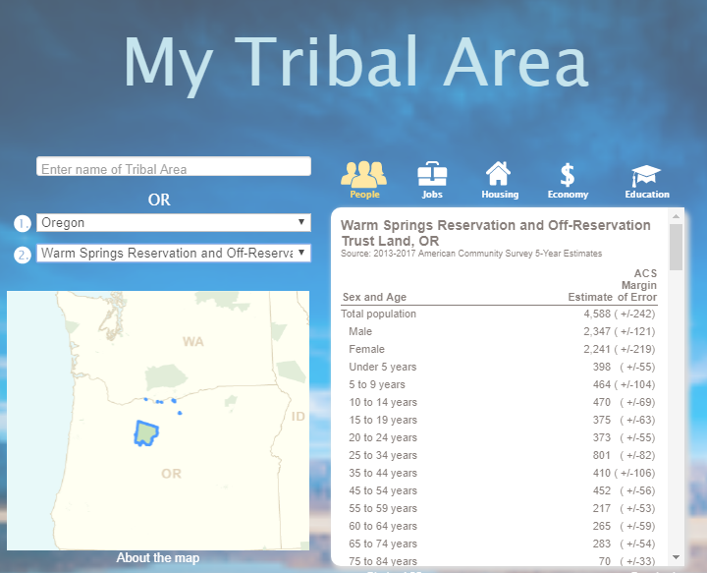
Data Tools
My Tribal Area
https://www.census.gov/tribal/
Response Outreach Area Mapper (ROAM)
https://www.census.gov/roam
Free Data Workshops and Webinar available to Tribes and Orgs
www.2020Census.gov

Slide 23
Tribal Complete Count Committees
A committee established by tribal, state and local governments, and community leaders or organizations to increase awareness and motivate residents to respond to the 2020 Census.
Focus is to encourage individuals in their community/tribe to self respond online, on the phone or by mail (if they receive a questionnaire by mail).
A formal partnership with the Census Bureau either by resolution, executive order or legislation. It provides the structure and support to engage the tribal, community and state’ stakeholders and encourage participation.
Census Bureau staff (Tribal Partnership Specialist) serve as liaisons and information resources for forming CCC.

Slide 24


Census Jobs
National Recruiting Week (October 20-27th)
Pay rate: $15-25 per hour
Paid weekly
Paid training
Flexible
SNAP,TANF,HUD, GA Waivers
Need for AI/AN Census Takers
www.2020census.gov/jobs

Slide 25
Next steps and To Dos?
Create Tribal Outreach Plan (Toolkit examples)
Identify barriers and challenges to participation.
Identify Key Community Events using Timeline.
Develop local messaging and materials.
Create or participate on a TCC or Local CCC.
Invite Census staff to your events/meetings/activities.
Apply for Census jobs and help us recruit a diverse staff for the ACO job positions.
Questions?

Slide 26

Contact Information
Shana M. Radford
Tribal Partnership Specialist – Oregon/Idaho
Los Angeles Regional Census Center
Shana.m.radford@2020census.gov
C: (541) 908-7911
Alaina Capoeman
Tribal Partnership Specialist-WA Lead
Los Angeles Regional Census Center
Alaina.j.capoeman@2020census.gov
C: (360) 862-3108

