Slide 1

WEAVE-NW
Chronic disease prevention through an indigenous perspective

Slide 2
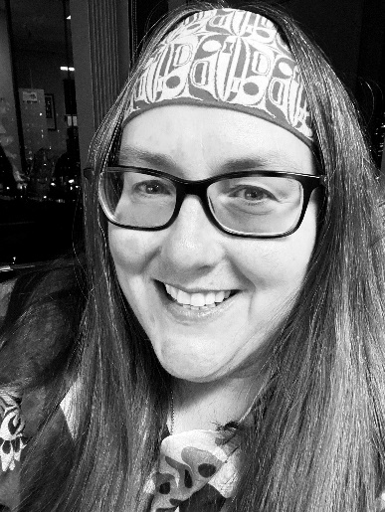
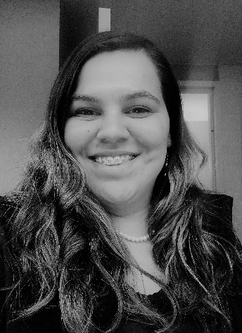
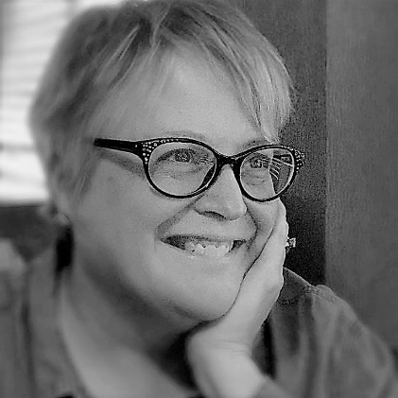
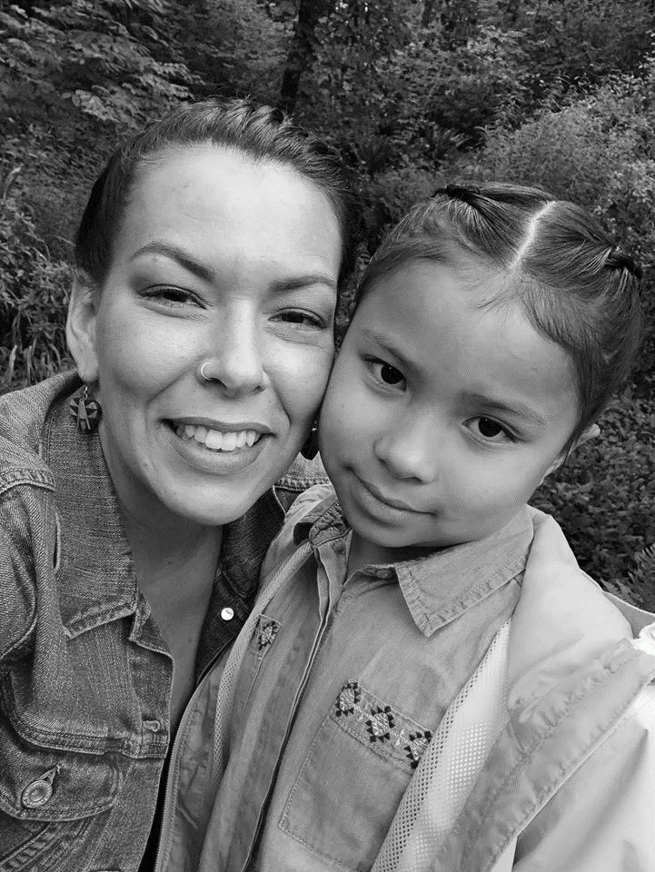
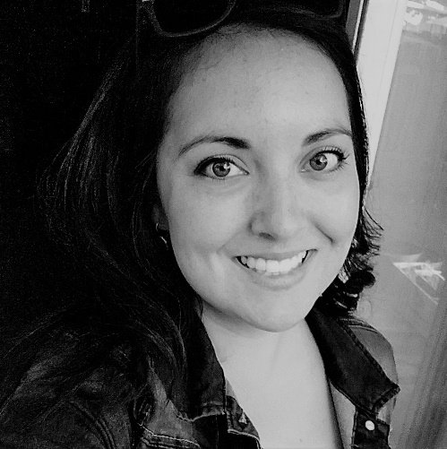
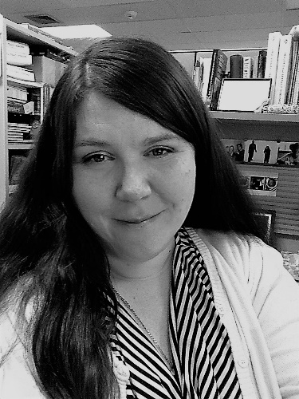
Your WEAVE-NW Team
Victoria - PI
Tam - PD
Chelsea - PA
Ryan - PM
Nora - PM
Jenine - PE
Notes:
Introduce superstar team

Slide 3

GHWIC Initiative
Centers for Disease Control and Prevention under the Good Health & Wellness in Indian Country (GHWIC) Initiative
Addresses chronic diseases which are among the most widespread, costly, and preventable causes of morbidity and mortality for AI/AN
Three components of funding
  Component 1: Tribes
  Component 2: Tribally-designated organizations or Urban Indian Organizations Component 3: Coordinating Center
  www.npaihb.org/weave
  https://www.cdc.gov/chronicdisease/resources/publications/aag/indian-country.htm
Weave-nw

Slide 4
Overview
GHWIC Long-Term Goal:
To decrease cardiovascular disease and stroke, commercial tobacco use, obesity, and type 2 diabetes for AI/AN
Focus:
Policy, systems and environment (PSE) projects
Culturally relevant and appropriate prevention activities
Notes:
TAM

Slide 5
Why PSE approaches?
We can try to educate people and encourage them to make healthier choices, but
  What if your environment makes it hard to change your behavior?
  What if the policies that are in place makes it easy to keep doing things the way you’re used to?
  What if there are systems that prevent you from changing?
Where you live affects how you live – PSE changes the context in which people make decisions that impact their health
Notes:
JENINE

Slide 6
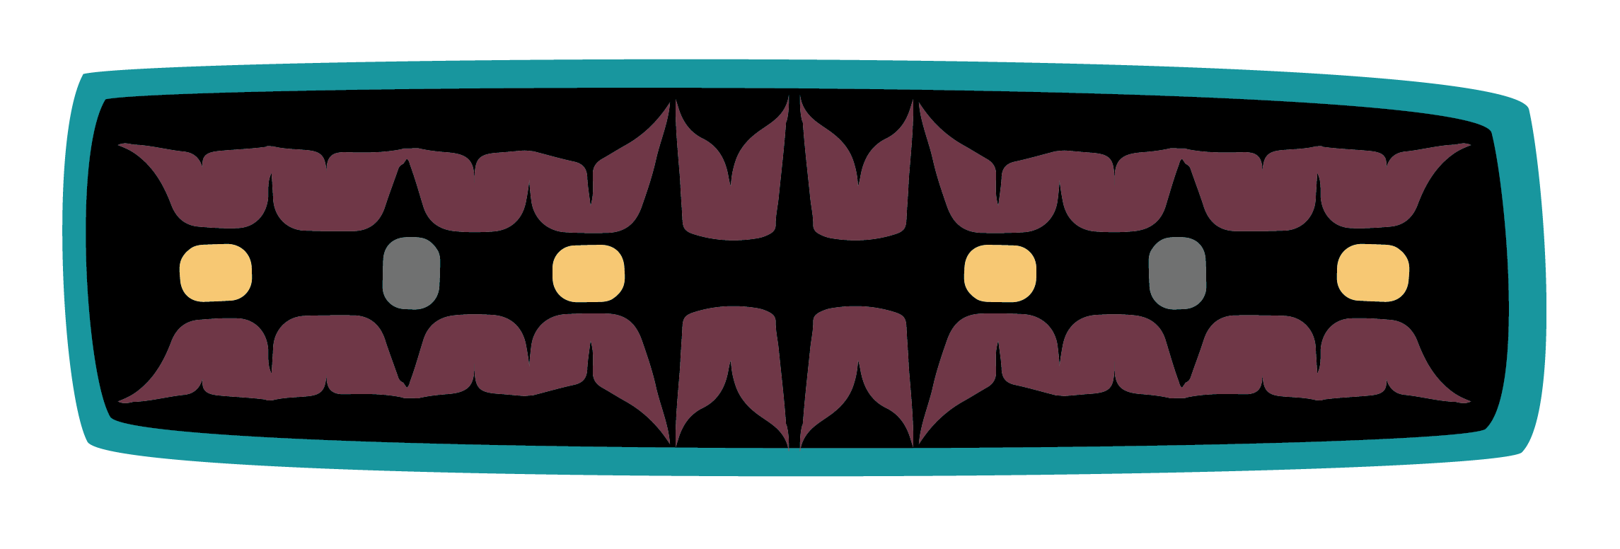
the last 5 years
WEAVE NW

Slide 7
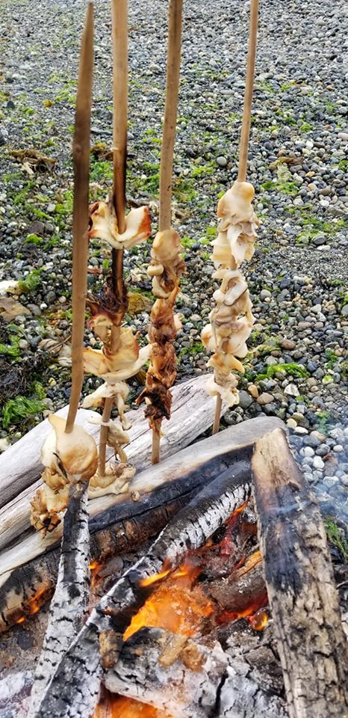
Food Sovereignty
NW Tribal Food Sovereignty Coalition
  Coalition Building
  Annual Gatherings
  Media Development
  Published paper in the Journal of Agriculture, Food Systems, and Community Development https://doi.org/10.5304/jafscd.2019.09B.001
Trainings
  Food Sovereignty Assessment Tool
  Traditional Foods Workshops
ATNI Food Sovereignty Sub-Committee
Awarded funding from the Native American Agriculture Fund
  NTFSC Support for strategic planning and technical assistance/trainings
Notes:
Through the NTFSC opportunities are built for tribes and tribal organizations to support cultural revitalization, empower communities, and use innovative strategies to implement food system changes and improve the health of Tribal communities.
Annual Gatherings
Some highlights from this year include:
Regional Food Policy Roundtable
Breastfeeding Roundtable
Hands-on skill building
Presentations

Slide 8
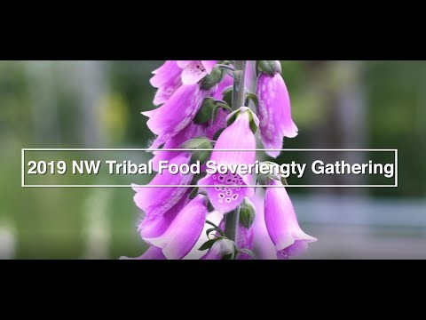
2019 Annual Gathering

Slide 9
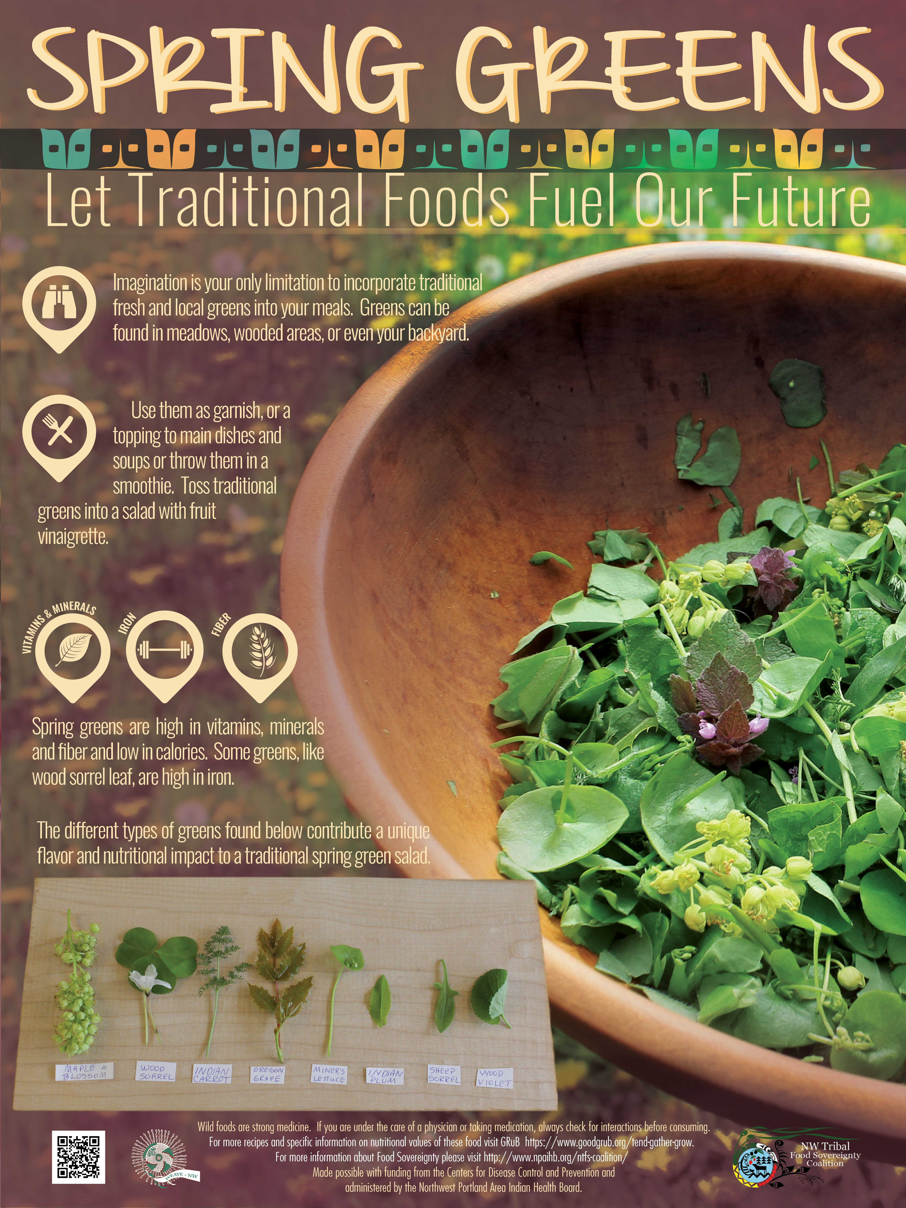
MEDia
6 Food Sovereignty posters
6 Breastfeeding posters
3 Videos (2 FS /Tobacco)
3 short “tasty” style videos

Slide 10
Tribal Policy Toolkit

Slide 11
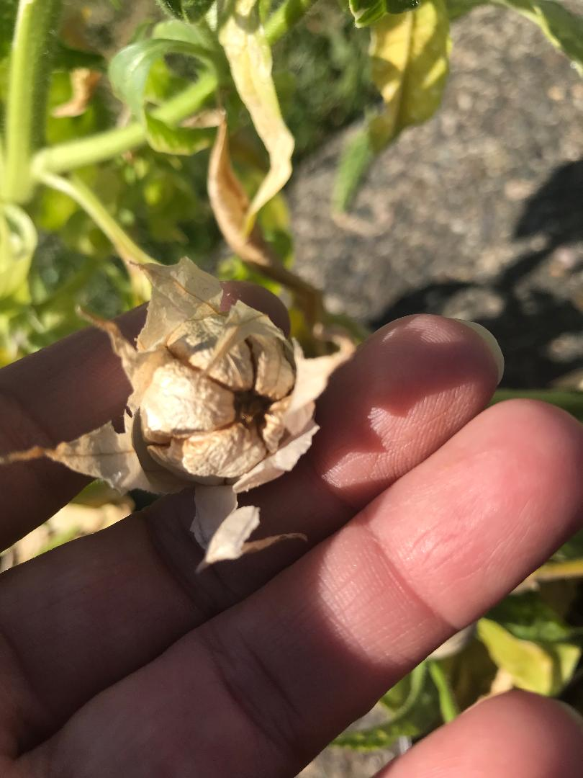
Tobacco
  Training
    Tobacco 101
    Traditional tobacco
    Tobacco Cessation training
    Tobacco policy implementation
    Electronic cigarette dangers/research
    Traditional medicines methods for tobacco reduction
    Quit kits
    Technical Assistance
  Policy Development
  Program Planning,
  Clinical Program Assessments
  Media/NA Oregon quit line campaign
Notes:
The project focuses on policy development, tobacco cessation and prevention by using culture as prevention and education.

Slide 12
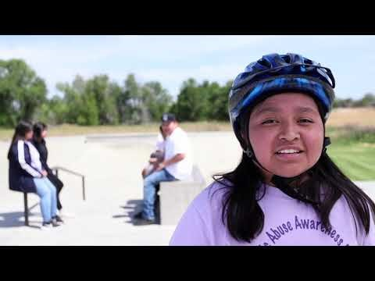
2019 Shoshone bannock vaping video

Slide 13



Diabetes ECHO
  Collaboration
  Training/Consultation
  Knowledge-Sharing
  Capacity Building

Slide 14
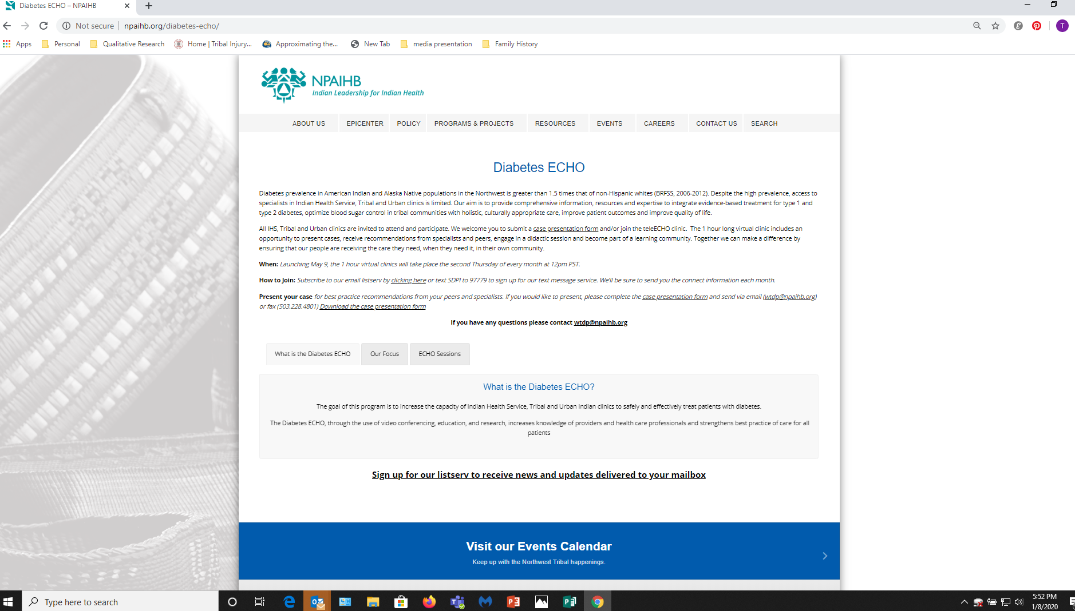
Where to find the Diabetes ECHO
Notes:
Add screen shot of Diabetes ECHO show were people can join in and log on
Ta

Slide 15
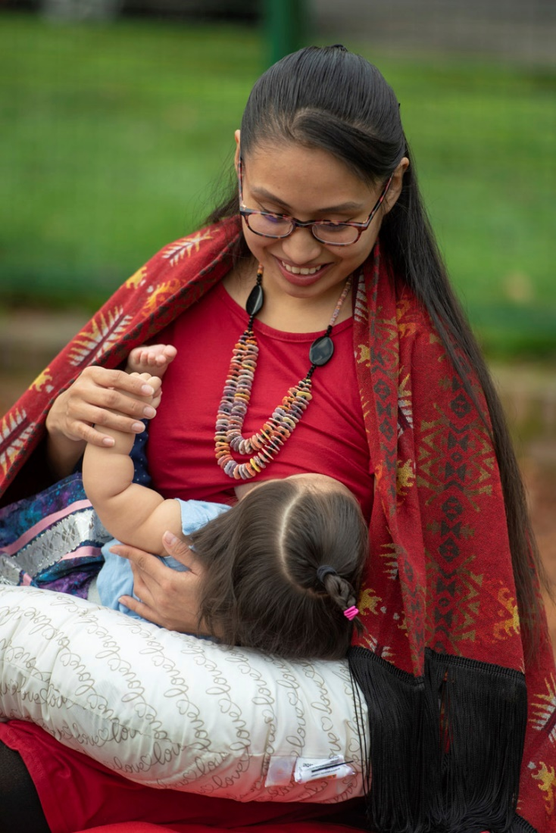
Breastfeeding
  Peer counselor training
  Assessments
  Media
  Coalition Building
Notes:
This project through coalition building and partnerships with Tribes aims to strengthen Tribal efforts to assess breastfeeding status, provide breastfeeding trainings and help plan for PSE approaches to improve and support breastfeeding.

Slide 16
Highlights 2014-2019
84 trainings, webinars and workshops; 2,182 participants across 41 of 43 Tribes
344 instances of TA across 39 of 43 Tribes
100% reach to our tribes to-date (including direct funding, TA, training, and coalition membership)
12 Diabetes ECHO clinics, serving 145 participants across 26 Tribes
42 sub-awards to 22 tribes/tribal organizations
3 Coalition gatherings
  October 2017 – 65 attendees from 24 Tribes
  September 2018 – 160 attendees from 24 Tribes
  June 2019 – 110 attendees from 24 Tribes

Slide 17
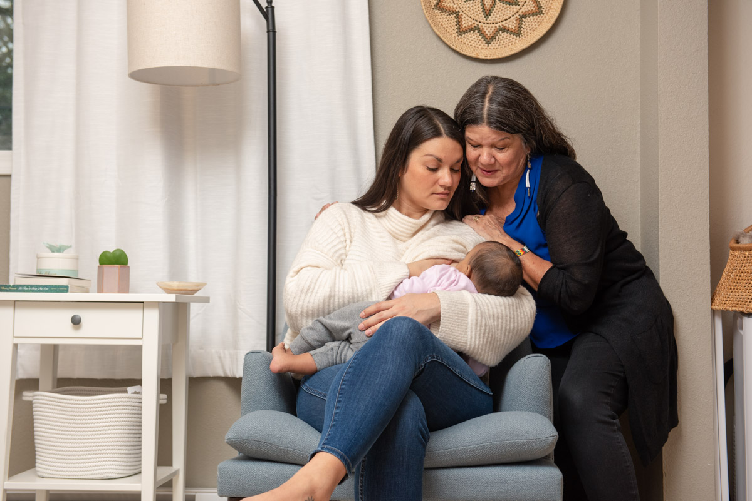

WEAVE 2.0 Strategies
Expand the implementation of Component 1 strategies and activities through 5 subawards to Tribes
Provide technical assistance, training, and resources to support the planning, development, implementation of Tribal activities
Assist Area Tribes in developing multi-sector partnerships with organizations to support strategies and activities.
Work with Tribes to develop and implement tailored health communication/ messaging strategies to reach AI/AN populations at greatest risk for obesity, commercial tobacco use, type 2 diabetes, and/or heart disease and stroke in order to increase awareness and encourage healthier behaviors.

Slide 18
WEAVE-NW 2.0 Subawards
5 subcontracts of up to $124,000 each
To federally recognized Tribes in Idaho, Oregon, and Washington
Projects must use policy, system or environment change (PSEs) approaches
Must address one the following health areas:
  Obesity – Food Systems Change
  Obesity – Breastfeeding Promotion and Support
  Commercial Tobacco Use
  Type 2 Diabetes
  Heart Disease and Stroke
Notes:
JENINE

Slide 19
Category 1- Obesity- Food Systems
Potential projects include:
Food code development to distribute food at farmers’ markets, schools, childcare settings, tribal enterprises, etc.
Developing and/or expanding community gardens or model farms
Restoring traditional food habitats
Food sovereignty or traditional/healthy foods media or education, if in support of the PSE change activities listed above.
All projects under this area must have a medium-term goal of increasing the number or percentage of places offering healthy/traditional foods within the community.
Notes:
NORA
Projects under this activity area seek to prevent obesity through improving access to healthy and traditional foods. Food sovereignty and food systems change-focused activities should select this area.
Potential projects include: (Read from slide)
Medium-term goal: (read from slide)
Note:
If one has not already been completed, applicants should consider conducting a baseline Food Sovereignty Assessment part of their activities. WEAVE-NW can provide training and technical assistance to support this work.
Applicants under this area are encouraged to participate in the Northwest Tribal Food Sovereignty Coalition.

Slide 20
Category 2- Obesity- Breastfeeding
Potential projects include:
Developing or expanding peer breastfeeding counselor training/programs
Establishing connections and/or MOU between hospitals and tribal clinics, WIC, or other partners to increase access to baby friendly and culturally competent birthing rooms for tribal mothers and strengthen connection between pre-natal care, delivery, and tribal services for new mothers
Developing tribal policies to support and encourage breastfeeding, e.g. paid breaks for milk expression
Data-driven breastfeeding media and education campaign based on assessment of community needs
All projects under this area will have the short-term goal of increasing the number of places that implement culturally-adapted continuity of care/community support strategies to promote and support breastfeeding and a medium-term goal of increasing the number of mothers who use these services.
Notes:
NORA
Projects under this activity seek to prevent obesity through increasing continuity of care/community support for breastfeeding.
Potential Projects Include: (Read from slide)
Short-term goal: (read from slide)
NOTE:
If one has not already been completed, applicants should consider conducting a baseline Breastfeeding Assessment part of their activities. WEAVE-NW can provide training and technical assistance to support this work.
Applicants under this area are encouraged to participate in the Northwest Tribal Food Sovereignty Coalition.

Slide 21
Category 3- Commercial Tobacco
Potential projects include:
Implementing commercial tobacco-free policies/flavored vape restrictions
Providing commercial tobacco cessation training for community providers and clinical staff
Improving health system to increase screenings and referrals to commercial tobacco cessation treatment
Creating tribal cessation training in conjunction with IHS
Incorporating traditional cultural activities/medicines into tobacco cessation programs
Developing education and/or media campaigns around commercial tobacco/vaping health risks, if in support of the PSE change activities listed above
Commercial tobacco prevention funding is available only to Washington and Idaho Tribes.
All projects under this area will have the medium-term goal of increasing the number of places in the community that implement commercial tobacco-free policies OR increasing the number of commercial tobacco users who receive cessation interventions.
Notes:
NORA
Projects under this activity seek to reduce the prevalence of commercial tobacco use tobacco-free policies and practices.
Potential projects include: (Read from slide)
PLEASE NOTE: Commercial tobacco prevention funding is available only to Washington and Idaho Tribes.
Medium Term-Goal: (Read from slide)
NOTE:
If one has not already been completed, applicants should consider conducting a baseline assessment of tobacco and vaping/e-cigarette use, clinical tobacco programs and/or community resources part of their activities. WEAVE-NW can provide training and technical assistance to support this work.

Slide 22
Category 4- Type II Diabetes
Potential projects include:
Improving screening, identification of at-risk patients, outreach and recruitment to diabetes prevention programs, including provider training
Establishing new diabetes prevention programs, or expanding the reach of existing programs
Develop culturally-relevant approaches to increase diabetes prevention program participation such as incorporating tribal cultural practices, utilizing traditional medicines, or connecting with traditional/healthy foods programs
Preference will be given to applicants who describe specifics of how they will incorporate traditional and/or healthy, locally grown foods and traditional medicines into diabetes prevention programs.
All projects under this area will have the medium-term goal of increasing the number of community members at high risk for diabetes enrolled in type 2 diabetes prevention programs offered in the community.
Notes:
NORA
Projects under this activity seek to reduce the incidence of type 2 diabetes through training, screening, and tribally adapted diabetes prevention programs.
Potential Projects Include: (Read from slide)
Please Note:
Preference will be given to applicants who describe specifics of how they will incorporate traditional and/or healthy, locally grown foods and traditional medicines into diabetes prevention programs.
Medium Term Goal: (Read from slide)

Slide 23
Category 5- Heart Disease/Stroke
Potential projects include:
Improving or developing team-based systems of care to support prevention, self-management and control of hypertension and high blood cholesterol
Developing culturally-relevant materials to link community members with clinical services to support prevention, detection and control of high blood pressure and/or high blood cholesterol.
Tribal adaptation of self-management and treatment programs for patients with high blood pressure and/or high blood cholesterol
Preference will be given to applicants who describe how they will incorporate traditional and/or healthy, locally grown foods and traditional medicines in self-management and treatment programs for patients with high blood pressure or high blood cholesterol.
All projects under this area will have the medium-term goal of increasing the percentage of patients with high blood pressure or high blood cholesterol engaged in self-management and treatment programs.
Notes:
NORA
Projects under this activity seek to reduce the prevalence of high blood pressure and high blood cholesterol through health system change and incorporation of tribal culture into clinical support services for patients with hypertension or high blood cholesterol.
Potential projects include: (Read from slide)
Please Note:
Preference will be given to applicants who describe how they will incorporate traditional and/or healthy, locally grown foods and traditional medicines in self-management and treatment programs for patients with high blood pressure or high blood cholesterol.
Medium-term goal: (Read from slide)

Slide 24

Thank You
Victoria Warren Mears, PI, NWTEC Director
Tam Lutz, Project Director
Chelsea Jensen, Project Assistant
Jenine Dankovchik, Biostatistician & Project Evaluator
Nora Frank-Buckner, Food Sovereignty Project Manager
Ryan Sealy, Tobacco & Breastfeeding Project Manager
Grant Number: 1 NU58DP006731-01-00
Funder: Centers of Disease Control and Prevention (CDC)
Good Health & Wellness in Indian Country Initiative (GHWIC)
weave@npaihb.org
www.npaihb/weave

