Slide 1


Indian Health Service
NPAIHB-QBM @ Tulalip Resort Casino
Dean M. Seyler
Director, Portland Area
January 14, 2019

Slide 2
Office of Clinical Support
SDPI
  Upcoming Meetings/Trainings
  Point of contact – CDR Roney Won - roney.won@ihs.gov or 503-414-5555
    TLDC Meeting, Washington DC: March 10-11
    CME/CE
      Diabetes Education: Thinking Outside the Box – Jan 29
      Patient-Centered Approach to CVD Risk Reduction – Feb 13
      Mindful Eating Basics – March 4
      Native Centered Nutrition Education – March 11
      Engaging Partners to Address Food Access and Food Insecurity – March 25
Goal 1: Access to Care; Obj. 2.2: Provide care to better meet the health care needs of American Indian and Alaska Native communities

Slide 3
Office of Clinical Support
Area Pharmacy & EHR Update
  Meetings & Trainings
    Integrated Behavioral Health – Jan 13-17
    Pharmacy Informaticist – CPOE Boot-camp – Jan 27-31
    Third Party Billing – March 4
  RPMS-EHR
    Electronic Prescribing of Controlled Substances (EPCS)
      Implementation to begin at Area RPMS sites
  US DHHS “Ready, Set, PrEP” Program
    Additional information and enrollment may be found at: https://www.hiv.gov/federal-response/ending-the-hiv-epidemic/prep-program
  IHS Adverse Event Reporting System (WebCident) Replacement
  Point of contact – CDR Roney Won - roney.won@ihs.gov or 503-414-5555
Goal 1: Access to Care; Obj. 2.2: Provide care to better meet the health care needs of American Indian and Alaska Native communities

Slide 4
Office of Clinical Support
      Dental, Privacy, Infection Control
      Acting Area Dental Consultant - CAPT Michael McLaughlin, Western Oregon Service Unit Chief Dental Officer
      February 3-7 Concepts III : CHEST Infection Control Training in Keizer OR
      March 2-6 Concepts I Course for Dental Directors
      April 2020- Infection Control Training Opportunity – OSAP IHS BootCamp
      June 2020 Annual Portland Area Dental Meeting
      Point of Contact – Ashley Tuomi@ihs.gov or 503-414-5555
Goal 1: Access to Care; Obj. 2.2: Provide care to better meet the health care needs of American Indian and Alaska Native communities

Slide 5
Office of Clinical Support
      Health Information Management
      CMS Coding Training- Review session to obtain/maintain certification
        April 20th – May 1st (5 days each week)
        Location - Portland
        Free Coding Books and Free Exam Fee
        25 from Portland area will be selected
        Application Due February 19th to Ashley Tuomi ashley.tuomi@ihs.gov
Goal 1: Access to Care; Obj. 1.2: Build, strengthen, and sustain collaborative relationships

Slide 6
Office of Administration Management
  Catastrophic Health Emergency Fund-FY19
  Status as of December 18, 2019
    71 total cases
    20 amendments
    $2,477,280.00 in reimbursements
    $572,041 pending reimbursement
    FY 2019 CHEF balance is $22,611,142 – as of November 30, 2019
    We will continue to submit FY19 cases until funding runs out
    If you have FY20 cases please submit to the Portland Area Office and they will be prepared for submission as soon as FY20 is open for reimbursement.
Goal 2: Quality, Obj. 2.2: Provide care to better meet the health care needs of American Indian and Alaska Native communities .

Slide 7
  Office of Administration Management
    CHEF Online Tool
    Fully automated paperless process for identifying, documenting and submitting CHEF cases for reimbursement.
    Currently implantation is on hold due to needed security improvements.
    Tribal programs have the option to opt-in/opt-out
    If your site is interested, please contact:
      Peggy Ollgaard, Director, Division of Business Operations
      (503) 414-5598
      Peggy.Ollgaard@ihs.gov
Goal 2: Quality, Obj. 2.2: Provide care to better meet the health care needs of American Indian and Alaska Native communities .

Slide 8
Office of Environmental Health & Engineering
Division of Health Facilities Engineering
Small Ambulatory Program (SAP)
  Four Portland Area Tribes submitted applications
  Congratulations to the Cowlitz and Shoshone-Bannock Tribes who received SAP Awards
Joint Venture Construction Program (JVCP)
  Two Portland Area Tribes participated on the pre-application process
  Nationally, 43 pre-applications were submitted, the largest ever response
  Congratulations and good luck to the Colville Tribes, one of ten Tribes invited to submit a final application.
Goal 1: Access to Care; Obj. 1.3: Increase access to quality health care services

Slide 9
Office of Environmental Health & Engineering
Division of Health Facilities Engineering
FY 2019 Project M&I Funds (BEMAR)
$2.766M ($979K for Federal and $1.787M for Tribal Facilities)
  Similar to FY18, PAFAC requested to provide input on the allocation procedure.
  Working toward having agreements in place by April.
Annual Combined Supportable Space Data Call
  Requesting Space and Deficiency data updates from all Tribal Health Programs.
  Looking to improve response rate: FY18 – 56%; FY19 – 56%; FY20 – 100%?
  Response required to be eligible for project M&I (BEMAR) Funding
  Packets sent out last week, Response Due by February 14th
Goal 1: Access to Care; Obj. 1.3: Increase access to quality health care services

Slide 10
Office of Environmental Health & Engineering
Sanitation Facilities Constructing Staffing Update
Portland Area Division of Sanitation Facilities Construction (SFC)
  CAPT Alexander Daily will join for the Portland Area IHS SFC as the Division Director for SFC
  Mr. Tyler Timmons, E.I.T., joined our team as an Environmental Engineer in the Portland Area Office.
Olympic District (Washington, West of the Cascade Mountains)
  LCDR David Kostamo, PE, Registered Sanitarian, joined our team as a Tribal Utility Consultant in the Olympic District Office.
  Ms. Sierra Schatz, Engineer in Training (E.I.T), joined our team as an Environmental Engineer in the Olympic District Office.
Goal 1: Access to Care; Obj. 1.1: Recruit, develop, and retain a dedicated, competent, and caring workforce

Slide 11
Chief Medical Officer Update
Recent SGMs
  SGM 19-03 IHS Health Care Providers Compliance with IHS Informed Consent Requirements
    Reaffirms requirement to obtain informed consent prior to procedures or treatment
    Exceptions for urgent/emergent care
    Outlines policy for limited exceptions allowing minors to give informed consent
Portland Area Survey Readiness Team (ASuRT) Site Visits
  AAAHC Readiness
Relevant Local Policies
  Credentialing and Privileging
  Peer Review
Goal 2: Quality, Obj. 2.2: Provide care to better meet the health care needs of American Indian and Alaska Native communities .

Slide 12
Chief Medical Officer Update
December 5, IHS and AAP CONACH released recommendation on screening diagnosis and treatment of neonatal opioid withdrawal syndrome – NOWS
Recommendations to the Indian Health Service on Neonatal Opioid Withdrawal Syndrome
Goal 2: Quality, Obj. 2.2: Provide care to better meet the health care needs of American Indian and Alaska Native communities .

Slide 13
Chief Medical Officer Update
Area Clinical Directors Meeting – Nov 6-8 in Seattle Paramount Hotel
  22 participants from all 6 federal sites and 13 tribal and urban clinics
  MAT training – 12 participants from 10 sites
  Topics:
    HPV (Region X HHS)
    HCV (WA DOH, NPAIHB)
    Two Spirit Affirming Care (NPAIHB)
    Behavioral Health Integration (Lori Raney)
Spring 2020 Meeting – April 23-24,
  preceded by annual Cancer Update April 22
  Location and Agenda TBD
  Joint meeting with Area Nursing Directors
Goal 2: Quality, Obj. 2.2: Provide care to better meet the health care needs of American Indian and Alaska Native communities .

Slide 14
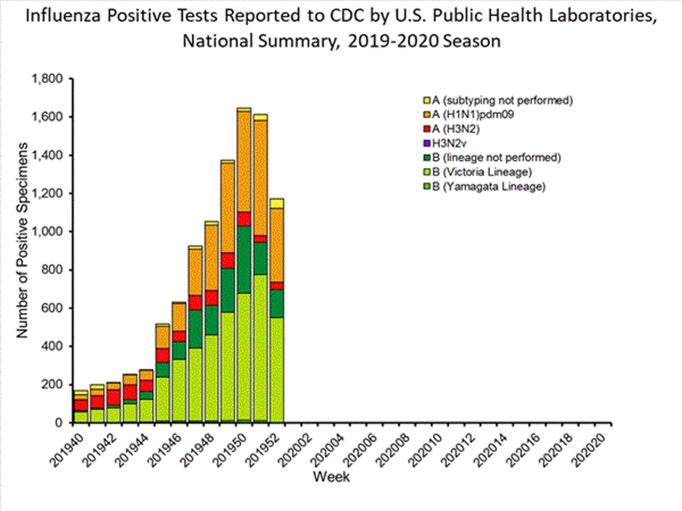
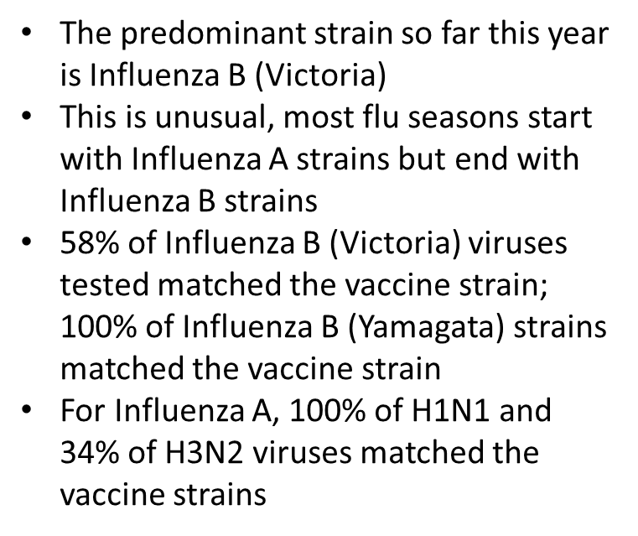
Goal 2: Quality, Obj. 2.2: Provide care to better meet the health care needs of American Indian and Alaska Native communities .

Slide 15
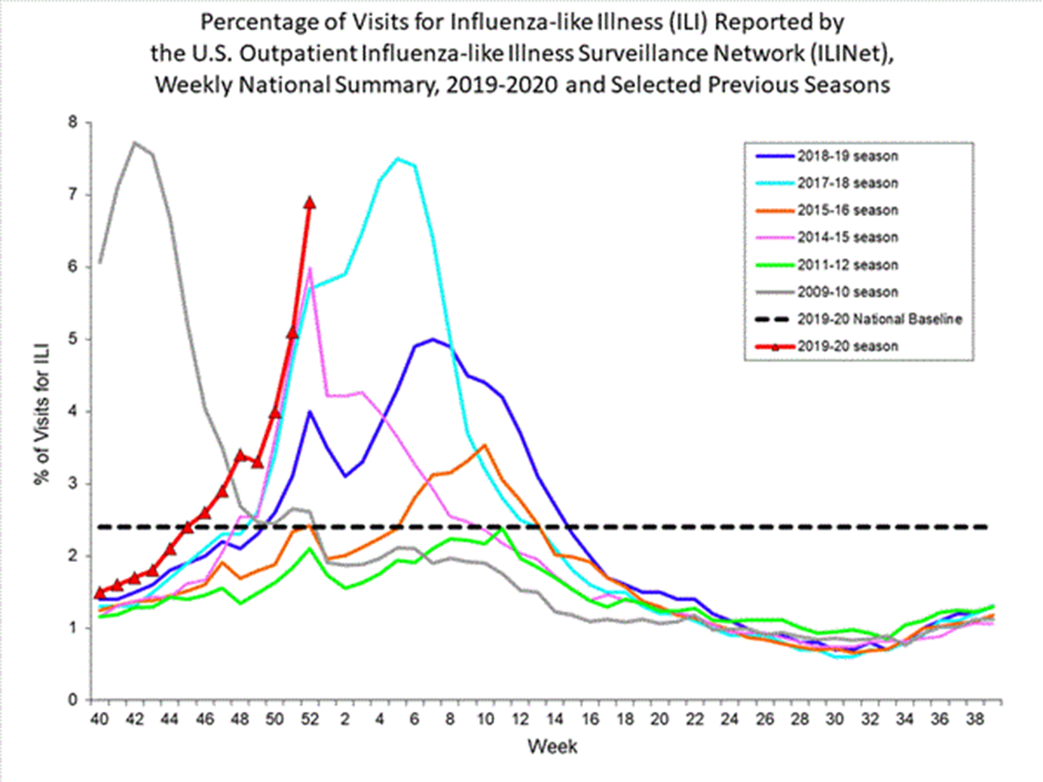
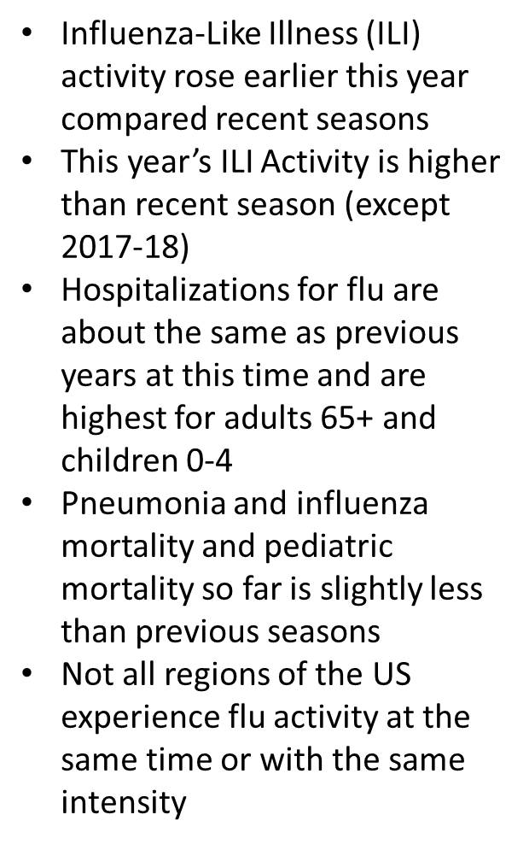
Goal 2: Quality, Obj. 2.2: Provide care to better meet the health care needs of American Indian and Alaska Native communities .

Slide 16
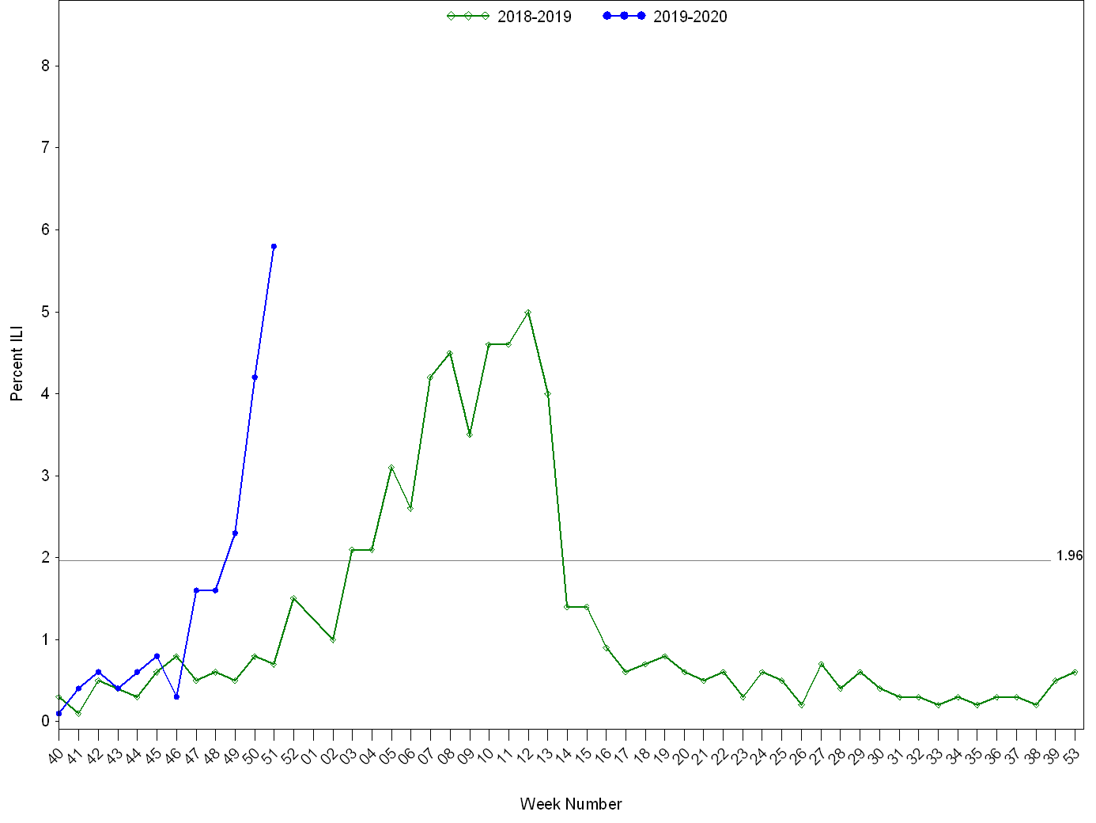
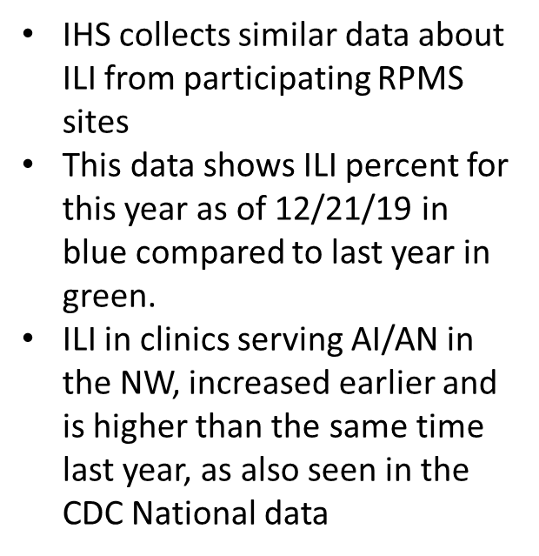
Goal 2: Quality, Obj. 2.2: Provide care to better meet the health care needs of American Indian and Alaska Native communities .

Slide 17
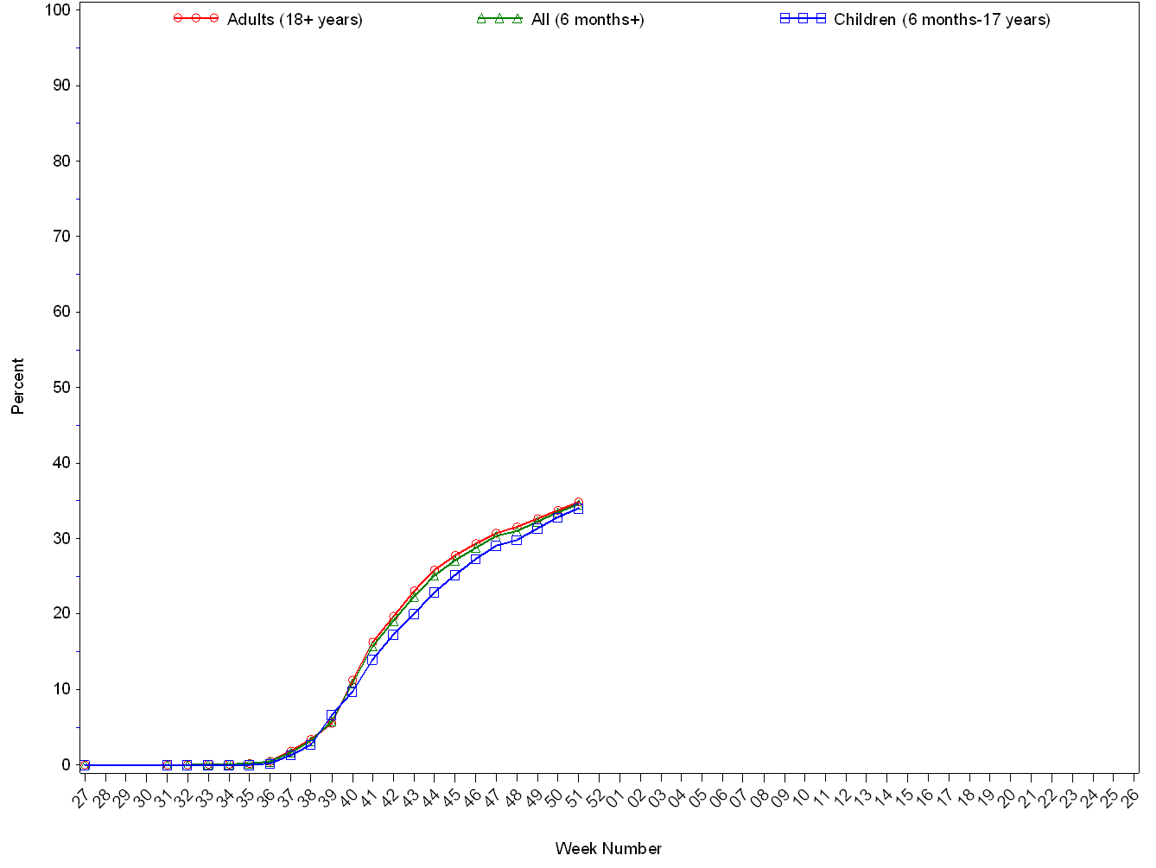
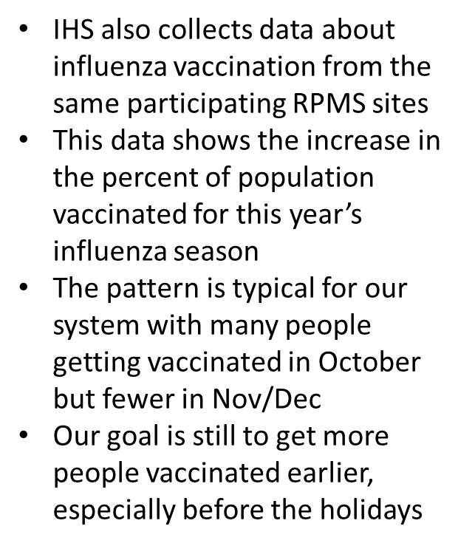

Goal 2: Quality, Obj. 2.2: Provide care to better meet the health care needs of American Indian and Alaska Native communities .

Slide 18
Key Points
Influenza activity is high nationally with outpatient visits for ILI and the percentage of respiratory specimens testing positive for influenza at levels similar to what have been seen at the peak of recent seasons. However, this week’s data may in part be influenced by changes in healthcare seeking behavior that can occur during the holidays.
Influenza B/Victoria viruses are predominant nationally, which is unusual for this time of year. A(H1N1)pdm09 viruses are the next most common. A(H3N2) and B/Yamagata viruses are circulating at very low levels.
CDC estimates that so far this season there have been at least 6.4 million flu illnesses, 55,000 hospitalizations and 2,900 deaths from flu.
It’s not too late to get vaccinated. Flu vaccination is always the best way to prevent flu and its potentially serious complications.
Antiviral medications are an important adjunct to flu vaccine in the control of influenza. Almost all (>99%) of the influenza viruses tested this season are susceptible to the four FDA-approved influenza antiviral medications recommended for use in the U.S. this season.
Goal 2: Quality, Obj. 2.2: Provide care to better meet the health care needs of American Indian and Alaska Native communities .

Slide 19
Portland Area
Indian Health Service
There are many different types of flu vaccine- high-dose for elders, egg-free recombinant, injection, nasal spray… The best flu vaccine is the one that you actually receive!
Goal 2: Quality, Obj. 2.2: Provide care to better meet the health care needs of American Indian and Alaska Native communities .

Slide 20


