Slide 1
EXECUTIVE DIRECTOR REPORT Tulalip Resort Casino January 14, 2020
Laura Platero, JD
Notes:
Announcements –
Glad you made it safely. More snow is coming in today and into tonight.
We did have 4 youth make it to the meeting – 2 from Lummi (William and Sadie), 1 from Quinault (Nakota), and 1 from Warm Springs (Cheydon). So
Youth presenting on Wednesday, January 15 at 4:15pm
A video crew is following the youth who will be documenting the interactions between the delegates and the youth. The documentary they will develop is a grant deliverable. The grant ends at the end of this year.
We have received a request for a change to the July QBM dates that will take place at Shoshone-Bannock. There is hold on the week of July 13-16. The hotel also has available the first week in July and last week in July.
Joe’s dinner is tonight at 6pm. Nick Lewis will be our MC for the evening.

Slide 2
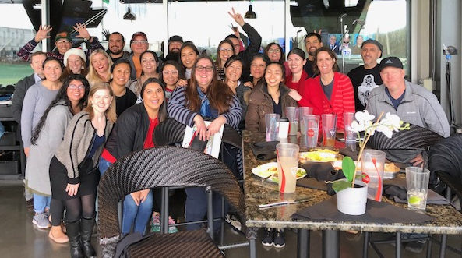
Highlights
Executive Director 60-Day Draft Work Plan
Personnel
Recognitions
Meetings
Strategic Plan Update
2020 Legislative and Policy Survey
Holiday Party – December 2019

Slide 3
Executive Director 60-Day Draft Work Plan
Sets forth focus of my first 60 days as ED
Includes my “to do list” in these areas
Finance
Development
Staff
Program
Operations
Outreach
Board and Tribes
Has been shared with Executive Committee and Staff

Slide 4
Personnel
New Hires
Dove Spector, NDTI Project Specialist II
Roger Peterson, Text Messaging Specialist
Amy Franco, Grants Management Specialist
Celeste Davis, Environmental Public Health Director

Slide 5
Personnel
PROMOTIONS/Transfer
Laura Platero, Executive Director
Paige Smith, Youth Engagement Coordinator
OPEN POSITIONS UPDATE
Notes:
OR Tribal Public Health Improvement Manager - Closed 1/10; Job offer pending
WA Tribal Public Health Improvement Manager - Closed 1/10; Job offer pending
Sr. Environmental Health Specialist - Closed 1/10; currently screening applications
Environmental Health Specialist - Closed 1/10; currently screening applications
Environmental Health Scientist - Closed 1/10; currently screening applications
OR Tribal Public Health Improvement Program Analyst - Closes 1/24
Communicable Disease Epidemiologist - Closes 1/24
TCHP & A/P Project Assistant - Closes 1/31
Policy and Programs Director - Closes 1/31

Slide 6
Recognitions
10 years of service Colbie Caughlan, THRIVE & Response Circles
20 years of service Tam Lutz, WEAVE/TOTS2Tweens/Native Cars Project Director
Employee of the Year Jamie Alongi, Network Administrator
Delegate of the Year Greg Abrahamson, Vice Chair, Spokane Tribe
Notes:
Pending Invitations (not confirmed)
Arlen Washines, Deputy Director of Yakama Nation DHS has asked their Health Committee if they would like to invite me to visit the Yakama Tribal Council in February during their regular session – February 4-7.
Warm Springs

Slide 7
Meetings
1/23 Skokomish Indian Tribe – ED Outreach Meeting
1/27-1/30 Affiliated Tribes of Northwest Indians- Portland
2/10-2/14 National Congress of American Indians ECWS – D.C.
Interior Public Witness Hearings – D.C.
National Tribal Budget Formulation Workgroup Meeting
2/26-2/27 NIHB 1st Quarterly Board Meeting-D.C. (tent.)
3/17-3/19 NIHB National Tribal Public Health Summit-Omaha (tent.)
3/31-4/1 CMS I/T/U Training – Seattle
4/7-4/8 HHS Annual Tribal Budget Consultation (tent.)

Slide 8
Strategic Plan
Staff and delegate input has been incorporated
Draft text copy is available for review
Major changes are highlighted in yellow
Please review and send feedback to nfrank@npaihb.org by January 31st
Approval of final edits at April QBM
Notes:
We’d like to draw your attention to the edits we made to the mission statement (we expanded the focus from healthcare to include public health and prevention more broadly)

Slide 9
2020 Legislative and Policy Survey
Survey was sent out to Delegates for initial input
Results will be shared at January QBM Committee Meetings
Committees will have opportunity to review the summary and provide additional input
Youth delegates will have the opportunity to set their own priorities which will be incorporated into the 2020 Legislative and Policy Priorities
Priorities will be finalized prior to NCAI ECWS (week of February 10)

Slide 10
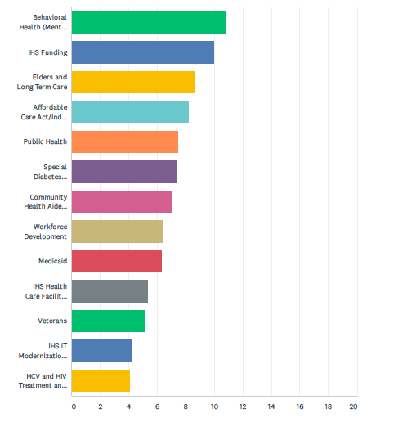
2020 Legislative and Policy Survey
Ranking of Priority Categories
12 respondents
Mainly recommended to move all priorities forward with a few changes or additions proposed
Notes:
Behavioral Health (Mental Health and Substance Use)
IHS Funding
Elders and Long Term Care
Affordable Care Act/Indian Health Care Improvement Act
Public Health
Special Diabetes Program for Indians
Community Health Aide Program
Workforce Development
Medicaid
IHS Health Care Facility Funding
Veterans
IHS IT Modernization
HCV and HIV

Slide 11
Questions…?

