Slide 1
NPAIHB Legislative & Policy Update
Quarterly Board Meeting
October 22, 2019
Hosted by: The Confederated Tribes of the Umatilla Indian Reservation

Slide 2
Report Overview
Hot Topics
Legislation
Future IHS Appropriations & Budget Formulation
New & Pending Federal Policies
Other Litigation
Recent and Upcoming National/Regional Meetings
DHAT State Legislative Update

Slide 3
Hot Topics
Brackeen v. Bernhardt - Update
Advance Appropriations – House subcommittee hearing and Senate bill
FY 2020 Appropriations
Other Indian-specific legislation to be introduced
NPAIHB Resolution Tracker

Slide 4
New! NPAIHB Resolution Tracker
Passed at July Joint QBM* | ATNI Oct | NCAI Oct
Ensure Medicaid Trust Responsibility to AI/AN | Passed | Not sent**
HHS OMH AI/AN Health Resources Adv Comm | Passed | Pending
Increase Funding for SBHPP with Tribal Shares Option | Passed | Pending
Support for Permanent Auth of SDPI with Tribal Shares Option | Passed | Pending
Move PRC Dependent Factor | Passed | Pending
*Other joint resolutions not listed above and passed at July QBM were not forwarded to ATNI since they were previously forwarded by NPAIHB to ATNI and passed; or similar resolution was already passed.
**This resolution was already enacted at NCAI (#DEN-19-054) but having one by ATNI will give more leverage to regional advocacy.

Slide 5
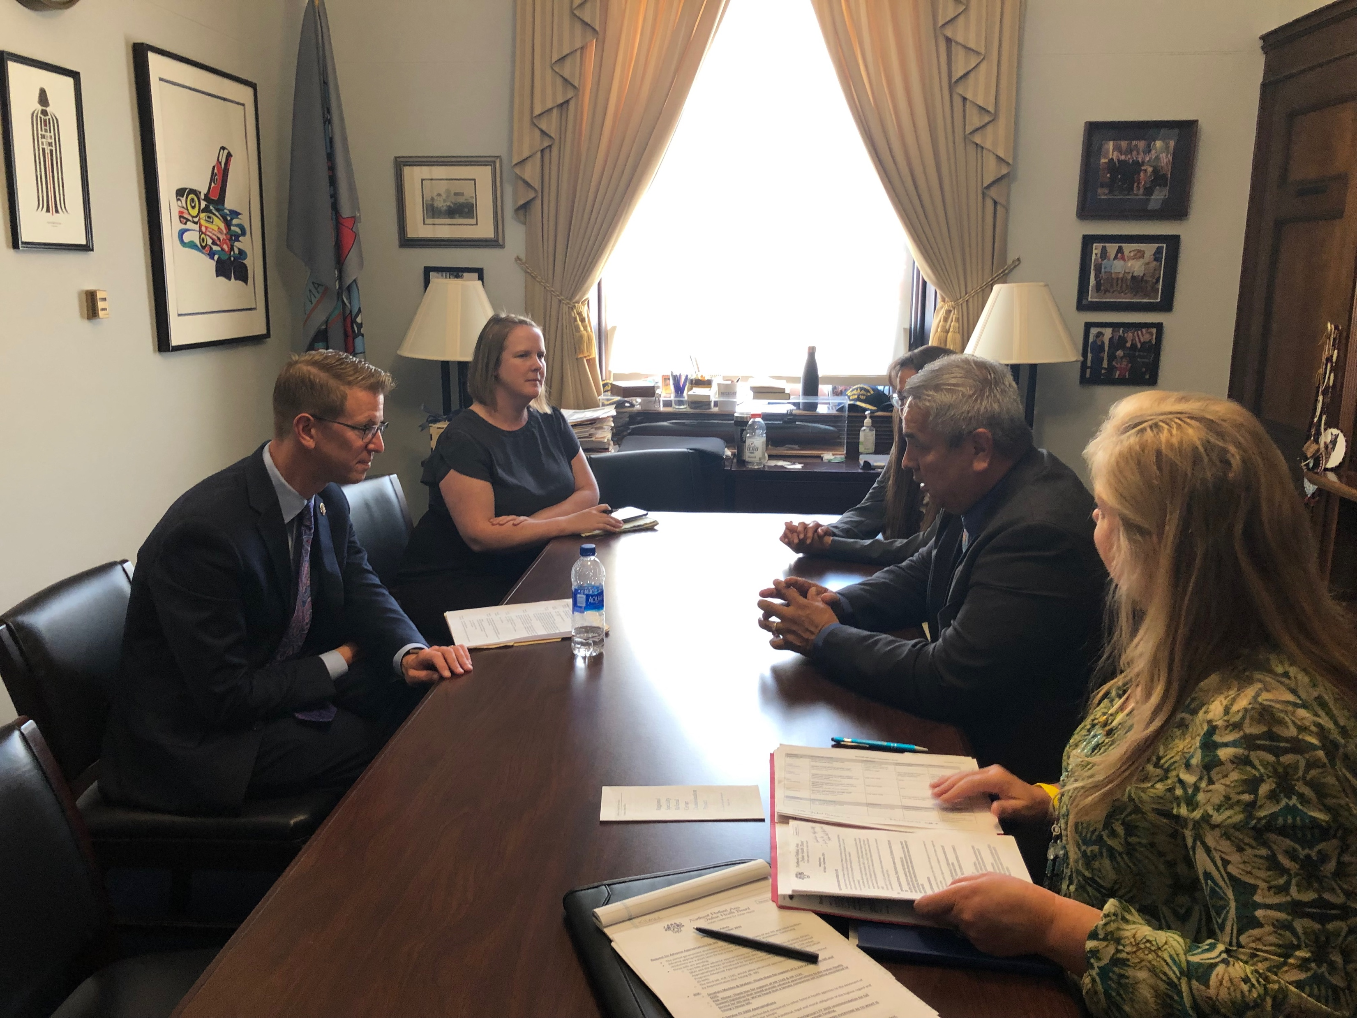
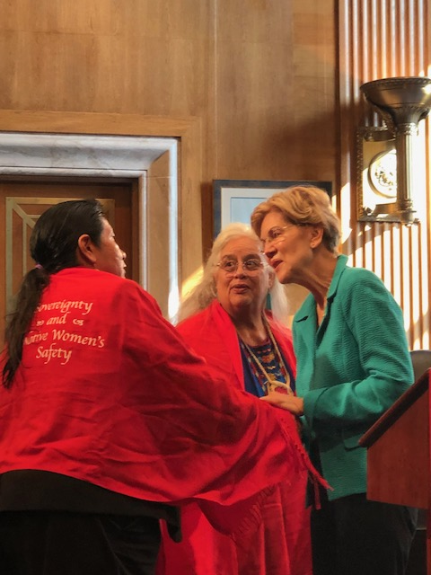
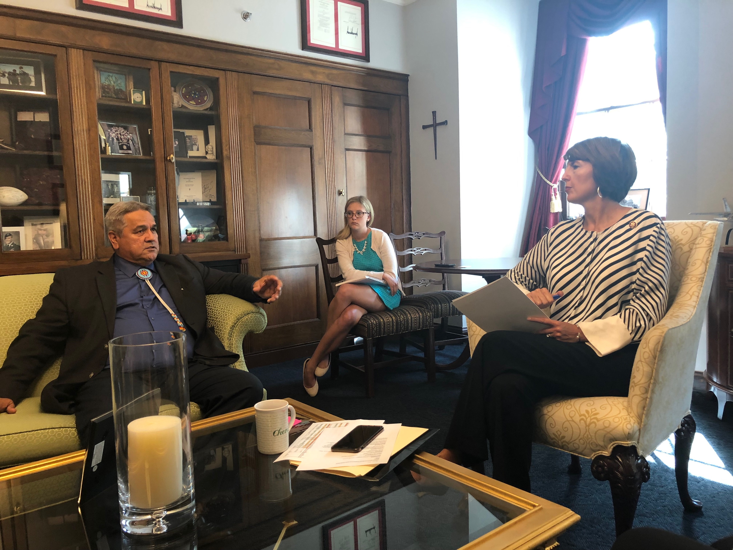
Legislation
NCAI Tribal Unity Impact Days & Hill Visits; September 10-11, 2019

Slide 6
FY 2020 Interior IHS Appropriations Summary
National Tribal Budget Formulation Workgroup recommended over $7 billion for IHS for FY 2020 (36% increase over FY 2017 enacted level).
President Released Budget on 3/11/19
Proposed $5.9 billion, an $82.6m increase above FY 2019 for services and facilities (1.7%) or $115 m (2%) increase overall above 2019 enacted level.
Continuing resolution through 11/21/19 (IHS and SDPI) under H.R. 4378.
House Bill Status: On 6/25/19, House passed Interior appropriations bill (with 4 others) ($537m above FY 2019)
Senate Bill Status: On 9/26/19, Senate Appropriations Committee passed Interior appropriations bill ($237m above FY 2019)

Slide 7
FY 2020 Interior IHS Appropriations Summary
 | FY 2019 Enacted | Pres Req. | House Bill | Senate Appr. Comm.
Clinical Svcs | $3,739,961 | $3,996,963 | $4,120,282 | $3,949,062
Prev Health | 174,742 | 118,257 | 181,062 | 178,636
Other Svcs | 188,487 | 171,321 | 255,526 | 191,186
Total Services | 4,103,190 | 4,286,541 | 4,556,870 | 4,318,884
Facilities | 878,806 | 803,026 | 964,121 | 902,878
Total w/o CSC | $4,981,996 | $5,089,567 | $5,520,991 | $5,221,762
CSC | 822,227 | 820,000 | 820,000 | 820,000
Total w/CSC | $5,804,223 | $5,909,567 | $6,340,991 | $6,041,762
Diff w/2019 Enacted | -------------- | +105m | +537m | +237m

Slide 8
FY 2020 IHS Clinical Services
 | FY 2019 Enacted | Pres Req. | House Bill | Senate Appr. Committee
H&HC | $2,147,343 | $2,363,278 | $2,420,568 | $2,339,707
EHR | 0 | 25,000 | 25,000 | 3,000
Dental | 204,672 | 212,369 | 227,562 | 210,315
MH | 105,281 | 109,825 | 125,332 | 108,569
Alcohol/SA | 245,566 | 246,034 | 280,151 | 247,828
PRC | 964,819 | 968,177 | 969,479 | 967,363
IHCIF | 72,280 | 72,280 | 72,280 | 72,280
Totals: | $3,739,961 | $3,996,963 | $4,120,282 | $3,949,062
H&HC:
-House bill includes $20m for CHAP expansion; $4m increase for DV prevention; $2m increase for TECs; $53m for 105(l) leases; $25m for HIV/HCV.
-Senate Appropriations Committee bill includes $97 million for 105(l) leases and only $5m for CHAP expansion; $0 for HIV/HCV; $8m for R&R.
Alcohol/SA: Senate Appropriations bill includes $10m for opioid grants.

Slide 9
FY 2020 IHS Preventative Health
 | FY 2019 Enacted | Pres Req. | House Bill | Senate Appr. Bill
PH Nursing | $89,159 | $92,084 | $95,307 | $92,677
Health Educ | 20,568 | 0 | 20,669 | 20,923
CHRs | 62,888 | 24,000 | 62,913 | 62,888
Immun AK | 2,127 | 2,173 | 2,173 | 2,148
Totals: | $174,742 | $118,257 | $181,062 | $178,636
Health Education & CHRs: House bill and Senate Appropriations Committee bill fund both health education and CHRs.

Slide 10
FY 2020 IHS Other Services
 | FY 2019 Enacted | Pres Req. | House Bill | Senate Appr. Comm.
Urban Health | $51,315 | $48,771 | $81,000 | $53,159
IHP | 57,363 | 43,612 | 90,656 | 57,796
Tribal Mngt | 2,465 | 0 | 2,521 | 2,465
Direct Ops | 71,538 | 74,131 | 75,385 | 71,945
Self Gov | 5,806 | 4,807 | 5,964 | 5,821
Totals: | $188,487 | $171,321 | $255,526 | $191,186
Urban Health: House bill includes $30m increase while Senate Appropriations Committee bill includes $1.8 m increase.
IHP: House bill language provides $50m for the loan repayment program.

Slide 11
FY 2020 IHS Facilities
 | FY 2019 Enacted | Pres Req. | House Bill | Senate Appr. Comm.
M&I | $167,527 | $168,568 | $174,336 | $168,952
Sanitation | 192,033 | 193,252 | 193,577 | 193,577
HC Fac Const | 243,480 | 165,810 | 304,290 | 249,279
Fac & Envir. | 252,060 | 251,413 | 266,831 | 261,983
Equipment | 23,706 | 23,983 | 25,087 | 29,087
Totals: | $878,806 | $803,026 | $964,121 | $902,878
Health Care Facilities Construction:
-House bill includes $10m for Green Infrastructure.
-Senate Appropriations Committee bill includes $15m for small ambulatory program; $5m for demonstration authority projects (construction and renovation of hospitals and health centers).
Joint Venture Construction Program: Both bills urge a more consistent competitive cycle between three and five years.

Slide 12
FY 2020 Labor HHS Education (LHE) Appropriations- Indian programs
Program | House Bill | Senate Appr. Bill
CDC- Good Health and Wellness in IC | $21m
SAMHSA-Tribal Opioid Response Grants | $50m | $50m
SAMSHA-Medication Assisted Treatment | $10m | $10m
SAMHSA-AI/AN Zero Suicide Program Tribal Set Aside | $2.2m | $2.2m
SAMHSA-AI/AN Suicide Prevention | $2.9m | $2.9m
SAMSHA Tribal Behavioral Health Program | $20m | $20m
ACL-NA Nutrition & Supportive Services | $37.2m (+$3m) | $34.2
ACL-NA Caregiver Support Services | $12m (+$2m) | $10m
NHSC Loan Repayment Program-I/T/Us | $15m | $15m
Status of LHE FY 2020 Appropriations:
-On 6/19/19, House passed the Labor HHS Education Bill.
-On 9/18/19, Senate Appropriations Committee released its bill.
-On 9/27/19, Continuing resolution until 11/21/19 signed into law.

Slide 13
Advanced Appropriations Bills for BIA/BIE/IHS and IHS only
S. 229 & H.R. 1122 – Advanced Appropriations for BIA and BIE at DOI and IHS at HHS
Senate Bill introduced by Sen. Tom Udall (D-NM) on 1/25/19.
House Bill introduced by Rep. Betty McCollum (D-MN-4) on 2/8/19.
Status: Both referred to respective House and Senate Committees; House Natural Resources Subcommittee on Indigenous Peoples’ hearing on 9/25/19.
H.R. 1135 & S. 2541 –Advanced Appropriations for IHS
House Bill introduced by Rep. Don Young (R-AK- At Large) on 2/8/19; referred to Committees.
Senate Bill introduced by Sen. Lisa Murkowski (R-AK) and RM Sen. Tom Udall (R-NM) on 9/24/19.
Status: Both referred to respective House and Senate Committees; House Natural Resources Subcommittee on Indigenous Peoples’ hearing on 9/25/19.

Slide 14
Special Diabetes Program for Indians Reauthorization
SDPI under continuing resolution through 11/21/19 (H.R. 4378). Surprise billing legislation most likely vehicle for extending SDPI:
H.R. 2328- Community Health Investment, Modernization, and Excellence Act of 2019 (Rep. Tom O’Halleran (D-AZ)-4 years at $150m)
Status: 7/17/19 – Ordered Reported by House E&C
S. 1895- Lowering Health Care Costs Act (Sen. Lamar Alexander (R-TN) – 5 years at $150m)
Status: 7/8/19- Placed on Senate Leg Calendar
Other pending bills:
H.R. 2668 – Special Diabetes Program Reauthorization Act of 2019 (Rep. Diana DeGette (D-CO)-5 years at $200m
Status: 6/4/19- House E&C Health Subcommittee Hearing
H.R. 2680 – Special Diabetes Programs for Indians Reauthorization Act of 2019 (Rep. Tom O’Halleran (D-AZ)- 5 years at $200m
Status: 6/4/19-House E&C Health Subcommittee Hearing
H.R. 2700 – Lowering Prescription Drug Costs and Extending Community Health Centers and Other Health Priorities Act (Rep. Michael Burgess (R-TX)- 1 year extension at $150m)
Status: 6/26/19- In Committees
S. 192 - Community and Public Health Programs Extensions Act) (Sen. Lamar Alexander (R-TN) – 5 years at $150m)
Status: 1/18/19- In HELP Committee

Slide 15
New Indian Legislation
H.R. 4530 – Native American Health Savings Act
H.R. 4532/S. 2558 – Nursing Home Care for Native Veterans Act
H.R. 4533 – Native American Health Access Improvement Act
H.R. 4534 – Native Health and Wellness Act

Slide 16
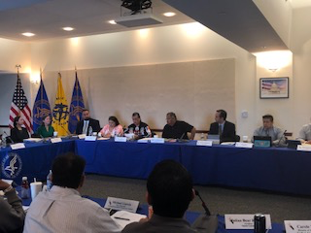
Future IHS Appropriations & Budget Formulation

Slide 17
FY 2021 IHS Budget Formulation
National Tribal Budget Formulation Workgroup met on March 14-15, 2019 in Washington D.C. and recommended full funding for IHS at $37.61 billion to be phased in over 12 years.
For FY 2021, a total of $9.1 billion for IHS is requested. Includes:
$257 m for full funding of current services
$413 m for binding fiscal obligations
$2.7 b for program increases (46% above FY 2019 enacted level)
And more!
Available at: https://www.nihb.org/legislative/budget_formulation.php

Slide 18
FY 2022 IHS Budget Formulation
National Tribal Budget Formulation Workgroup (NTBFW) met on June 27-28 in Reno, Nevada.
Workgroup decided to request full funding now (not 12 year phased in funding).
An analysis will be conducted to determine what that amount is.
Recommendation for FY 2022 will be based on NTBFW request for FY 2021, plus 30%.
Portland Area Budget Formulation Meeting for FY 2022 is November 14, 2019 in Portland, Oregon.

Slide 19
New & Pending Federal Policies
HHS STAC Meeting, Washington, D.C, September, 2019

Slide 20
Executive Order
E.O. 13875: Evaluating and Improving the Utility of Federal Advisory Committees-Issued 6/14/19
Directs agencies to terminate at least 1/3 of its current committees established under 9(a)(2) of FACA, including other committees.
Imposes the following three deadlines on federal agencies:
August 1, 2019: agencies must provide a detailed plan to the Office of Management and Budget recommending the termination or continuance of its Section 9(a)(1) committees
September 1, 2019: OMB shall make recommendations to the President about terminating presidential committees.
September 30, 2019: 1/3 of agency committees must be terminated.
On 7/30/19, many tribal organizations signed a letter opposing this requirement to White House, OMB and EPA.
Impact on Tribal Advisory Committees is still not clear.

Slide 21
HHS Proposed Rule on Confidentiality of Substance Use Disorder Patient Records (42 CFR Part 2)
Issued 8/26; Comments Due 10/25, 5pm EST
Proposes changes to the Confidentiality of Substance Use Disorder Patient Records regulations at 42 CFR Part 2.
These changes were prompted by the need to continue aligning the regulations with advances in the U.S. health care delivery system, while retaining important privacy protections for individuals seeking treatment for substance use disorders (SUDs).

Slide 22
CMS Request for Information: Treating Pain and Substance Use Disorders
CMS Request for Information (RFI): Treating Pain and Substance Use Disorders; comments submitted
SUPPORT Act directs the HHS Secretary to develop an action plan to prevent opioid addiction and increase access to MAT
Action Plan will include a review of Medicare and Medicaid payment policies

Slide 23
CMS-Pending Responses and/or Ongoing Issues
Work Requirements
Four Walls Limitation- FAQs
Decision on Appeal of Washington DHAT SPA
Tribal Consultation
Managed Care
Anti-Kickback Laws/Safe Harbors or Exemptions for IHCP

Slide 24
IHS-Special Diabetes Program for Indians Update
FY 2020- SDPI under a continuing resolution until 11/21/19.
NIHB coordinated an SDPI Summit on 9/19/19 to discuss the future of SDPI funding, and tribal shares option.
Tribal Consultation on the Distribution of Funding for SDPI in FY 2021; DTLL 10/2/19; Comments Due on 12/2
Portland Area consultations on:
October 28 and November 15

Slide 25
IHS-Behavioral Health/Opioid Funding DTLLs
Tribal Consultation conducted on Recommendations by the IHS National Tribal Advisory Committee on Behavioral Health for Behavioral Health Funding; DTLL 8/2/19; comments due 10/1/19; comments submitted.
Tribal Consultation and Urban Confer conducted on Developing IHS Opioid Grant Program to Distribute the FY 2019 Opioid Funding; DTLL 7/5/19; comments submitted.
Related to $10m for Special Behavioral Health Program for Indians, FY 2019 appropriation.

Slide 26
IHS-Community Health Aide Program (CHAP) Expansion
Tribal Consultation conducted on Community Health Aide Program Interim Policy; DTLL on 5/8/19; comments submitted.
IHS Community Health Aide Program (CHAP) Workgroup reviewed comments on 9/9/19.
House bill $20m; Senate Appropriations Committee bill $3m
NPAIHB actively advocating for CHAP expansion funding and to be a demonstration project if funded

Slide 27
IHS-Section 105(l) Leases
Tribal Consultation conducted on Long and Short Term Options for Meeting ISDEAA 105(l) Requirements, DTLL 3/12/19
Comments submitted requesting an indefinite discretionary appropriation like CSC
RADM Weahkee recently reported that over 190 proposals have been submitted at a cost of $103m and it is continuing to rise.
House bill $53m; Senate Appropriations Committee bill $97m
A Technical workgroup has being established under National Tribal Budget Formulation Workgroup

Slide 28
Contract Support Costs (CSC)
Results of Tribal Consultation on CSC Alternative Method for Calculating Indirect Costs Associated with Recurring Service Unit Shares (also known as “97/3 Split”); DTLL 8/6/19
IHS substantially changed the 97/3 provision by making it something both the Area Office and the Tribe have to agree to use, rather than something that is the exclusive option of the Tribe.

Slide 29
IHS-Other Recent DTLLs
Tribal Consultation and Urban Confer to Seek Input on the Memorandum of Understanding and Related Performance Measures between the VA, VHA, HHS and IHS; DTLL 9/4/19
First consultation at NIHB conference in September; future consultations to be scheduled.
Invitation to Provide Updated Facility Master Plans and/or Identified Health Care Facility Needs to Local IHS Area Facilities Program Director for Possible Inclusion in the 2021 IHS and Tribal Health Care Facilities Needs Assessment Report to Congress; DTLL 7/5/19; Data Due 12/31

Slide 30
HRSA Update
HRSA Rural Access to Health Care Services Request for Information; comments submitted
Seeks information about measuring access to health care in rural communities through a set of "Questions for Public Comment."
HRSA Tribal Advisory Committee
At last HHS STAC meeting, HRSA leadership announced that it will be convening a HRSA Tribal Advisory Committee (request from HHS Region 10 Consultation).

Slide 31
HRSA Update Cont’d
HRSA Shortage Designation Modernization Project (SDMP)
New Auto-HPSA designation scores will be applicable to the 2020 National Health Service Corp application cycle (application cycle begins February 2020).
8/30/19: HRSA Auto-HPSA online portal opened on for tribes to upload facility-specific data and supplemental data to increase scores (replacement of the ACS data)and tribes can request rescores. (Portal- https://bhw.hrsa.gov/sdmp)
9/9/19: HRSA rescored dental health and mental health Auto-HPSAs for I/T/Us with additional data provided by IHS.
For instructions on how to upload data, watch the June 25 Webinar: Auto-HPSA Portal Training for I/T/Us.
Email SDMP@HRSA.GOV for assistance or your state HRSA representatives.
Webinar recordings available at: https://bhw.hrsa.gov/sdmp

Slide 32
VA Updates
VA/IHS Consultation Session at NIHB Conference on 9/16/19 to seek input on the MOU and related measures to improve access and health outcomes for AI/AN veterans.
Wolfe v. Wilkie: Federal court ruled that VA wrongly denied reimbursements to veterans. Class action lawsuit was the result of VA failing to fully reimburse veterans for emergency room care at non-VA facilities.
H.R. 4532/S. 2258- Nursing Home Care for Native Veterans Act, addresses the lack of nursing homes for veterans on tribal lands.

Slide 33
Other Litigation

Slide 34
Texas v. United States Challenge to Affordable Care Act
On December 14, 2018, Judge Reed O’Conner (USDC ND Texas) held:
That the individual mandate enacted as part of the ACA is unconstitutional because it cannot be justified under Congress’ taxing power (Congress reduced tax penalty to $0).
The entire ACA must be invalidated because the individual mandate is not severable and essential to the ACA’s operation.
If ACA struck down, ICHIA would also be struck down.
Appealed to USCA for the the Fifth Circuit.
483 tribes and tribal organizations(including NPAIHB) joined an amicus brief.
On March 25, 2019, a coalition of states intervened in the case in order to defend the ACA while Department of Justice filed a two-sentence letter with the court announcing that the U.S. had changed its position in the litigation.
On July 9, 2019, a three-panel judge in the Fifth Circuit heard oral arguments.
Fifth Circuit Decision pending- likely to be appealed to the Supreme Court.

Slide 35
Brackeen v. Bernhardt Challenge to ICWA
On 10/5/18, Judge Reed O’Conner (USDC ND Texas) ruled that ICWA is unconstitutional in Brackeen v. Zinke.
Found that Morton v. Mancari rule does not apply because ICWA extends to Indians who are not members of tribes.
ICWA struck down in violation of equal protection.
Appealed to USCA for the Fifth Circuit and now titled, Brackeen v. Bernhardt.
Many tribes and tribal organizations (including NPAIHB) joined the amicus brief.
Status:
On 8/9/19, the Fifth Circuit Reversed D.C. Grant of Summary Judgment - A win for Indian Country!
On 10/1/19, plaintiffs filed for a rehearing en banc.

Slide 36
Recent and Upcoming National/Regional Meetings
HHS Annual Tribal Budget Consultation, Washington, DC, April 2019

Slide 37
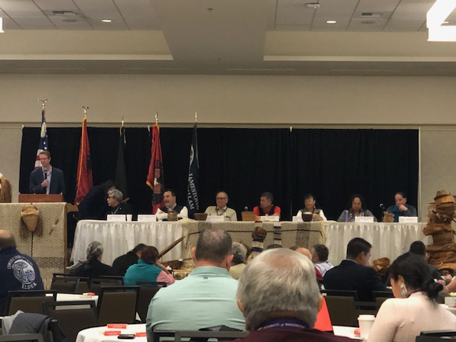
Recent Meetings (not Committees)
NIHB Quarterly Board Meeting: September 15
NIHB Tribal Health Conference: September 16-19
HRSA Consultation Session (9/16)
Joint IHS/VA Consultation Session (9/16)
CMS Listening Session (9/16)
IHS Listening Session (9/17)
Special Diabetes Program for Indians Summit (9/19)
Affiliated Tribes of Northwest Indians: October 7-10
ATNI, October 2019

Slide 38
Upcoming Meetings October-December 2019
NCAI Annual Convention and Marketplace, October 20-25, Albuquerque, NM
MMPC/CMS TTAG Meeting November 6-8, Washington, D.C.
NIHB 4th Quarter Board Meeting, November 13-15, Washington, D.C.
Portland Area Budget Formulation Meeting, November 14, Portland, OR
Tribal Leaders Diabetes Committee Meeting, December 2-3, Washington, D.C.

Slide 39
DHAT State Legislative Update​
Washington state will continue to pursue statewide licensing bill that will enable UIPs to employ dental therapists. Bill should also remove current CMS argument about reimbursement as services are far less restricted than tribal bill.

Slide 40
DHAT State Legislative Update​
Oregon is looking to introduce statewide licensing bill in 2020 session. Our pilot project expires in May 2021, and legislation is best pathway to allow current DHATs to continue practice and establish the profession in OR for all underserved populations.
Idaho passed legislation this past year that will grant state licenses to dental therapists practicing on tribal lands.

Slide 41
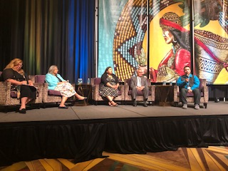
Discussion and Questions
NIHB Tribal Health Conference, Temecula, CA
October 2019

