Slide 1
Legislative & Policy Update
Quarterly Board Meeting
January 15, 2019
Hosted by: The Tulalip Tribe

Slide 2
Report Overview
Hot Topics
Appropriations
Legislation
New & Pending Federal Policies
Litigation
Recent and Upcoming National/Regional Meetings
5. DHAT State Legislative Update

Slide 3
Hot Topics
Rear Admiral (RADM) Michael D. Weahkee Nomination Hearing
⎼12/11/19: RADM Weahkee answered questions from Senate Committee on Indian Affairs Committee members on long-standing challenges in providing quality and comprehensive healthcare- from the lack of federal housing for clinicians, chronic issues with provider recruitment and retention, to reoccurring cuts to IHS funding. ⎼NPAIHB sent a letter to the Committee in support of RADM Weahkee 11/19/19
U.S. v. Texas Update
⎼12/18/19: Fifth Circuit Court of Appeals concluded that the ACA individual mandate provision is unconstitutional. BUT the Court remanded the case back to the district court to consider if there are severable provisions in the ACA.
FY 2020 Appropriations
⎼12/19/19: Congress approved and the President signed two measures that funded all 12 appropriations bills through FY 2020, including a roughly 4% Increase to IHS Overall and 5-month extension of SDPI

Slide 4
Appropriations
IHS Portland Area SDPI Consultation Session; November 15, 2019

Slide 5
FY 2020 IHS Appropriations Enacted
12/20/19: H.R. 1865 – Further Consolidated Appropriations Act, 2020 (P.L. 116-94) includes 8 appropriations bills including Interior (IHS) and Labor-Health and Human Services-Education.
⎼H.R. 3052 and H. Rept. 116-100: Manager’s Explanatory Statement House bill and report.
⎼S.2580 and S. Rept. 116-123: Manager’s Explanatory Statement Senate bill and report.
IHS Total Funding: $6.04 billion, a 4% increase above FY 2019 enacted level.
Congress did not fully fund the Administration’s request for EHR modernization, providing $8 million rather than the $25 million requested and $5 million to expand CHAP rather than the $20 million requested.
The proposed increase of $25 million as part of the Administration’s HIV/Hepatitis C initiative was not approved.

Slide 6
FY 2020 Interior IHS Appropriations Summary
 | FY 2019 Enacted | FY 2020 Final Bill | House Bill | Senate Bill
Clinical Svcs | $3,739,961 | $3,934,831 | $4,120,282 | $3,949,062
Prev Health | 174,742 | 177,567 | 181,062 | 178,636
Other Svcs | 188,487 | 202,807 | 255,526 | 191,186
Total Services | 4,103,190 | 4,315,205 | 4,556,870 | 4,318,884
Facilities | 878,806 | 911,889 | 964,121 | 902,878
Total w/o CSC | $4,981,996 | $5,227,094 | $5,520,991 | $5,221,762
CSC | 822,227 | 820,000 | 820,000 | 820,000
Total w/CSC | $5,804,223 | $6,047,094 | $6,340,991 | $6,041,762
Diff w/2019 Enacted | -------------- | +243m | +537m | +237m

Slide 7
FY 2020 IHS Clinical Services
 | FY 2019 Enacted | FY 2020 Final Bill | House Bill | Senate Bill
H&HC | $2,147,343 | $2,324,606 | $2,420,568 | $2,339,707
EHR | 0 | 8,000 | 25,000 | 3,000
Dental | 204,672 | 210,590 | 227,562 | 210,315
MH | 105,281 | 108,933 | 125,332 | 108,569
Alcohol/SA | 245,566 | 245,603 | 280,151 | 247,828
PRC | 964,819 | 964,819 | 969,479 | 967,363
IHCIF | 72,280 | 72,280 | 72,280 | 72,280
Totals: | $3,739,961 | $3,934.831 | $4,120,282 | $3,949,062
105(l) Lease Costs: $125m – Directs DOI and DHHS to consult with Tribes and work with House and Senate committees of jurisdiction, OMB and Committees on Appropriations to formulate a long-term accounting, budget and legislative strategies to address the situation
Hospitals &Health Clinics: $10m for domestic violence; $5.4m for TECs; $2m for quality & oversight; $5m CHAP
EHR: $8m
Dental: $2m for electronic dental health records system
Alcohol/Substance Abuse: $10m for opioid grants

Slide 8
FY 2020 IHS Preventative Health
 | FY 2019 Enacted | FY 2020 Final Bill | House Bill | Senate Bill
PH Nursing | $89,159 | $91,984 | $95,307 | $92,677
Health Educ | 20,568 | 20,568 | 20,669 | 20,923
CHRs | 62,888 | 62,888 | 62,913 | 62,888
Immun AK | 2,127 | 2,127 | 2,173 | 2,148
Totals: | $174,742 | $177,567 | $181,062 | $178,636
Health Education & CHRs: Level funding for both health education and CHRs.

Slide 9
FY 2020 IHS Other Services
 | FY 2019 Enacted | FY 2020 Final Bill | House Bill | Senate Bill
Urban Health | $51,315 | $57,684 | $81,000 | $53,159
IHP | 57,363 | $65,314 | 90,656 | 57,796
Tribal Mngt | 2,465 | 2,465 | 2,521 | 2,465
Direct Ops | 71,538 | 71,538 | 75,385 | 71,945
Self Gov | 5,806 | 5,806 | 5,964 | 5,821
Totals: | $188,487 | $202,807 | $255,526 | $191,186
Urban Health: $6.4m increase
IHP: House bill language provides $40m for the loan repayment program and $4m general program increase to help with the recruitment and retention of health professionals.

Slide 10
FY 2020 IHS Facilities
 | FY 2019 Enacted | FY 2020 Final Bill | House Bill | Senate Bill
M&I | $167,527 | $168,952 | $174,336 | $168,952
Sanitation | 192,033 | 193,577 | 193,577 | 193,577
HC Fac Const | 243,480 | 259,290 | 304,290 | 249,279
Fac & Envir. | 252,060 | 261,983 | 266,831 | 261,983
Equipment | 23,706 | 28,087 | 25,087 | 29,087
Totals: | $878,806 | $911,889 | $964,121 | $902,878
Health Care Facilities Construction: $5m for Green Infrastructure and $25m for small ambulatory clinics which includes $5m for replacement and expansion projects.

Slide 11
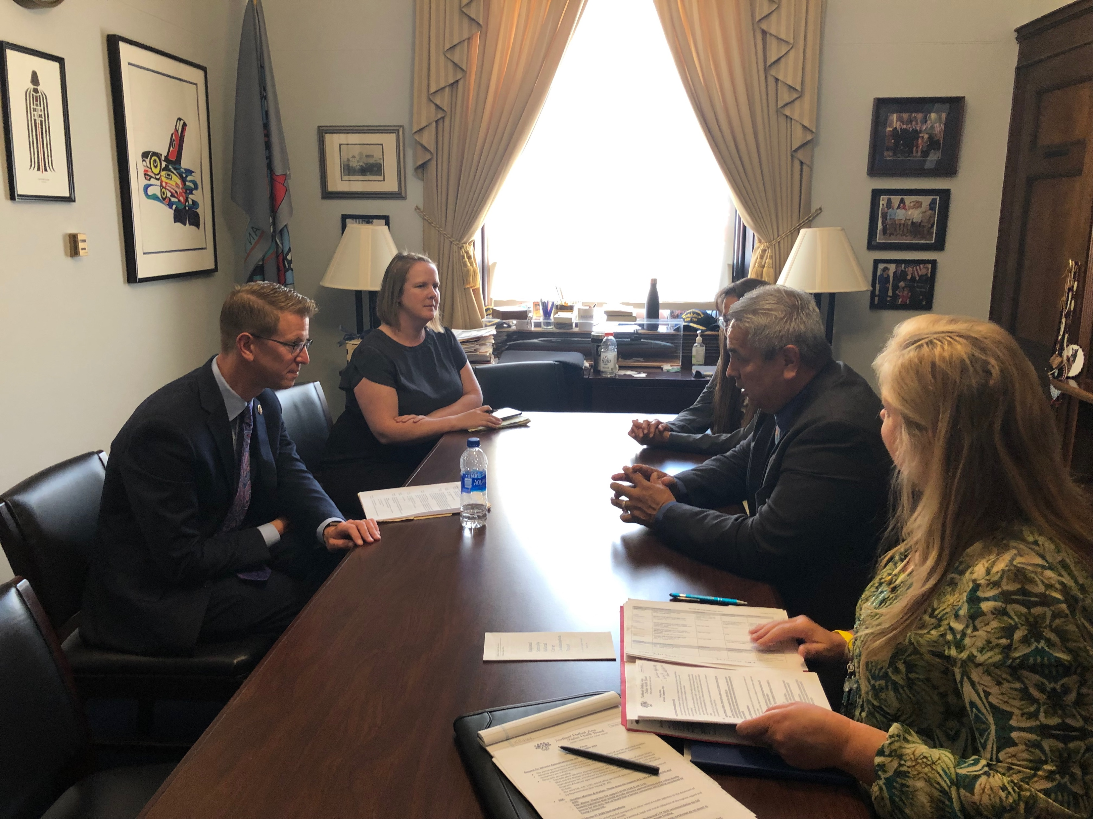
Legislation
NCAI Tribal Unity Impact Days & Hill Visits; September 10-11, 2019
ATNI; October 7-10, 2019

Slide 12
Advanced Appropriations Bills for BIA/BIE/IHS and IHS only
FY 2020 House Appropriations Committee Report directs IHS to report on what changes would be needed to develop and manage an advance appropriations for IHS and report back within 180 days.
The following bills will carryover into the second session of the 116th Congress in 2020.
S. 229 & H.R. 1128 – Advanced Appropriations for BIA and BIE at DOI and IHS at HHS
Senate Bill introduced by Sen. Tom Udall (D-NM) on 1/25/19.
House Bill introduced by Rep. Betty McCollum (D-MN-4) on 2/8/19.
Status: Both referred to respective House and Senate Committees; House Natural Resources Subcommittee on Indigenous Peoples’ hearing on 9/25/19.
H.R. 1135 & S. 2541 –Advanced Appropriations for IHS
House Bill introduced by Rep. Don Young (R-AK- At Large) on 2/8/19; referred to Committees.
Senate Bill introduced by Sen. Lisa Murkowski (R-AK) and RM Sen. Tom Udall (R-NM) on 9/24/19.
Status: Both referred to respective House and Senate Committees; House Natural Resources Subcommittee on Indigenous Peoples’ hearing on 9/25/19.

Slide 13
Special Diabetes Program for Indians Reauthorization
H.R. 1865-Further Consolidated Appropriations Act, 2020
Extends authorization for several mandatory-funded health programs, including SDPI and Community Health Clinic program through May 22, 2020.. SDPI has been authorized at $96,575,342 (64% of 150M or equivalent to just under 8 months.
H.R. 2328- Community Health Investment, Modernization, and Excellence Act of 2019 (Rep. Tom O’Halleran (D-AZ)-4 years at $150m)
Status: 7/17/19 – Ordered Reported by House E&C
S. 1895- Lowering Health Care Costs Act (Sen. Lamar Alexander (R-TN) – 5 years at $150m)
Status: 7/8/19- Placed on Senate Leg Calendar
Other pending bills:
H.R. 2668 – Special Diabetes Program Reauthorization Act of 2019 (Rep. Diana DeGette (D-CO)-5 years at $200m
Status: 6/4/19- House E&C Health Subcommittee Hearing
H.R. 2680 – Special Diabetes Programs for Indians Reauthorization Act of 2019 (Rep. Tom O’Halleran (D-AZ)- 5 years at $200m
Status: 6/4/19-House E&C Health Subcommittee Hearing
H.R. 2700 – Lowering Prescription Drug Costs and Extending Community Health Centers and Other Health Priorities Act (Rep. Michael Burgess (R-TX)- 1 year extension at $150m)
Status: 6/26/19- In Committees
S. 192 - Community and Public Health Programs Extensions Act) (Sen. Lamar Alexander (R-TN) – 5 years at $150m)
Status: 1/18/19- In HELP Committee

Slide 14
New Indian Legislation
H.R. 5323 – Tribal Elder Care Improvement Act of 2019 (Rep. Tom O’Halleran (D-AZ)
⎼Amends the Older Americans Act of 1965 to expand supportive services for Native American aging programs.
⎼Status: 12/5/19 Referred to the House Committee on Education & Labor.
H.R. 4957 – Native American Child Protection Act (Rep. Ruben Gallego (D-AZ)
⎼Amends the Indian Child Protection and Family Violence Prevention Act
⎼Status: 12/5/19 Ordered to be reported by unanimous consent by the House Committee on Natural Resources
S. 2871 – Indian Health Service Health Professions Tax Fairness Act (Sen. Tom Udall (D-NM)
⎼Excludes from gross income, for income tax purposes, payments under the IHS Loan Repayment Program and certain amounts received under the Indian Health Professions Scholarships Program.
⎼Status: 11/14/19 Referred to the Senate Committee on Finance.
H.R. 4908 – Native American Veteran Parity in Access to Care Today Act (Rep. Ruben Gallego (D-AZ)
⎼Prohibits collection of health care copayment by VA from a veteran who is tribal member.
⎼Status: 11/8/19 Referred to House Committee on Veterans’ Affairs Subcommittee on Health.
Notes:
-

Slide 15
GAO Report: IHS- Facilities Reported Expanding Services Following Increases in Health Insurance Coverage and Collections
On 9/3/19, GAO issued a report describing (1) significant increases in health insurance coverage and third-party collections at federally operated and tribally operated facilities from FY 2013-2018, and (2) the effects of any changes in coverage and collections.
GAO Found:
⎼During FY 2013-2018 patients at federally operated hospitals and health centers reported an average increase of 14% in health coverage. Tribally operated facilities also experienced increases in coverage.
⎼Federally operated IHS facilities’ third-party collections totaled $1.07 billion in FY 2018, increasing 51% from FY 2013. Tribally operated facilities also experienced increases in collections.
⎼Facilities have been increasingly relying on third-party collections to pay for ongoing operating (i.e. staff payroll and facility maintenance) and have expanded onsite services (i.e. volume or scope of services offered- adding new providers or purchasing medical equipment).

Slide 16
GAO Report: Tribal Programs- Resource Constraints and Management Weaknesses Can Limit Federal Program Delivery to Tribes
On 11/19/19, GAO issued a report describing (1)capacity and funding constraints and budget uncertainty and (2) management weaknesses that limit the effective delivery of federal programs for tribes and their members. GAO made more than 50 recommendations related to its high-risk area and more than 40 recommendations for tribal water infrastructure, tribal self-governance and tribal consultation of which 60 recommendations are open.
GAO Found:
⎼High staff vacancies and insufficient staff capacity. In February 2017, GAO reported that IHS had over 1,550 vacancies for healthcare positions in 2016, and the insufficient workforce was the biggest impediment to providing timely primary care.
⎼Inadequate funding. Inadequate program funding to meet tribal needs may limit tribal options for administering federal programs using self-determination contracts or self-governance compacts. Many tribes supplement federal funding, which diverts funding from economic development and services provided.
⎼Effects of budget uncertainty. Budget uncertainty arises during CRs and government shutdowns. Impacts on tribal health care programs and operations include recruitment and retention of staff challenges and additional administrative burden and cost.
⎼Oversight weaknesses. Found weaknesses in IHS’s oversight of timeliness of patient care leading to long wait times at IHS facilities. Recommendation that IHS develop standards for patient wait times and take corrective action. IHS has done this and it developing monitoring capacity.

Slide 17
Federal Administrative & Regulatory Policy
RADM Weahkee visiting NPAIHB; September, 2019

Slide 18
HHS OIG Proposed Rule: Anti-Kickback Statute
Issued 8/26; Comments Submitted 10/25
The Anti-Kickback Statute (AKS) prevents healthcare providers from entering into arrangements where one provider gives another provider payment or an incentive to bill federal healthcare programs.
The HHS OIG created a number of safe harbors, however none of the existing safe harbors are designed for Indian healthcare programs.
New Safe Harbors: 1) Coordinated Care Arrangements; 2) Value-Based Care: Substantial Downside Financial Risk; 3) Value-Based Care: Full Financial Risk; 4) Patient Engagement and Support; 5)
NPAIHB requested an Indian-specific safe harbor with language from the CMS TTAG.

Slide 19
CMS Proposed Rule: Medicaid Fiscal Accountability Regulation
Issued 11/18/19; Comments Due 2/1/20
Proposes new reporting requirements for states to provide CMS with more detailed information on supplemental and DSH payments to Medicaid providers.
Clarifies that permissible state or local funds for the state share include: state general fund dollars appropriated directly to Medicaid; Intergovernmental transfers (IGTs) from units of government (including tribes) derived from state or local taxes, and transferred to the state Medicaid agency; and certified public expenditures (CPEs) reported to the state.
Concern: Belief that it could negatively affect participation of tribes to perform Medicaid State administrative activities (i.e. in OR and WA). For example, states can or could pay for a portion of the non-federal match on certain services.

Slide 20
IHS Recent DTLLS
DTLL on 12/2/19: Notification of upcoming deadline to file a hardship exception application to CMS for not having access to certified Health Information Technology to meet the Medicare Quality Payment Incentive Program (Application Due 12/31/19)
DTLL on 11/27/19: Update on short-term continuing appropriations for FY 2020 that affect tribal health programs with performance periods starting within the CR period for October 1, 2019 through December 20, 2019.
DTLL on 11/15/19: Updates on recent developments associated with modernizing Agency Health Information Technology and release of October 2019 final report and roadmap executive summary.

Slide 21
IHS Strategic Options for Modernizing Health IT
IHS HIT Modernization Project Roadmap provides guidance to HHS and IHS in their efforts to modernize the IHS HIT system.
The Roadmap is an overarching plan to support improved clinical and non-clinical operations across I/T/U healthcare facilities through HIT.
The Project was designed to identify and frame the initial path required to achieve success; however, the proposed modernization program requires an immediate and long-term commitment

Slide 22
IHS Health IT Modernization High-level Operation Plan

Slide 23
IHS Strategic Options for Modernizing Health IT Proposals
Charter a HIT Modernization Advisory Committee to support the collaboration to advance innovation for technology improvements for the Indian health delivery system.
Establish a multi-member governing body that interacts regularly with stakeholder groups, both formally through tribal consultation policies and informally through leadership and subject matter expert stakeholder groups.
Leadership must fully understand and establish a long-term commitment to the HIT modernization program through engagement and support for appropriate governance, resourcing, and accountability.
Need for additional evaluation and endorsement of key findings by IHS.

Slide 24
IHS Strategic Options for Modernizing Health IT

Slide 25
IHS Special Diabetes Program for Indians Update
FY 2020: short-term extension of SDPI for 5 months, through May 22, 2020.
No funds have been authorized for the next SDPI grant cycle yet (FY 2021-2025)
Tribal Consultation on the Distribution of Funding for SDPI in FY 2021; DTLL 10/2/19; Comments Submitted on 12/2
1/10/20: TLDC on recommendations to provide to RADM Weahkee.
IHS will provide decisions for the FY 2021-2025 grant cycle by DTLL in early 2020. The FY 2021 Notice of Funding Opportunity released in Spring 2020.
Portland Area Recommendations:
⎼Proposed changes to the funding distribution for more funds to go to current SDPI grantees and new grantees from undisbursed funds, SDPI Data Infrastructure, and SDPI Program Support.
⎼ Generally did not recommend any changes to the national funding formula, but any changes must hold tribes harmless.

Slide 26
Active IHS Consultations
Distribution of funding for IHS Special Diabetes Program for Indians (SDPI) in FY 2021
⎼Initiated 10/2/19; Comments submitted 11/27/19
2010 Memorandum of Understanding and Related Performance Measures between IHS and U.S. Department of Veterans Affairs
⎼ Initiated 9/14/2019; Listening Session 9/16/19
Mechanism to Distribute Behavioral Health Initiatives currently Distributed through Grants
⎼ Initiated 5/18/2018 and 8/2/2019; Comments submitted 10/1/2019
FY 2019 Funding Decision for New Behavioral Health Funding to address Opioids- To Develop an IHS Opioid Grant Program
⎼Initiated 6/19/19; Comments submitted 9/3/19
Draft IHS policy to implement, outline, and define a national CHAP
⎼Initiated 5/18/19; Comments submitted 6/7/19
Short- and Long-term solutions to Meet Statutory Requirements of the Section 105(l) leases, ISDEAA 25 U.S.C § 5234(l)
⎼ Initiated 2/29/19 and 3/12/19; Comments submitted 4/26/19
Detailed Analysis of Purchased/Referred Care Program Implications and Feasibility for the State of Arizona to be identified as a Purchased/Referred Care Delivery Area (PRCDA), pursuant to IHCIA 25 U.S.C. § 1678
⎼ Initiated 11/20/2018 and 2/27/19; Comments submitted 11/15/19

Slide 27
Litigation: U.S. v. Texas Update
Fifth Circuit held that the individual mandate became unconstitutional when Congress reduced the individual mandate penalty to zero, as part of the 2017 Tax Cuts and Jobs Act.
Fifth Circuit was not convinced by the district court’s holding that because the individual mandate was unconstitutional, the entire ACA must be invalidated.
Three Supreme Court Potential Future Actions:
Reject review and allow district court to move forward with the Fifth Circuit separable analysis;
Grant the requested expedited review, which would allow the Court to make a ruling during the current term before the 2020 presidential election; or
Grant review on its typical schedule during the Court’s next term that begins in the fall.

Slide 28
Recent and Upcoming National/Regional Meetings
HHS Annual Tribal Budget Consultation, Washington, DC, April 2019

Slide 29
Upcoming Meetings January-March 2020
January 23-24: IHS Tribal Self-Governance Advisory Committee (TSGAC) 1st Quarter Meeting, Washington, D.C.
January 27-30: ATNI Winter Convention 2020, Portland, OR.
February 6-7: HHS Secretary’s Tribal Advisory Committee, Washington, D.C.
February 10-13: NCAI Executive Council Winter Session, Washington, D.C.
February 11-12: IHS Direct Service Tribes Advisory Committee (DSTAC) 1st Quarter Meeting, Arlington, VA.
February 13-14: FY 2022 National Tribal Budget Work Session, Crystal City, VA.
February 25-27: NIHB 1st Quarter Meeting, Washington, D.C.
February 25: NIHB MMPC Face-to-Face Meeting, Washington, D.C.
February 26-27: CMS TTAG Face-to-Face Meeting, Washington, D.C.
March 11-12: IHS Tribal Leaders Diabetes Committee (TLDC) Meeting, Washington, D.C.
March 12-13: CDC/ATSDR Tribal Advisory Committee, Chamblee, GA.
March 17-19: NIHB National Tribal Public Health Summit, Omaha, NE.

Slide 30
OR State Dental Therapy Legislation
Oregon is introducing statewide dental therapy licensing bill. Our pilot project expires in May 2021, and legislation is best pathway to allow current DHATs to continue practice and establish the profession in OR for all underserved populations.
OR legislative session starts Feb. 3 and runs for 35 days.
Draft bill language and fact sheet are available and letters of support from Oregon Tribes have been requested and are being generated.
First informational hearing is tomorrow, with NPAIHB, CTCLUSI and Coquille amongst those attending/presenting.
NPAIHB received funding from the Northwest Health Foundation to actively lobby on this bill.

Slide 31
WA State Dental Therapy Legislation
Washington state legislature convened yesterday, January 13, and many of us are at AIHC lobby day today lobbying for statewide licensing bill that will enable UIPs to employ dental therapists and should also remove current CMS argument about reimbursement as services are far less restricted than tribal bill.
NPAIHB received a very generous grant from the Group Health Foundation that allows us to significantly increase our lobbying and paid media on this dental therapy bill.

Slide 32
How to engage with dental therapy legislative efforts!
We will be sending weekly legislative updates and action items to delegates and Tribal Health Directors in OR and WA, and anyone interested in following these two bills.
For more information and to get copies of the legislation and supporting materials please contact Pam Johnson, NDTI Manager, pjohnson@npaihb.org, 206-755-4309

Slide 33
Discussion and Questions
Surprise visit from RADM Weahkee to the Board; September 2019

