Slide 1
Indian Health Service Maternal & Child Health Program: Reach Out & Read Collaboration
Dr. marcy Ronyak
Director, office of clinical & community services
Northwest Portland Area Indian Health Board Quarterly Board Meeting
October 22, 2019

Slide 2
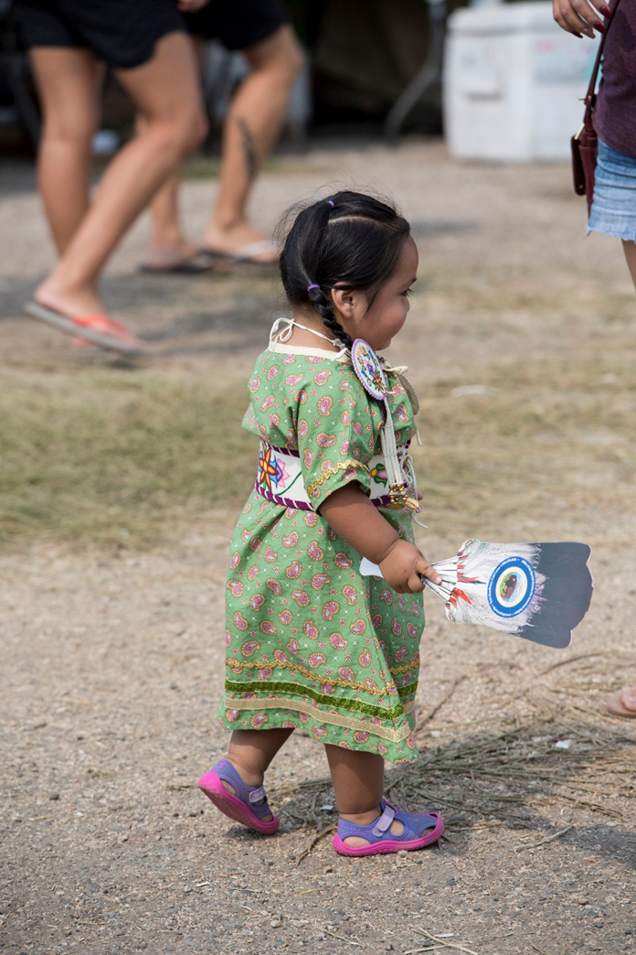
Reach Out & Read Initiative
A nonprofit, national organization
Provides young children a foundation for success
Encourages families to read aloud together
Current Contract:
Support clinic-based early child literacy programs
Site-based training and technical assistance
Goal 1: Access to Care, Obj. 1.3: Increase access to quality health care services
Notes:
Reach Out and Read (ROR) is a nonprofit, national organization that provides young children a foundation for success by incorporating books into pediatric care and encouraging families to read aloud together.
The purpose of this contract is to utilize the ROR model to implement and continue to support clinic-based early child literacy programs and to provide site based training, technical assistance, and quality improvement for IHS, Tribal, and Urban (I/T/U) health care facilities serving children and their families.

Slide 3
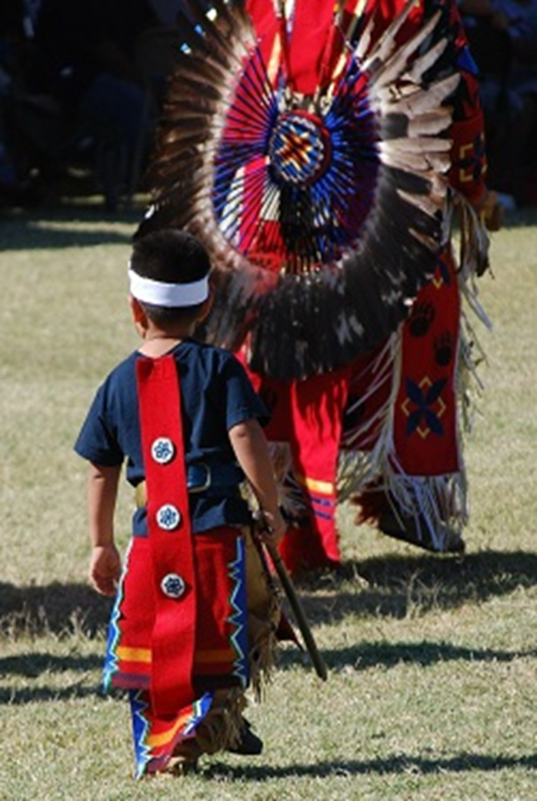
Reach Out & Read Initiative
IHS Contract:
In August of 2019, there were 183 active sites serving 53,874 children
Base year plus 2-year contract funded at $40,180/year
Option year 2 began on August 28, 2019
Focus on technical assistance and programmatic expenses
Goal 1: Access to Care, Obj. 1.1: Recruit, develop, and retain dedicated, competent, and caring workforce
Notes:
Option year 2 of the contract began on August 28, 2019 and ends on August 27, 2020.
Technical Assistance: The Contractor provides technical assistance to the participating sites, professional development, orienting new clinical and administrative staff to the program and assist with online trainings ( $11,429).
Programmatic Expenses: The Contractor purchases and distributes books for children (10,455 books at $2.75 each) to participating clinics/hospitals ($28,751).

Slide 4
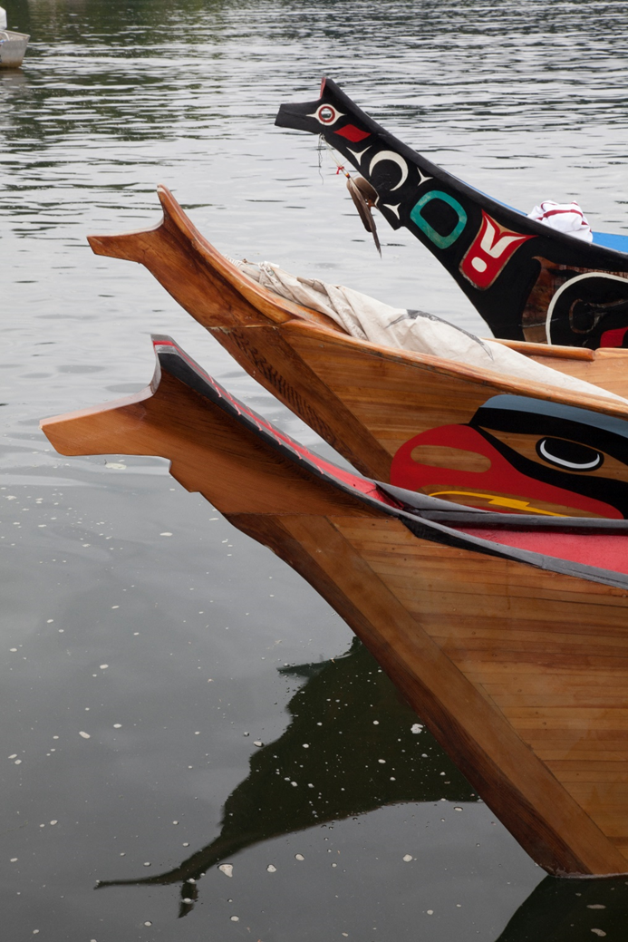
Opportunities for Collaboration
Modified the contract to reach an additional 2,000 children
Proposed expansion in the following IHS Areas/States:
Portland Area (1 in Oregon and 1 in Washington)
Currently Oregon has one site that is considered inactive and looking at relaunching the program.
Goal 1: Access to Care, Obj. 1.2: Build, strengthen, and sustain collaborative relationships
Notes:
There are opportunities for collaboration on the expansion of the contact.
A modification to contract was completed in FY19 to reach an additional 2,000 children with proposed sites in the Portland Area.
IHS is seeking recommendations for sites in Oregon and Washington to prioritize for consideration of establishing a Reach Out & Read program.
Oregon site has not been fully active since January 2018 due to staffing changes and inconsistent book funding.

Slide 5
Implementation of Reach Out & Read
Dr. Allison Empey
Assistant Professor, Department of Pediatrics
Deputy Director, Northwest Native American Center of Excellence
Oregon Health & Science University

Slide 6
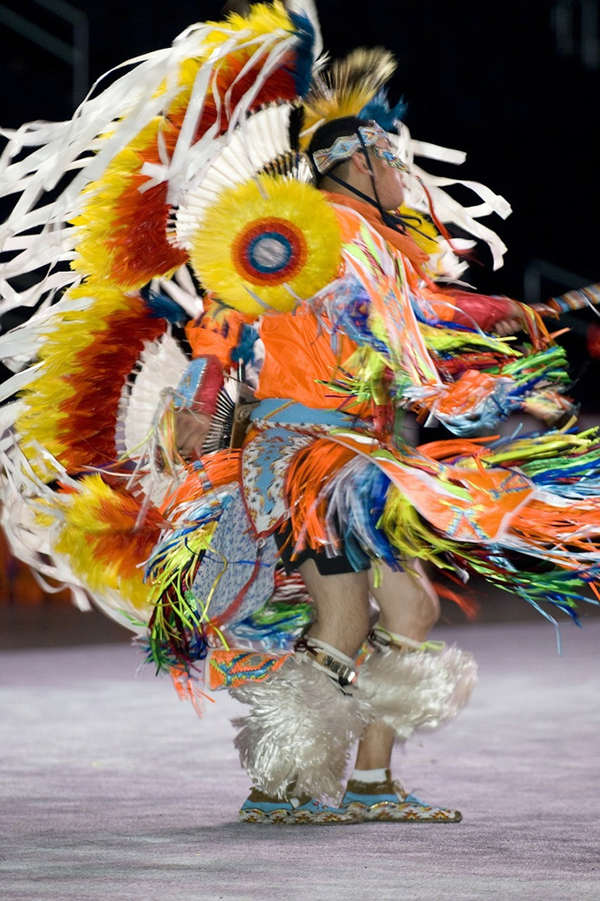
How Does ROR Work?
During well child exams, medical providers give out new, developmentally appropriate books to children 6 months-5 years
Advise parents about the importance of reading aloud
ROR has partnership with Scholastic and other book distributors to receive discounted books

Slide 7
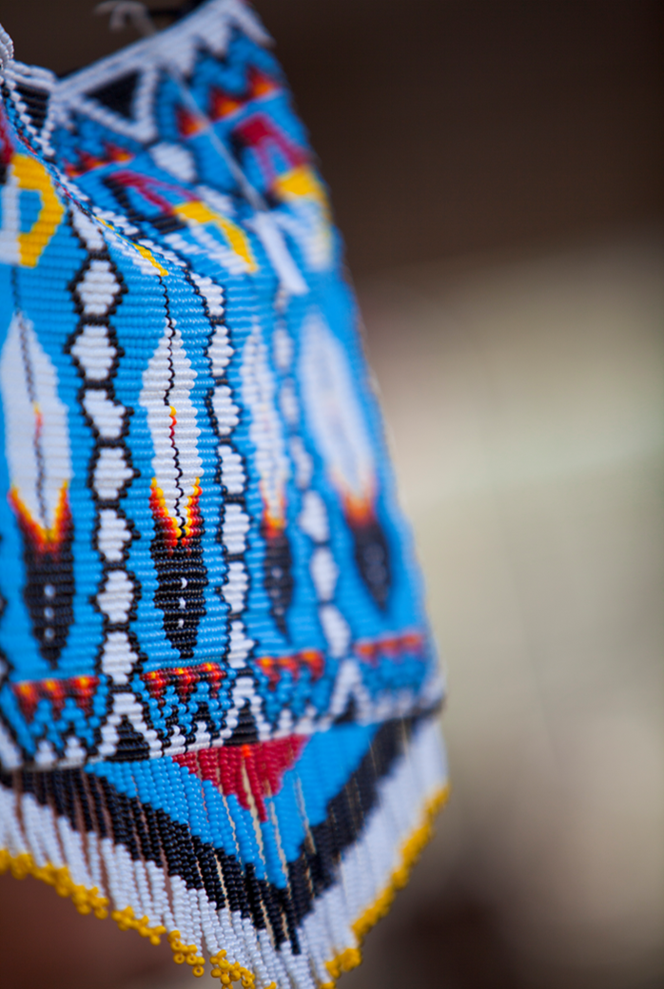
Who Benefits from ROR?
Medical providers use books as valuable assessment tools and build bonds with families
Parents are given essential information about reading aloud and suggestions for parent-child interactions
Children get all the early literacy benefits of reading aloud and have 10 books of their own by age 5

Slide 8
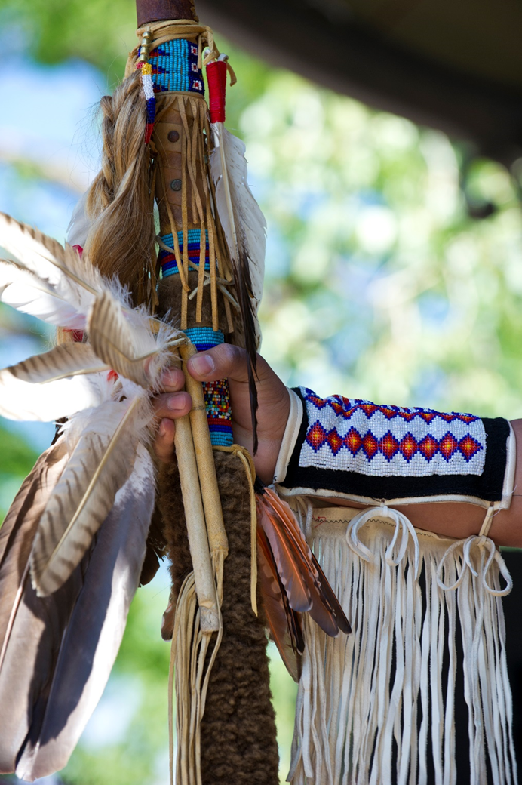
Studies Supporting ROR
Families 4X more likely to read to children with ROR (Needlman et. al., 1991)
Increase receptive and expressive vocabulary scores in children who received ROR intervention (Mendelsohn et al, 2001)
Children in ROR start kindergarten 6 months ahead on verbal scores (Theriot, et al. 2003)

Slide 9
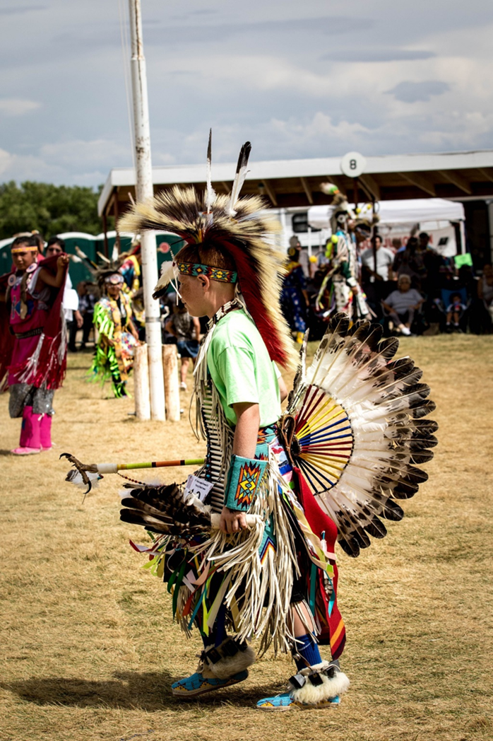
Starting Reach Out & Read Independently
Identify ROR Clinic Champion and Medical Consultant
Collect Data (number of well child visits 6 months-5 years)
ROR application
ROR training for office (MD’s, NP’s, Nurses, MA’s)
Identify culturally appropriate books
Make waiting room literacy friendly
Children’s books and reading aloud hand outs
Order books!

Slide 10
The Details
Grand Ronde Health and Wellness
Established 2014
Identified nurse as clinic champion
Identified ~ 250 well child visits (6 mos-5yrs)
Trained all staff (Dr. Allison Empey is a ROR trainer but online
Training is available) with CME credit
Ordered books: Each book costs ~ $3.00 from scholastic
Received funding from Oregon Pediatric Society for first year
Clinic reports to ROR every 6 months

