Slide 2
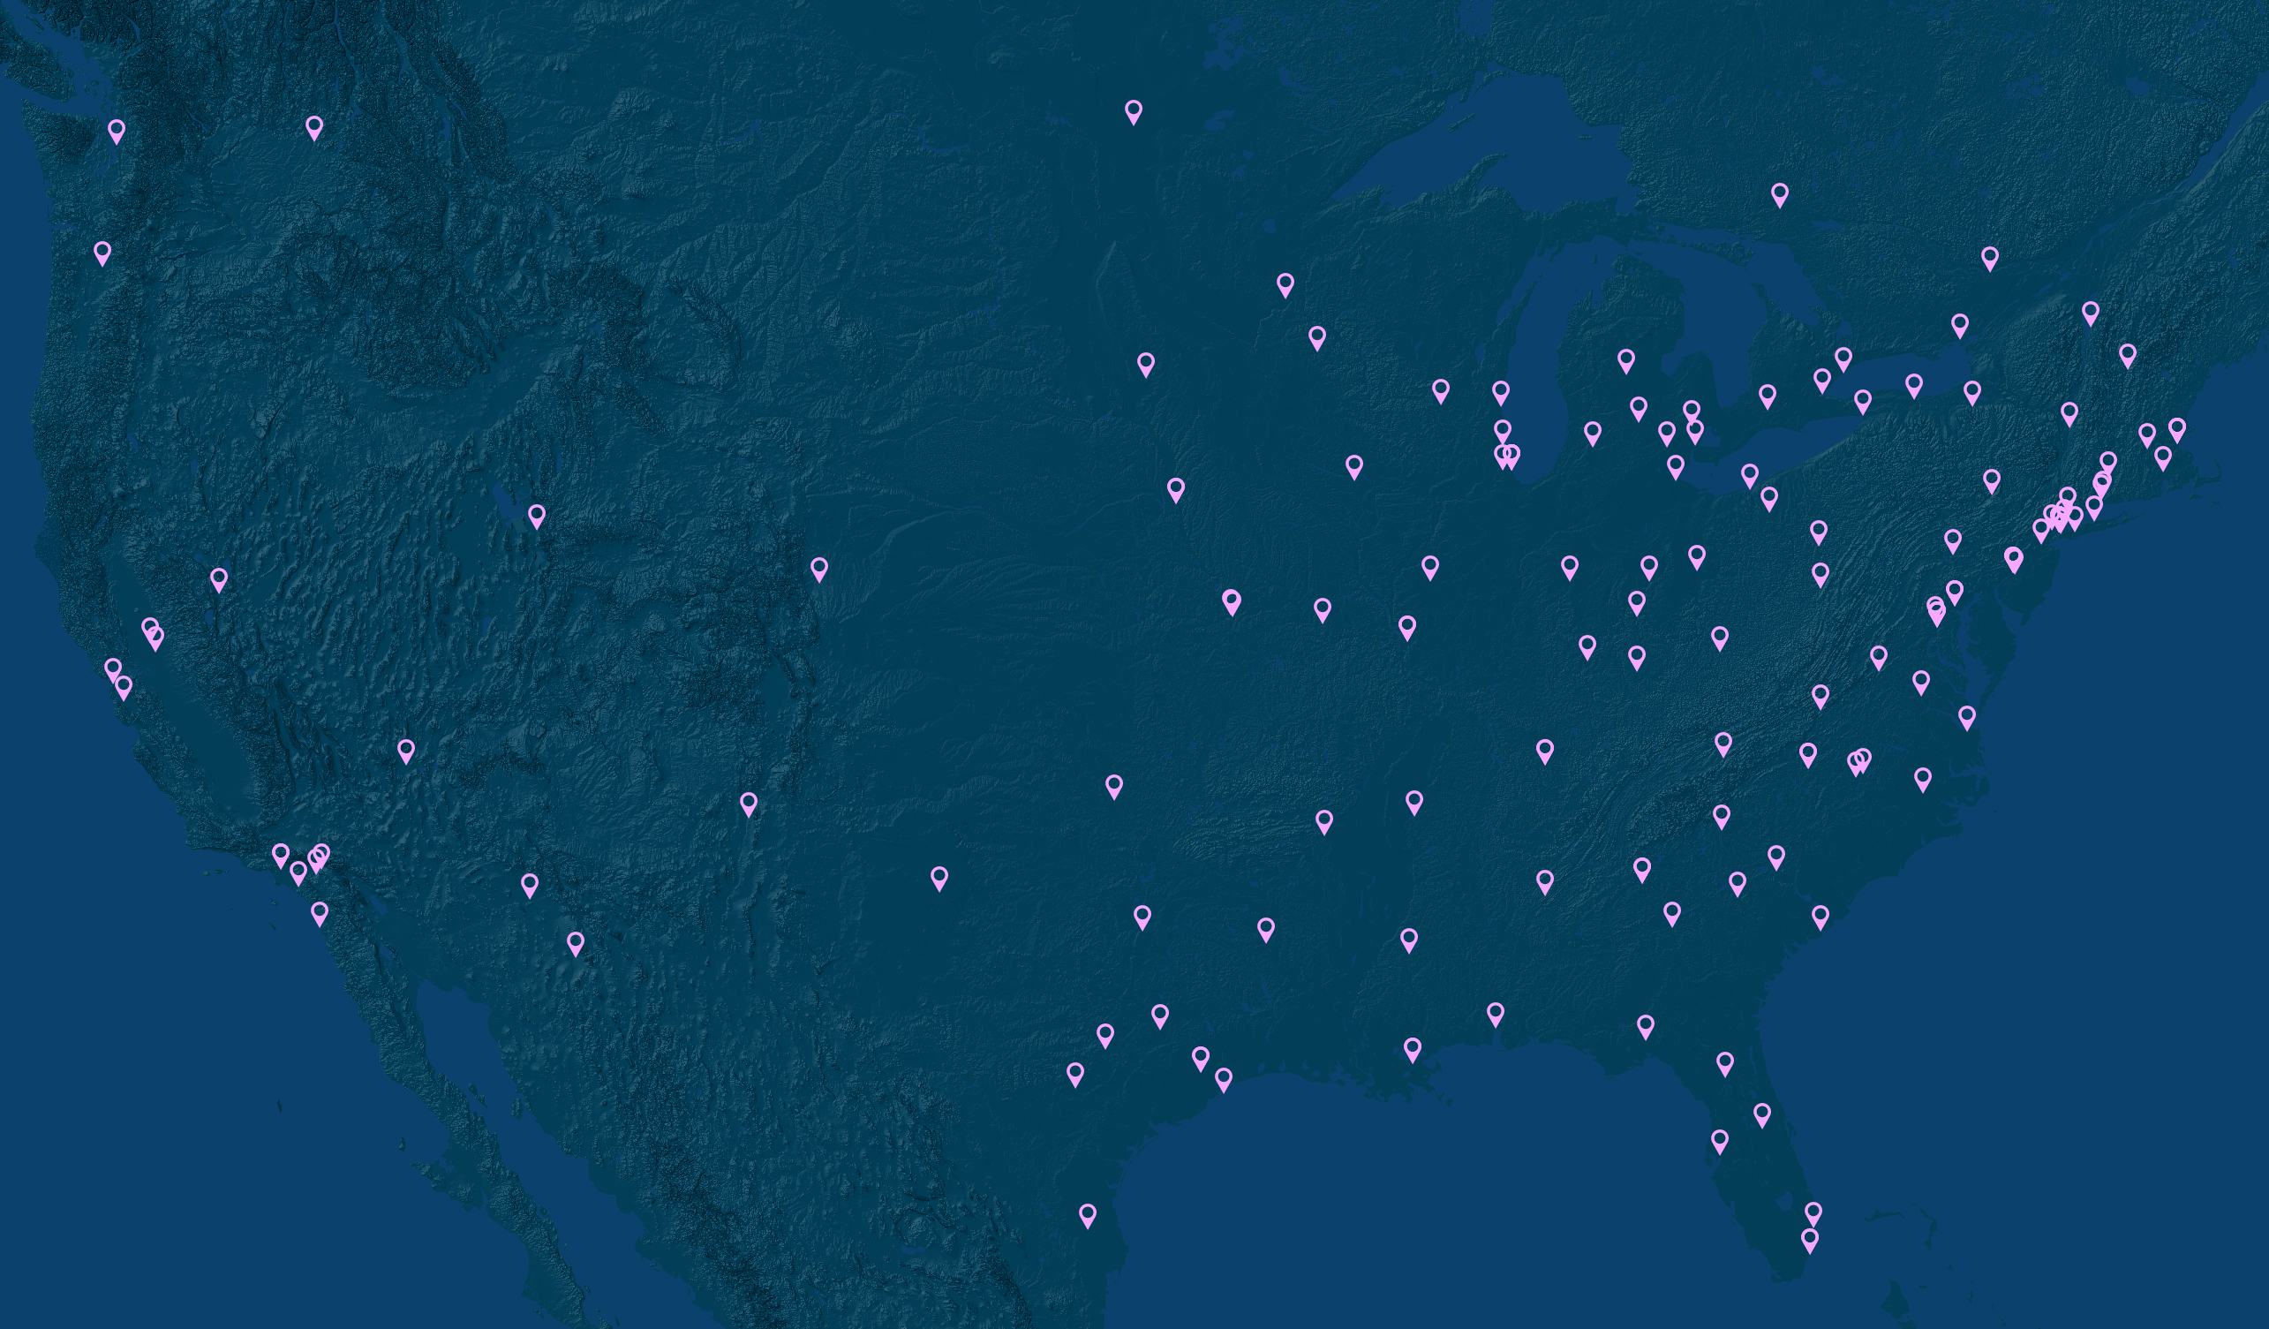

Slide 3
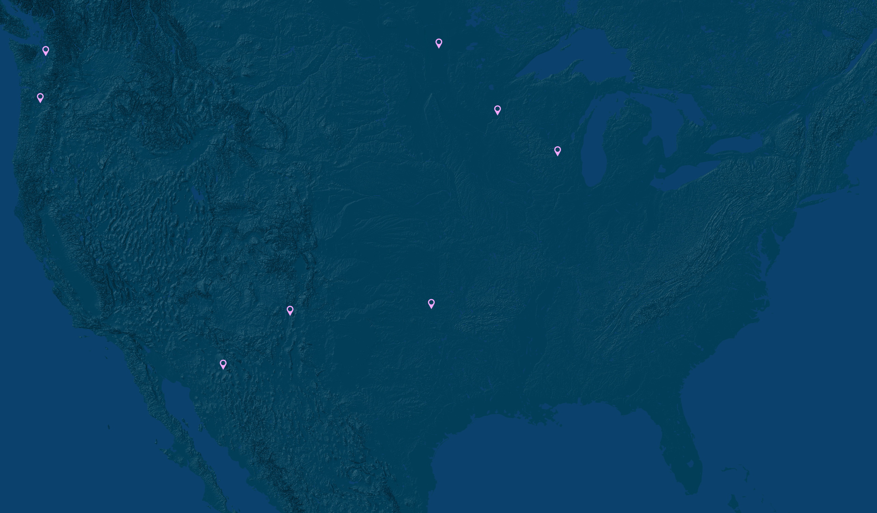

Slide 4
US MEDICAL SCHOOLS WITHOUT AI/AN STUDENTS
AAMC Data Warehouse, October 2018 – Acosta, D. Et Al. Reshaping the Journey: American Indians & Alaska Natives in Medicine

Slide 6
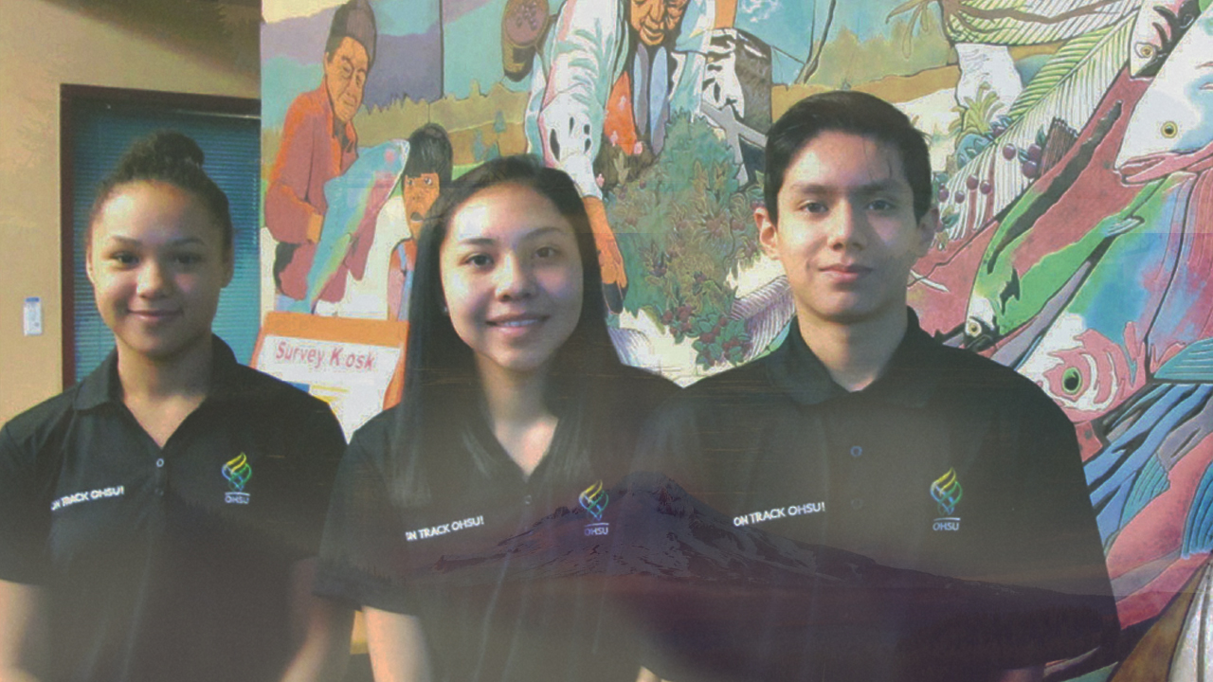
Notes:
3 active tribal sites, up to 5 scholars/site
Expanding to 5 tribal sites this year

Slide 7
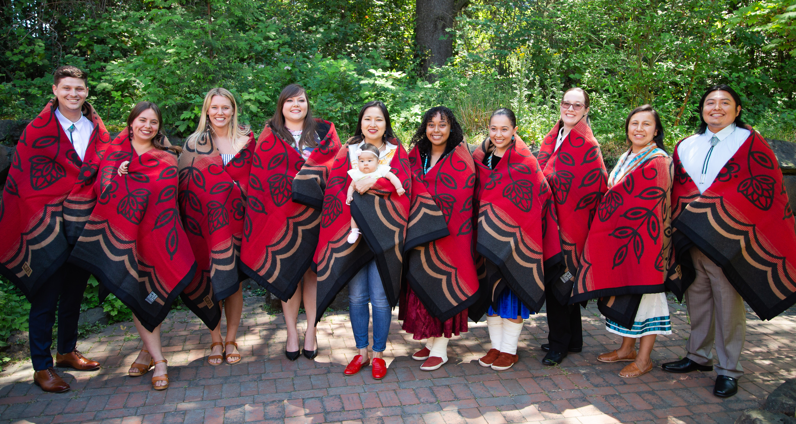
Notes:
Wy’East Academic Enhancement – NEW DAWN – (DECK CHAIRS ON TITANIC)
ONE SCHOOL – OHSU – increase number of AIAN matriculants by over 15% if trends hold
Collectively applied to over 100 medical schools – rejected from ALL OF THEM – now they are future health leaders!

Slide 8
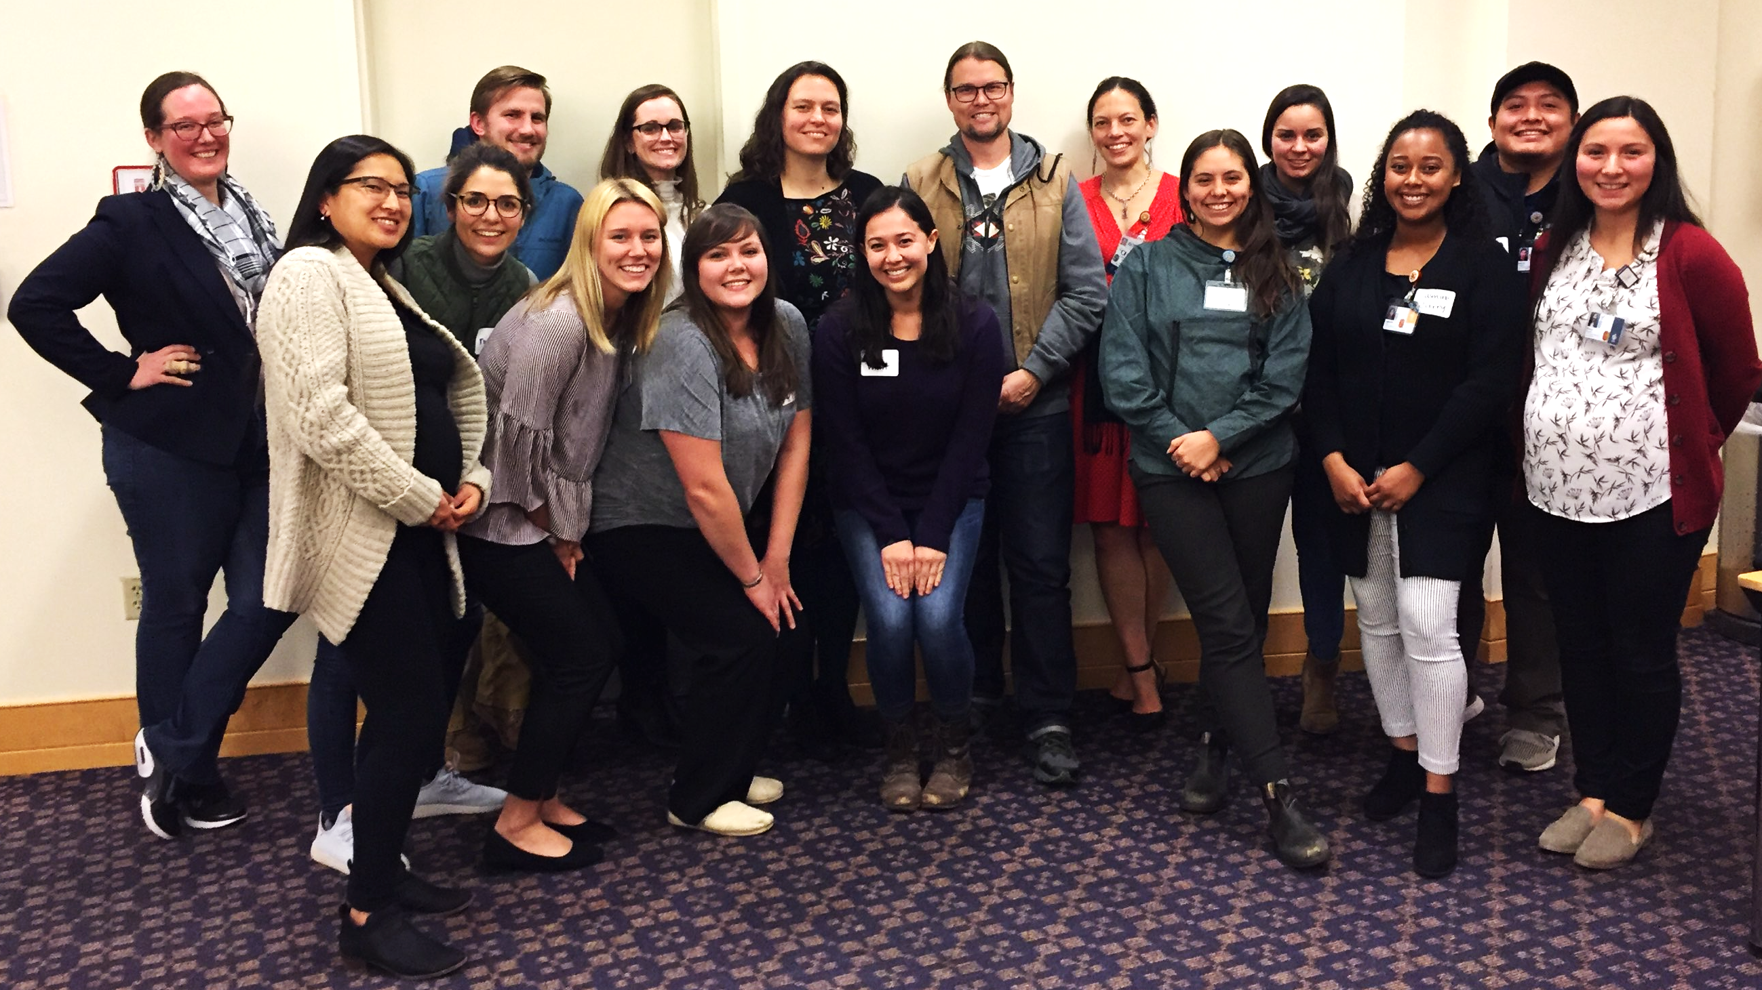
Notes:
AIAN Faculty & Learners at OHSU - +215% faculty & +290% learners in past 5 years

Slide 9
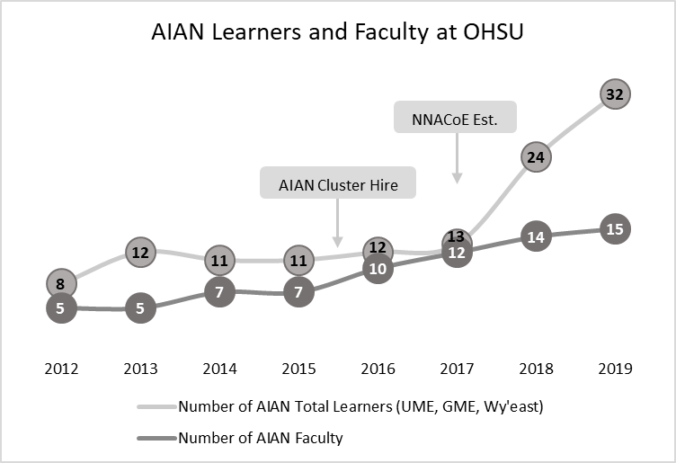
Notes:
215%+ Faculty – 290%+ Learners at OHSU in 5 years

Slide 10
NEW DIRECTIONS
Re-imaging IndianS into MedicinE (RISE)
OHSU + WSU CoM + UC-Davis SoM
COMPADRE Training RURAL & TRIBAL MDs (Portland to Sacramento!)
MISSION ACT expand residency training
Notes:
RISE – OHSU, WSU & UC-Davis – Wy’East & AIAN-specific Summer Academy
COMPADRE – AMA “Reimagining Residency Training” Recipient BIG DEAL & YOU’RE at AMA – PREACH COMPADRE!!!

Slide 11
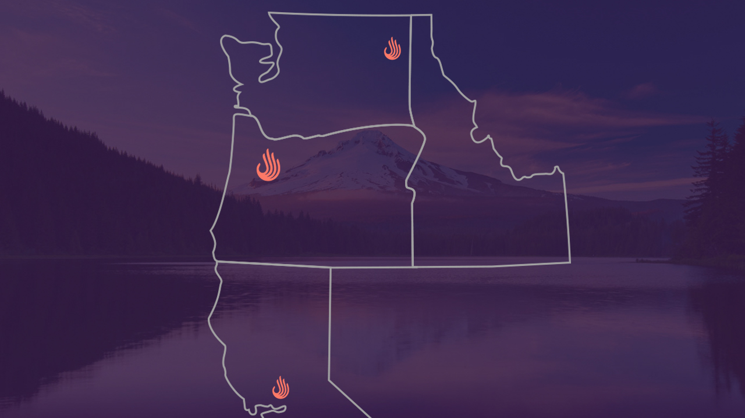

Slide 12
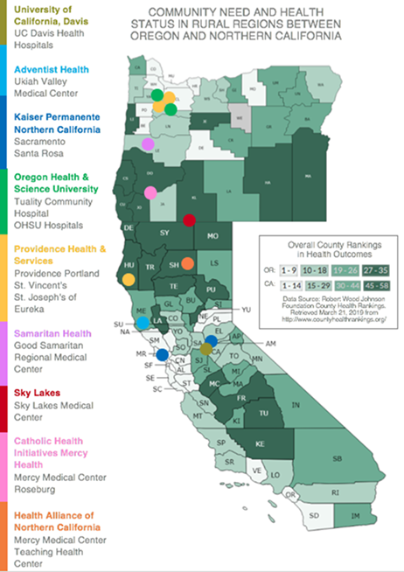
COMPADRE
A robust GME collaborative from Sacramento to Portland to reduce health disparities by transforming the physician workforce – to be better prepared, more equitably distributed and more deeply connected to underserved communities.
10 Health Systems
16 Primary Hospitals
10 GME Sponsors
31 GME Programs
Family Medicine (12)
Internal Medicine (6)
Psychiatry (4)
General Surgery (3)
Pediatrics (2)
EM (2)
OB/GYN (2)

Slide 13
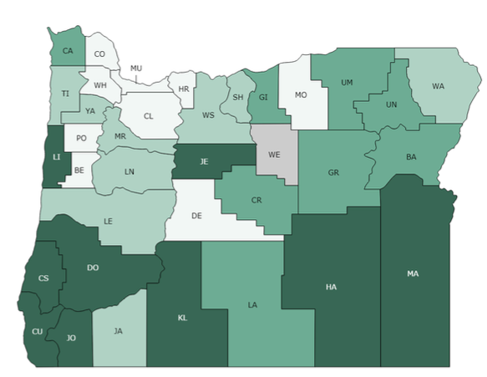
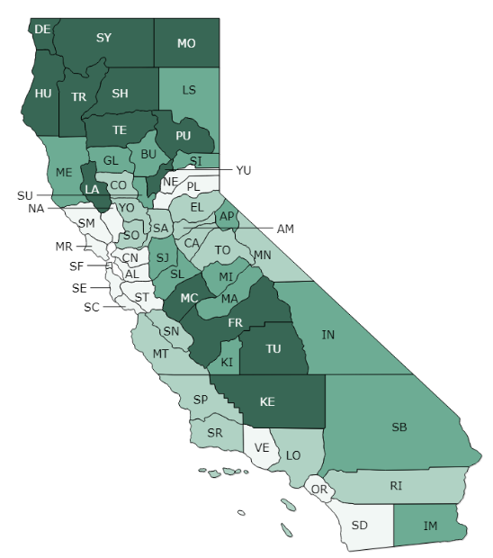
COMMUNITY NEED AND HEALTH STATUS IN RURAL REGIONS BETWEEN OREGON AND NORTHERN CALIFORNIA
Tribe
Confederated Tribes of Coos, Lower Umpqua and Siuslaw
Confederated Tribes of Grand Ronde Community of Oregon
The Klamath Tribes
Confederated Tribes of Siletz Indians
Cow Creek Band of Umpqua Tribe of Indians
Confederated Tribes of Warm Springs Reservation of Oregon
Cowlitz Indian Tribe
Fort Bidwell Paiute Reservation
Redding Rancheria
Toiyabe
Greenville Rancheria
Karuk Tribe
Sonoma County Indian Health Project
Mathiesen Memorial Health Clinic
Pit River
United Indian Health Services, Inc.
Chapa-De Indian Health
Feather River Tribal Health
Hoopa Valley Tribe
Quartz Valley Indian Reservation
Coquille Indian Tribe
Health Centers and Hospitals
University of California, Davis
UC Davis Health Hospitals
Adventist Health
Ukiah Valley
Medical Center
Kaiser Permanente Northern California
Sacramento
Santa Rosa
Oregon Health & Science University
Tuality Community Hospital
OHSU Hospitals
Providence Health & Services
Providence Portland
St. Vincent’s
St. Joseph’s of Eureka
Samaritan Health
Good Samaritan Regional Medical Center
Sky Lakes
Sky Lakes Medical
Center
Catholic Health Initiatives Mercy Health
Mercy Medical Center Roseburg
Health Alliance of Northern California
Teaching Health Center
Dignity Health
Mercy Medical Center
Redding
Overall County Rankings
in Health Outcomes
OR:
CA:
Data Source: Robert Wood Johnson Foundation County Health Rankings. Retrieved March 21, 2019 from http://www.countyhealthrankings.org/
Notes:
60-75% of GME graduates work within 100 miles of training site

Slide 14
Training YOUR future physicians
Share current activities & programs
Complete Tribal Health Workforce Needs Survey
Offer Rotations for learners (UME & GME)
Explore Residency “Tribal Training Tracks”

Slide 15
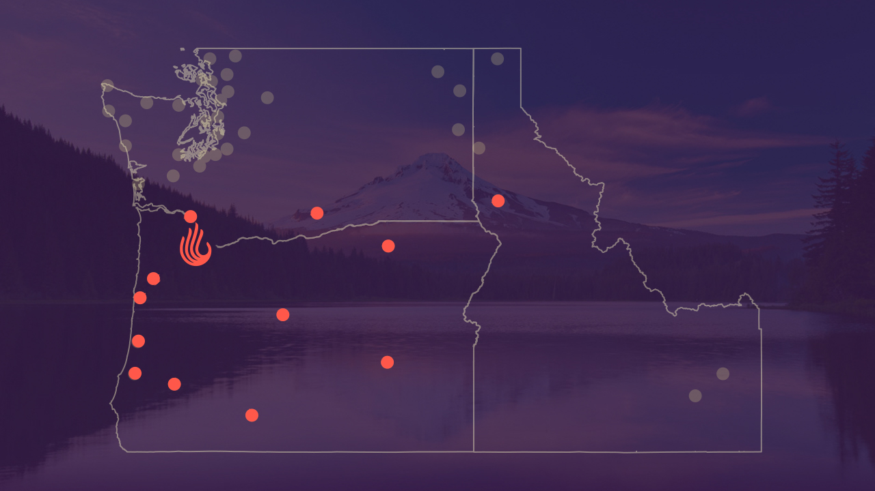

Slide 16
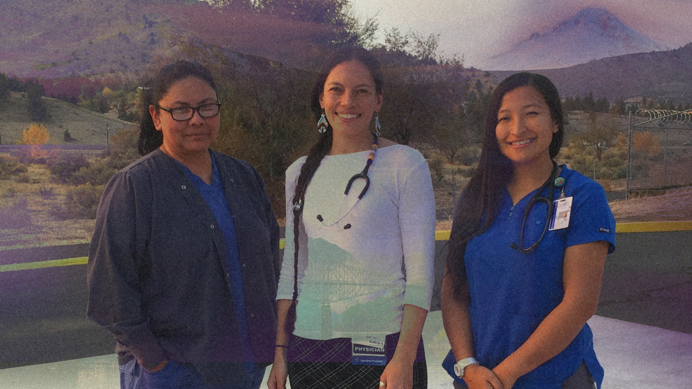

Slide 17
www.NNACOE.org
brodt@ohsu.edu

