Slide 1

Project Update
Improving Data & Enhancing Access
(IDEA-NW) Project
Northwest Tribal Epidemiology Center
Northwest Portland Area Indian Health Board
October 23rd, 2019
Notes:
Picture Source: Marianne Nicolson, Indigenous artist, seeks to explore the deep connection of indigenous art to the land, and the margins at which public access to First Nations artifacts clashes with the preservation of indigenous cultural knowledge.

Slide 2
Visibility through Data
“Closing [economic and health disparity] gaps and addressing program and policy issues is complicated by the invisibility of American Indians and Alaska Natives in their own land.
It is not clear if invisibility results from lack of data or if lack of data leads to invisibility.”
-Michelle Connolly (Blackfeet/Cree) et al, 2019, Statistical Journal of the IAOS 35(1)

Slide 3
Project Goals
Improving Data
  Conduct record linkages to reduce AI/AN misclassification in state datasets
  Work with tribal, state, and federal partners to improve collection of health data for AI/AN communities
Enhancing Access
  Provide NW Tribes with up-to-date health data through data reports, fact sheets, manuscripts, and online dashboards
  Expand EpiCenter access to state and federal data systems
  Provide training and technical assistance to improve utilization of data by Tribes and other partners

Slide 4






Project Support
Current Funding Source: CDC’s Tribal Epidemiology Centers – Public Health Infrastructure Cooperative Agreement (September 2017 – September 2022)
Dr. Chiao-wen Lan
Epidemiologist
Karuna Tirumala
Biostatistician
Joshua Smith
Health Communications/Evaluation Specialist
Heidi Lovejoy
Substance Use Epidemiologist
Sujata Joshi
Project Director
Victoria
Warren-Mears
Principal Investigator

Slide 5
Project Highlight:
Linkages to reduce AI/AN misclassification

Slide 6


AI/AN Misclassification
Misclassification is the incorrect recording of a person’s race in a data or surveillance system.
In the Northwest, AI/AN are often misclassified as White.
Race:
x
White
x
Black
AI/AN

Slide 7

AI/AN Misclassification
Misclassification causes AI/AN to be under-represented in health data, which leads to:
  Inaccurate AI/AN health data
  Artificially lowered disease burden
  Too few AI/AN to calculate stable disease rates and trends
  Incomplete health data for public health decision-making
?
?
?

Slide 8


Record Linkages
Since 1999, NWTEC has been correcting misclassified AI/AN data through record linkages between the Northwest Tribal Registry and state health data systems.
We regularly link with:
Birth and death records
State Cancer Registries
Hospital discharge data
Communicable Disease registries
NTR
Death certificates
Northwest Tribal Registry

Slide 9
Linkages: September 2017 - present
Completed 14 data linkages
Linked with almost 5 million records
Identified and corrected over 19,000 misclassified AI/AN records

Slide 10

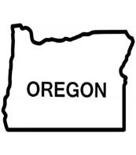

Misclassification Effect on Mortality Rates
Age-adjusted All-cause Mortality Rate
Oregon Residents, 2014-2017
10.4%
increase
10.9%
increase

Slide 11
Misclassification Effect on
Hospitalization Rates
Age-adjusted All-cause Hospitalization Rate
Washington, 2016
45.7%
increase

Slide 12
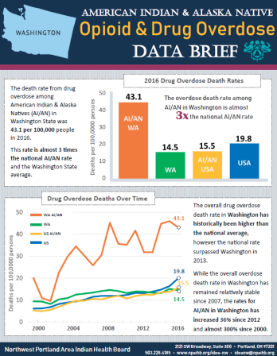
Recent Data Products
Suicide Data fact sheets for ID, OR, WA
Opioid & Drug Overdose data briefs for OR & WA
Regional Mortality Data Report
Planned Data Products:
-Opioid & Drug Overdose data briefs for Idaho and Northwest Region
-Maternal and Child Health data profiles for Idaho, Oregon, Washington
-Updated Cancer Data Fact Sheets

Slide 13
How can we assist?
Data Requests for local, state, or regional data
Technical assistance with:
  Data collection, analysis, interpretation, presentation
  Developing data sharing agreements
  Other data-related issues
Health Data Literacy Trainings
  Overview of core epidemiology concepts
  Information on local/regional sources of data
  Using GIS apps to collect and visualize data
  Using data for policy development

Slide 14




Opioid Data & Surveillance Project

Slide 15


Opioid Data & Surveillance Project
Overview
3-Year grant through the CDC (Centers for Disease Control and Prevention)
Add-on to the TEC-PHI grant
Goal is to improve opioid & drug surveillance among Northwest tribes, and improve tribal access to drug/opioid data

Slide 16
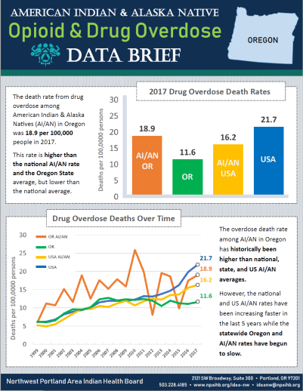
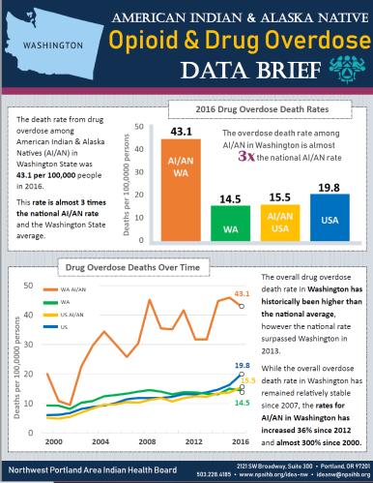
Opioid Data & Surveillance Project
Goals
Produce opioid/substance data reports for AI/AN
Assist NW tribes with opioid/substance data needs
Gain access to additional opioid/substance data sources
Work with partners to address racial misclassification in data systems

Slide 17
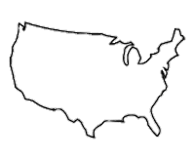



National Drug Overdose Deaths:
Trend Since 1999
21.7
3.6x
Increase
13.1
10.1
6.1
National Public Health Emergency Declared
in 2017
National Age-Adjusted Rates per CDC NCHS Multiple Cause of Death Files 1999-2017 on CDC WONDER Online Database

Slide 18
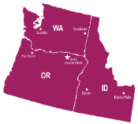
AI/AN Drug Overdose Deaths in the Northwest:
Trend Since 1999
43.1
Washington AI/AN
18.9
Oregon AI/AN
National AI/AN
16.2
National Age-Adjusted Rate per CDC NCHS Multiple Cause of Death Files 1999-2017 on CDC WONDER Online Database; Washington & Oregon Age-Adjusted Rates per State Death Certificates, corrected for AI/AN racial misclassification

Slide 19
Project Accomplishments & Successes
-Planning & Infrastructure-
Hired Epidemiologist focused solely on substance & opioid-related data
Created NPAIHB Opioid Workgroup
  Coordinate across multiple opioid projects at the Board and EpiCenter
Joined Washington State Opioid Response Data Workgroup
  Ensure AI/AN are considered in all stages of the state plan
Established many new & expanded partnerships to support opioid/substance data work
  State/national partners, other TECs, data & program managers, SUD researchers
Contributed to development the Tribal Opioid Strategic Agenda
  Developed specific Data & Surveillance section
    Defines goals in opioid/substance surveillance, data improvement, data dissemination
Identified tools to enhance capacity for tribes to obtain or access opioid data

Slide 20
Project Accomplishments & Successes
-Data Access-
Death certificates for WA, OR, and ID
  Fatal drug overdose analyses almost completed for all three states
  Data Brief Reports completed for WA & OR (visit npaihb.org/idea-nw/)
    Idaho and 3-state regional Data Briefs planned (soon)
    Expanded fatal drug overdose reports planned
Emergency Department (ED) data for WA & OR
  Conducted Washington analyses for overdose-related ER visits
  OR analyses planned
  Reports planned
Other data obtained with analyses to be conducted:
  Hospitalization data for OR and WA
  Washington State Healthy Youth Survey (HYS)
  Idaho Youth Risk Behavior Surveillance System (YRBSS)
  Baltimore HIDTA Overdose Detection Mapping Application Program (ODMAP)

Slide 21
Project Accomplishments & Successes
Identified over 40 additional sources for substance/opioid data
  Prioritizing which sources most useful for NW tribes
Completed 13 requests for opioid/substance data assistance, 6 presentations
Identified multiple datasets with AI/AN racial misclassification errors
  Corrected several datasets so far & run corrected AI/AN overdose statistics
  Plan to link with and correct additional datasets
  Working with states to incorporate and address these issues
AI/AN Race Corrected
Up to 20% underrepresentation
in AI/AN overdose death rate
AI/AN Race Un-Corrected

Slide 22
Upcoming Activities
In progress data sources:
  Oregon Prescription Drug Monitoring Program (PDMP)
  Washington Emergency Medical Services (WEMSIS)
Planned activities for grant year 2
  Explore access to additional data sources
    Idaho ED data
  Create in depth opioid/substance reports for NW AI/AN
  Develop online dashboards to communicate data
  Provide training to tribes on opioid/substance epidemiology
  Continue providing assistance to tribes on opioid/substance data
  Work with medical examiners/coroners to improve race collection on death certificates
  Work with states to develop standards for incorporating corrected AI/AN status information into surveillance systems
  More!

Slide 23



Data Highlight:
Emergency Department (ED) Data
Emergency departments report information about why people visited the ED into a data system
Most states collect this information for many conditions, including drug overdose
  The information available will vary by state
PRO: Unlike most data sources, ED data is reported and available quickly, with almost no time-lag (“real-time”)
CON: It’s a newer system, so can’t look at trends very far back
Note: ED data is also often called:
  Syndromic surveillance
  ESSENCE
  BioSense
  NSSP
  Washington State calls it “RHINO”
  …I don’t know why it has so many names (!)

Slide 24



Washington State:
Emergency Department Visits for Drug Overdose
Jan 2018 – Oct 9, 2019
Race
Sex
(AI/AN)
Age
(AI/AN)
AI/AN
1.6x higher
47.1%
Male
52.9%
Female
AI/AN aged 15-34 experienced the highest rate of drug overdose ED visits
Drug
44% opioid-related
Data Sources: Washington State Department of Health Rapid Health Information NetwOrk (RHINO)

Slide 25

Need Opioid/Drug Data?
Contact me!
Overdose deaths in your county/area
Emergency department visits for overdose in your county/area
Other opioid/drug-related data
Heidi Lovejoy, MSc
Substance Use Epidemiologist
HLovejoy@npaihb.org
(503) 416-3251

Slide 26
Suicide Monitoring and Prevention Planning Project
Chiao-Wen Lan
Epidemiologist
Improving Data & Enhancing Access (IDEA-NW) Project
Northwest Tribal Epidemiology Center
Northwest Portland Area Indian Health Board
October 23rd, 2019
Notes:
Picture Source: Marianne Nicolson, Indigenous artist, seeks to explore the deep connection of indigenous art to the land, and the margins at which public access to First Nations artifacts clashes with the preservation of indigenous cultural knowledge.

Slide 27
BACKGROUND

Slide 28
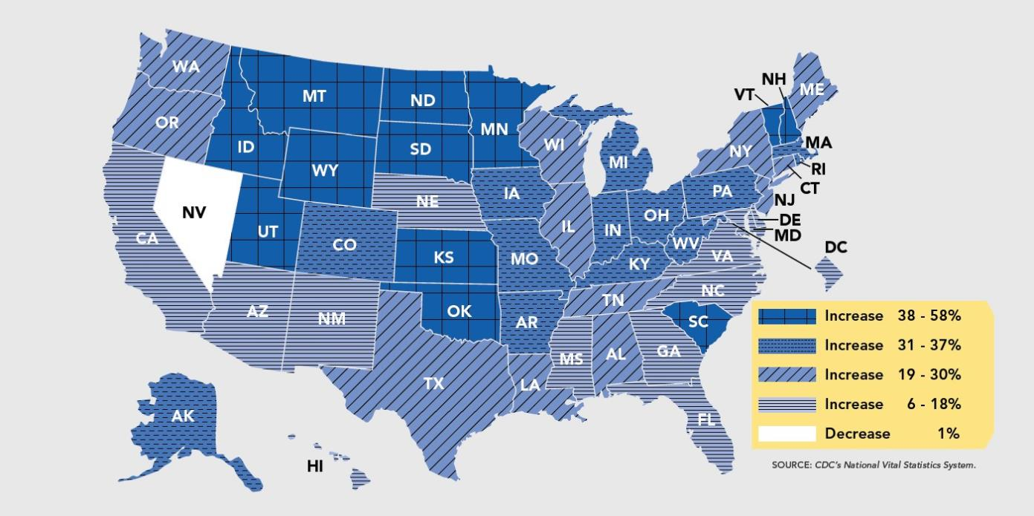
Suicide rates are up nearly 30% since 1999
Notes:
CDC reports that suicide rates are up by 30 percent across the US since 1999
Source: https://www.cdc.gov/vitalsigns/suicide/index.html

Slide 29
Pacific Northwest
  Suicide was the 7th leading cause of death among AI/AN living in Idaho, Oregon, and Washington
  Suicide was the 2nd leading cause of death for Northwest AI/AN between ages 15-44
  Disproportionately affects younger individuals
    Over 75% of AI/AN suicide completion occur before age of 50
    Men had significantly higher suicide rates compared to women
    Firearms were involved in 42.7% of AI/AN suicide deaths
Notes:
In the NW, suicide was the 7th leading causes of death,
And the second leading causes of death among individuals age 15-44.
From the preliminary data we gathered, suicide disproportionately affects younger individuals:
Over 75% of all suicide completion occur before the age of 50;
Men had higher rates than women
And firearms were involved in nearly half of all deaths
(There were 260 AI/AN deaths from suicide between 2008 and 2012 in Idaho, Washington, and Oregon)

Slide 30
NPAIHB
Suicide Monitoring and Prevention Planning Project
Notes:
In respond to the rising suicide rates, the Board launched a pilot project on suicide monitoring and prevention planning.
This funding is provided through the CDC’s Tribal Epi Center Public Health Infrastructure (TEC-PHI) project

Slide 31
  Need for Local Data
Select, adapt, and evaluate suicide prevention programs
Understand scope and impact of suicide on families and community
Identify risk and protective factors
Notes:
Because suicide rates vary among AI/AN populations and regions, gathering local data is key to understanding the unique circumstances surrounding suicidal behaviors in specific tribal communities.
There is no one-size-fits-all approach because each tribe has its own unique history, culture, and tradition.
Understand the nature and extent of its impact to guide strategic planning
Identify community needs (e.g., risk and protective factors) to effective utilize resources
Choose, adapt, and measure the impact of prevention efforts
We are not trying to general and say all Native American communities have high suicide rates. Some tribes have very low suicide rates and some have zero.

Slide 32
THREE PILOT PROJECT GRANTEES
2019
Notes:
Three NW Tribes participated in the pilot project in 2019

Slide 33
  Project Activities
  Form new partnerships and contacts (e.g., local county department of health; local health organizations)
  Strategic planning meetings with partners for suicide data collection and prevention for Northwest Tribes
  Identify suicide-related data indicators, data sources, data collection/sharing methods, and prevention strategies
  Identify resilience factors to prevent suicide
  Develop inventories of existing local sources of suicide-related data and suicide prevention resources
Notes:
Here is a brief summary of the project activities.
During the 8-month project period,
New partnerships were formed, including with local county department of health; local health organizations
Several strategic planning meetings were held at the participating NW Tribes with partners for suicide data collection and prevention in the Tribal communities
Along with the partners, we identified suicide-related data indicators, data sources, data collection/sharing methods, and prevention strategies (some suicide-related risk indicators identified included: bullying and cyber bullying, access to lethal means, misuse of substances, and generations of trauma)
At the same time, we also focused on identifying suicide-related resilient indicators (including cultural connection, coping skills, community support/after school program, family connections, and peer support, just to name a few) In suicide prevention efforts, we also need to focus on the strengths of the communities and what make the communities resilient
During the pilot project phase 1 period, the participating tribes also developed inventories of existing local sources of suicide-related data and suicide prevention resources

Slide 34
  Project Activities Cont’d
  NWTEC provided TA and analyzed suicide-related data to establish baselines
    Death Certificates
    Hospitalizations
    Emergency Department Visits
  Two Data Training Webinars
    NW Tribal suicide surveillance program success story
    HIPAA considerations when sharing information about suicide attempts/behaviors
Notes:
Additionally, as requested by the participating Tribes, NWTEC provided technical assistance and acquired and analyzed suicide-related data to establish baseline. We were able to analyze death certificates, hospital inpatient discharge data from Washington, and emergency department visits.
We also held two data training webinar related to the project goal:
The first webinar session was about the NW tribal suicide surveillance program success story and included examples of flow charts for reporting suicidal behaviors within a community, and how reporting systems are different from referral systems.
The second webinar was a discussion and Q&A about HIPPA concerns related to sharing information about suicide attempts/behaviors.

Slide 35
  What’s Next?
  Implementation Phase (Phase 2) FOA will be released so that Phase 1 participating Tribes can implement the data collection and response plans developed during Phase 1
  Tribal strategic plan for data collection and suicide prevention
  Tribal council approvals for strategic plan
  Data sharing agreements
  Local data collection
Notes:
Tribes who successfully developed a community or clinic-level strategic plan for suicide prevention, which includes plans for data collection and monitoring and plans for linking at-risk individuals to care
Obtain tribal council support and/or approvals for implementing data collection and prevention plans
Develop data sharing agreements, memorandums of agreement, or other documents to facilitate the sharing of information on suicide risk, attempts, ideation, or completions across departments or agencies

Slide 36

“Suicide surveillance requires communication and is a form of preservation of our cultural & people”
- Tribal respondent from Garrett Lee Smith grantee
Notes:
Garrett Lee Smith Tribal Youth Suicide Prevention Grant was funded by SAMHSA
We hear of the risk factors and the negative health outcomes, but it’s so important to change the paradigm and talk about the strengths in the communities and think about the “connectedness” as a protective factor.
Background Art Credit: Christi Belcourt (Métis),The Wisdom of the Universe (detail), 2014, acrylic on canvas; Art

Slide 37
Contact
Please contact us for:
Data and resources related to suicide and suicide prevention
Other tribal suicide surveillance program success stories
Sujata Joshi
sjoshi@npaihb.org
Project Director
Chiao-Wen Lan
chiaowenlan@npaihb.org
Epidemiologist

Slide 38
Project Update
IDEA – NW
Communication Changes
Northwest Tribal Epidemiology Center
Northwest Portland Area Indian Health Board
October 23rd, 2019
Notes:
Picture Source: Marianne Nicolson, Indigenous artist, seeks to explore the deep connection of indigenous art to the land, and the margins at which public access to First Nations artifacts clashes with the preservation of indigenous cultural knowledge.

Slide 39
Current Issues
We have amazing data but have had limited capacity to share those results with tribes

Slide 40
Lets Explore the Past
Community Health Profiles
Could be well over 250 pages for each state
Very resource intensive
Short period of relevance
Limited audience
Reports
Similar problems as above, but to a lesser degree

Slide 41
What are we going to do about it?
We are currently still trying to figure that out
Pros:
We could still use any feedback you want to share
Our changes will address underlying issues
New products will be just what you need
Cons:
It will take time to see change

Slide 42
Issue:
We have amazing data but have had limited capacity to share those results with tribes
Actions:
Explore user-friendly platforms
  E.g., Piktochart
Streamline our data products
  E.g., change mediums, expand audiences

Slide 43
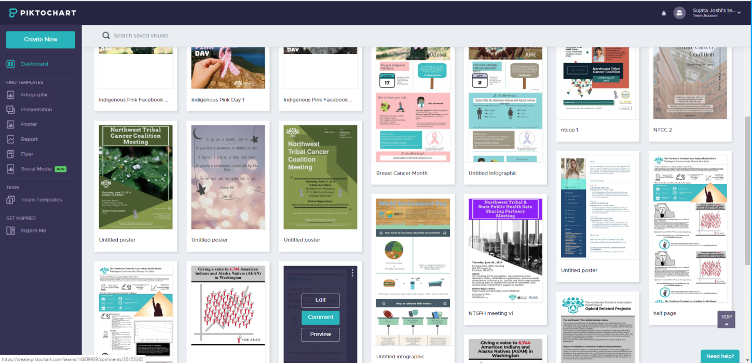
Explore User-Friendly Platforms

Slide 44
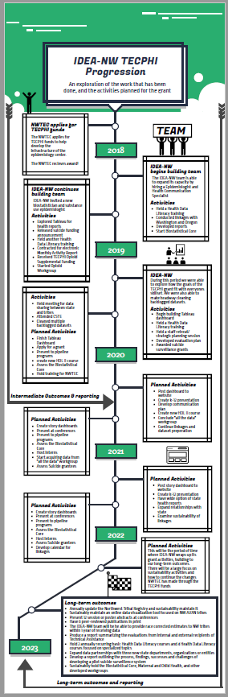

Explore User-Friendly Platforms

Slide 45
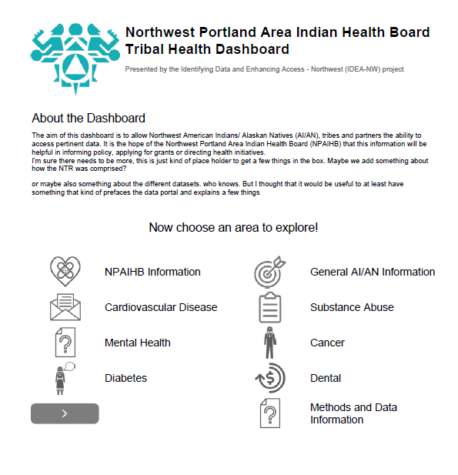
Streamline Data Products

Slide 46
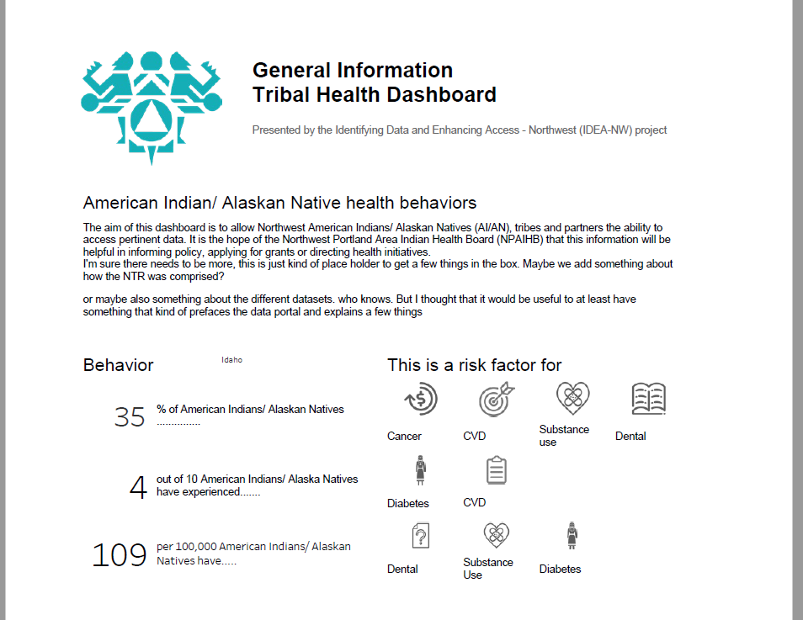
Streamline Data Products

Slide 47
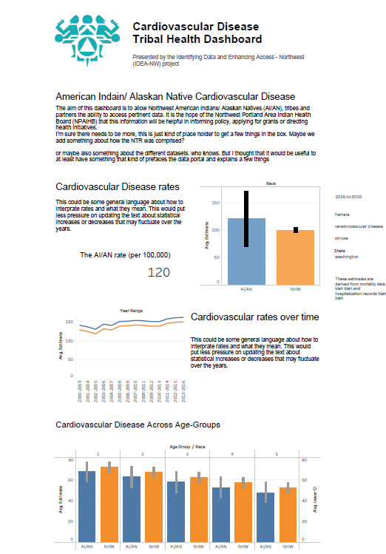
Streamline Data Products

Slide 48
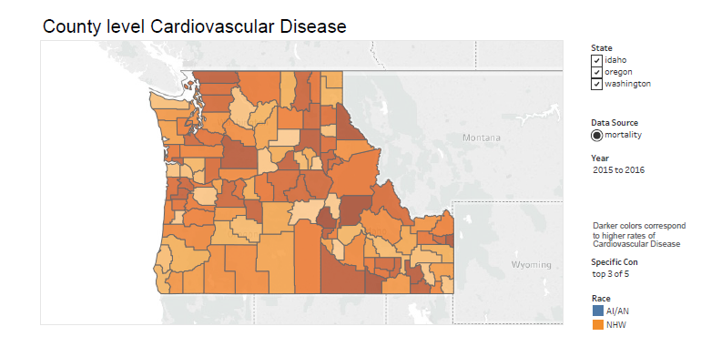
Streamline Data Products

Slide 49
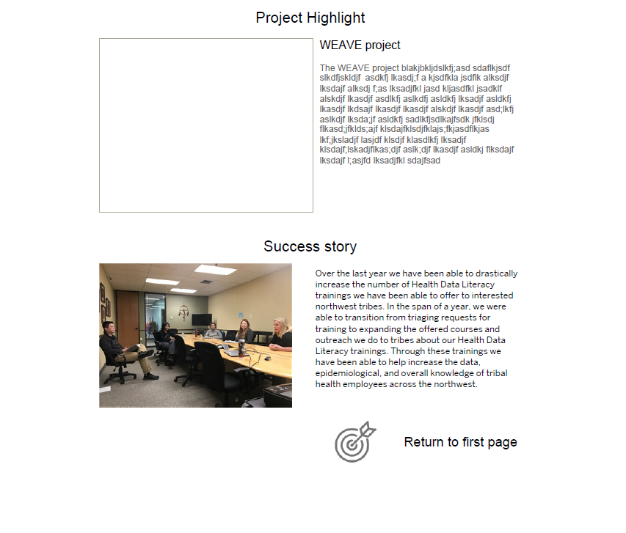
Streamline Data Products

Slide 50
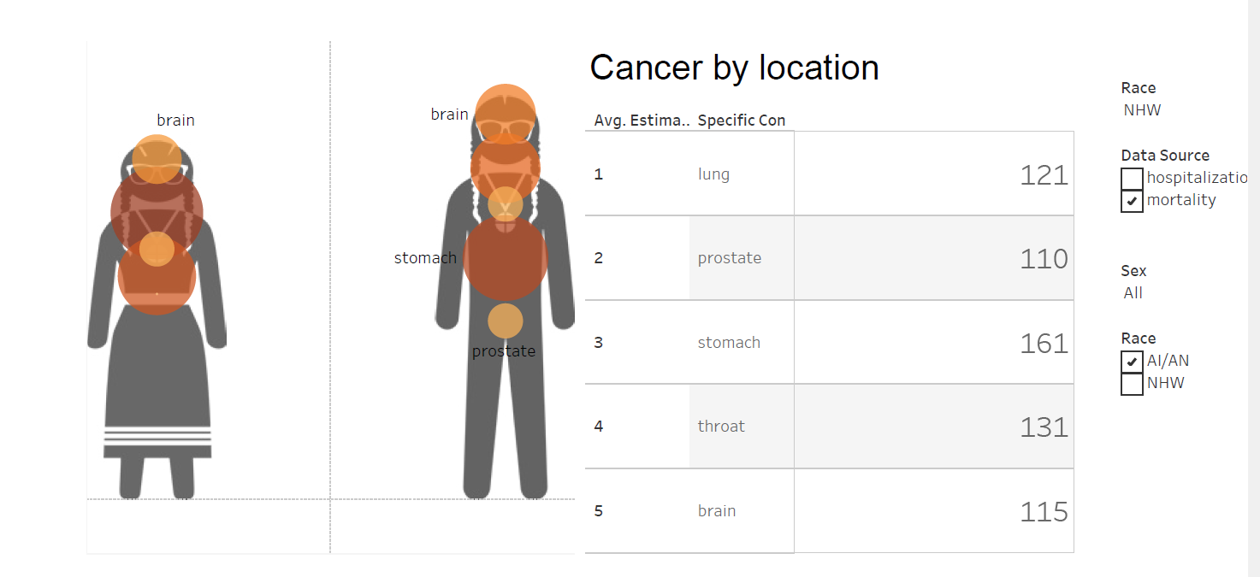
Streamline Data Products

Slide 51
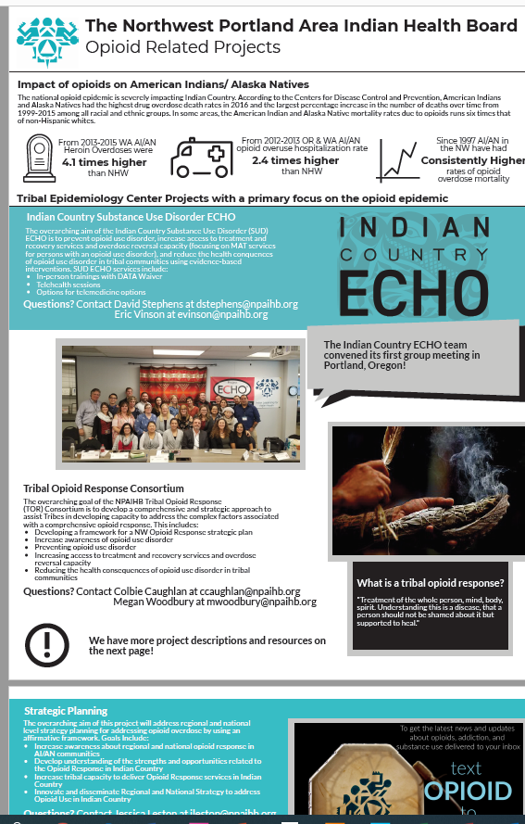
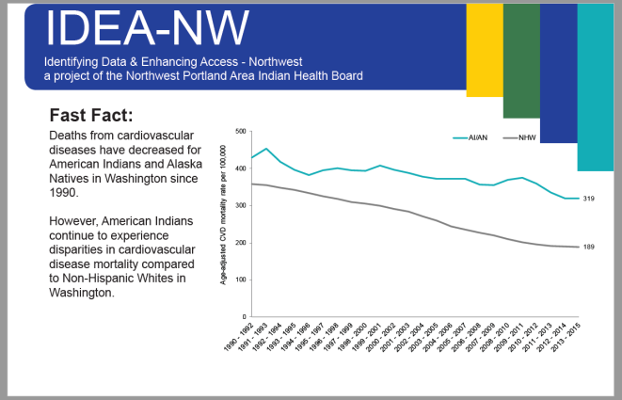
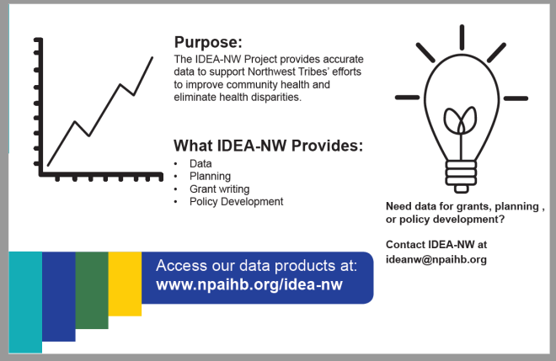
Streamline Data Products

Slide 52
Thank you!
We are nothing without the people we serve
We look forward to innovating the way we meet your data needs
We would appreciate any feedback you would share
  Especially those handy surveys we passed out earlier

Slide 53





Contact
Chiao-wen Lan
chaiowenlan@npaihb.org
Karuna Tirumala
ktirumala@npaihb.org
Joshua Smith
jsmith@npaihb.org
Heidi Lovejoy
hlovejoy@npaihb.org
Sujata Joshi
sjoshi@npaihb.org
Visit our website for data reports and linkage resources:
http://www.npaihb.org/ideanw

