Slide 1
Telling Our Stories
The Good Health and Wellness in Indian Country StoryMap
April 27, 2018

Slide 2
Welcome! Let us begin in a good way…
Notes:
Mandatory Slide
Thank you for welcoming us to the land of the Multnomah.

Slide 3
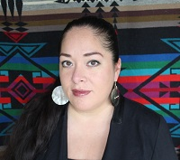
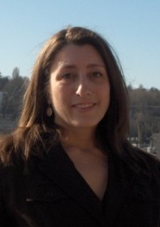

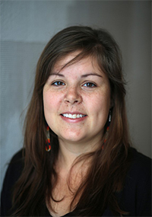

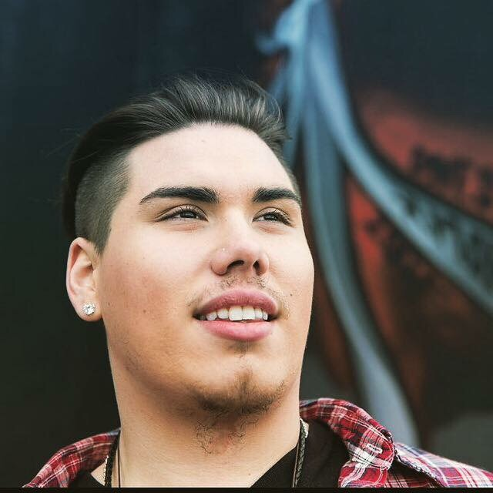
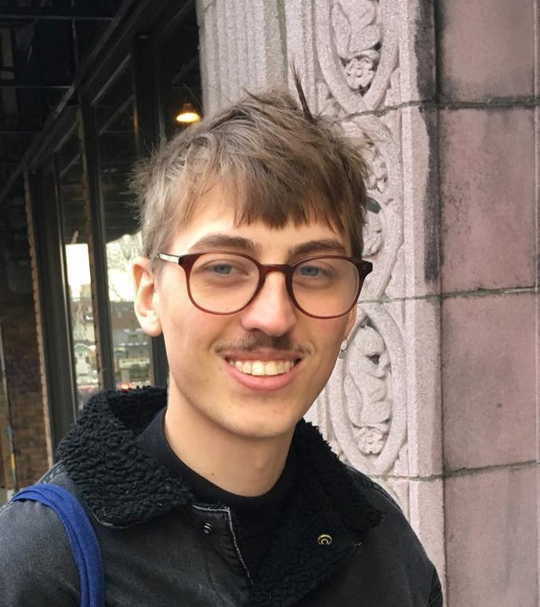
Rose James, PhD
Director, Research & Evaluation
UIHI Good Health and Wellness Team
Abigail Echo-Hawk, MA
UIHI Director
Kelsey Liu, MPH
Program Manager
Francesca Murnan, MPA
Program Manager
Colin Gerber, MPH
Epidemiologist I
Thomas Lawrence, BA
Program Manager
Gunnar Colleen, BA
Project Associate
Notes:
These are the UIHI staff who have contributed to the Story Map

Slide 4
Learning Objectives
Name the four core principles of Indigenous Evaluation
Demonstrate the use of technologies as continuing indigenous methods of storytelling
Tell the story of the Story Map
Notes:
Mandatory Slide

Slide 5

Who is the Urban Indian Health Institute?
One of 12 Tribal Epidemiology Centers (TECs)
Serving Urban American Indians and Alaska Natives (AI/AN) since 2000
Supports the Urban Indian Health Network
  62 organizations including Urban Indian Health Programs and urban Indian social and health service organizations
UIHI serves to improve the health of AI/AN by:
  Identifying & understanding health disparities and resiliency
  Strengthening public health capacity
  Disease surveillance and disease prevention
  Health promotion and disease prevention grounded in indigenous methodologies
Notes:
Mandatory Slide. All TECs partner with local Tribes and communities to improve health and well-being through culturally-competent approaches to disease control and prevention. TECs often coordinate between Tribes, the Indian Health Service, other federal agencies, state governments, and academic institutions.
UIHI started in 2001. UIHI is the one TEC tasked with serving urban AI/AN all over the country. 70% of AI/AN live in urban areas. The other TECS serve tribes in their specific IHS Region.

Slide 6
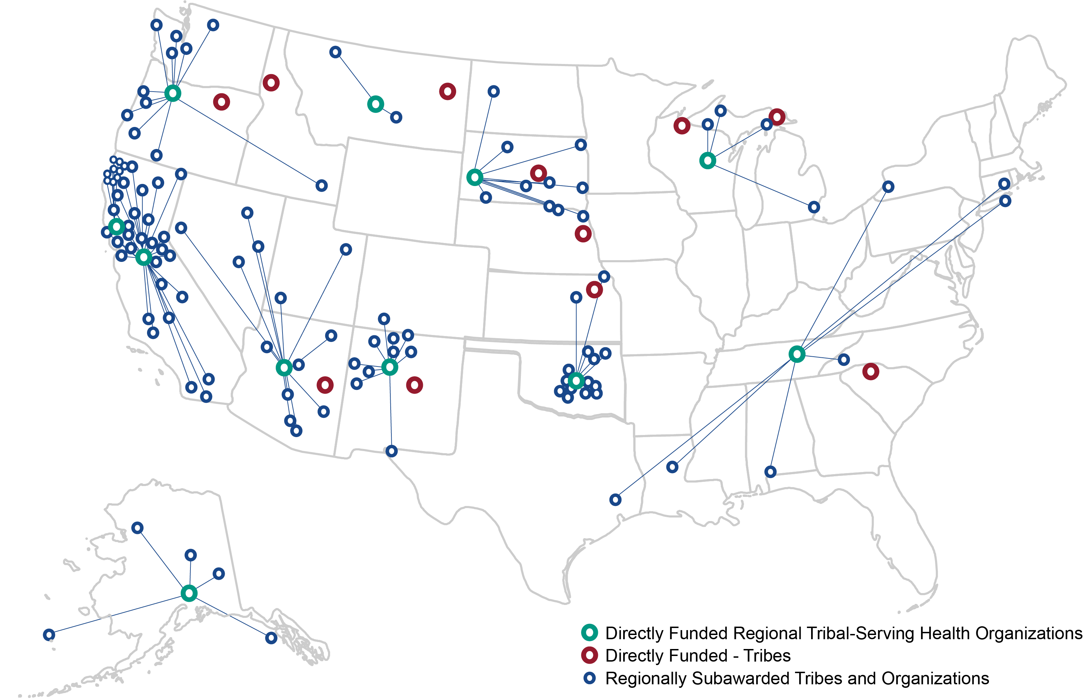
Good Health & Wellness in Indian Country
Notes:
Single largest investment to date by CDC in Indian Country
5-year, $16 million chronic disease prevention program funded by four CDC divisions:
Office on Smoking and Health
Division of Diabetes Translation
Division for Heart Disease and Stroke Prevention
Division of Nutrition, Physical Activity, and Obesity
This map is to show the full scale of this initiative. UIHI serves as National Evaluation Coordinating Center to:
12 tribal nations under Component 1
11 tribal organizations under Component 2
100+ additional tribal and tribal organization subawardees under Component 2
Grantees focus on implementing policy, systems, and environmental improvements for chronic disease prevention. Overall key areas include: diabetes, physical activity, nutrition, commercial tobacco prevention, health systems strengthening, and epidemiology and surveillance.

Slide 7
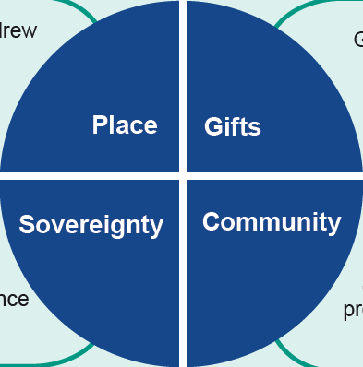
What is “Indigenous Evaluation”?
LaFrance, J., & Nichols, R. (2009). Indigenous evaluation framework: Telling our story in our place and time. Written for the American Indian Higher Education Consortium.
Notes:
The Indigenous Evaluation Framework is a specific approach to evaluation in and with indigenous peoples, described in the book “Indigenous Evaluation Framework: Telling Our Story in Our Place and Time” by Joan LaFrance and Richard Nichols. These are the four core values which drive the GHWIC evaluation.
Place: Situate programs by describing their relationship to the community and the land, including its history. What occurs in one place may not be easily transferred elsewhere
Gifts: Look to strengths and use a holistic approach to assessing merit or value. Acknowledge different means of expression and use multiple methods to gather a story. Respect the cultural/traditional knowledge and expertise of communities in the design & implementation of an evaluation
Community: The community & family are central and must be engaged when planning and implementing an evaluation. Make processes transparent and understand that programs may focus on restoring community health and well-being in addition to individual achievement
Sovereignty: Follow tribally-approved processes to build capacity in the community. Report findings in ways meaningful to the community
**The next iteration of GHWIC will include 14 awards to UIHPs. We will ensure this framework will adapt to the unique needs of urban Indian-serving programs.

Slide 8
Why the GHWIC Story Map?
We wanted to make something useful to the communities
Evaluation reports not accessible to everyone
Grantees wanted an easier way to learn from each other
UIHI wanted a more flexible, accessible medium of disseminating GHWIC progress
Notes:
Not everyone wants to read a 20 page report

Slide 9

The GHWIC Interactive Story Map
Uses free ArcGIS Story Map technology to showcase grantee program progress and success
Interactive online platform supports multiple mediums (photo, video, audio, text, etc.)
Innovative platform uses unfiltered grantee-created content to highlight successes
Notes:
Tech is free
Platform is flexible and interactive. Almost any medium can be used
To our knowledge, this kind of evaluation reporting has never been done before
After this slide, tab out to map.
Key highlights:
Alaska NTHC: Show embedded video. ANTHC partnered with the Play Every Day campaign to create and distribute resources and tools inspired by and relevant to Alaskan Native people
Yavapai-Apache: Sub-awardee garden revitalization. Worked collaboratively w/ tribal gov’ts and external partners to build 30 boxes. Shared info and cooking classes on traditional Yavapai-Apache foods.
Albuquerque: Works w/ the Southwest Tribal Tobacco Coalition on commercial tobacco prevention and control. Resources include: Keep Tobacco Sacred toolkit – eguide for tribal communities in the Southwest to help implement commercial tobacco cessation & prevention, and a comic book for youth.

Slide 10
Key Points
The Story Map technology combines evaluation and storytelling practices to share local successes and demonstrate national impact
Communities find it helpful, informative; the funder too
Interactive and self-directed
Story Map iterates and evolves as the work progresses
Notes:
In seeking to be of service to these communities, we created a tool that bridges the needs between grantees, the funder, and the evaluators. Several UIHI interns helped get this project off the ground as well, part of building a public health workforce attuned to working in Indian Country
Users can explore at their own pace and are not constrained to a traditional report format
Once the grant ends, it can serve as a repository for the grant’s history.

Slide 11
This is Indigenous Evaluation
Living, evolving, ever-changing
Notes:
The most important takeaway: This is Indigenous evaluation.
Communities tell their stories in their voice, in a way that is meaningful to them.
Communities use these stories to reflect on their programs and practices to improve the health and well being of their people.

Slide 12
UIHI thanks all grantee partners for their work and contributions to the Good Health & Wellness in Indian Country program (DP14-1421PPHF14)
Thank you!
Questions?

