Slide 1

Trauma and Drama: Responding to Trauma in Care
  Danica Love Brown, PhD, MSW, CACIII
  Choctaw Nation of Oklahoma
  Behavioral Health Programs Director the NPAIHB

Slide 2
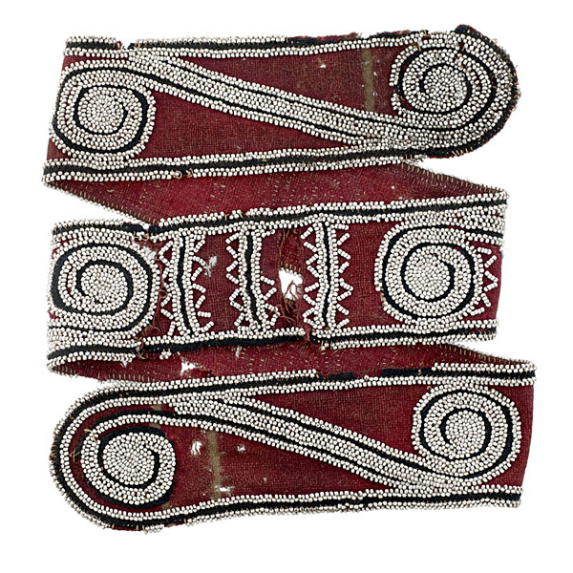
Objectives
Participants will be able to define Indigenous Trauma Care
Participants will be able to connect histories of trauma and health outcomes
Participants will be able to identify skills that are effective in mitigating the impact of trauma and substance use disorders

Slide 3
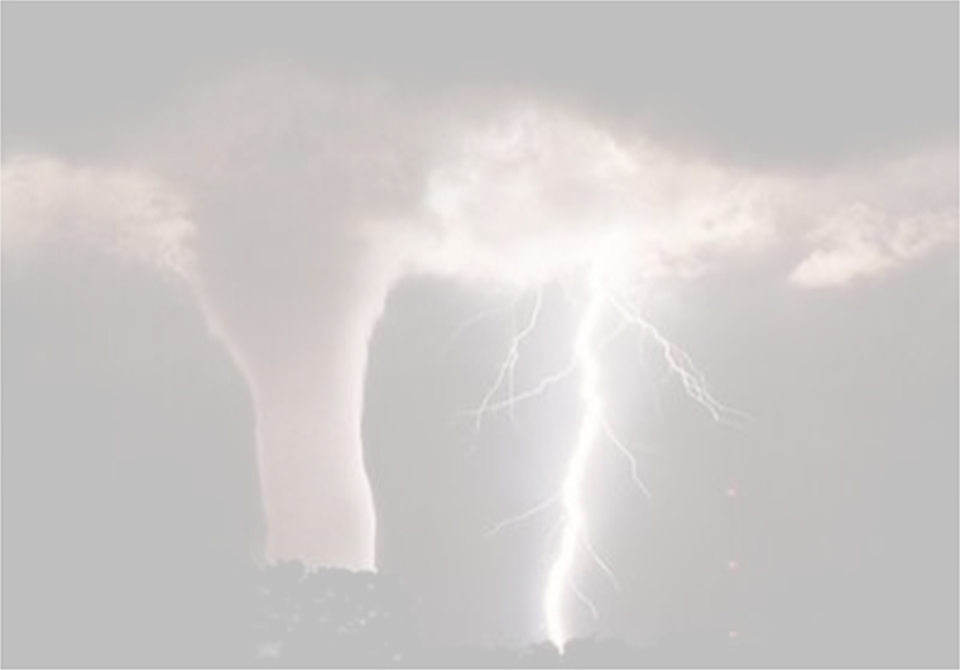
What is trauma?
“Using trauma terminology implies that the individual is responsible for the response, rather than the broader systemic force caused by the state’s abuse of power”
Linklater, 2014
Notes:
The source and type of trauma dictate its impact and magnitude
Lived memory, reliving the memory
AOD use/dependence
Treatment is difficult
Pervasive and ongoing attacks and slights associated with one’s identity
As assessment of trauma should be made in light of the client’s cultural life history and ethnic back ground

Slide 4

Types of trauma
Acute trauma
Repetitive trauma
Complex trauma
Developmental trauma
Vicarious trauma
Cultural, Historical Intergenerational
Notes:
Complex trauma describes both children’s exposure to multiple traumatic events—often of an invasive, interpersonal nature—and the wide-ranging, long-term effects of this exposure. These events are severe and pervasive, such as abuse or profound neglect. They usually occur early in life and can disrupt many aspects of the child’s development and the formation of a sense of self. Since these events often occur with a caregiver, they interfere with the child’s ability to form a secure attachment. Many aspects of a child’s healthy physical and mental development rely on this primary source of safety and stability.
Developmental Trauma is a term used in the literature to describe childhood trauma such as chronic abuse, neglect or other harsh adversity in their own homes.
Vicarious trauma is the emotional residue of exposure that counselors have from working with people as they are hearing their trauma stories and become witnesses to the pain, fear, and terror that trauma survivors have endured. It is important not to confuse vicarious trauma with “burnout”.

Slide 5
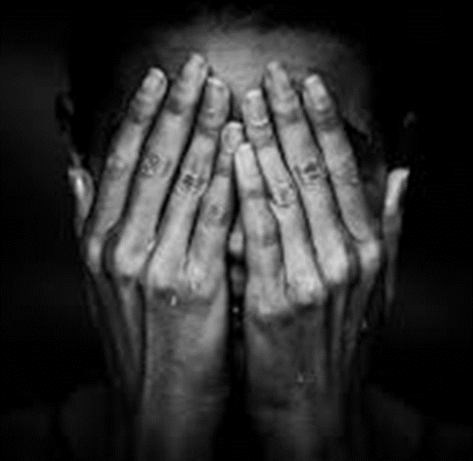
Vicarious Trauma
Is the emotional residue of exposure that counselors have from working with people as they are hearing their trauma stories and become witnesses to the pain, fear, and terror that trauma survivors have endured.
Notes:
Care workers have sympathetic response to those we serve, (yawn yawn), breath, voice caring place
It is important not to confuse vicarious trauma with “burnout”.

Slide 6

Historical Trauma
Historical trauma - Cumulative emotional and psychological wounding from massive group trauma across generations, including lifespan.
(Brave Heart, 2004)
Notes:
Historical trauma results from the long-term effects of the oppressive traumatizing policies, attitudes, and beliefs of the colonizer towards AI; the lack of resources and opportunities for AI; and current treatment of AI in this country. Brave Heart Yellow Horse (2004) defines historical trauma as “…cumulative emotional and psychological wounding over the lifespan and across generations, emanating from massive group trauma” (pg. 4), and Duran (2006) refers to this a “soul wounding.” These “soul wounding” symptoms of historical loss are interconnected; each one affecting the other to varying degrees. Historical trauma “can often produce complex and profound individual and collective bio-psycho-social-cultural-spiritual responses” related to significant health disparities (Beltrán & Begun, 2014, pg. 160). There is a direct connection between colonization to the effects of historical trauma - depression, substance abuse, and suicidal ideation and other health risk factors. The negative impact of broad social factors that have been influenced by colonization, such as racism, acculturation, poverty, are translated into everyday physical and emotional distress experienced by American Indian’s. This trauma is epigenetically transferred from generation to generation and is expressed in many ways that are connected to the disproportionate rates of poverty, chronic physical and mental health issues, mortality rates, and substance abuse/dependency rates.
Historical trauma response (HTR) is a constellation of features in reaction to massive group trauma, includes historical unresolved grief (similar to Child of Survivors Complex re: Jewish Holocaust survivors and descendants, Japanese American internment camp survivors and descendants)
There is some evidence of an epigenetic transfer of the trauma. Trauma can be passed down to offspring due to epigenetic changes in DNA. But positive experiences seem able to correct that. ... In recent years researchers have learned that trauma can be inherited—passed down due to changes in DNA, what's known as epigenetics.
Severe stress doesn’t just affect one generation: it is passed down, both socially — affecting parenting — and physiologically, by actually changing how children’s genes are read, which can alter both brain and body, a phenomenon known as epigenetics.
Trauma can be passed down to offspring due to epigenetic changes in DNA. But positive experiences seem able to correct that. ... In recent years researchers have learned that trauma can be inherited—passed down due to changes in DNA, what's known as epigenetics.

Slide 7
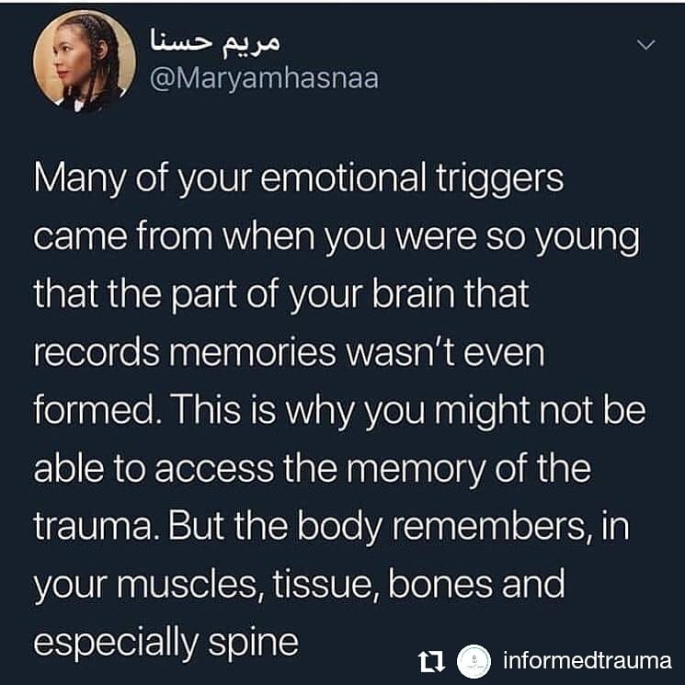
Notes:
Trauma is stored in the limbic system which is not connected to language
Memory is stored in the cerebral cortex with language
Bring the limbic system back to health communicating with the cerebral cortex

Slide 8

Our bodies are designed to remember danger
Each of us begins to maintain a database of threats in the environment.

Slide 9
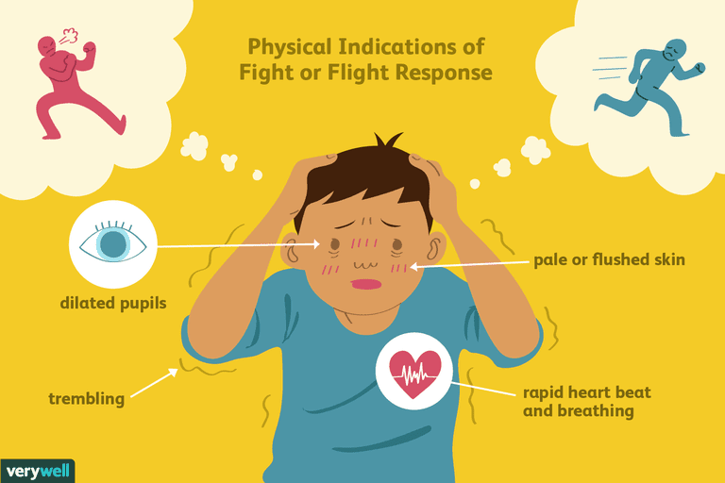
ANCIENT SURVIVAL RESPONSES
TO LIFE THREATENING CIRCUMSTANCES
Bracha, H. (2004). Freeze, flight, fight, fright, faint: Adaptationist perspectives on the acute stress response system. CNS Spectrums, 9(9), 679-685.
Notes:
Fight can be seen as anger, anxiety and adrenaline rushes. Being short with people and ourselves.
Flight can be seen as overexcitement and anger. Focusing on work and other activities.
Freeze can been seen as depression, sadness and ambivalence. Not able to focus on anything, executive functioning is compromised.
Fawn-In a nutshell, “fawning” is the use of people-pleasing to diffuse conflict, feel more secure in relationships, and earn the approval of others. It's a maladaptive way of creating safety in our connections with others by essentially mirroring the imagined expectations and desires of other people.
During a pandemic: As we gather new information, all the time and constantly, the limbic system again decides we are in danger and cycles through the fight, flight freeze options. As providers we are both expected to gather data and interpretive this data for our communities. This "Infodemic" is also contributing to our trauma experience and it is hard to get away from all the information that is out there right now.
Trauma and fear create detachment, and the antidote is attachment and connection, in this pandemic we are asked to social distance, which then impacts our ability to stabilize in crisis. Which then impacts the trauma response. It’s a vicious cycle.

Slide 10
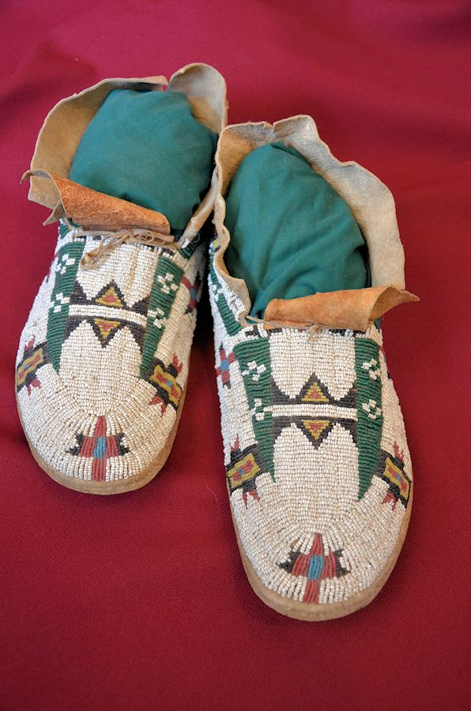
Social effects of trauma
All of these conditions are correlated with stress in children that manifests as brain damage
Poverty
Violence
Sexual abuse
Family disruption
Substance abuse and dependency
To little emotional support
Low educational level
Lack of commitment to parenting
Lack of maternal maturity

Slide 11
INITIAL REACTIONS TO TRAUMA CAN INCLUDE
exhaustion,
confusion
sadness
anxiety
agitation
numbness
dissociation
confusion
physical arousal
and blunted affect.
Most responses are normal in that they affect most survivors and are socially acceptable, psychologically effective, and self-limited.
Center for Substance Abuse Treatment , issuing body, publisher. (2014). Trauma-Informed care in behavioral health services : A treatment improvement protocol. (Treatment improvement protocol (TIP) series ; 57). Rockville, MD: U.S. Department of Health and Human Services, Substance Abuse and Mental Health Services Administration, Center for Substance Abuse Treatment.

Slide 12
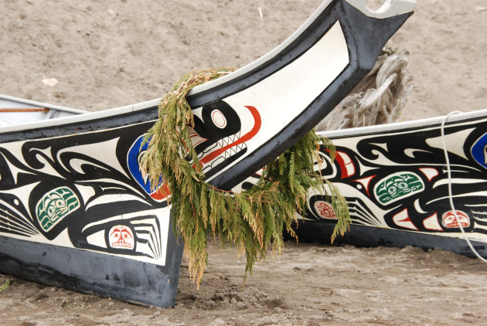
Cognitions and Trauma
Cognitive errors
Excessive or inappropriate guilt
Idealization
Trauma-induced hallucinations or delusions
Intrusive thoughts and memories
Compromised executive functioning
Center for Substance Abuse Treatment , issuing body, publisher. (2014). Trauma-Informed care in behavioral health services : A treatment improvement protocol. (Treatment improvement protocol (TIP) series ; 57). Rockville, MD: U.S. Department of Health and Human Services, Substance Abuse and Mental Health Services Administration, Center for Substance Abuse Treatment.
Notes:
Initial reactions to trauma can include exhaustion, confusion, sadness, anxiety, agitation, numbness, dissociation, confusion, physical arousal, and blunted affect. Most responses are normal in that they affect most survivors and are socially acceptable, psychologically effective, and self-limited.
Cognitive errors: Misinterpreting a current situation as dangerous because it resembles, even remotely, a previous trauma (e.g., a client overreacting to an overturned canoe in 8 inches of water, as if she and her paddle companion would drown, due to her previous experience of nearly drowning in a rip current 5 years earlier).
Excessive or inappropriate guilt: Attempting to make sense cognitively and gain control over a traumatic experience by assuming responsibility or possessing survivor’s guilt, because others who experienced the same trauma did not survive.
Idealization: Demonstrating inaccurate rationalizations, idealizations, or justifications of the perpetrator’s behavior, particularly if the perpetrator is or was a caregiver. Other similar reactions mirror idealization; traumatic bonding is an emotional attachment that develops (in part to secure survival) between perpetrators who engage in interpersonal trauma and their victims, and Stockholm syndrome involves compassion and loyalty toward hostage takers (de Fabrique, Van Hasselt, Vecchi, & Romano, 2007).
Trauma-induced hallucinations or delusions: Experiencing hallucinations and delusions that, although they are biological in origin, contain cognitions that are congruent with trauma content (e.g., a woman believes that a person stepping onto her bus is her father, who had sexually abused her repeatedly as child, because he wore shoes similar to those her father once wore).
Intrusive thoughts and memories: Experiencing, without warning or desire, thoughts and memories associated with the trauma. These intrusive thoughts and memories can easily trigger strong emotional and behavioral reactions, as if the trauma was recurring in the present. The intrusive thoughts and memories can come rapidly, referred to as flooding, and can be disruptive at the time of their occurrence. If an individual experiences a trigger, he or she may have an increase in intrusive thoughts and memories for a while. For instance, individuals who inadvertently are retraumatized due to program or clinical practices may have a surge of intrusive thoughts of past trauma, thus making it difficult for them to discern what is happening now versus what happened then. Whenever counseling focuses on trauma, it is likely that the client will experience some intrusive thoughts and memories. It is important to develop coping strategies before, as much as possible, and during the delivery of trauma-informed and trauma-specific treatment.

Slide 13
Using Information About Biology and Trauma
Frame
Frame reexperiencing the event(s)
Communicate
Communicate that treatment and other wellness
Refer
Refer certain clients to a psychiatrist
Discuss
Discuss traumatic stress symptoms and their physiological components.
Explain
Explain links between traumatic stress symptoms and substance use disorders
Normalize
Normalize trauma symptoms.
Notes:
Support your clients and provide a message of hope—that they are not alone, they are not at fault, and recovery is possible and anticipated.
Trauma is something that happens to them, it is not who they are “You are having a normal response to and extraordinary event”
Frame reexperiencing the event(s), hyperarousal, sleep disturbances, and other physical symptoms as physiological reactions to extreme stress.
Communicate that treatment and other wellness activities can improve both psychological and physiological symptoms (e.g., therapy, meditation, exercise, yoga).
You may need to refer certain clients to a psychiatrist who can evaluate them and, if warranted, prescribe psycho-tropic medication to address severe symptoms.
Discuss traumatic stress symptoms and their physiological components.
Explain links between traumatic stress symptoms and substance use disorders, if appropriate.
Normalize trauma symptoms. For example, explain to clients that their symptoms are not a sign of weakness, a character flaw, being damaged, or going crazy.

Slide 14

What Works
Those who are fluent in many theories and models of treatment.
Who are client centered/counselor driven.
Focus on strengths and protective factors
Who are able to develop trusting therapeutic relationships.
Who are work within their area of expertise.
Culture as prevention

Slide 15

Motivational Interviewing
“Motivational interviewing is a collaborative conversation style for strengthening a person’s own motivation and commitment to change.”
Miller & Rollnick, 2013

Slide 16

M.I. Spirit
  Partnership,
  Acceptance,
  Compassion,
  Empowerment
Notes:
Maintaining Empathy- Acceptance facilitates change, ambivalence is normal, reflective listening is fundamental
Avoid Argumentation- Arguments are counter productive, labeling, the goal is new perspectives for the client
Building Self Efficacy- Belief in possibility is an important motivator, the client is responsible for choosing and carrying out change
Promoting Discrepancies- To create and amplify discrepancy between present behavior and broader goals.
Rolling With Resistance - Resistance is normal and should be expected and planned for.

Slide 17
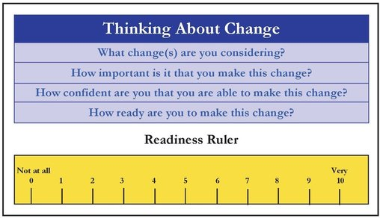
Readiness Ruler
Notes:
https://iprc.iu.edu/sbirtapp/mi/ruler.php
https://uncmotivationalinterviewing.wordpress.com/2017/08/21/motivational-interviewing-questions-evoking-change-talk-through-importance-and-confidence-rulers/

Slide 18


Slide 19
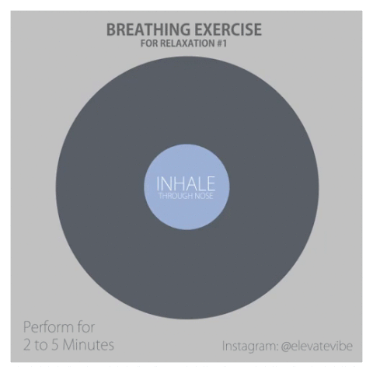
Notes:
From: https://gph.is/2dfntfr
Practice this exercise for 2 -5 minutes throughout the day…lets practice!!!

Slide 20

Culture is Medicine
Notes:
Encourage clients to participate in Indigenous healing practices and cultural traditions to support thier overall health and wellness.
Incorporating Traditional Indigenous Knowledge in treatment settings and interventions that are grounded in Indigenous knowledge

Slide 21

COMMUNITY CARE IN INDIAN COUNTRY
CONNECTION & BELONGING
  CULTURAL CONNECTION
  ANCESTRAL CONNECTION
  LAND CONNECTION
  COMMUNITY CONNECTION
SACRED SPACE
STORYTELLING/STORY LISTENING
PRAYER/MINDFULNESS/CONTEMPLATION/MEDITATION
CREATE
Notes:
COMMUNITY CARE IN INDIAN COUNTRY
Ceremony
Talking Circle
Mutual Aid / Indigenous Economies
Justice Movements (Standing Rock, Mauna Kea, MMIWG2S marches)
Cultural Gatherings/Events
Intergenerational Connection
Practicing/Learning traditional arts, dance, music Food
Wellbriety group
CONNECTION & BELONGING
We are lonely
There is a loneliness epidemic. Loneliness & social isolation can be as damaging to health as smoking 15 cigarettes a day. Especially true among youth and elders. Made worse by covid pandemic and the rise of social media.
Community = Survivance
Humans are social creatures and Native people often experience our sense of self, connection to the sacred, and sense of meaning through communal activity. Community is about possibility.
Belonging Heals
A sense of belonging is essential to our well-being. It helps with depression, anxiety, and creating a strong sense of self. Belonging restores our sacred sense of interconnection.
PRAYER/MINDFULNESS/CONTEMPLATION/MEDITATION
Connect to a sense of wonder, awe, to something bigger than you. Prayer can be singing, smudging, talking, listening, breathing, dancing, drumming, ceremony, a hike. Mindfulness practice - focusing on breath or a word to return to the present moment.
CREATE
Write, paint, dance, sing, draw, bead, weave, plant a garden,
make some babies, design a skirt, sew a new wardrobe
ANCESTRAL CONNECTION
They love you, they miss you, they prayed for you to be here, we
are the descendants of survivors, they can hear you.
SACRED SPACE
Ceremony, church, temple, house of worship, altar building, time outdoors, visits to traditional sites, collecting first foods & plant medicines, on a sports field or court, In a barn, on a farm
STORYTELLING/STORY LISTENING
Story is medicine, we cannot tell stories without also knowing how to listen deeply, meditation, ritual, ceremony, reading to your children and having them read to you.

Slide 22
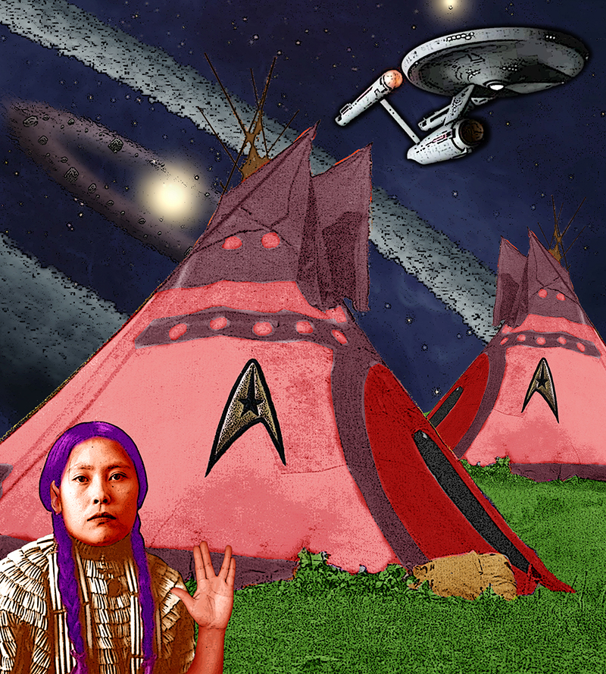
Notes:
If trauma impacts the epigenetic transfer of trauma, culture and connection can mitigate these affects. If we want to prevent substance misuse we need to focus more on stress, trauma, and poverty while providing intervention options that are grounded on Traditional Indigenous Knowledge. (Brown, 2020)
We can heal our communities through culture, connection, and developing interventions and policies that are grounded in traditional indigenous knowledge, tribal best practices, and evidence-based practice. This is not just true in the case of SUD, but in other conditions as well.

