Slide 1
Medical Emergencies in the Dental Setting
Dr. Amy Suhr, DDS
ABOMS Diplomate
Portland AREA DENTAL MEETINg
August 15th, 2023

Slide 2
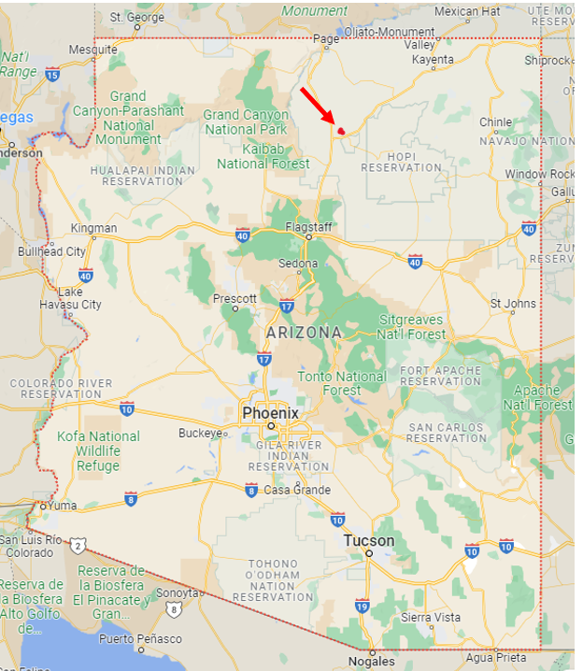
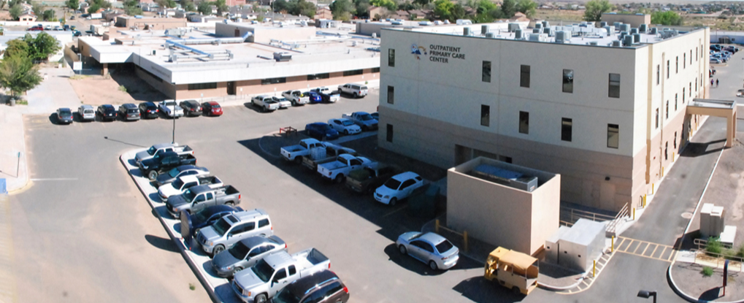
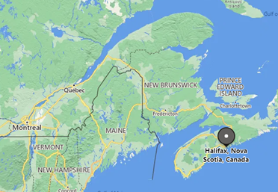
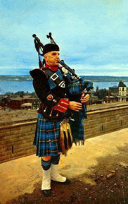



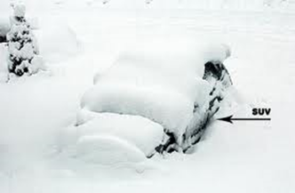
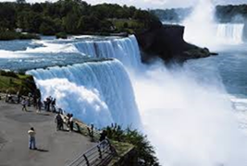
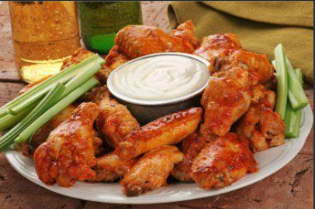

Tuba City Regional Healthcare Corporation, Tuba City, AZ
Clinical Fellowship, Dalhousie University Halifax,
Nova Scotia Canada
OMFS Residency, St. Josephs Regional Medical Center in Paterson, NJ
General Practice Residency, University of Vermont, Burlington, VT
DDS, School of Dental Medicine at SUNY Buffalo, NY
Native of Buffalo, NY

Slide 3
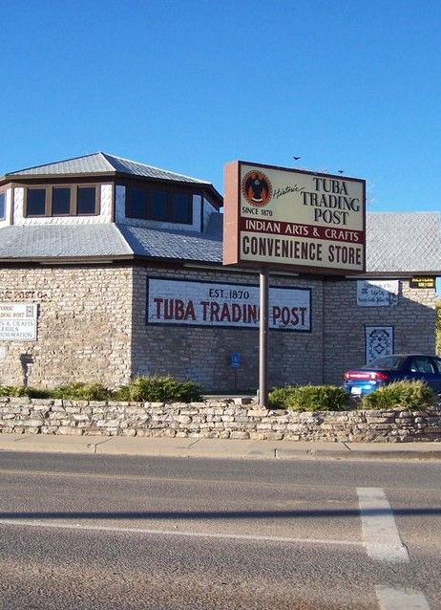
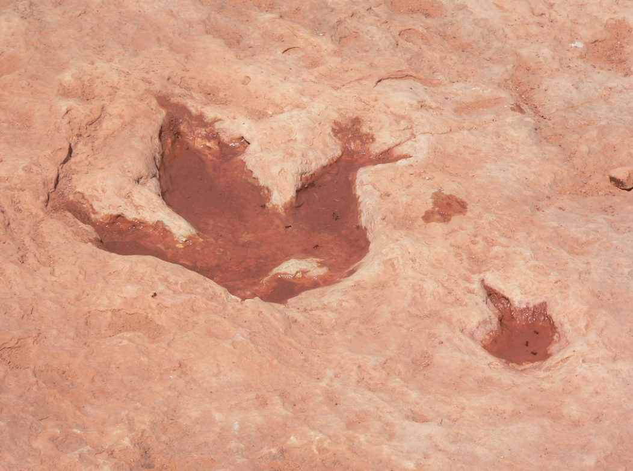


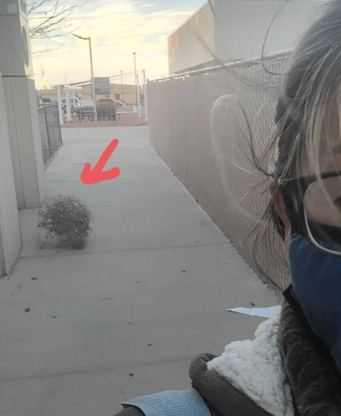
Tuba City, AZ
Some random facts:
TCRHCC became Navajo Nation owned; “638” in 2002
Population 8k in 2020
We have 2 traffic lights
6 fast food restaurants
1.5 hrs from the closest larger towns (Flagstaff and Page)
Driving distance to major attractions: Grand Canyon, Horseshoe Bend, Sedona, Antelope Canyon, Monument Valley, and so much more!!
Lots of stray dogs, cats, and occasional cows and horses walking through the neighborhoods

Slide 4
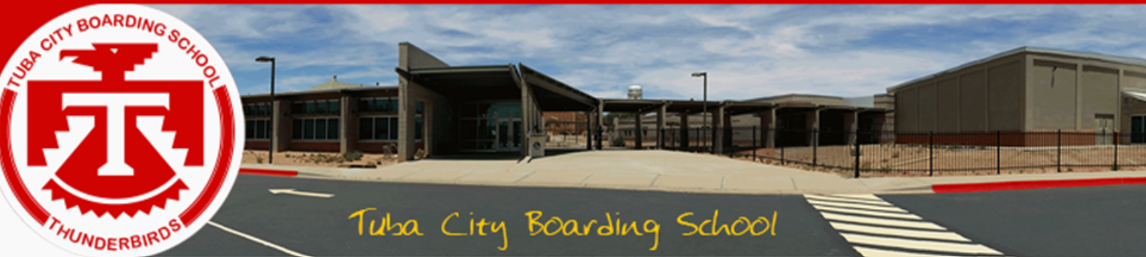
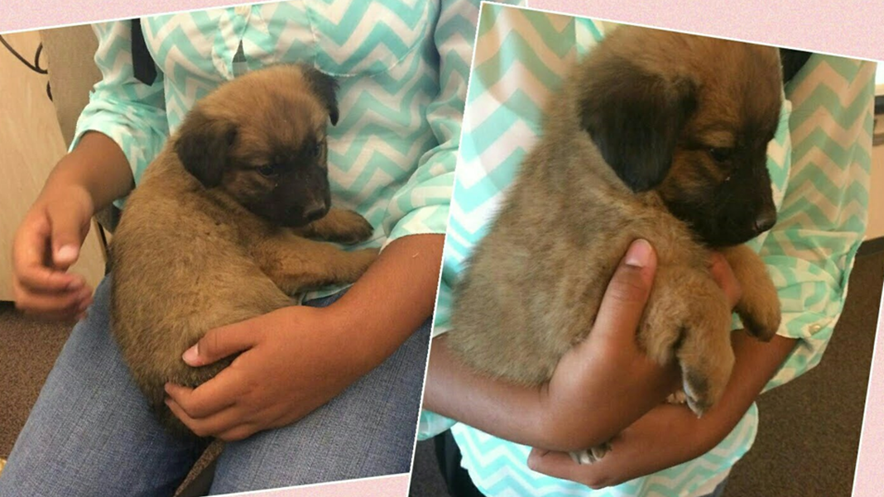
“Rez to Riches”

Slide 5
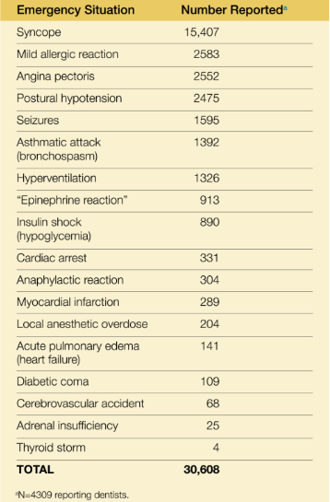
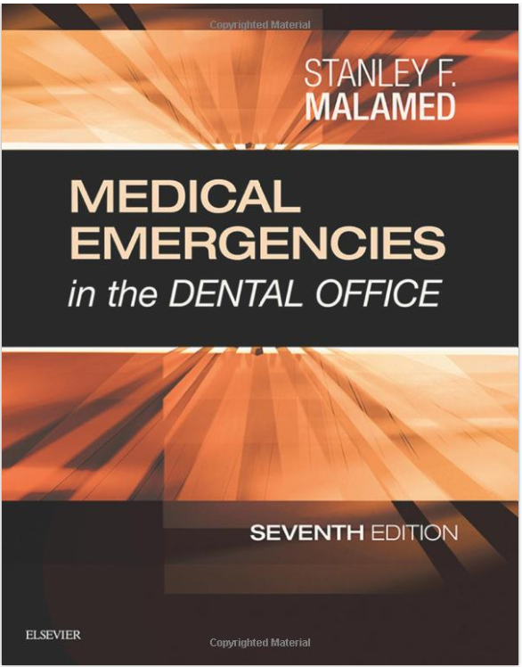
Most common emergencies reported in Dental settings:
Malamed, S. Medical emergencies in the dental Office, 8th Ed. Elsevier. 2023

Slide 6
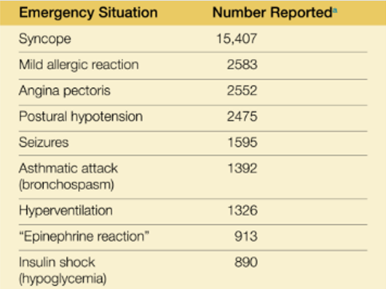
Outline
Review Office and Staff preparedness
Review the top 9 emergencies
Management of each emergency situation.
Case Scenarios
  Tie in other possible complications or dental emergencies.

Slide 7
Staff Preparedness
The ENTIRE dental staff must be prepared to fully assist in the recognition and management of any potential emergency situation.
Staff BLS training
Written Emergency Protocol
  Location and contents of emergency kits
  911 protocol: Meet EMS, directing EMS to location, etc
  Manual of Emergency Protocols (“Ten Minutes Saves a Life,” provided by ADSA)
  Emergency team with predefined roles, Drills
Universal Treatment Algorithm

Slide 8
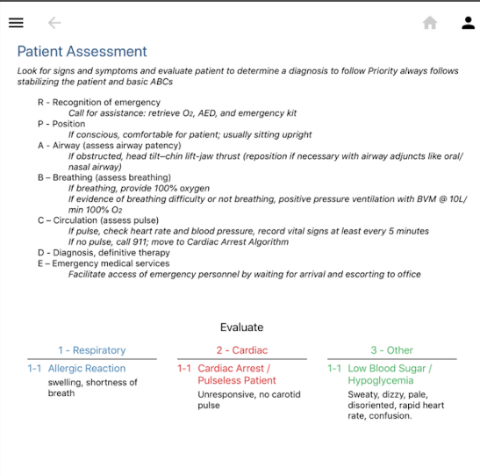
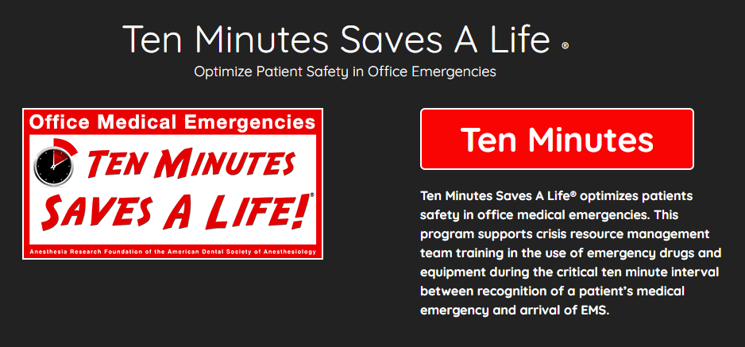
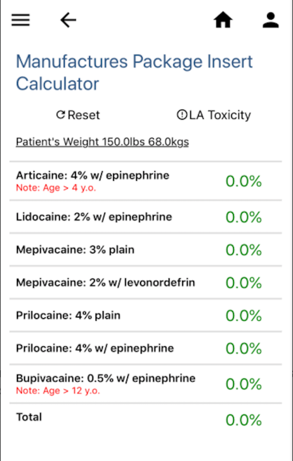
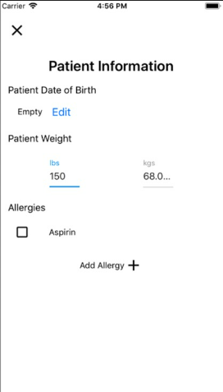
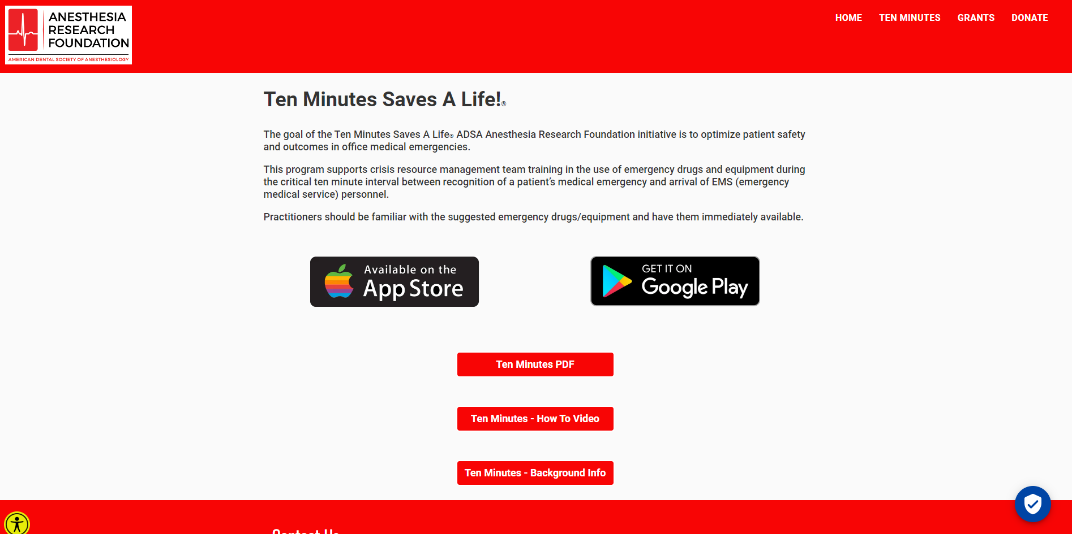
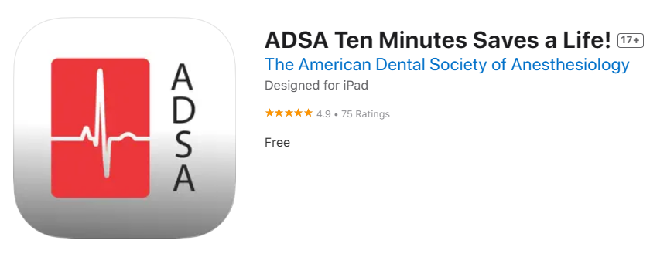
Emergency Protocol Resource

Slide 9
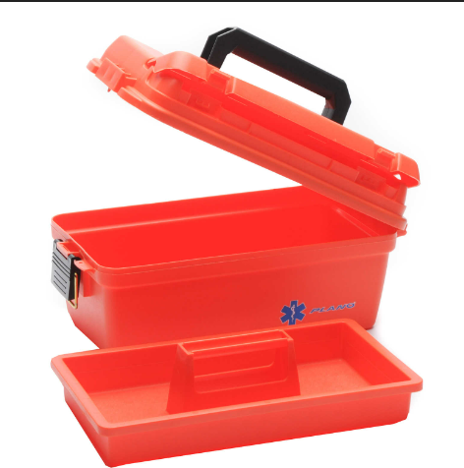
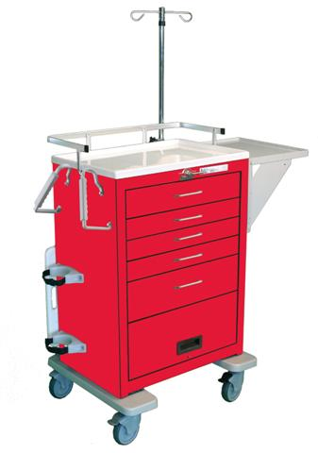
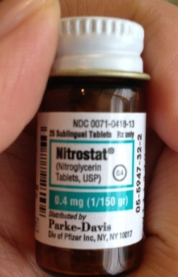
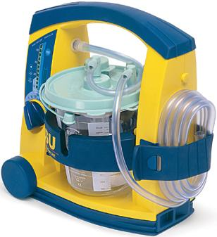
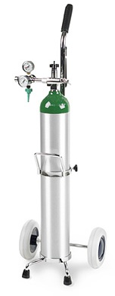
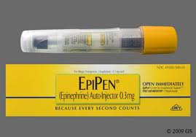
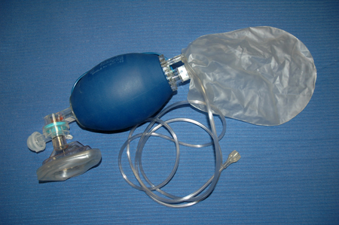
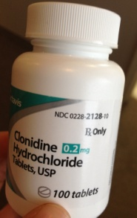
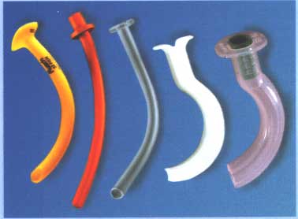
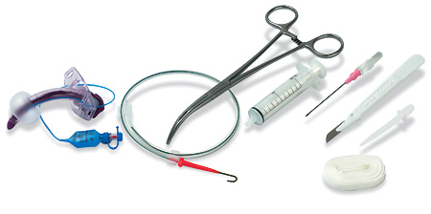
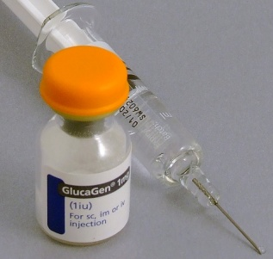
Emergency Kit/Cart
Emergency Equipment
Defibrillator
Portable suction
Oxygen tank
Face mask
  (non-rebreathing)
Ambulance bag
Oral airways
Nasal airways
Tracheostomy/
cricothyroidotomy set
Emergency Drugs:
Epinephrine
Nitroglycerin
Albuterol MDI
Diphenhydramine
Aspirin
Ammonium Salts
Clonidine
Labetalol
Glucagon**
Diazepam**
Midazolam**
Atropine**
Succinylcholine**
50% dextrose*
Esmolol*
Vasopressin*
Notes:
** comes in IM form as well (not just IV)

Slide 10
Awareness
Occurrence of complications:
Immediately before treatment 1.5%
During or after LA administration 54.9%
During treatment 22.0%
After treatment 15.2%
After leaving dental office 5.5%
Treatment being performed at the time of complication:
Tooth Extraction 38.9
Pulp extirpation 26.9
Unknown 12.3
Other treatment 9.0
Preparation 7.3
Malamed, S. Medical emergencies in the dental Office, 8th Ed. Elsevier. 2023

Slide 11
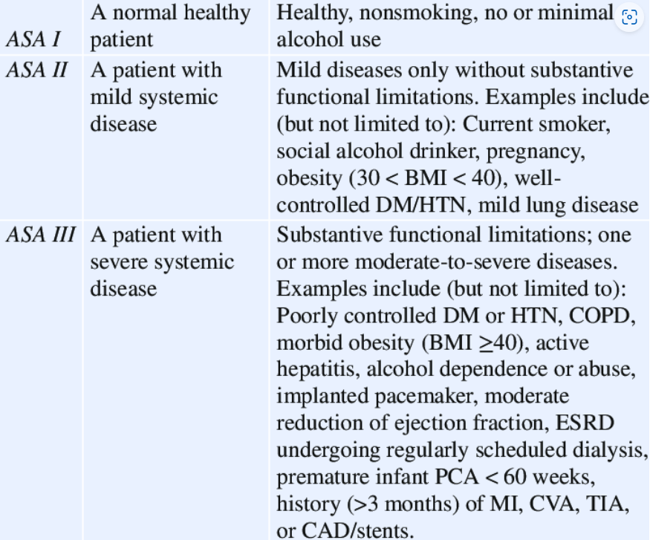
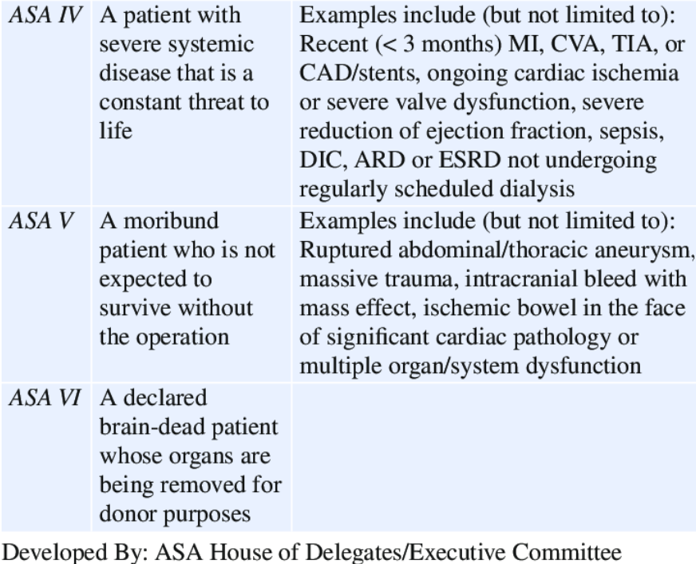
ASA Physical Status Classification

Slide 12


Prevention
90% of life threatening emergencies can be prevented by completing a thorough and appropriate H&P
How can we help decrease these incidences? :
  Pretreatment physical eval
  Medical history (MdHx)
  Dialogue history**
  Modifications in dental care.
MDHX!!
Occurrences are infrequent. However several factors may increase these incidences:
  Older patients
  Therapeutic advances in medicine
  Longer dental appointments.
  Increase use of drug administration

Slide 13
Prevention
Recognizing Anxiety:
Unnaturally stiff posture
Nervous play with tissue, hands
White-knuckle syndrome
Perspiration of forehead and hands
Over willingness to cooperate with doctor
Quick answers
….(Rude?)
Most medical emergencies are entirely stress induced; With exacerbation of preexisting conditions due to stressful situations.
Malamed, S. Medical emergencies in the dental Office, 8th Ed. Elsevier. 2023

Slide 14
Universal Treatment Algorithm
R: RECOGNITION of the emergency
  Call for help, get O2, AED, emergency kit, remove material from mouth
P: Positioning
A: Airway
B: Breathing
C: Circulation
D: Diagnosis, Definitive treatment
E: Emergency Medical Services
  Facilitate access of EMS personnel
BLS, ACLS→ “CAB”

Slide 15
Provider’s thought process…
Questions to ask yourself as a the dental provider:
Is the pt capable of tolerating the stress involved in the proposed dental treatment?
Is the patient a greater risk than normal during the planned dental care?
If so, what kind of treatment modifications should be employed to minimize this risk?
Is the risk too great for the patient to be managed safely in YOUR dental office or setting?
Specifically for us today…
Do you work in a stand alone clinic?...in a hospital based clinic?
Does 911 work in your area?

Slide 16

Please practice Safely!

Slide 17

Syncope
Transient loss of consciousness and postural tone secondary to acute decrease in cerebral flow.
Characterized by rapid recovery of consciousness without resuscitation
Causes:
  Vasovagal (aka neurocardiogenic, “simple faints”)
  Cardiac
  Seizure disorder
  Orthostatic/postural hypotension
  Severe cerebrovascular disease
  Other non-cardiogenic causes: Hypoglycemia, hyperventilation, hypovolemia, medications
Anxiety,
pain, heat, humidity

Slide 18


Syncope
Vasovagal- the most common cause of syncope. (>50%)
  Caused by emotional stress, pain, fear, extreme fatigue
  Bradycardia, vasodilation, ↓BP and ↓Cerebral perfusion
  Can occur at any age, but if 1st episode is in a pt >40 years,
  be reluctant to make this diagnosis.
ASK YOURSELF:
  is there any underlying cardiac history?
  Is the pt diabetic?
*must differentiate between cardiac and non cardiac etiologies!*
Premonitory symptoms:
Pallor, diaphoresis, lightheadedness, nausea, dimming of vision, roaring in ears.
You may notice:
Sudden jerky movements,
slow weak pulse
Dilated pupils
Notes:
Usually when blood pools in the lower extremities, you get decrease in CP, stroke volume and BP. However these changes Are compensated for by increased sympathetic tone (vasoconstriction and tachycardia), decreaseing parasympathetics,
Because syncope may be the 1st manisfestation of a life threatening cardiac condition: arrythmias, structural heart disase-hypertrophic cardiomyopathy. Atrial stenosis, mitral stenosis., massive MI.

Slide 19
Syncope
Cardiac syncope→ usually more sudden without prodromal symptoms. (“face hits the floor”)
Seizure induced→ duration of unconsciousness tends to be longer; bladder control is often lost.
Orthostatic hypotension→ common in elderly patients, diabetics (autonomic neuropathy), medications (vasodilators, diuretics, etc). Usually accompanied with prodromal symptoms

Slide 20
Syncope-Management
R
P
A
B
C
D
E
Rule out life threatening causes. (MIs, arrythymias)
Cardiac in nature: Call 911, initiate BLS, ACLS
Get vitals
For Non-cardiogenic syncope:
Place pt in supine position, head lower than chest, elevate legs
Supplemental O2
Ammonia smelling salts
Cold compress

Slide 21



Slide 22
Allergic reactions
Symptoms can be mild to severe
  Food, drugs, latex, environmental, seasonal
Drug Allergy
  Adverse drug reaction vs allergic drug reaction.
  unintended side effects of a medication, while drug allergies are an immune system response to a medication.

Slide 23
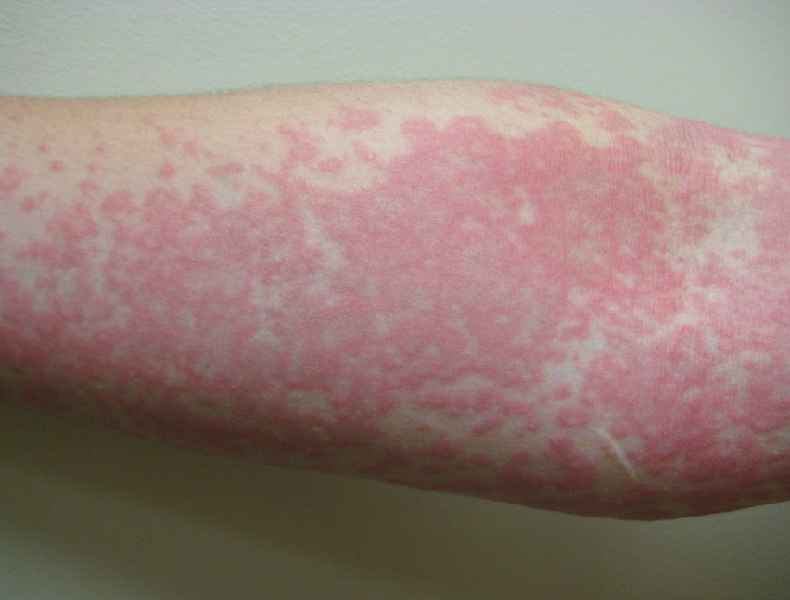
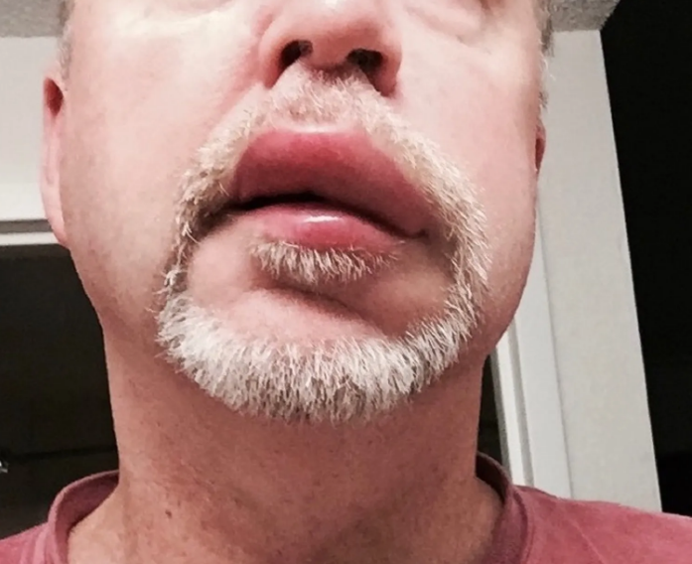
Allergic Reactions
Uticaria (Hives): (Cutaneous)
  Wheals, blanching, itchiness
Angioedema
  Fluid extravasation in deeper layers of skin/subcutaneous tissues
  Can occur with uticaria
  Eye lids, lips, tongue, genitalia, hands, feet
  Nonpitting firm swelling that is tender
Respiratory:
  tightness in chest, sneezing, bronchospasm
Ocular:
  watering of eyes, conjunctivitis
Hypotension
EMminor2010 - Hives - Wikipedia
Angioedema Lips | Sitelip.org

Slide 24
Allergic reaction-Management
  Remove offending antigen.
  Antihistamines
    Diphenhydramine (Benadryl) 50-100mg
    Chlorpheniramine maleate 4-12 mg PO, IV or IM
  Systemic corticosteroids
  SC epi for laryngeal or bronchial involvement.
  Follow up meds in 4-6 hrs

Slide 25
Anaphylaxis
Estimated to be fatal in 0.7 to 2 percent of cases
Estimated 1500 fatalities/year in the US (JAMA 2001)
PCN is the most common cause of drug-induced anaphylaxis, causing ~75% of all anaphylactic deaths in the US
Estimated 0.7-10% have a PCN allergy in the US.
  1% cross allergy to 1st gen cephalosporin, higher in 2nd Gen, negligeable in 3rd and 4th gen
Notes:
Other allergies: latex, sodium bisulfite, ester anesthetics

Slide 26
Anaphylaxis
Acute onset anaphylactic reaction:
  Appearance of urticaria, angioedema,
  SOB, wheezing, upper airway obstruction, syncope, hypotension

Slide 27
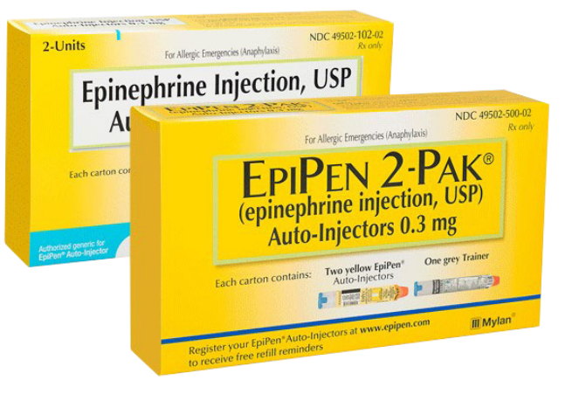
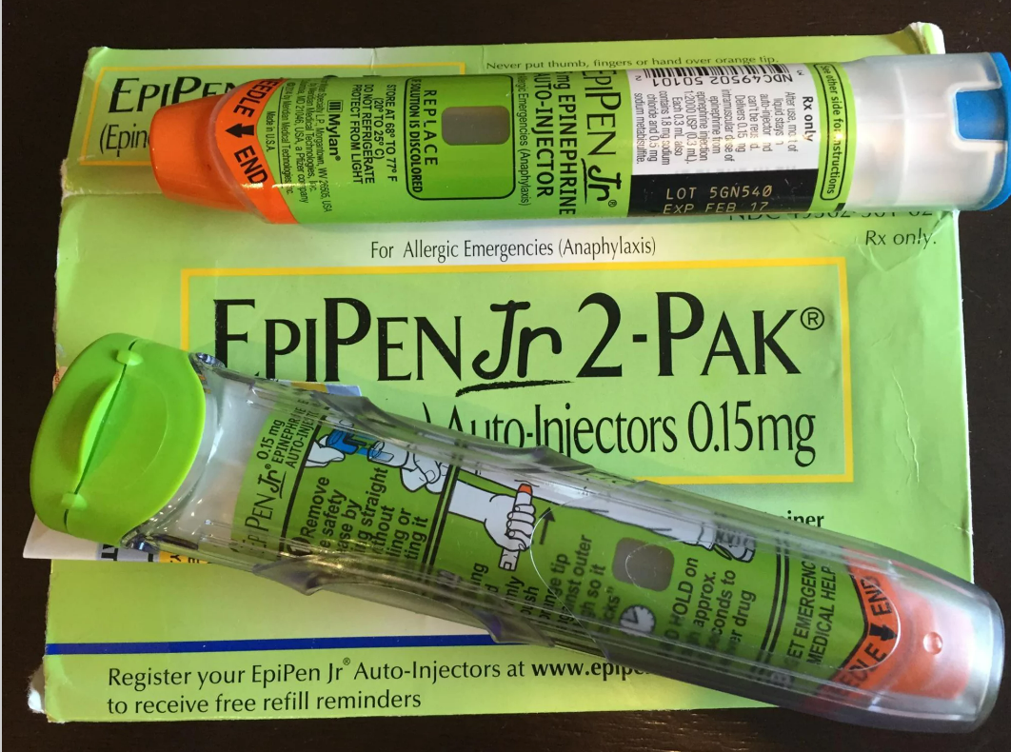

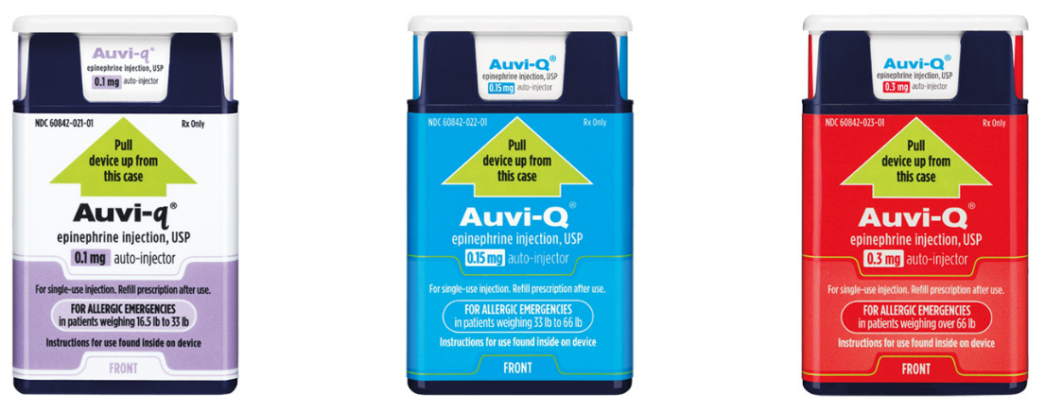
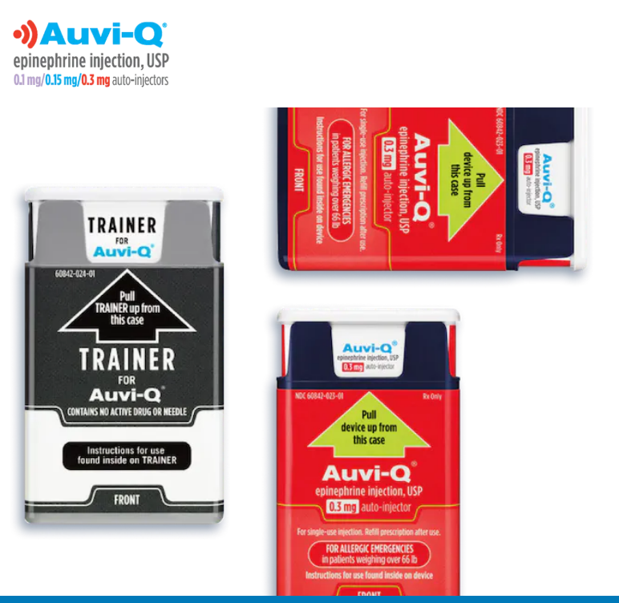
Anaphylaxis- Management
Discontinuation of suspected medication
Call 911
Albuterol
Secure stable airway
Obtain vitals
.01 mg/kg SC of 1:1000 epi in children
.3-.5 ml SC of 1:1000 Epi in adult
  Can repeat q10-15mins, up to 3 times
  Provide supplemental O2
Establish IV access
  Combo of H1 and H2 blockers (eg. Diphenhydramine25-50mg IV and cimetidine 300mg IV)
  Fluids

Slide 28


Slide 29
Angina Pectoris
  Transient Ischemia without myocardial necrosis
  EKG – transient elevation or depression of ST segment
  Stable Angina is normally exercise or stress induced with resolution at rest or NTG use.
  Unstable Angina is present at rest
  May indicate rupture of plaque or lack of collateral blood flow.
  May lead to MI
  Progression from Stable to Unstable Angina is a poor prognostic factor

Slide 30
Angina
M
D
HX
!!
Stable
DM, Hyperlipidemia, HTN, cigarette smoking. Men> 45 and Women <55
Chest pain or substernal pressure; <10-15 min
    “heaviness, pressure, squeezing”
Unstable
Chronic angina, chest pain at rest, new onset angina, severe and worsening
Symptoms coincide with nSTEMI
Need to r/o MI

Slide 31

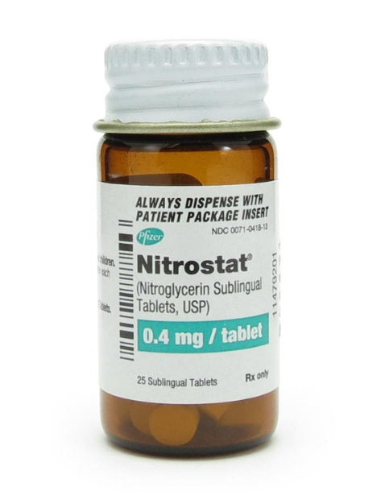
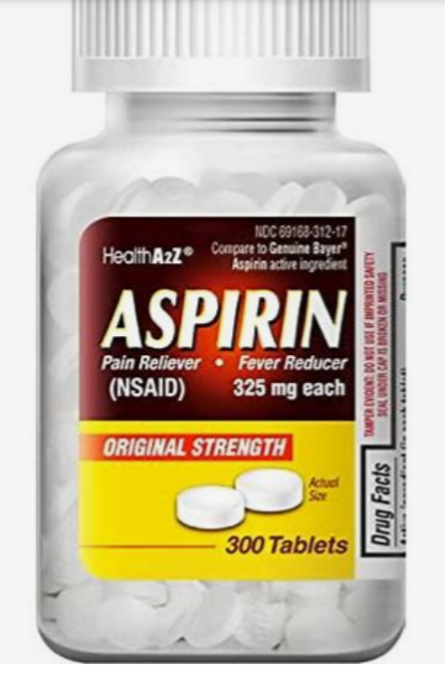
Angina Pectoris -Management
Stable:
Nitroglycerin
Relieved by rest or NTG
NTG 1 tab q 3-5 mins
Consider ASA 325 mg (non enteric coated)
Unstable:
Need to r/o MI
Call for help and patient will need further work up and hospital setting care.
In the meantime,
  Get vitals. BP
    NTG 1 tab q 3-5 mins (But avoid if HYPOtensive)
    ASA 325 mg (non enteric coated)
    O2 supplement (<94%)
BLS, ACLS

Slide 32

Postural Hypotension
Aka. Orthostatic Hypotension
Defined as drop of ≥20 mmHg in SBO and or a decline of ≥10 mmHG in the DBP
Impaired homeostatic mechanisms of BP regulation, age, CVD related; antiHTN meds
Identity at-risk pt:
  Age >60
  Dehydration
  Heart conditions.
  Neurological conditions
  Anemia, vit b12 deficiency
  Meds (diuretics, anti-hypertensives)

Slide 33
Postural Hypotension- Management
Symptoms
Lightheadedness, dizziness upon standing
Blurry vision
Weakness
Fainting
Confusion
What to do?!
Immediately return pt to supine position for 5-10 mins.
Administer O2 via Nasal cannula
Eval vital signs
Allow to stand for 2 mins
Reeval vital signs
Activate EMS if condition declines
Schedule after meal
Profound LA
Return to upright position SLOWLY

Slide 34

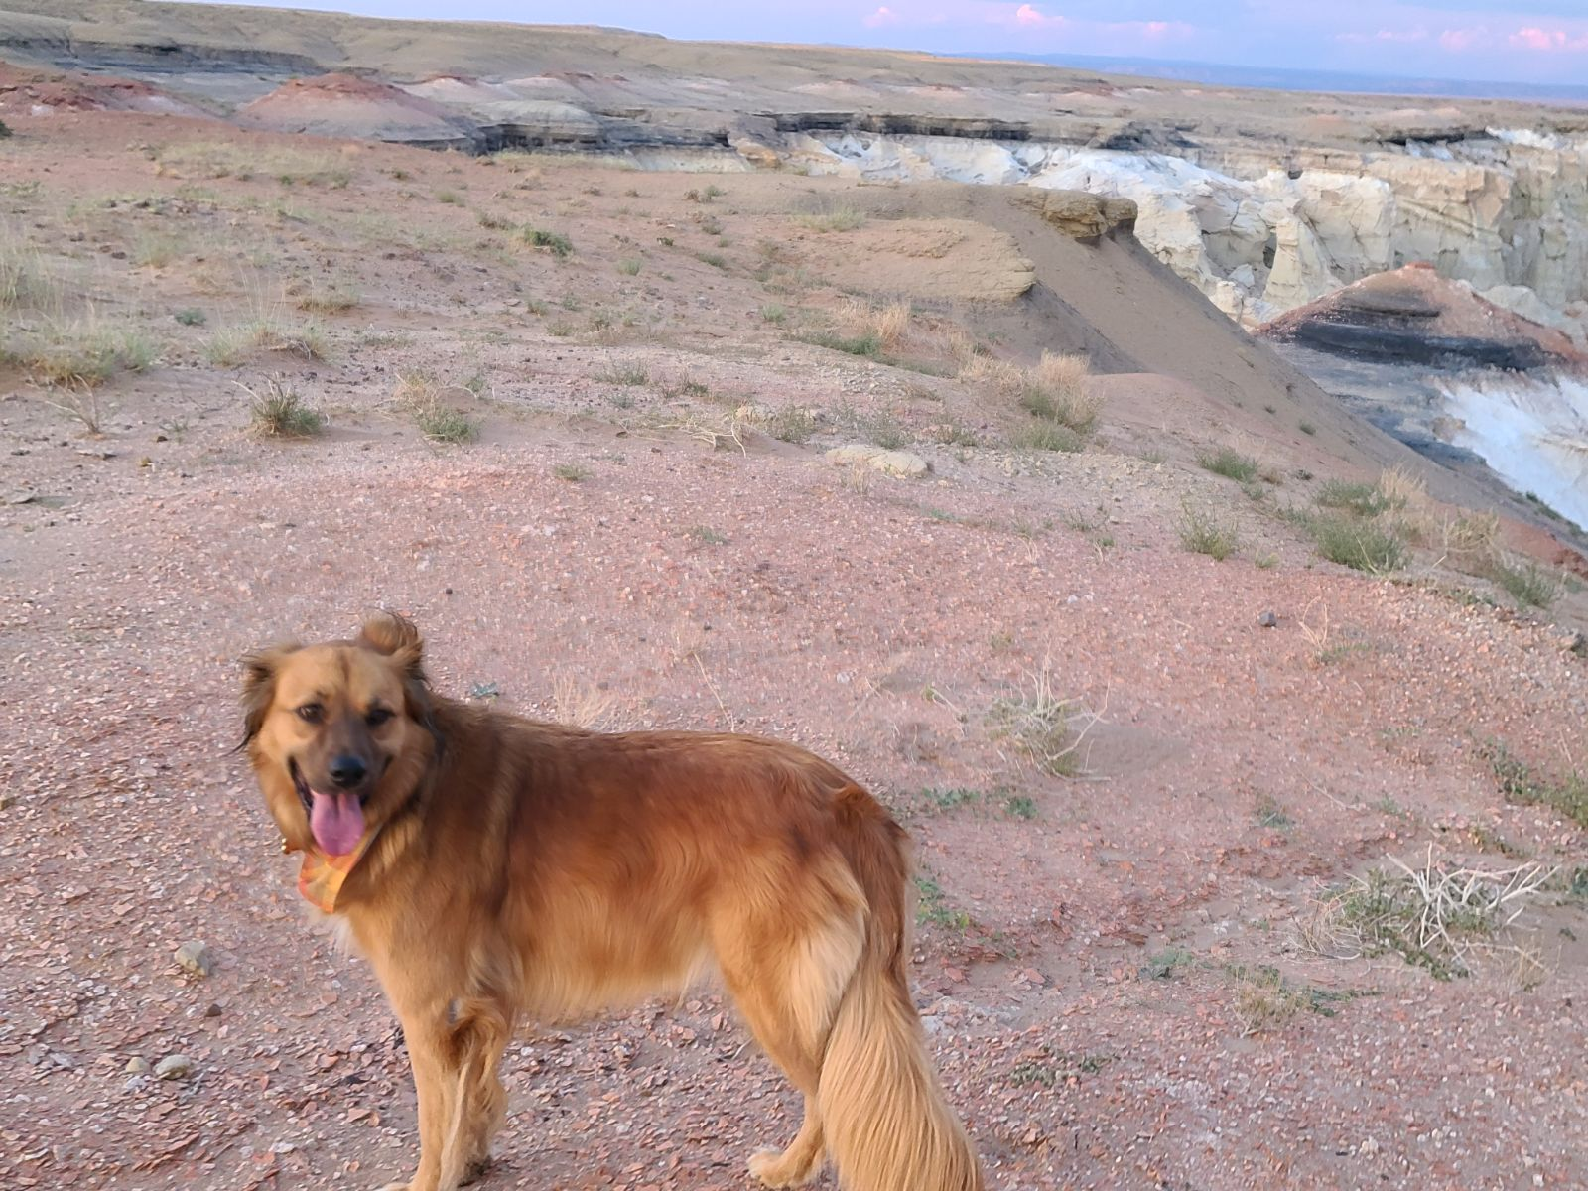

Slide 35


Epilepsy
A sudden abnormal discharge of electrical activity in the brain.
Questions to ask:
  what is the patient’s baseline?
  description of seizures—aura?
  What do they look like?
  any known triggers?
  How frequent? Last episode? Allowed to drive?
  Compliance with meds? Levels?
Types:
  Partial Seizure
    Simple partial seizure
    Complex partial seizure*
  Generalized seizure
    Tonic-clonic (grand mal)*
    Absence (petite mal)*
DIALOGUE!
Notes:
LOC, consciousness is impaired.

Slide 36
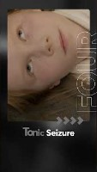

Slide 37
Epilepsy- Management
Secure airway→remove any objects from the mouth.
Prevent injury to the patient
Place in supine position
Roll patient to side to prevent aspiration
If prolonged seizure → Status epilepticus; mortality rate of 20%
  Call 911
  Supplemental O2
  IV, IM Diazapam or Midazolam

Slide 38


Slide 39


Asthmatic Attack
Asthma is a condition in which your airways narrow and swell and may produce extra mucus. This can make breathing difficult and trigger coughing, a whistling sound (wheezing) when you breathe out and shortness of breath.
Asthma prevalence increased from 7.3% in 2001 to 8.4% in 2010, when 25.7 million persons had asthma in the US. Currently at it’s highest level.
Prevalence was higher among children than adults, and among multiple-race, black, and American Indian or Alaska Native persons than white persons.
Compared with adults, children had higher rates for asthma primary care and ED visits, similar hospitalization rates, and lower death rates
DIALOGUE!
Questions to ask:
What triggers the attack?
When was the last attack?
Have you ever had to go to the ER or be hospitalized (intubation, mechanical ventilation) for your asthma?
Do you carry an inhaler with you?

Slide 40

Asthmatic Attack
Symptoms:
  SOB, wheezing, chest tightness, cough,
  diaphoretic, agitated, tachycardic, tachypneic with shallow breaths.
  Paradoxical movement of the abdomen and diaphragm on inspiration is sign of impending respiratory failure, muscle fatigue.

Slide 41

Asthmatic Attack- Management
2 puffs of albuterol
Supplemental 100% O2
Call 911
0.3 mg of 1:1000 solution of epinephrine SC
IV access
Laryngospasm breaking dose of succinylcholine (10-20mg IV)
Consider Ketamine IV
Benadryl(diphenhydramine) 50mg IV, PO
Dexamethasone 20 mg IV
Mask ventilation
Surgical airway

Slide 42

Hyperventilation
Dyspnea and tachypnea
  Anxiety, pain, environmental stressors
Low CO2 concentration with rapid breathing leads respiratory alkalosis.
Lightheadedness, dizziness, Syncope.
Paresthesia burning or prickly feeling in face and extremities.
tetany w severe respiratory alkalosis

Slide 43

Hyperventilation-Management
Reduce anxiety
Good local anesthesia
Upright or semi reclining position
Instruct pt to take shallow breath and hold as long as possible, 6-10 times.
Rebreathe expired air from paper bag.
No O2 supplementation
Monitor vitals
(Preventative)

Slide 44

Duncan’s Cove, Nova Scotia
Atlantic Ocean!

Slide 45

Epinephrine Reaction
More common Side effects:
Tachycardia
Hypertension
Headache
anxiety, apprehension
palpitations, diaphoresis
nausea, vomiting,
Weakness
tremors
Intraorally: Mouth ulcers
Less commonly:
Blurred vision
Facial paralysis
Lockjaw
Muscle spasms in neck and and back
Allergies to Epinephrine is very unlikely.
  Most likely allergic the to sulfite preservatives in the local anesthetic.
  Higher Risk factors:
  Elderly
  Uncontrolled Hyperthyroidism
  Uncontrolled HTN
  How to Prevent?
  Aspirate

Slide 46
Epinephrine Reaction-Management
Usually resolves within in 5 mins.
Recline
O2 supplementation
Cold compresses to forehead

Slide 47

Hypoglycemia
Hypoglycemia: blood glucose level is <60mg/dl
Missed meals, meds, heavy exercise, anxiety and infection can cause,
Symptoms:
  nausea, anxiety, weakness, seating, tremors. clammy skin, diaphoresis, visual disturbances, paresthesia, lethargy, irritability, delirium, confusion, seizures, coma.
Again, differentiate from cerebrovascular events, vasovagal syndrome, etc.

Slide 48
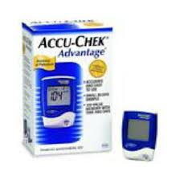

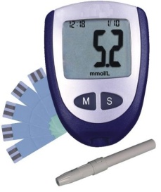
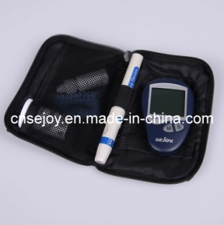
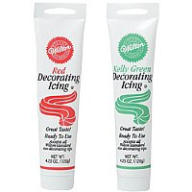
Hypoglycemia- Management
Place in semi reclined position
have juice available for pts
Measure blood sugar level
Attain IV access
Administer 1 ampule of 50% dextrose (25g of sugar)
Frosting can be applied sublingually
1 mg of glucagon IM/SC can also be given.
Monitor!

Slide 49


Slide 50

Peri-operative & Surgical Complications

Slide 51
CASE SCENARIOS

Slide 52


Case 1: “CHOOSE YOUR OWN ADVENTURE”
IN YOUR OPERATORY,
A pt has known h/o HTN. He has always been anxious about going to the see the dentist. He is complaining of severe pain with #19. It has been hurting for months, but he didn’t come sooner because he was afraid to. Now, the pain is unbearable. He is in visible pain.
You decide to take his BP.
(Of course, you make sure you have the right cuff size when you measure it.)
Hypertensive URGENCY:
BP> 210/120
Extract tooth anyway
(ASYMPTOMATIC)
Do not take out tooth, and send to ED
Hypertensive EMERGENCY:
diplopia
Dizziness
headaches
SOB
sudden leg swelling
chest pain
papilloedema,
renal failure (end organ damage)!!
SEND TO ED, Call EMS

Slide 53
Case 2
24 yr old male presents as walk-in to your clinic, c/o pain and swelling over tooth #19.
HPI: my tooth was bothering me, but I never came in, and this morning I woke up with this swelling.
MdHx: pt is healthy.
On PE, there is significant swelling along the L body of the mandible with severe pain on touching. (+) moderate trismus, MIO 28mm with pain.
MUST ASK:
Odynophagia vs Dysphagia?
Trismus?
EXAMINE the PT!
FOM elevation?
Tongue soft?
Uvula midline?
If not you, who??

Slide 54
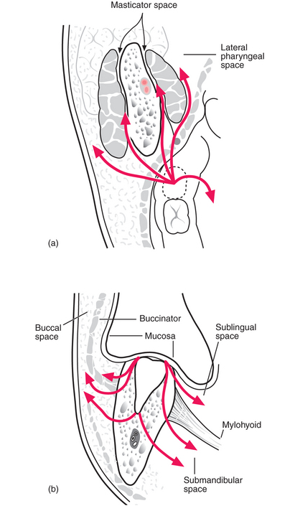
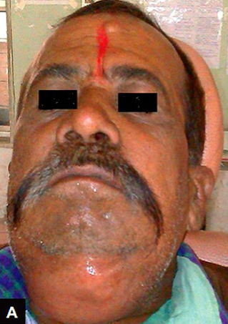

Infections
Does it have to be fluctuant to drain? What if the swelling is firm?
“Don’t let the sunset on pus.”
  Can you palpate the inferior border of the mandible?
Submandibular, sublingual, submental infections
  Pharyngeal space infection
  Compromised airway
Maxillary infections can also be serious.
→Orbital cellulitis, by way of sinus.
Ludwig’s angina: BILATERAL Cellulitis of the
    Submandibular, Sublingual, Submental spaces.
PDF: Ludwig’s Angina - Emergency Treatment (odontologiavirtual.com)
Source link: 7: Spreading infection | Pocket Dentistry
If you can drain it,
DRAIN IT.
ANGINA DE LUDWIG TRATAMIENTO QUIRURGICO PDF (serviceacsurabaya.me)

Slide 55

Case 3
A 42 yr old female presents through walk ins and is determined to have a non-restorable tooth #28.
A know-it-all new dentist has just started in your clinic.
The dentist decides to extract the tooth, and while elevating, fractures off the crown of tooth #28, below the bone height.
After digging at it for it for what seems like hours, he is not making any progress.
What should you do?
He agrees that he needs to do a surgical extraction and asks for a handpiece.
Is it acceptable to just give him the regular high-speed handpiece, or should you give him a surgical handpiece?
Why or why not?

Slide 56


Subcutaneous emphysema
Potentially life threatening.
Severe facial edema which can spread to neck and chest
Dysphagia, dyspnea, + crepitus, pain
DePinto N, Toth S, Kelly S, York J. A rare case of subcutaneous emphysema following routine dental care in a dental school setting. J Case Rep Images Dent 2015;1:5–7.
Shah, N., Sharma, B., Campbell, N. et al. Extensive subcutaneous emphysema secondary to endodontic treatment. Br Dent J 234, 88–91 (2023). https://doi.org/10.1038/s41415-022-5407-z

Slide 57
Case 4
A different but equally irritating dentist is now working on a screaming 6-year-old with a toothache.
The child is not getting numb, and the dentist has used 4 carpules of lidocaine with epinephrine.
Is there a limit that needs to be considered?
YES.
Lidocaine Toxicity
LAST (Local Anesthetic Systemic Toxicity)

Slide 58
LAST (Local Systemic Anesthetic Toxicity)
All Local anesthetics can cause LAST.
Greatest risk in geriatric and pediatric patients
PREVENTION!!!
  Pt H&P. Know your patient!
    Age, weight, systemic disease, genetics
  Knowing your doses
In Pediatric patients,
~1 carpule per 20lbs.
Notes:
Medications such as H2 blockers (cimetidine/tagamet)—competes for hepatic enzymes with the LA
Demeral , phenytoin(dilantin) increases LA blood levels, so can have toxic reactions at lower levels.
Hepatic and renal dysfunction
Congestive heart failure decreases liver perfusion, and also increases half lives of amide local anesthetics
Allergies to
LAs can be assigned a cardiovascular collapse (CC) to CNS ratio (CC:CNS), which is the ratio of the drug dose required to cause cardiac collapse to the drug dose required to produce seizures. LAs with higher CC:CNS theoretically have a greater margin of safety, as early CNS symptoms may allow intervention to prevent subsequent cardiac arrest. Based on animal models, bupivacaine has the lowest CC:CNS ratio of the commonly used LAs, followed in increasing order by levobupivacaine, ropivacaine, and lidocaine [24].

Slide 59

Cannon Beach, Oregon
Pacific Ocean!

Slide 60
Case 5
68 yr old male presents for extraction of multiple teeth and root tips for fabrication of upper and lower partials.
MdHx reviewed: DM II, ESRD, HTN, A-fib, chronic knee pain.
Meds: sevelamer 1200 mg, apixaban, amlodipine5mg, Levemir 100 units/ml, semaglutide 0.5mg/0.5ml SC solution, atorvastatin 40mg, Losartan 25mg, Carvedilol 25mg, cetirizine 10mg, olopatadine 0.1% eye drops
PSHx: Pacemaker placement, AV fistula, L great toe amputation
SocHx: “used to drink”
NKDA

Slide 61

Apixaban? → A-fib
  Stop?
Pre medicate?
Scheduling of extraction?
Okay, so it turns out this patient has a h/o being a raging alcoholic, and is now having some pretty enthusiastic bleeding after the extraction
Notes:
Traumatic Ulcerative Granuloma with Stromal Eosinophilia (TUGSE) is an uncommon condition considered to be a, reactive benign lesion of the oral mucosa, usually affecting the tongue. Its aetiopathogenesis is still uncertain. However, trauma has been found to be a contributing factor in a majority of the cases. Clinically, it often presents as an isolated ulcer or an indurated submucosal mass. Microscopically, it is characterized by a diffuse polymorphic cell infiltrate composed predominantly of eosinophils, B and T lymphocytes, macrophages, and large atypical cells involving the superficial mucosa and extending deep into the submucosa causing degeneration of the underlying muscle. TUGSE is rare and may be easily mistaken for a cancer or microbial infection, but it is self-limiting and tends to resolve spontaneously.

Slide 62







Bleeding- Management
THIS,
NOT THIS.
DIRECT PRESSURE, pack with gauze
Bone burnishing
Gelfoam, Surgicel, Collaplug
Primary wound closure
Transexamic acid
Aminocaproic acid (Amicar)
Factor replacement
Desmopressin
But because you are an excellent clinician, you complete a thorough medical history on the patient, and order the proper lab tests, and find out his coagulation values, speak with his PMD and have the hemostatic agents you need, prepared ahead of time. (Yay!)
Must be ordered ahead of time.
Notes:
TXA is a synthetic reversible competitive inhibitor to the lysine receptor found on plasminogen. The binding of this receptor prevents plasmin (activated form of plasminogen) from binding to and ultimately stabilizing the fibrin matrix.
TXA used for hereditary angioedema works by its indirect effect of reducing complement activation. By reducing plasmin activity, it reduces the consumption of C1 esterase inhibitors.[29]
Amicar is 6-aminohexanoic acid, which acts as an inhibitor of fibrinolysis.
Desmopressin (DDVAP): synthetic form of vasopressin, increase plasma factor 8 and Vw factors; pill or nasal spray. The signaling cascade resulting in the production of cyclic adenosine monophosphate also induces exocytosis of von Willebrand factor and factor VIII from its storage sites, as well as the Weibel-Palade bodies and the alpha granules of platelets.[1] Von Willebrand factor functions as the first step in thrombogenesis, acting as the bridging factor of the Gp1b factor on platelets to the subendothelial collagen following tissue injury
Gelfoam: gelatin sponge
Surgicel: oxidized cellulose polymer
Collaplug: collagen
For hemophilia A

Slide 63

HOW MANY PUPPIES (INCLUDING RIPLEY)
CAN YOU FIND?

Slide 64

Case 6
23 yr old female presents for routine exam, with a chief complaint of pressure around her lower wisdom teeth.
A Panorex is taken:
She is otherwise healthy.

Slide 65
Sinus Communication
Aka. Oral antral communication (OAC)
Most common sites: 1st, 2nd, 3rd molars
Incidence of oral antral communication from 3rd molar extractions: .08-.25%
Determine size of defect.
  <2mm will close on its own with sinus precautions.
Complications of an oral-antral communication:
  Oroantral fistula (OAF)
  Chronic sinus infections

Slide 66

Sinus Communication-Management
If greater than 2-6mm, collagen plug, and figure-of-eight suture
Or advancement flap:
  Buccal advancement flap
  Buccal fat pad advancement flap
  Palatal flap
Post Operative Instructions:
  Avoid smoking
  Sinus precautions
    Do not blow the nose
    Antibiotics—Augmentin, clindamycin
    Antihistamines
    Nasal decongestants
    Avoid valsalva maneuvers*
    Stool softeners *

Slide 67

…into the Maxillary Sinus
Fight the temptation to probe or explore the extraction site.
Use suction tip
Take radiograph
Caldwell-luc

Slide 68



…into the Infratemporal Fossa
CT scan to visualize and locate position.
Wait 7 days to several weeks for fibrosis to occur around the tooth.
Incision extends posteriorly to the tonsillar fauces, blunt dissect, avoid the pterygoid plexus
Careful follow-up if asymptomatic

Slide 69



…into the Sublingual space
Palpate it digitally and push it back into socket.
Full thickness flap on lingual.

Slide 70



Bonus Question: From where my dog’s name, Ripley, come from?
(I was on the phone for too long.)
Insta: #ripleyalienslayer

Slide 71
Case 7
78 yr old female presents to the clinic to have multiple teeth and root tips removed in preparation for CU/CL dentures.
HPI: poor oral hygiene, hates the dentist, and doesn’t even lie about not flossing
PMH: HTN, DM 2, Obesity, high cholesterol; NKDA
Meds: Metformin, insulin, ASA 81mg, lisinopril, simvastatin
PSx: c-sections, cholecystectomy
As you complete the Med Reconciliation, you notice the patient is becoming more and more agitated, answering with curt answers.
You finally get through the consent form with some difficulty due to the patient asking somewhat confusing questions.
As you prepare for administering LA,
The assistant who is suctioning saliva, suddenly asks the patient, “Mrs. Whitehorse, are you alright??”
You look over and she is visibly sweating trembling.

Slide 72
That’s all folks!

Slide 73

Thank you for your attention.
Questions, Comments?
Amy.suhr@tchealth.org
(928) 283-2104

Slide 74
References
Stark BJ Sullivan TJ Biphasic and protracted anaphylaxis. J Allergy Clin Immunol. 1986;7876- 83
Boston Collaborative Drug Surveillance Program, Drug-induced anaphylaxis. JAMA. 1973;224613- 615
Malamed SF. Managing medical emergencies. J Am Dent Assoc. 1993 Aug;124(8):40-53. PMID: 8354783.
Dalal R, Grujic D. Epinephrine. [Updated 2023 May 1]. In: StatPearls [Internet]. Treasure Island (FL): StatPearls Publishing; 2023 Jan-. Available from: https://www.ncbi.nlm.nih.gov/books/NBK482160/

