Slide 1
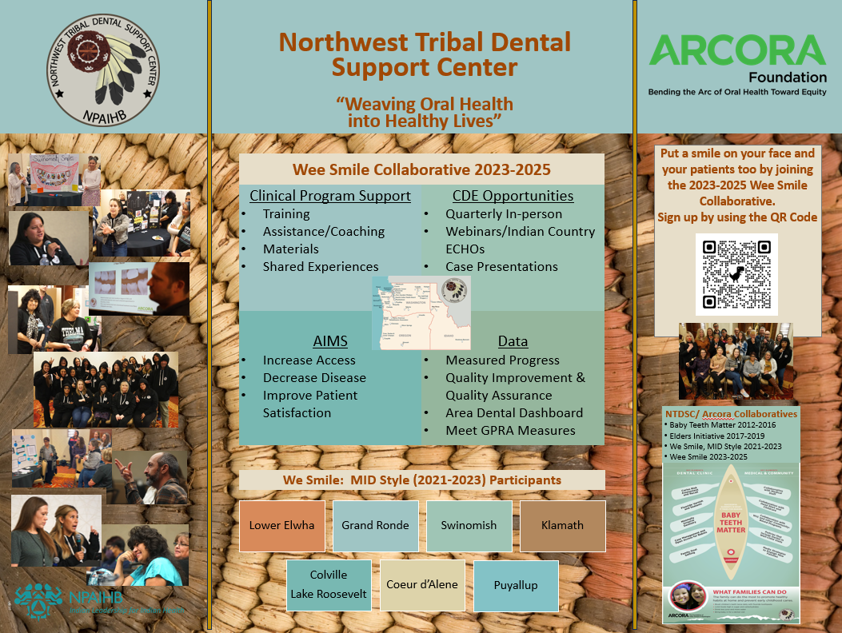
Wee
Smile Collaborative:
https://vimeo.com/809960679
Notes:
Lunch time slide and link to We Smile Video

Slide 2
Today’s Agenda
12:00 - 1:00 Lunch
Introductions of all participants
1:00-1:30 IHS and NTDSC Updates
1:30 - 2:30 Policies & Procedures, Protocols/SOPs
2:30-2:45 Break
2:45-3:30 Data and QI/QA
3:30-3:45 Staffing
3:45-4:30 Conflict Management and Resolution
4:30-4:45 Wee Smile Collaborative Recruitment
4:45-5:00 Final Comments/Closing
Notes:
Today’s schedule

Slide 3
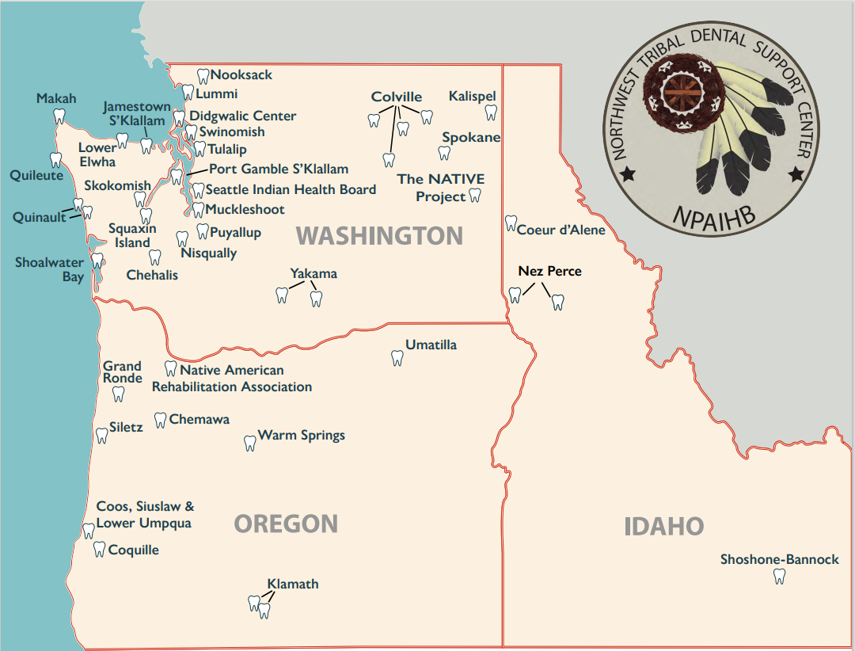
2023 Annual Portland Area
Dental Director’s Meeting
WELCOME!
Notes:
(Image from the CTCLUSI Administration Office in Coos Bay, OR)

Slide 4
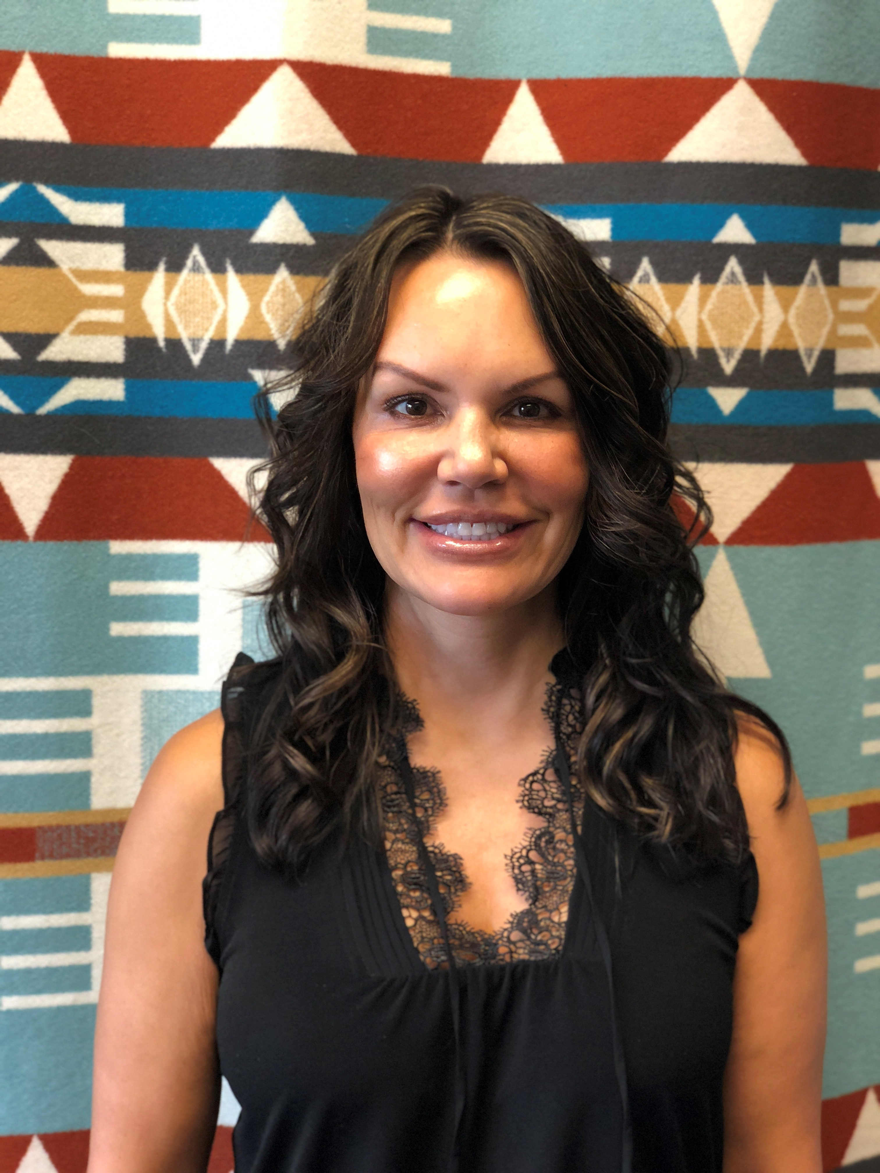
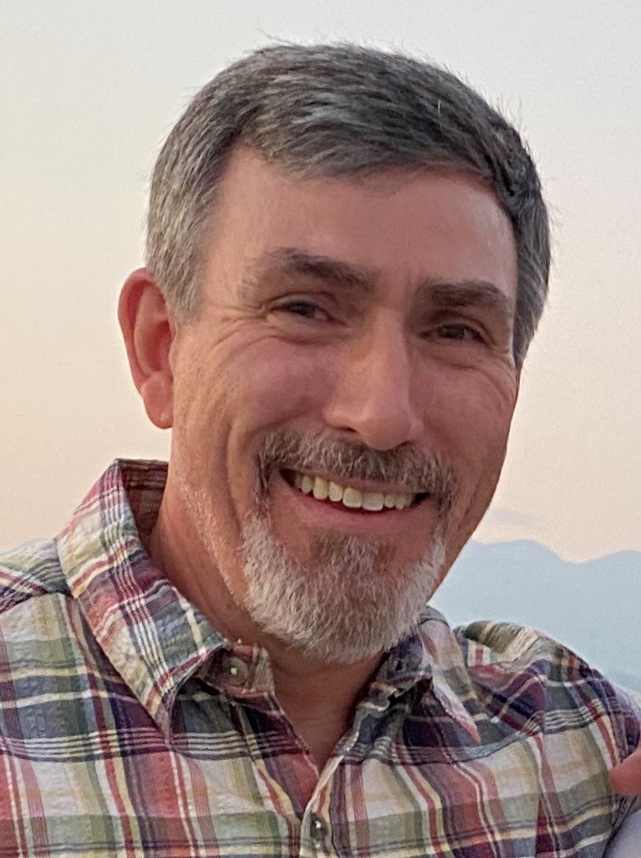
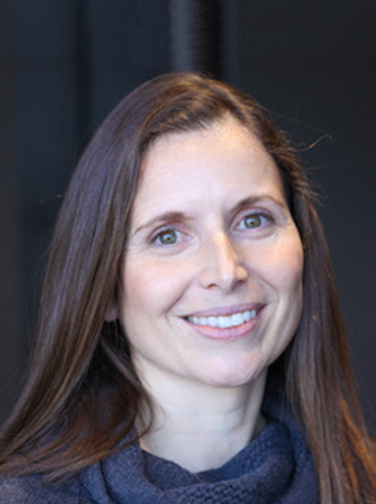
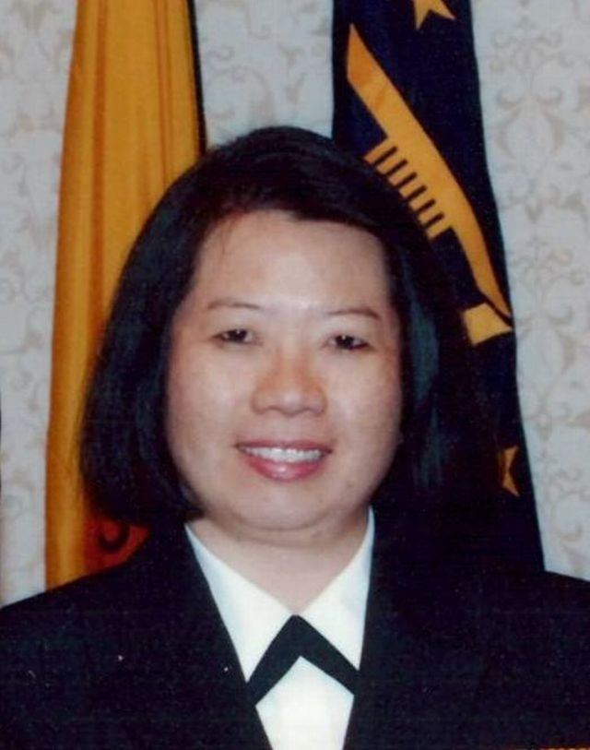
Today’s meeting is a combined effort between the Northwest Tribal Dental Support Center and the IHS Portland Area Office
Ticey Mason, MAOL
NTDSC Director
Sean Kelly, DDS, MSHS
NTDSC Clinical Consultant
Miranda Davis, DDS, MPH
NDTSC Prevention Consultant
Lynn Van Pelt, DDS
IHS Area Dental Consultant
Portland Area Dental Staff and Consultants

Slide 5
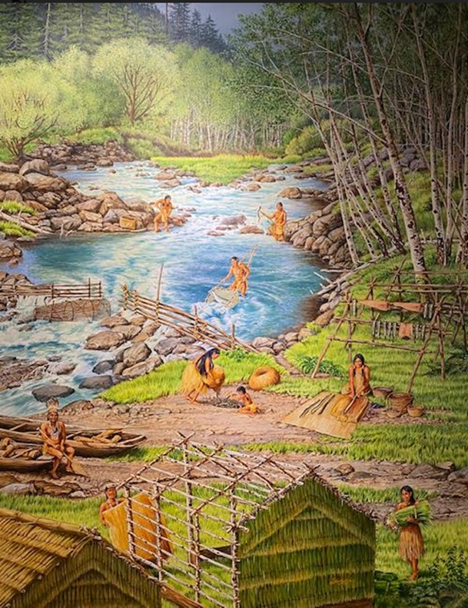

2023 Annual Portland Area
Dental Director’s Meeting
DISCLAIMER:
We have no financial disclosures
or conflicts of interest with the
information in this presentation.
However, we may thank the Arcora Foundation for their sponsoring this meeting and providing our lunch.
Photo of artwork in CTCLUSI tribal offices
Notes:
Disclaimer (read quickly and move on).
Image from the Nez Perce National Historical Park Visitor Center

Slide 6
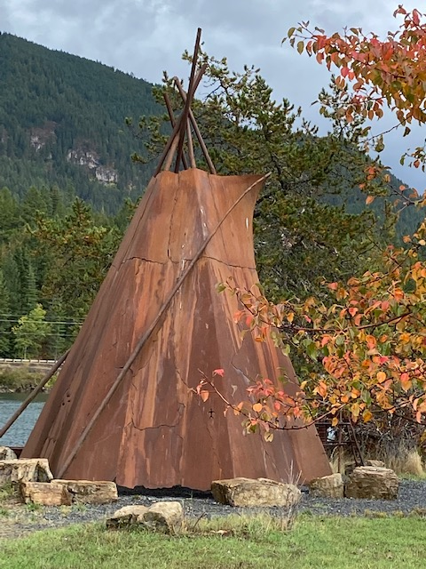
Learning Objectives:
Upon completion of this course, participants will be able to:
1. Identify resources to update clinic policies and procedures, protocols and standard operating procedures.
Use data to design and implement quality assurance and quality improvement methods
3. Employ strategies to manage conflicts in the clinic
Notes:
Here are the “published” course objectives for the overall monthly meetings, we hope to ….1. 2. 3. (read quickly)

Slide 7
Learning Objectives:
Most importantly:
Enjoy Yourselves!
Additionally, some quizes have been added:
For Example; each equation contains initials for words that when completed make a correct statement.
Example: 26 = L of the A.
Letters of the Alphabet.
Notes:
Here are the “published” course objectives for the overall monthly meetings, we hope to ….1. 2. 3. (read quickly)

Slide 8
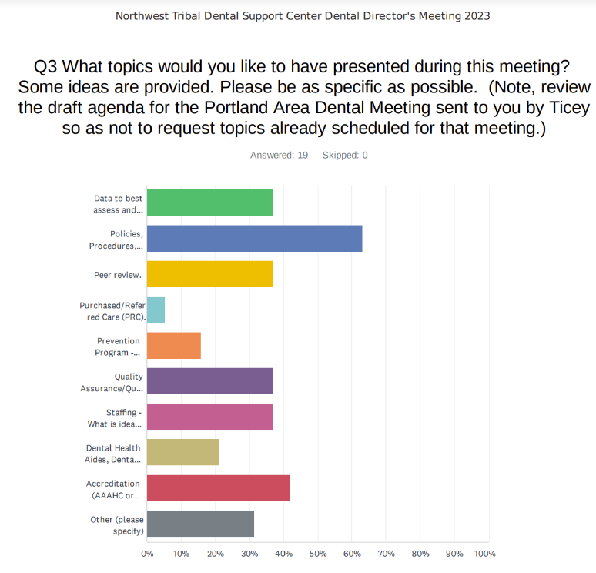
The Survey of Topics
Notes:
Recent dental directors survey, your responses

Slide 9
Today’s Agenda
12:00 - 1:00 Lunch
Introductions of all participants
1:00-1:30 IHS and NTDSC Updates
1:30 - 2:30 Policies & Procedures, Protocols/SOPs
2:30-2:45 Break
2:45-3:30 Data and QI/QA
3:30-3:45 Staffing
3:45-4:30 Conflict Management and Resolution
4:30-4:45 Wee Smile Collaborative Recruitment
4:45-5:00 Final Comments/Closing
Notes:
Today’s schedule

Slide 10
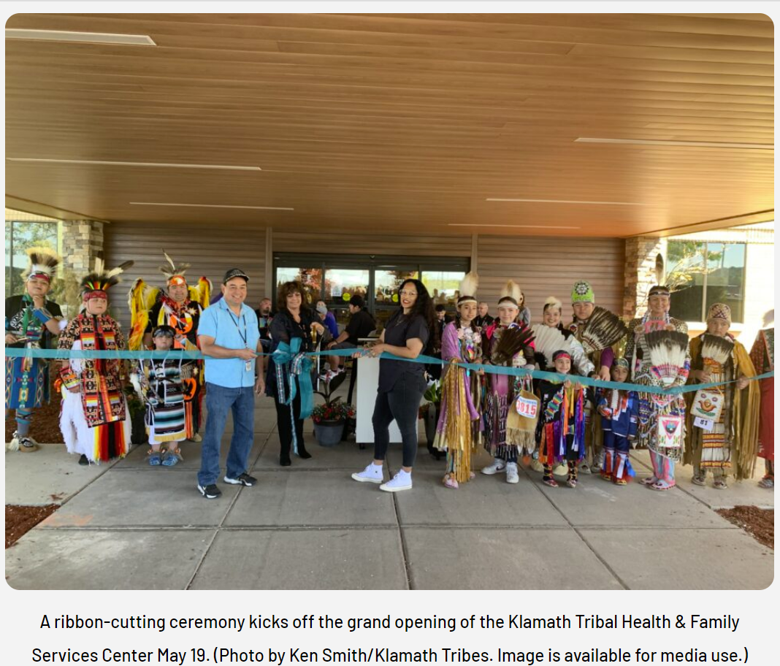
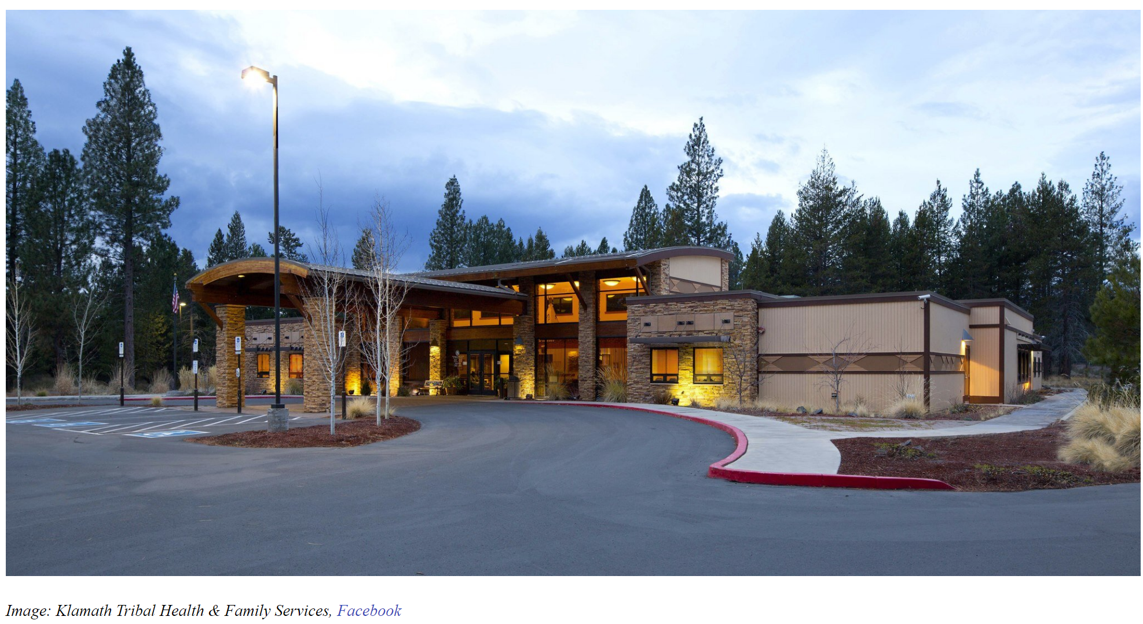
GO FIGURE:
32 = D at which WF
Shout out the answer!
Notes:
32 degrees at which water freezes.

Slide 11

IHS Updates:
Notes:
IHS Updates presented by Lynn Van Pelt your Area Dental Consultant from the IHS Portland Area Office.

Slide 12
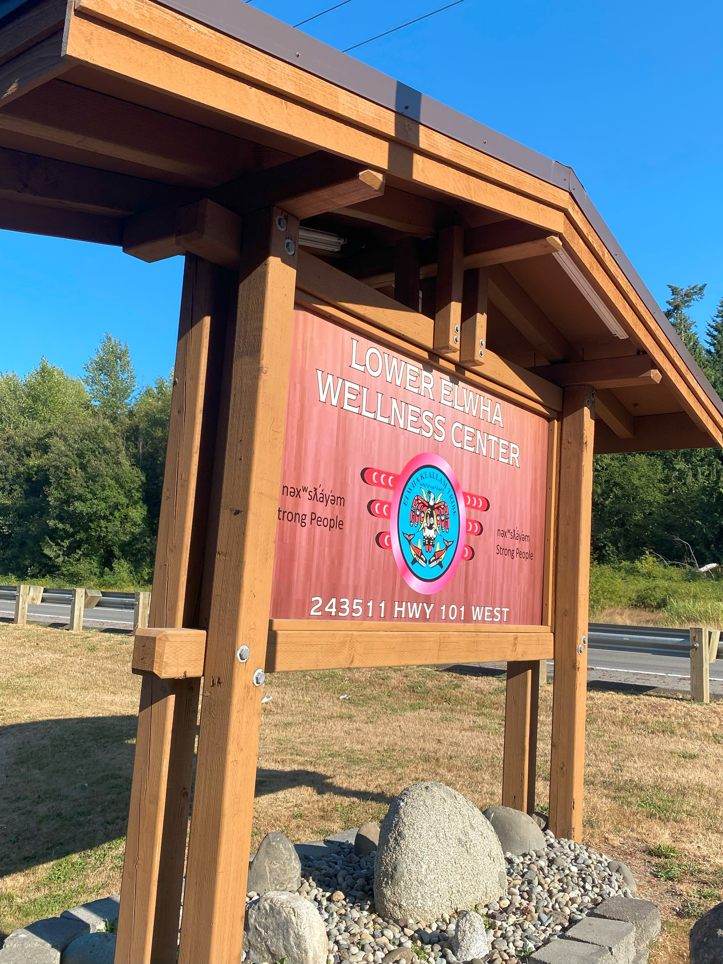
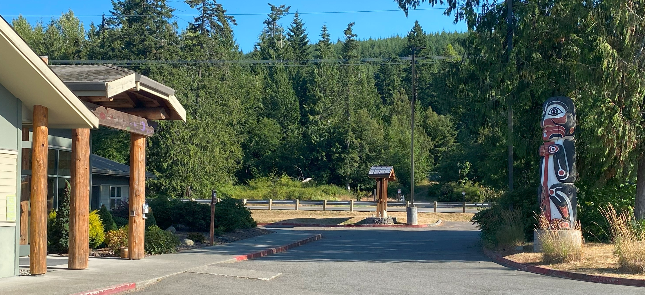
GO FIGURE:
5 = D in a ZC
Shout out the answer!
Notes:
5 digits in a zip code

Slide 13
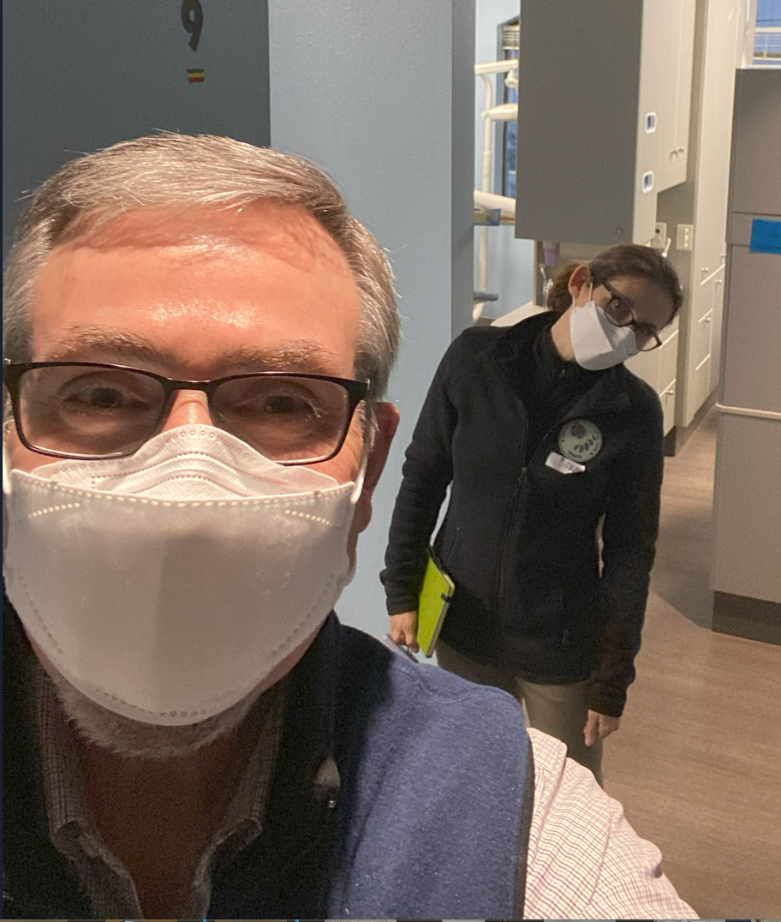
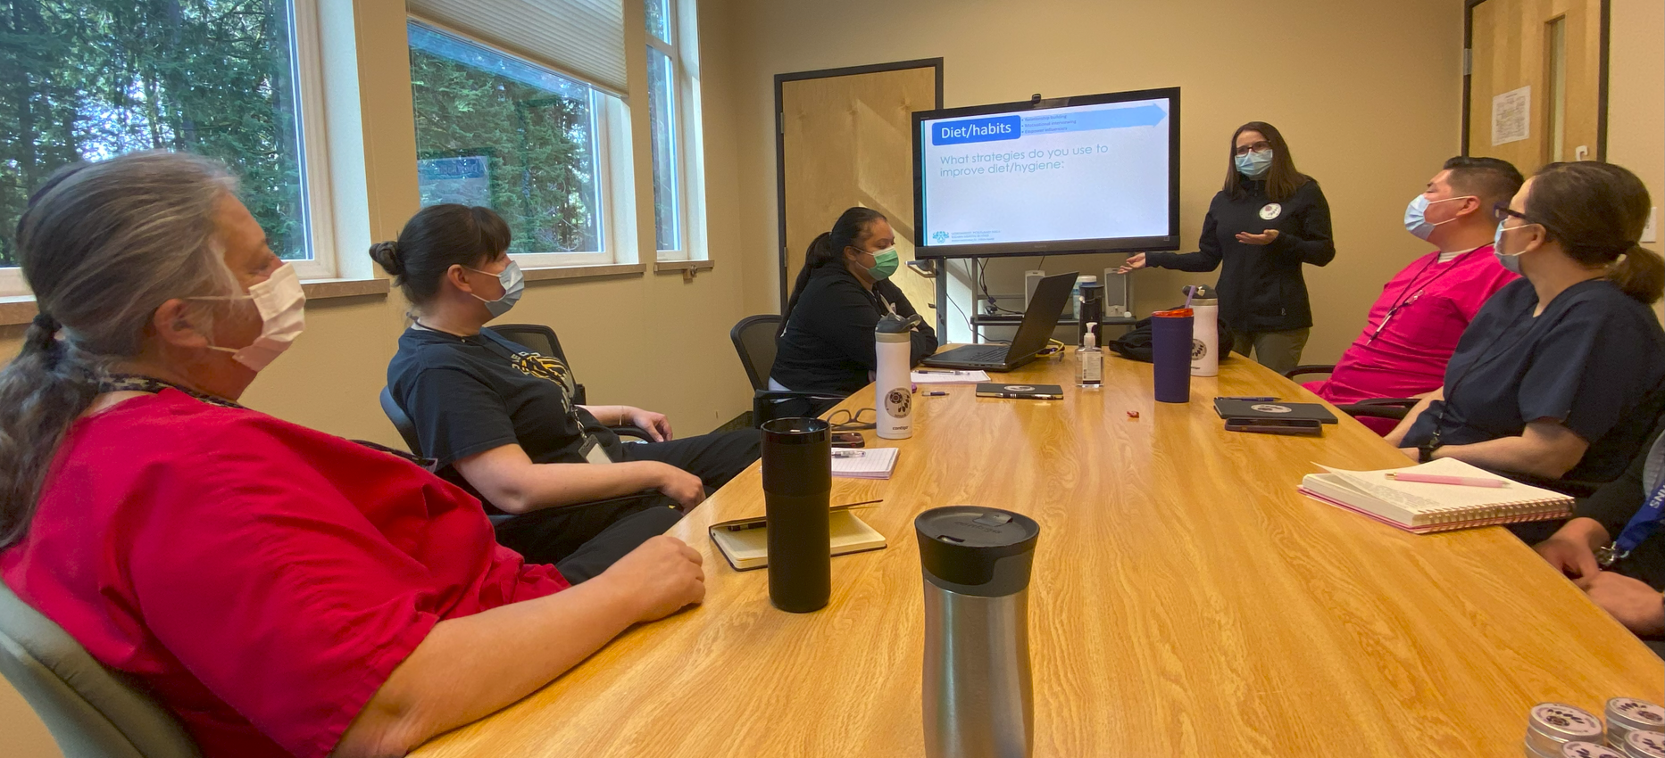
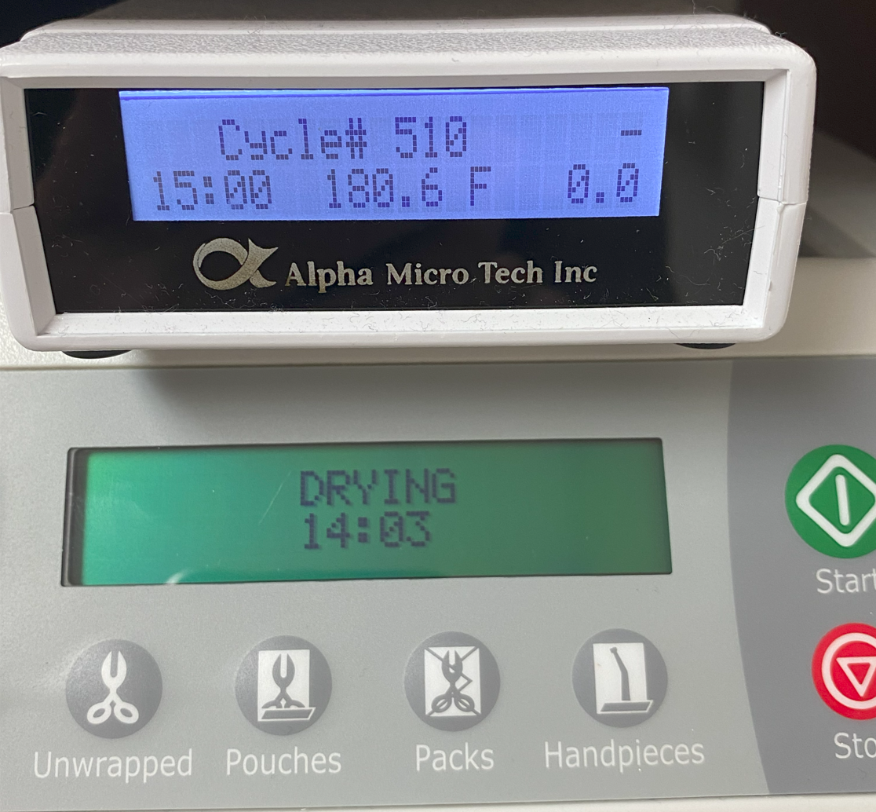
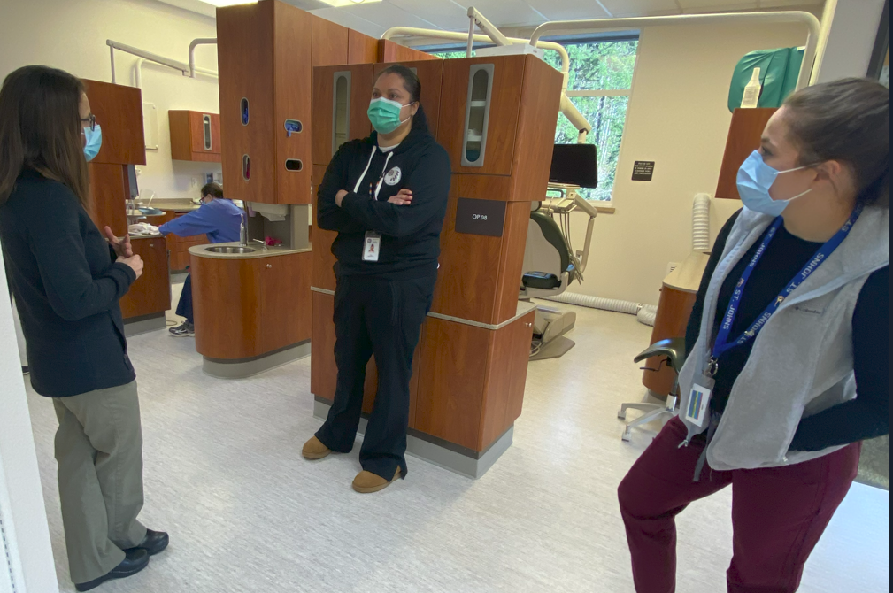
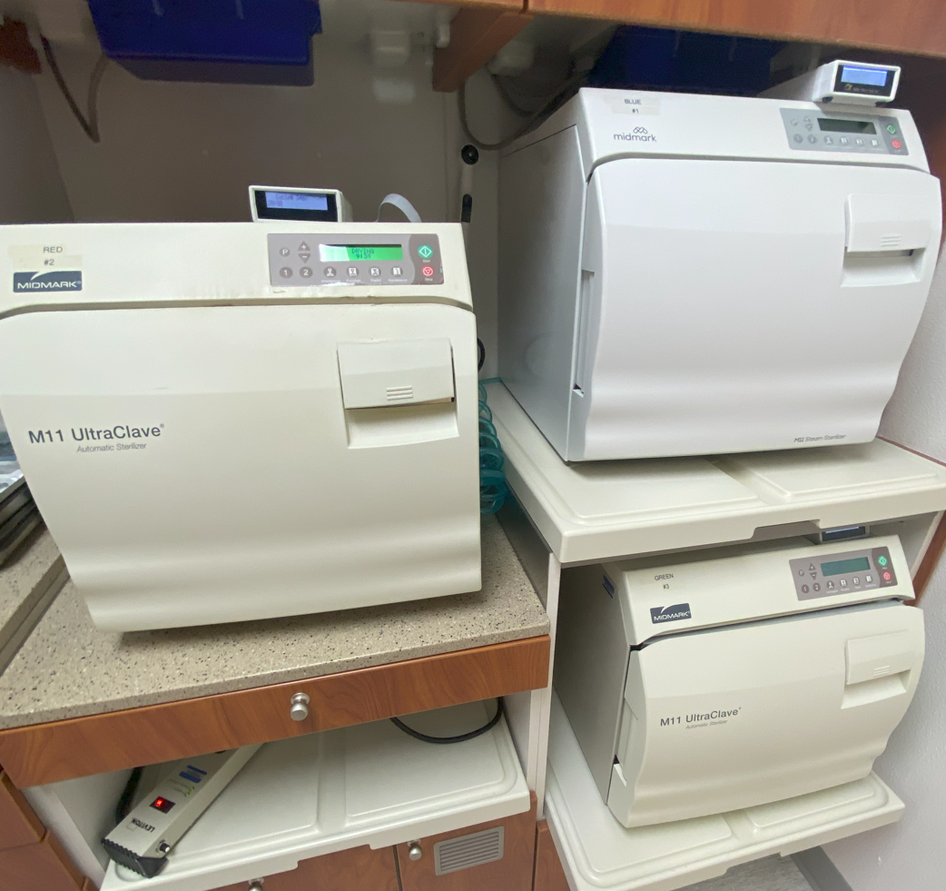
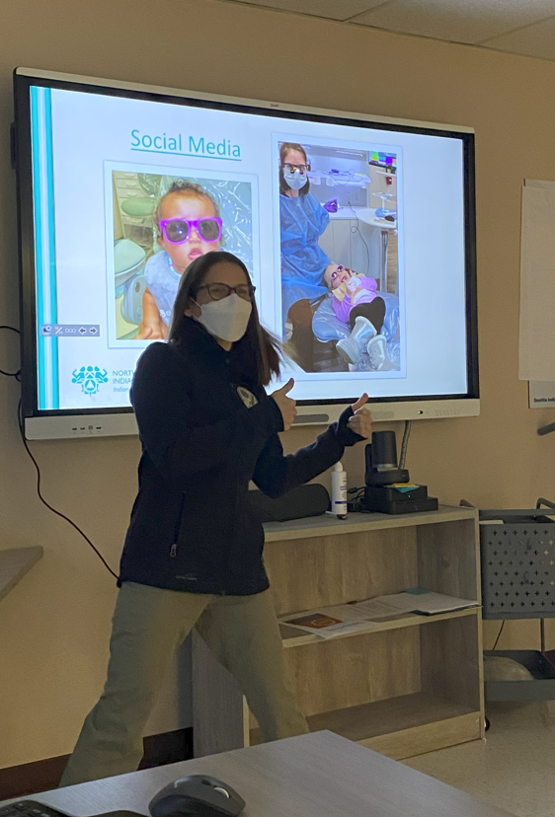
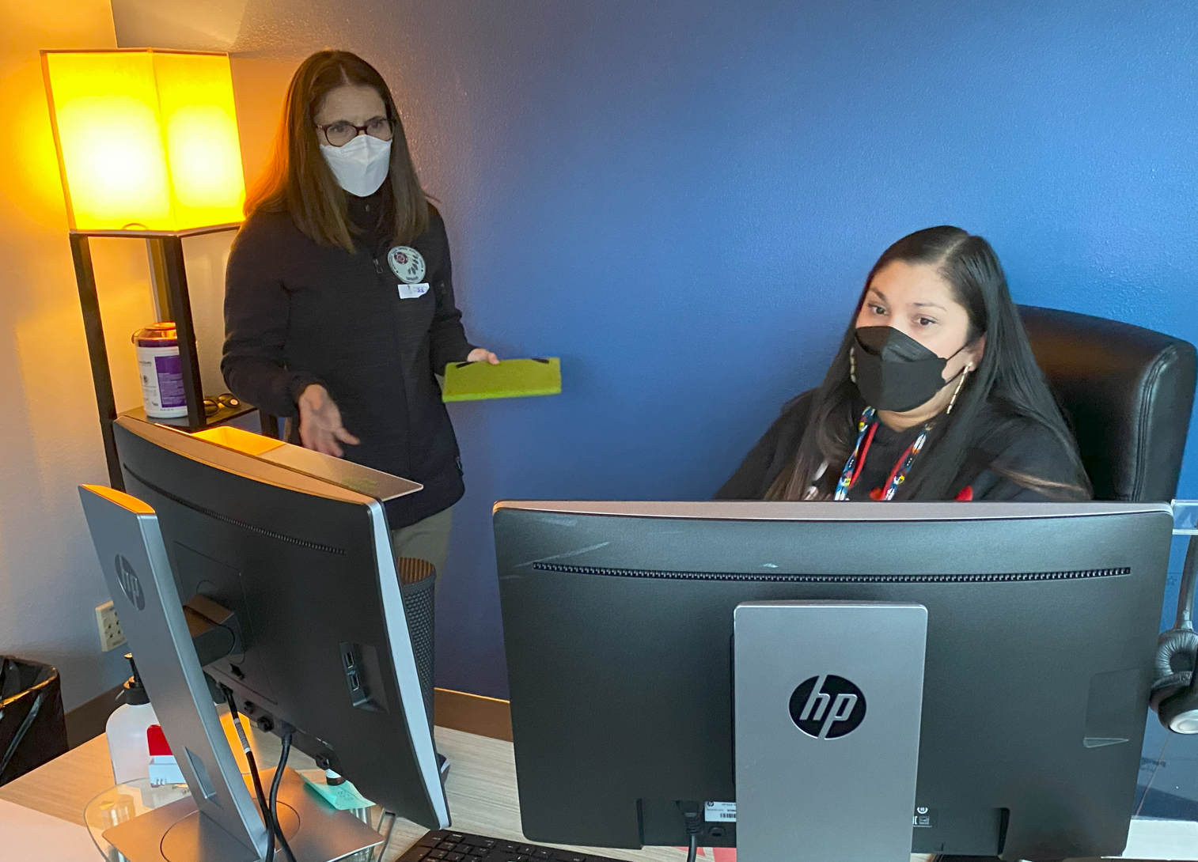
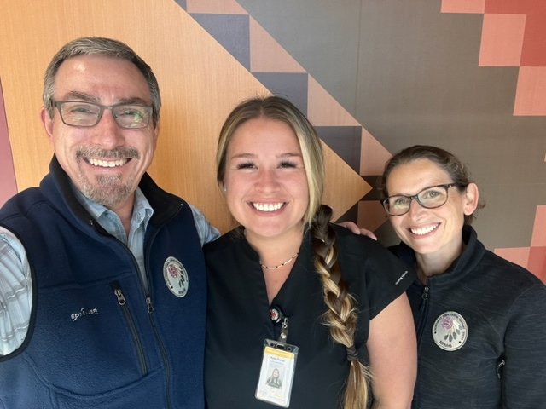
NTDSC Updates:
Site Visits
Collaboratives
Dental Data Dashboard
CDE
Needs Assessment
Perio EFDA
Biopsy and Radiology
Annual Dental Meeting
Notes:
Letter sent out in January and schedule visits usually March through August, cover an array of topics, many of which we are discussing in today’s presentation.

Slide 14
NTDSC Updates:
Site Visits
Collaboratives
Dental Data Dashboard
CDE
Needs Assessment
Perio EFDA
Biopsy and Radiology
Annual Dental Meeting
Notes:
Collaboratives, just finished the We Smile, MID Style Collaborative and are now recruiting for the Wee Smile, with a focus on 0-5 year olds. More on that later
We are also offering as a collaboration with Arcora an area wide Dental Data Dashboard, We will obtain aggregate data so you may monitor and manage certain efficiency and effectiveness measures and be able to compare your work to other clinics in our area. We will cover more later.

Slide 15
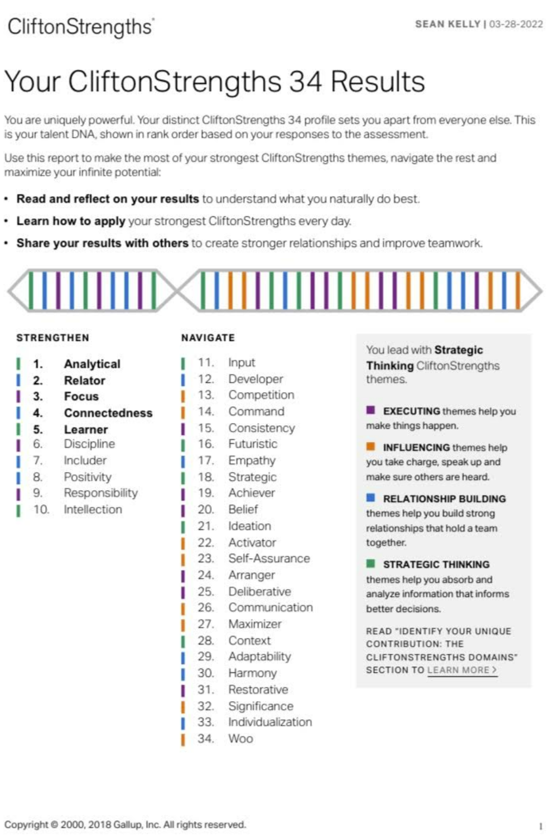
NTDSC Updates:
Site Visits
Collaboratives
Dental Data Dashboard
CDE
Needs Assessment
Perio EFDA
Biopsy and Radiology
Annual Dental Meeting
Notes:
4. CDE for the Portland Area includes the collaborative, of course this annual dental meeting, an opioid CE series, the Indian Country ECHO’s MID series and access to the Clifton Strength’s training. Here is an example of the 34 Clifton Strengths profile report. This allows you and your staff to see each others' strengths and weakness which may help with assigning people various tasks based on their strengths, or at least to better understand the personnel dynamics of your clinic.

Slide 16
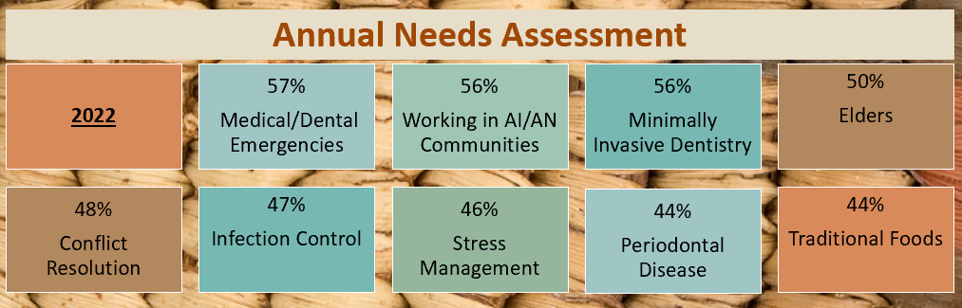
NTDSC Updates:
Site Visits
Collaboratives
Dental Data Dashboard
CDE
Needs Assessment
Perio EFDA
Biopsy and Radiology
Annual Dental Meeting
Notes:
5. We will soon have the annual needs assessment survey sent to all the programs; this helps us to determine where we should focus our resources for the coming year so to best meet the needs of the Portland Area Dental Programs. Please look for that email from Ticey soon.

Slide 17
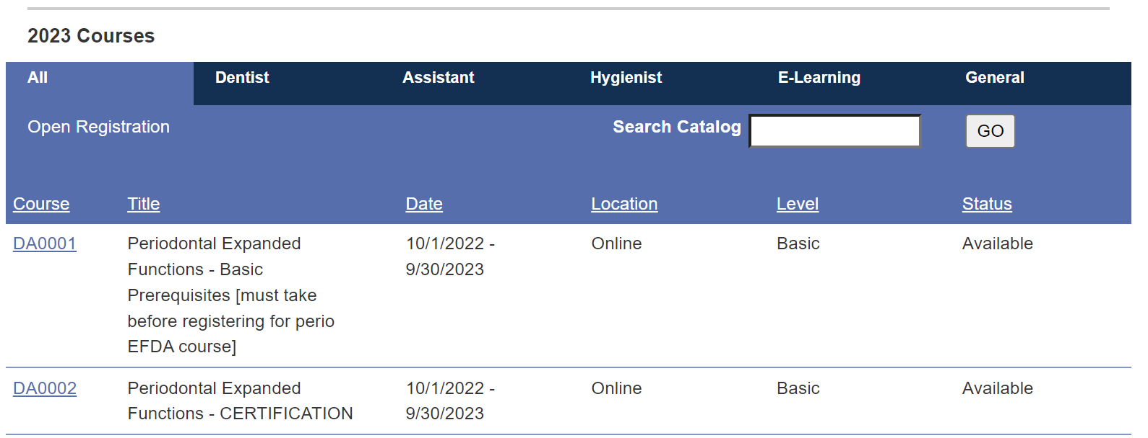
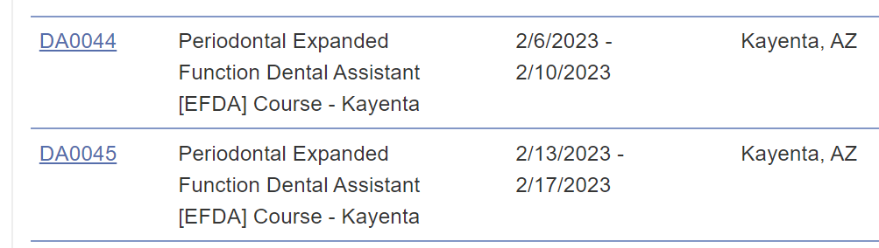
NTDSC Updates:
Site Visits
Collaboratives
Dental Data Dashboard
CDE
Needs Assessment
Perio EFDA
Biopsy and Radiology
Annual Dental Meeting
Notes:
6. Who is interested in having dental assistants trained for EFDA in Perio? WHY is this a good idea? How is your RDH scheduling?
We are looking for sites to host, the ideal is 3 operatories and to be available for 1 week. 6 Students enroll, host clinic has priority, then other area clinics and then clinics outside our area. Looking to have Pam Ready, RDH from NPAIHB to be a certified trainer.

Slide 18
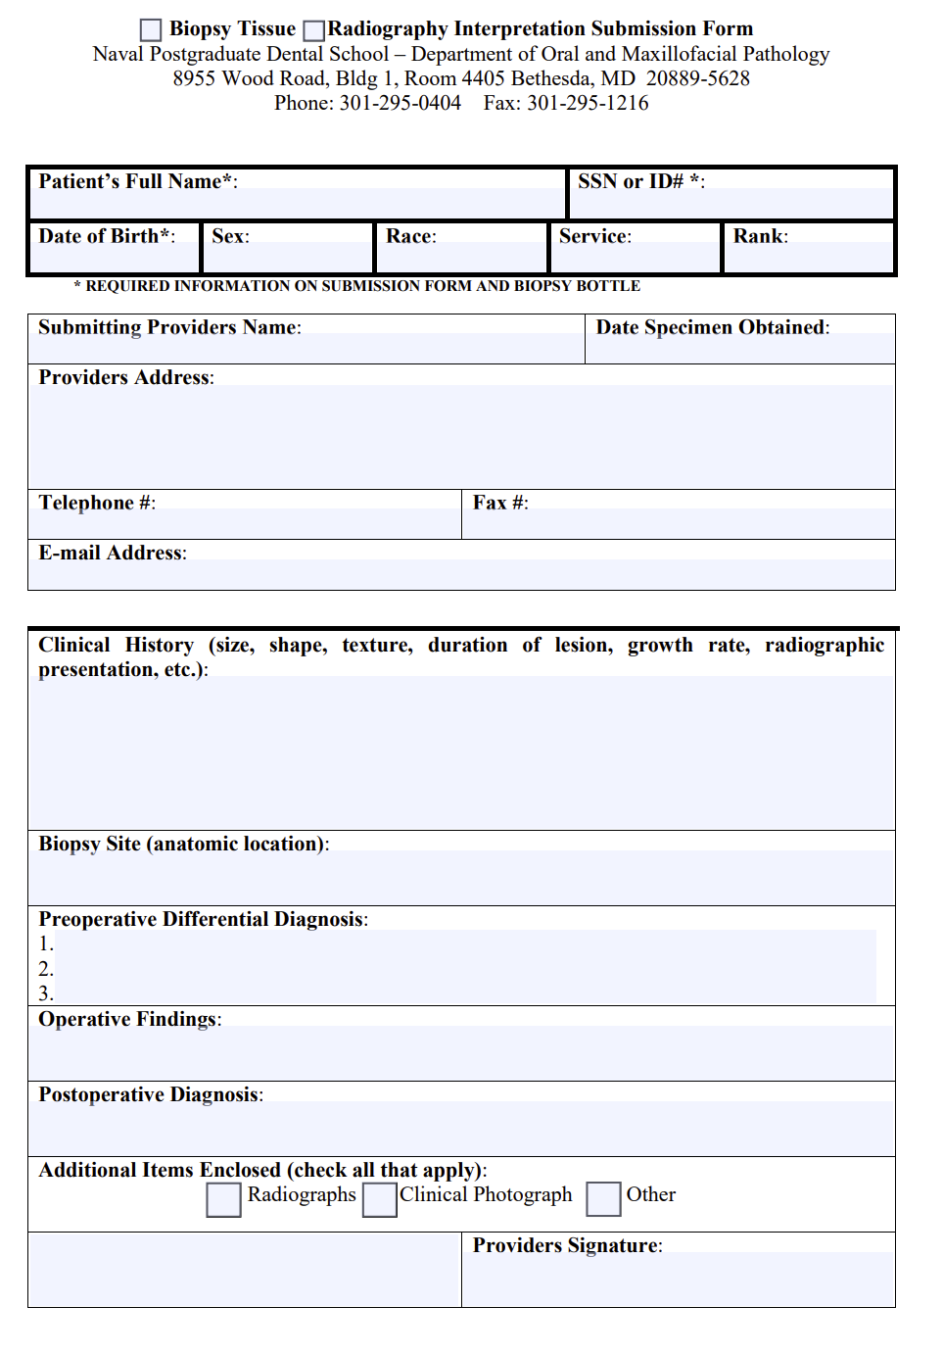
NTDSC Updates:
Site Visits
Collaboratives
Dental Data Dashboard
CDE
Needs Assessment
Perio EFDA
Biopsy and Radiology
Annual Dental Meeting
Notes:
7. Who utilizes the biopsy form from the Naval Postgraduate Dental School - Department of Oral Pathology? There is a fillable pdf format. IF you do not have it I we can send it to you. Did you know you may also send radiographs for digital interpretation? We have an MOU for this service. It and the pathology submissions are free. AS you can see at the top of this form you indicate which you are submitting.

Slide 19
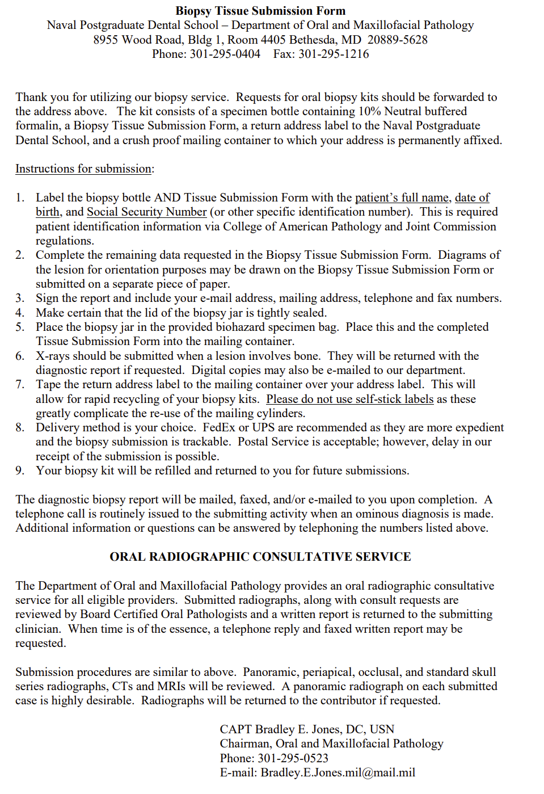
NTDSC Updates:
Site Visits
Collaboratives
Dental Data Dashboard
CDE
Needs Assessment
Perio EFDA
Biopsy and Radiology
Annual Dental Meeting
Notes:
The form includes these instructions, biopsy kits are provided by the Dental School

Slide 20

NTDSC Updates:
Site Visits
Collaboratives
Dental Data Dashboard
CDE
Needs Assessment
Perio EFDA
Biopsy and Radiology
Annual Dental Meeting
Notes:
8. Annual Dental Meeting, next year’s registration will be through a single representative for each Dental Program. So, for next year please be prepared to assign as the Point of Contact one person to handle all registrations and reservations for your clinic. This will include assigning the scholarship for your staff.

Slide 21
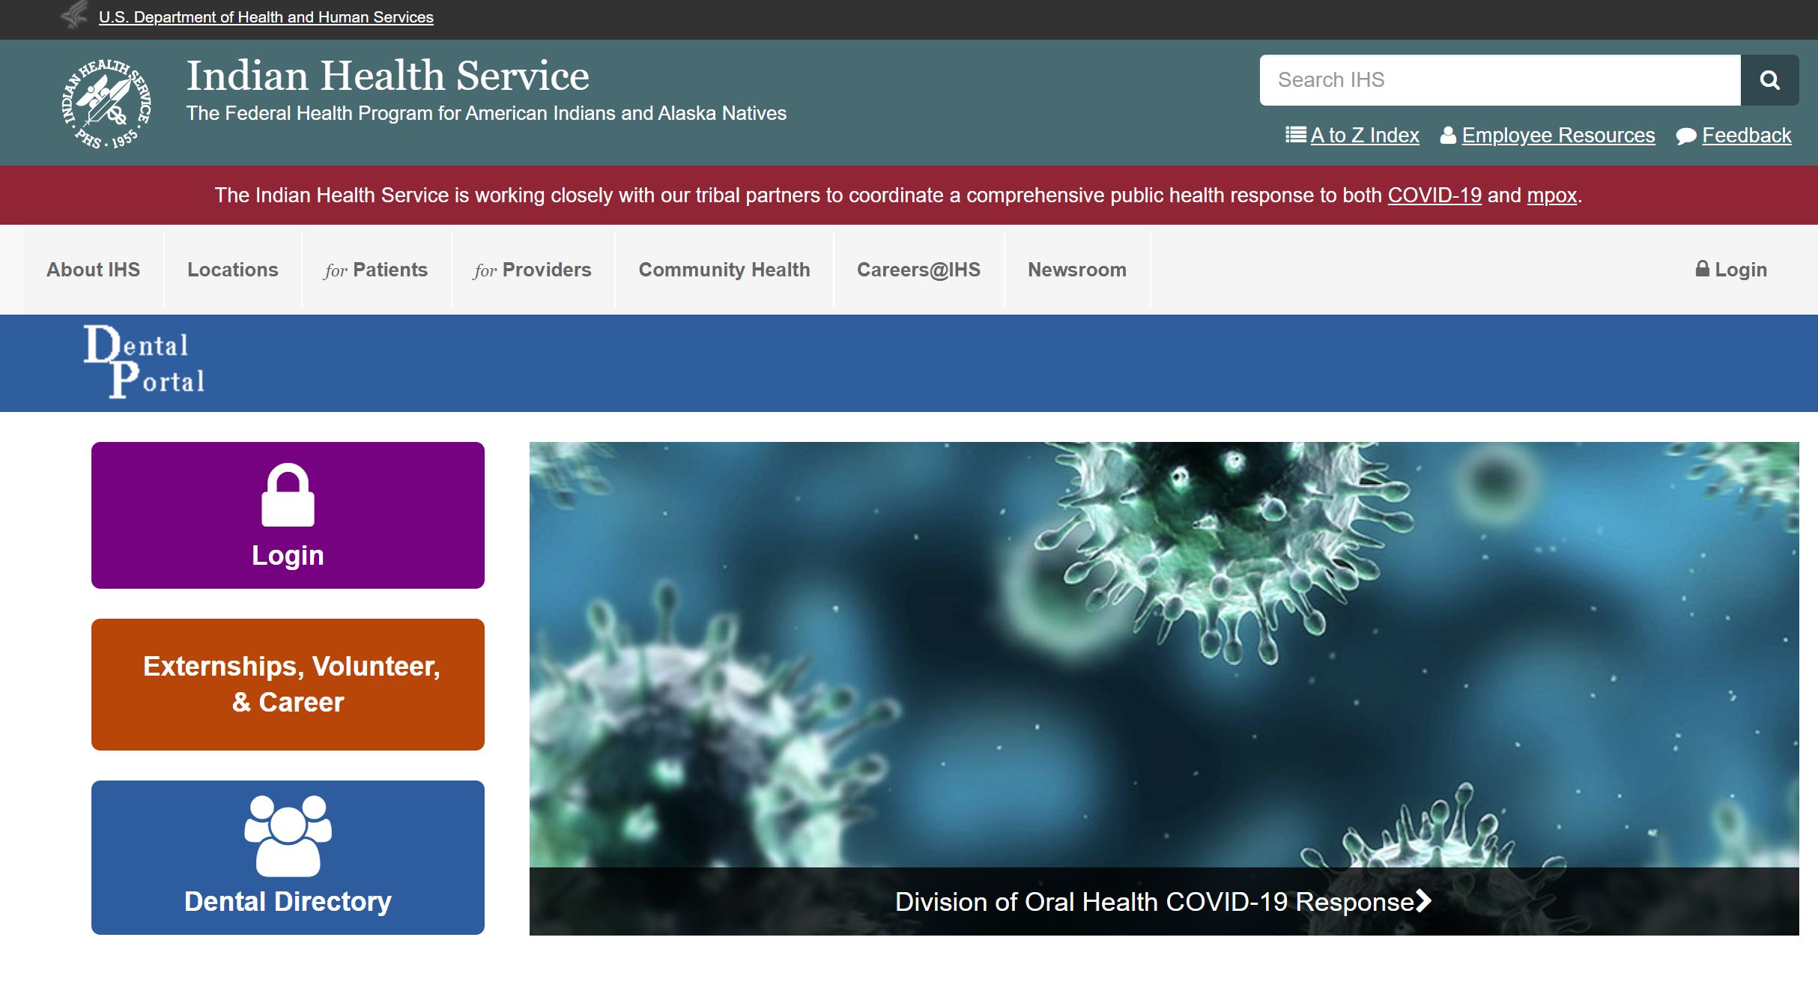
IHS Division of Oral Health (DOH) website
Dental Portal
https://www.ihs.gov/DOH/index.cfm?fuseaction=home.showportalhome&CFID=90172535&CFTOKEN=15330717
Notes:
This is the link to the IHS DOH Dental Portal and what it looks like. Who has not used this Website?

Slide 22
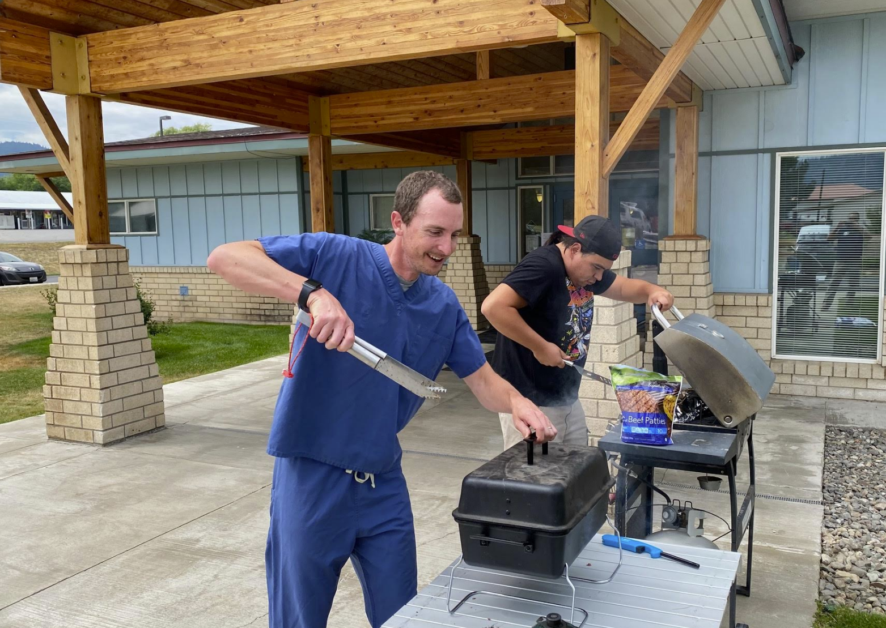
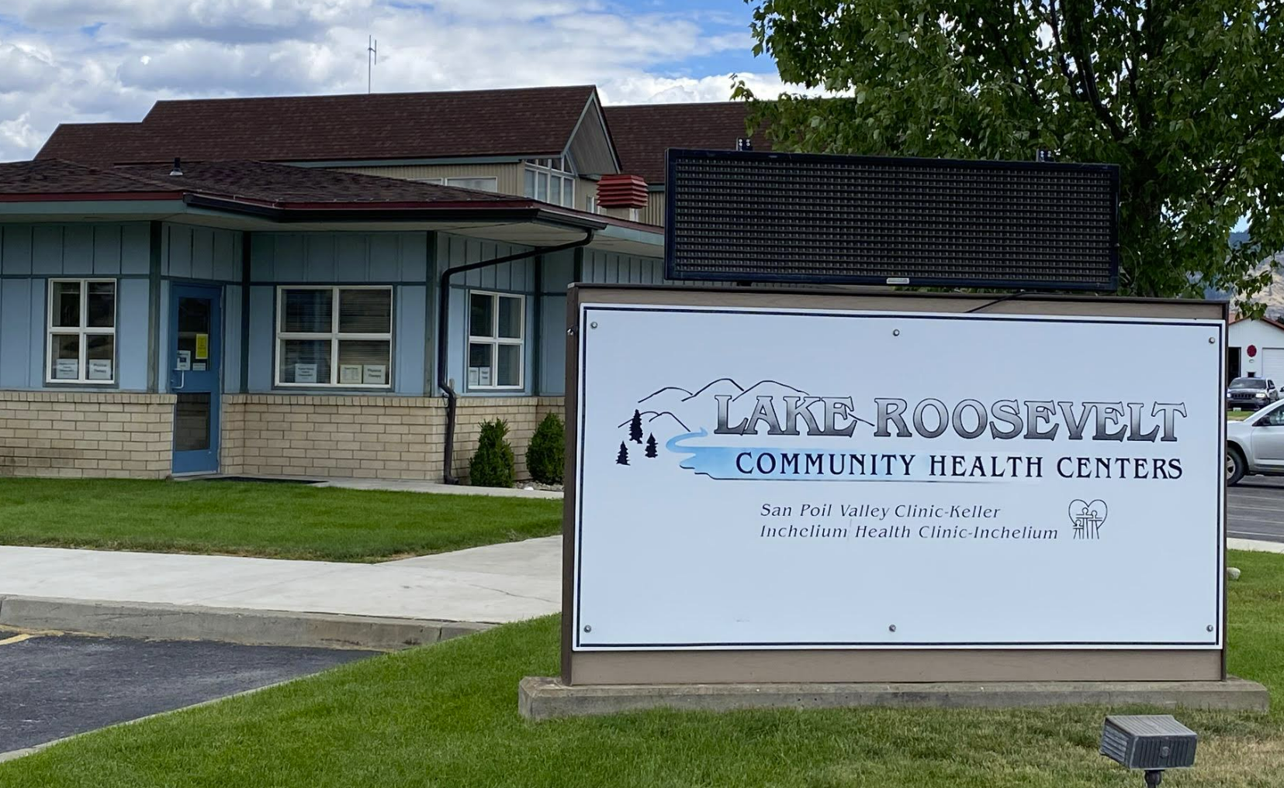
GO FIGURE:
Nice grip on those forceps Dr. Graves.
64 = S on a CB
Shout out the answer!
Notes:
64 Squares on a Chess Board (or Checkerboard) Dr. Graves and his assistant going in for the extraction. Nice grip on those forceps Dr. Graves.

Slide 23
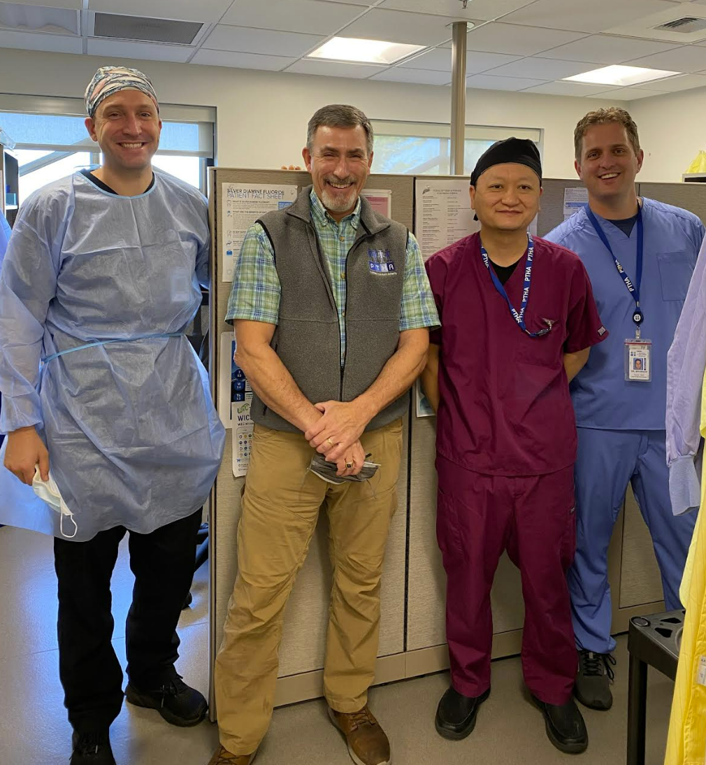
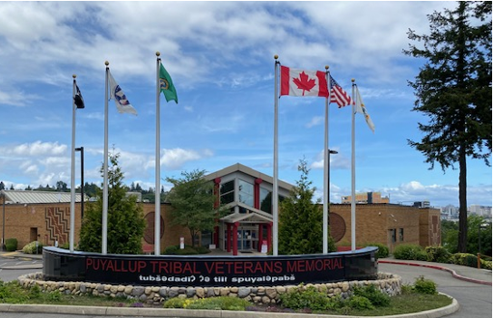
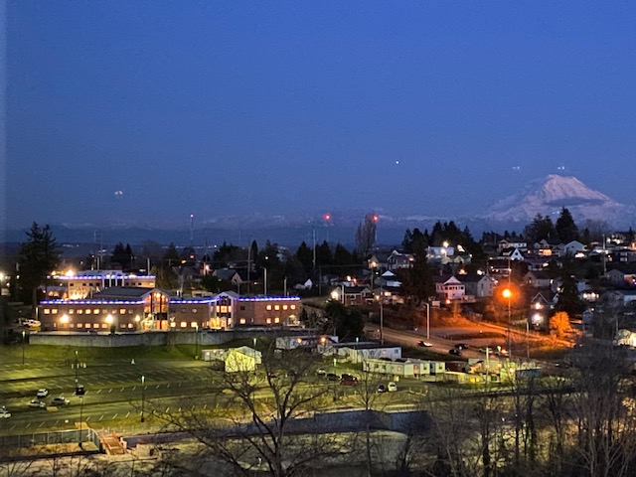
Policies and Procedures, Protocols and Standard Operating Procedures:
Policy and Procedures
  Organizational wide or Interdepartmental
  Require Governing Body approval
    Tribal Council or Health Board
2. Protocols and Standard Operating Procedures
a. Departmental
b. Day to day activities
c. Easier to update as new workflows are developed or new information is provided.
3. No paper! Central electronic access only!
4. IHS DOH Dental Portal Examples
https://www.ihs.gov/DOH/chiefs/index.cfm?fuseaction=duties.display
(Puyallup Tribal Health Authority)
Notes:
Ask questions for responses to naming a topic and what category it falls into,
ie. Sharps stick, caries risk assessment, absenteeism, types of radiographs taken during UC, or frequency of the types for an exam.
Why no longer paper? Too difficult to share and to track, someone has a hardcopy somewhere that is obsolete.

Slide 24
Policies and Procedures, Protocols and Standard Operating Procedures:
Hierarchy approach to safe practices:
1. Rules and Regulations (OSHA, FDA, EPA, FGI)
2. State and Local requirements. (State & Local health department)
3. Manufacturers Instructions for Use (IFUs)
4. Evidence-Based Guidelines and National Standards (CDC)
5. Consensus Documents (AAMI) (stricter, if you use AMMI for one aspect of IC, then you need to use it for all other aspects, can't pick and choose.)
6. Organization’s Infection Prevention and Control Policy
Credit for this outline to:
Damon Pope, DMD
IHS DOH National Dental Infection Control & Safety Coordinator
Indian Health Service HQ
Notes:
FGI (Facility Guidelines Institute: for building and designing hospitals and clinics). AAMI (The Association for the Advancement of Medical Instrumentation® (AAMI) is a nonprofit organization founded in 1967. It is a diverse community of more than 10,000 professionals united by one important mission—the development, management, and use of safe and effective health technology. AAMI is the primary source of consensus standards, both national and international, for the medical device industry, as well as practical information, support, and guidance for healthcare technology and sterilization professionals.

Slide 25
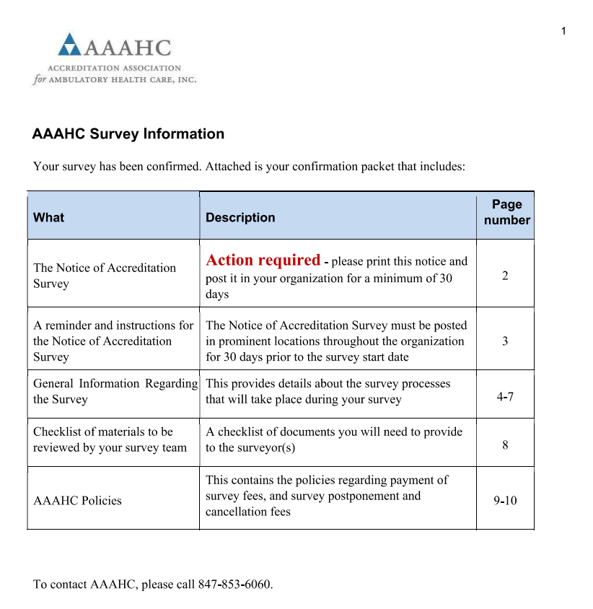
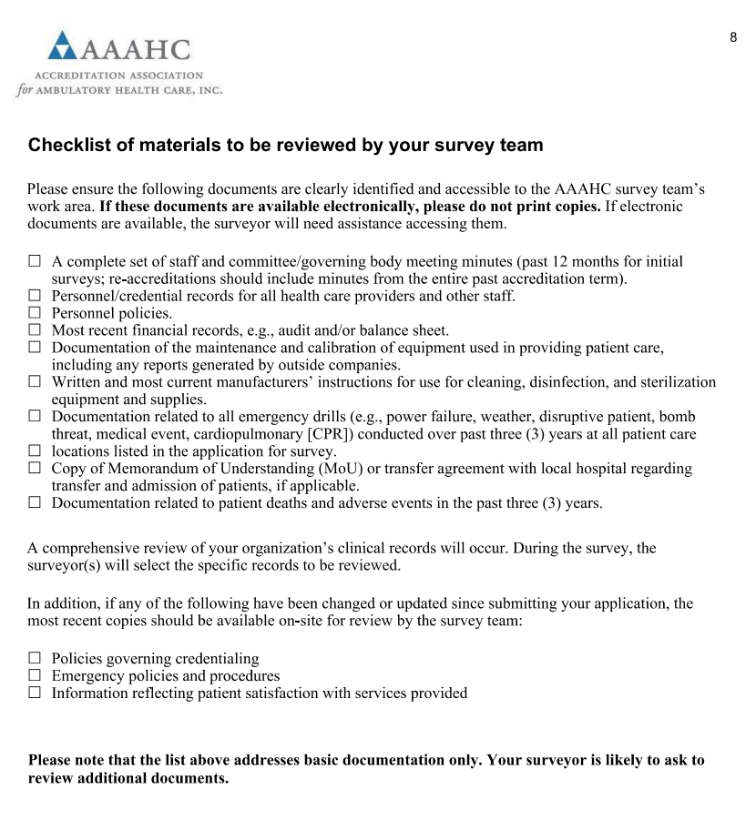
Policies and Procedures, Protocols and Standard Operating Procedures:
AAAHC
Notes:
When scheduling a AAAHC Survey, they provide several pages of Survey Information to include a checklist of the materials to be reviewed by your survey team.
Key for any accreditation process is to have written policies that are current and that you follow. Nothing is worse to a surveyor than to have a written policy that does not apply to your program, especially if it contradicts what you are actually doing.

Slide 26

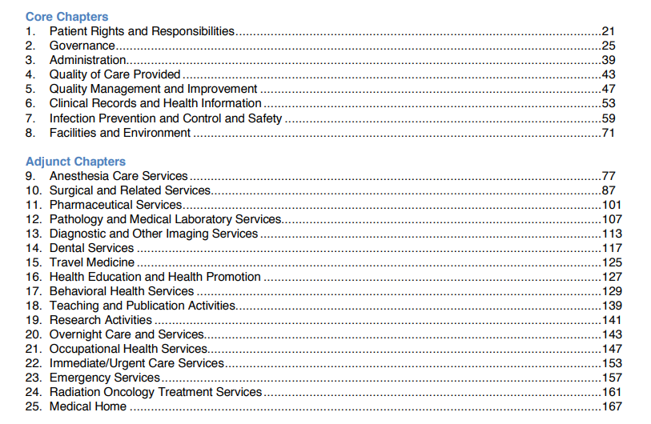
Policies and Procedures, Protocols and Standard Operating Procedures:
AAAHC
Notes:
This from the 2020 Survey Year. AAAHC Chapters. Other than the Core Chapters that include Infection Prevention and Control and Safety, the Adjunct chapters that are key to Dental are chapters 9 Anesthesia Care Services, Chapter 10 Surgical and Related Services, Chapter 13 Diagnostic and Other Imaging Services and of course Chapter 14 Dental Services. If opted for Medical Home then Chapter 25 as well. Raise your hand if you personally have completed a AAAHC Survey within the last 3 years? Look around. If you have questions to ask, these are your people. I will be happy to take questions as well.

Slide 27
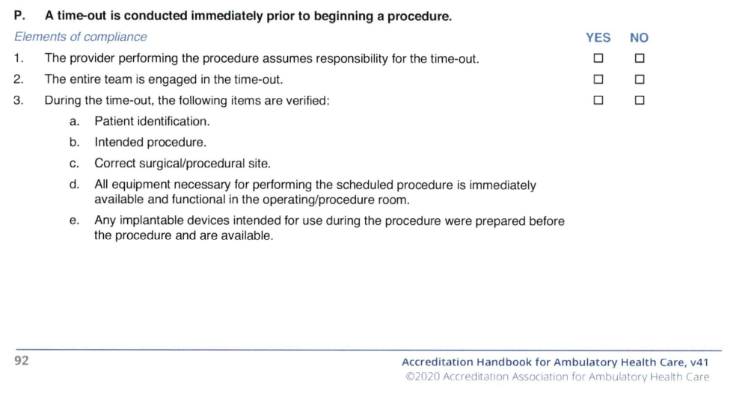
Policies and Procedures, Protocols and Standard Operating Procedures:
AAAHC
Notes:
Let's look at an example of a the AAAHC survey from Chapter 10 Surgical and Related Services. A show of hands of those who have personally completed a AAAHC Survey in the last 3 years, how many of you had a dentist be one of the surveyors?

Slide 28
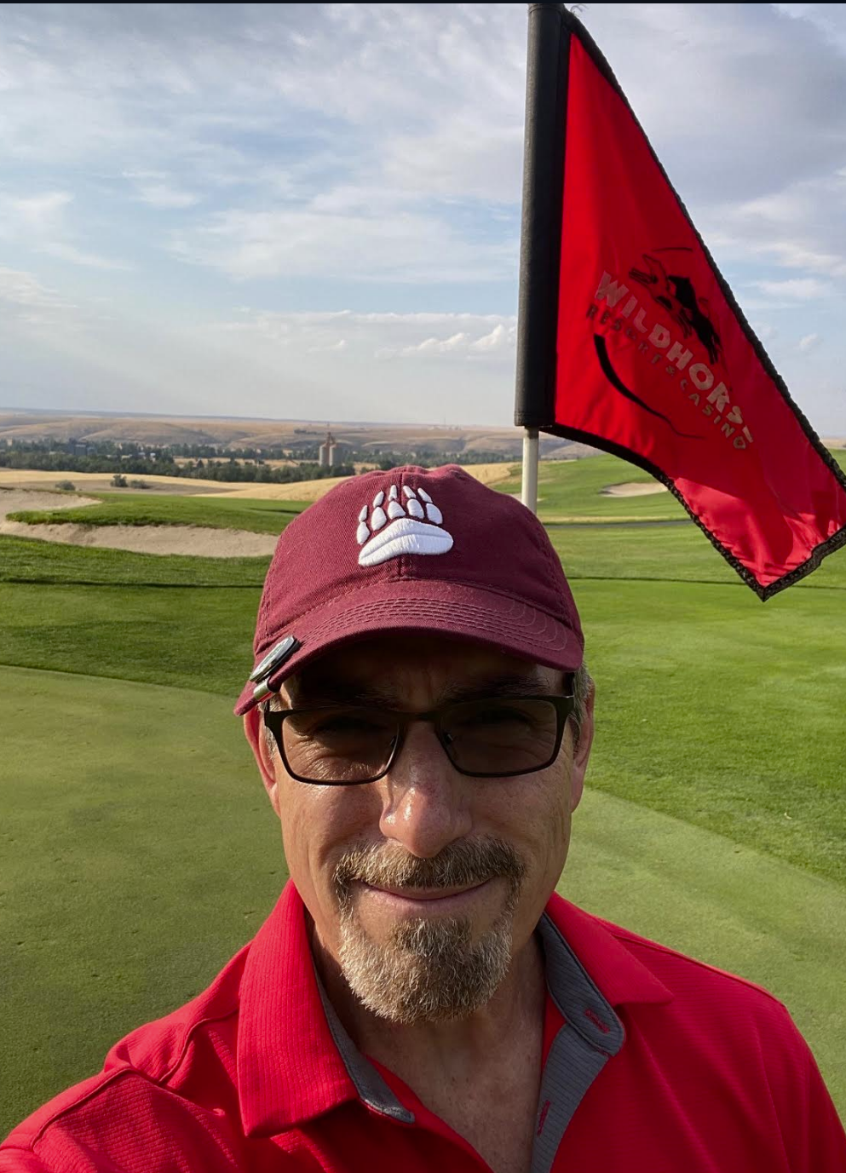
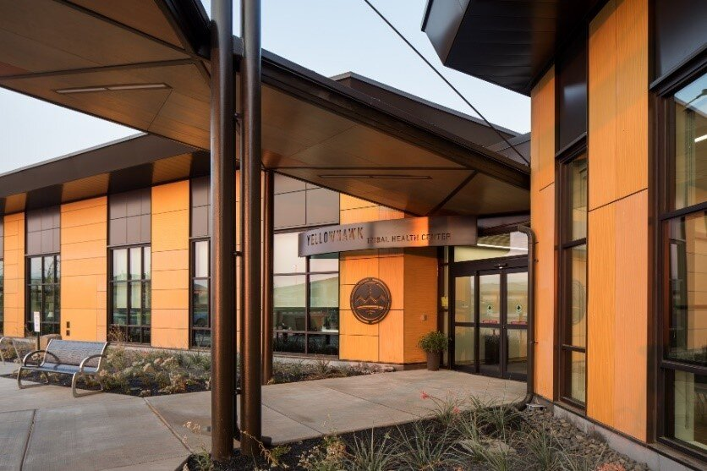
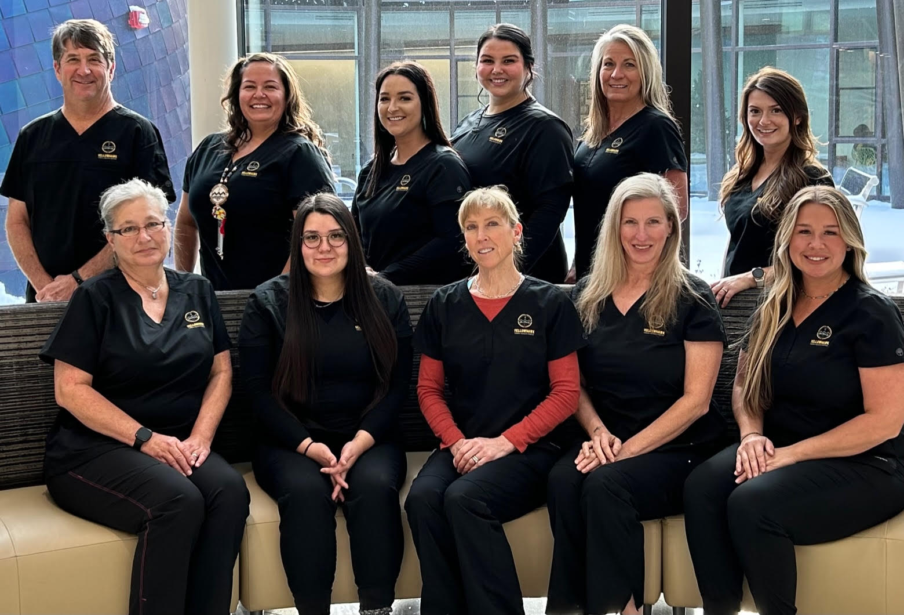
GO FIGURE:
18 = H on a GC
Shout out the answer!
Notes:
18 Holes on a Golf Course

Slide 29
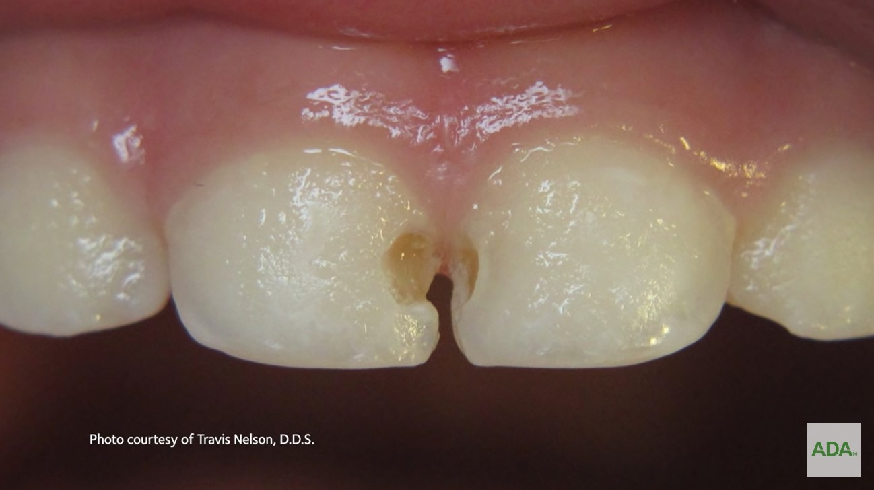
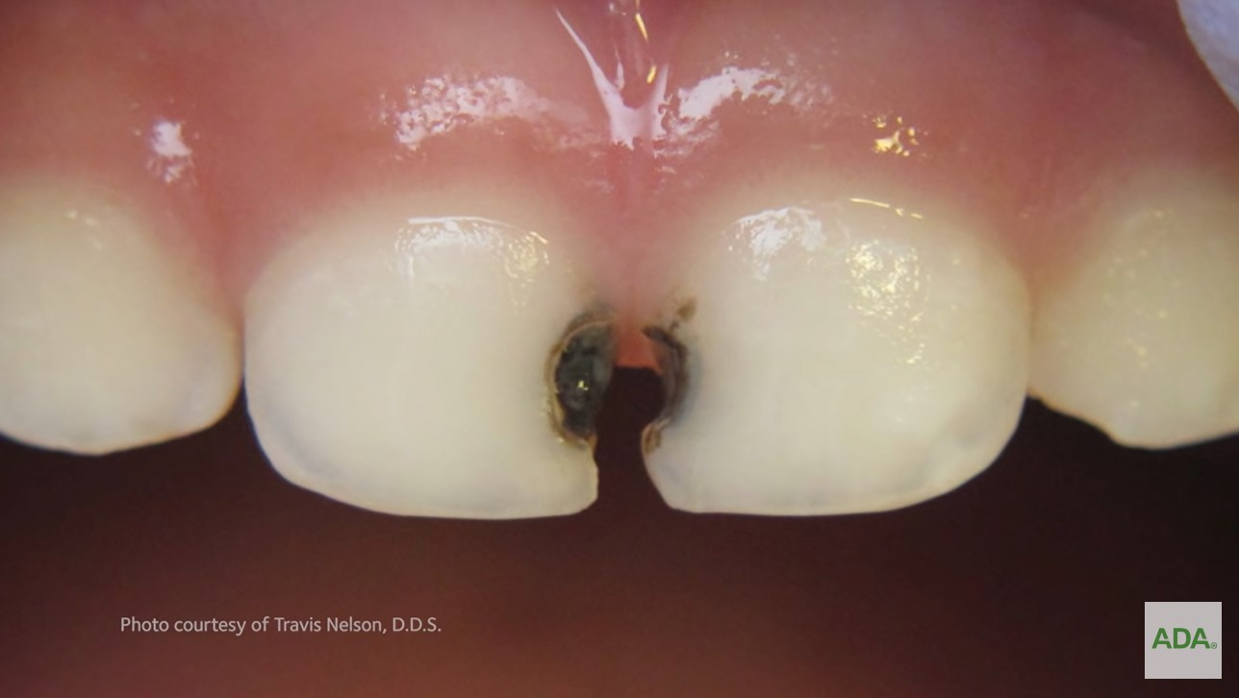
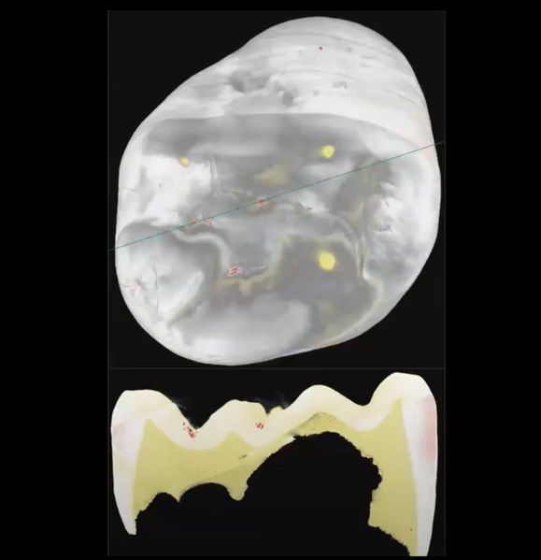
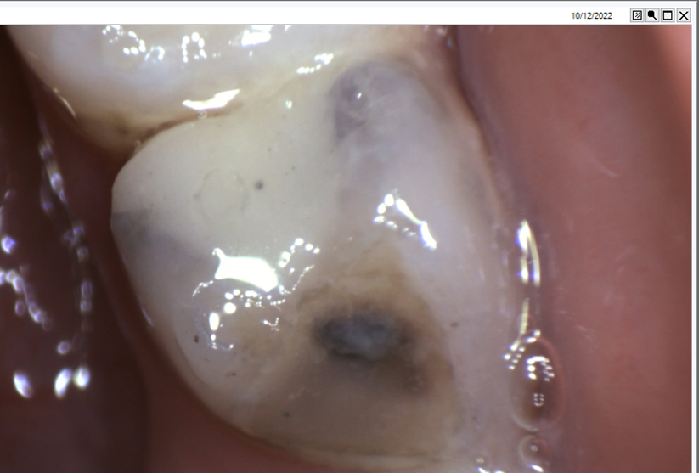
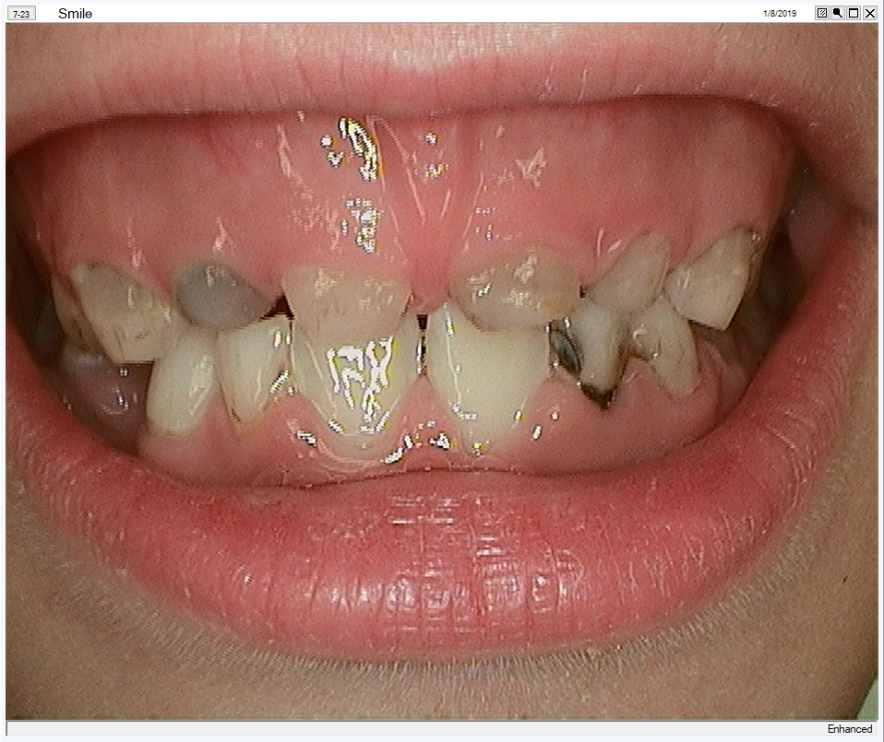
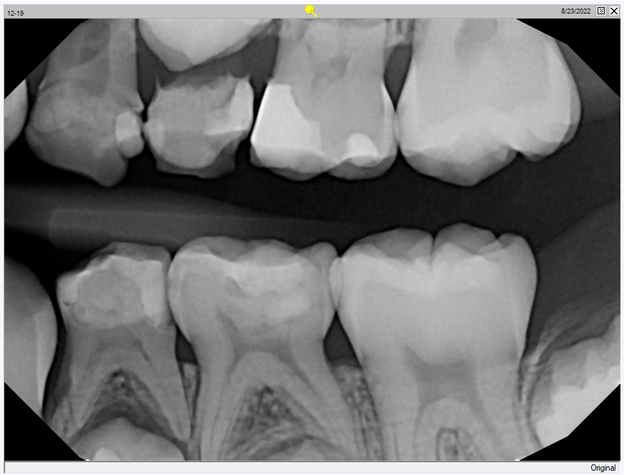
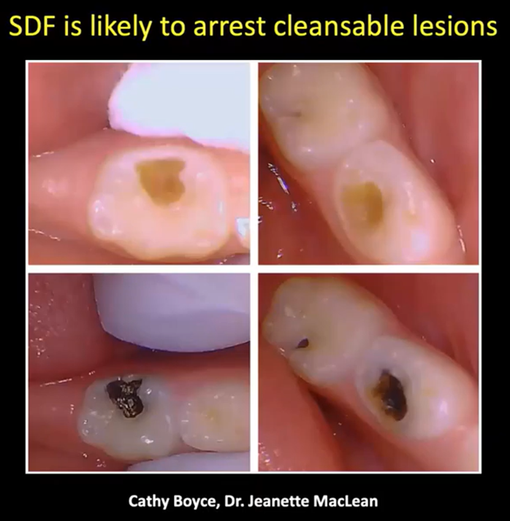
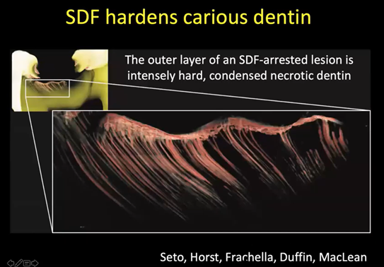
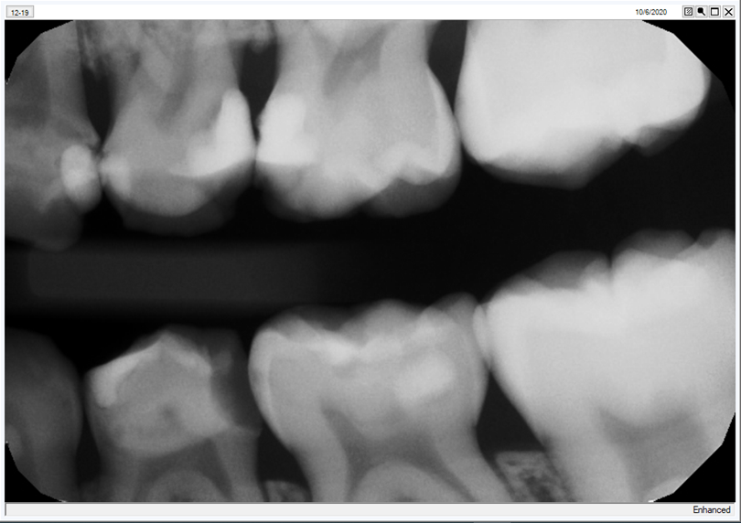
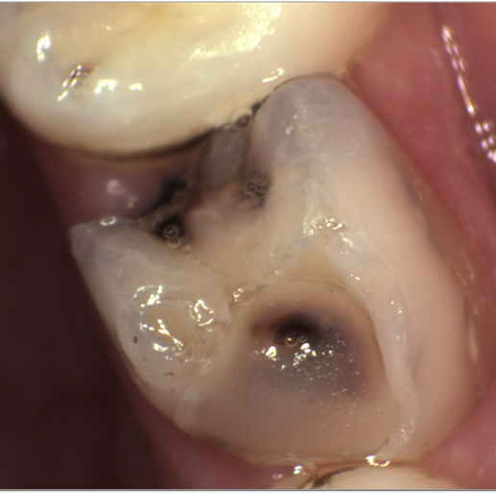








15 minute Break
Dr. Davis’s 2nd favorite Dental Prevention Slide, who can name her favorite?
Notes:
You all seem so anxious since none of what we presented so far has teeth, so here you are you can relax now. Let’s take 15 minutes and reconvene at >>>>>>
Dr. Davis’s favorite Dental Prevention Slide is “Zone of Fusion”

Slide 30


GO FIGURE:
1000 = W that a P is W
Shout out the answer!
(Seattle Indian Health Board)
Notes:
A 1,000 words that a picture is worth

Slide 31


Data, QA/QI:
Dental Data Dashboard
  A. Phase 1
    Access
      Unique Users (# of patients)
      Number of appointments
      Number of kept appointments (broken appointment rate)
    Disease
      Number of exams
      Number of treatment plans complete (Using a NNOHA measure)
    Prevention
      Number of sealants (2–15-year-olds)
      Number of fluoride treatment (2–15-year-olds)
Notes:
DDD by NTDSC and Arcora, not that Aggregate data will allow your program to compare with area averages. A tool to help you relate to other programs and give you an idea of where you are excelling and where you need improvement. No one else can see your individual data. The more programs that participate, the more meaningful the data. More information will be provided in the future.
NNOHA is the National Network for Oral Health Access
C. i. and ii. are GPRA measures.

Slide 32

Data, QA/QI:
Clinical Productivity, Efficiency and Effectiveness Standards are available on the
IHS DOH Dental Portal
https://www.ihs.gov/doh/index.cfm?fuseaction=clinicmanagement.ee
Notes:
Note it is encouraged to review and assess your clinic for these measures or indicators at least once every one to two years. I would suggest this be an ongoing process and some require monthly monitoring or at least quarterly. Note that for the first two you should know your User Population. I also have a spread sheet that gives you the instructions for these reports if you use Dentrix, DXONE.

Slide 33

Data, QA/QI:
IHS Portland Area User Population
It’s complicated….. uses a 3-year period for patient access to any healthcare service (not just dental)
PRCDA’s are Purchased Referred Care Delivery Areas
Notes:
Due to the Portland Area’s unique situation where most Tribal PRCDA’s are overlapping, resulting in multiple counties being shared by two or more Tribes, UP is determined through a combination of both Tribal affiliation and workload
-Each Tribe receives as part of its total UP all of its own Tribal members who reside in its Delivery Area counties
-AI/AN who are not members of the Tribe(s) whose Delivery Area county they reside in are Unaffiliateds. These unaffilitateds are apportioned among the Tribe(s) whose Delivery Area includes that county, based on workload data accepted at the NDW.
I like to add that for some clinics that treat Non-AI/AN patients they then will have a higher user population than is reported.
AND Note that the User Population may be used to help determine appropriate staffing and to determine some of the IHS DOH Efficiency and Effectiveness Measures.
NDW = National Data Warehouse via the National Patient Information Reporting System (NPIRS).
When I do site visits and we look at your staffing relative to the User Population I attempt to paint a positive picture despite the circumstances, meaning if you are understaffed for your user population then I make the argument that more staff is needed to meet the oral health needs of your community. If your clinic is over staffed based on your UP, then I make the argument that this allows for providing high levels or care or services in your clinic, more complex procedures AND operating at a level than may prevent disease as opposed to treating disease. Or allows the opportunity to provide services to Non-AI/AN patients such as Medicaid services to your community allowing for addition collections to help support your dental program.

Slide 34
Data, QA/QI:
An example using Data for a Quality Assurance or Quality Improvement project and/or Peer Review.
  Want to open the schedule from 4 weeks out to 3 months. How will this change affect kept appointments (broken appointment rate)?
  Is staff entering the broken appointment code? A Peer Review is established that includes chart/schedule review and the entry of the BA code. This may include only providers (dentists, hygienists and dental therapists), or auxiliary personnel.
  Once the peer review provides the needed information, then proceed as necessary. More training and accountability for code entry? More automation in the EDR? Code entry is appropriate? If so proceed with the change, but…..
Proceed with a smaller sample, test first (PDSA). Perhaps schedule 8 weeks out. Monitor broken appointment rate and make changes to your plan as necessary.
Any examples you like to share?
Notes:
QA is verifying that the BA code is being properly utilized. The Peer Review is a tool to assess this. The QI is making changes to improve the organization through a process or workflow so to provided better healthcare outcomes.
Share your examples? (SIHB regarding the Epic’s ability to provide patient’s risk for failing an appointment.)

Slide 35

Data, QA/QI:
Assess QI studies—especially goals—against SMART criteria:
Specific: The goal is clear and easy to understand. It translates into action by using words like “increase” or “decrease”
Measurable: The goal is objective and can be assessed by gathering quantitative data, e.g., 25%, 20 minutes, all, none
Achievable: Those responsible for the goal have the knowledge, skills and resources to deliver the result Relevant: The goal “matches” the purpose and is relevant to the services the organization provides and the patients the organization serves, e.g., improves compliance, increases patient satisfaction, or saves money
Time-bound: The goal has a completion date, e.g., by 12/31, third quarter
-2020 AAAHC QUALITY ROADMAP • Accreditation Association for Ambulatory Health Care
Notes:
SMART

Slide 36

Data, QA/QI:
The best darn Data, QA/QI CDE ever!
https://www.ihs.gov/DentalCDE/index.cfm?fuseaction=elearning.display&cat=online&sort=title&order=asc

Slide 37
Data, QA/QI:
The best darn Data, QA/QI CDE ever!
DE0389
2020 OCA-BEM-GPA Area Dental Meeting, Session 2 [Recorded Webinar]
10/1/2022 - 9/30/2023
Learning Objectives:
Upon completion of this course, participants will be able to: 1. Describe how to use IHS recommendations for clinical efficiency and effectiveness as a benchmark for their programs. 2. Utilize Excel spreadsheets to manage monthly QI/QA Data. 3. Develop a meaningful QI/QA Plan.
Notes:
Due to the Portland Area’s unique situation where most Tribal PRCDA’s are overlapping, resulting in multiple counties being shared by two or more Tribes, UP is determined through a combination of both Tribal affiliation and workload
-Each Tribe receives as part of its total UP all of its own Tribal members who reside in its Delivery Area counties
-AI/AN who are not members of the Tribe(s) whose Delivery Area county they reside in are Unaffiliateds. These unaffilitateds are apportioned among the Tribe(s) whose Delivery Area includes that county, based on workload data accepted at the NDW.
I like to add that for some clinics that treat Non-AI/AN patients they then will have a higher user population than is reported.
AND Note that the User Population may be used to help determine appropriate staffing and to determine some of the IHS DOH Efficiency and Effectiveness Measures.
NDW = National Data Warehouse via the National Patient Information Reporting System (NPIRS).
When I do site visits and we look at your staffing relative to the User Population I attempt to paint a positive picture despite the circumstances, meaning if you are understaffed for your user population then I make the argument that more staff is needed to meet the oral health needs of your community. If your clinic is over staffed based on your UP, then I make the argument that this allows for providing high levels or care or services in your clinic, more complex procedures AND operating at a level than may prevent disease as opposed to treating disease. Or allows the opportunity to provide services to Non-AI/AN patients such as Medicaid services to your community allowing for addition collections to help support your dental program.

Slide 38


GO FIGURE:
12 = S of the Z
Shout out the answer!
Notes:
12 Signs of the Zodiac

Slide 39
Staffing:
Resource Requirement Methodology (RRM)
2. Community Health Aide Program (CHAP)
Notes:
AAMI (The Association for the Advancement of Medical Instrumentation® (AAMI) is a nonprofit organization founded in 1967. It is a diverse community of more than 10,000 professionals united by one important mission—the development, management, and use of safe and effective health technology. AAMI is the primary source of consensus standards, both national and international, for the medical device industry, as well as practical information, support, and guidance for healthcare technology and sterilization professionals.

Slide 40
IHS Websites
(Not the Dental Portal)
Resource Requirements Methodology (RRM)
The RRM estimates the requirements for dental staff to provide dental clinical treatment and community dental health promotion and dental disease prevention services. The workload parameter that is the key variable in the staffing estimation is User Population.
https://www.ihs.gov/dper/planning/rrm-references/dental/
IHS
https://www.ihs.gov/index.cfm
Notes:
The RRM Dental staffing module estimates the requirements for dentists, dental assistants, dental hygienists, Deputy Dental Chief, Dental Health Aide Therapist, and Dental Assistant Supervisor to provide dental clinical treatment and community dental health promotion and dental disease prevention services. The workload parameter that is the key variable in the staffing estimation is User Population.

Slide 41
Staffing:
Clinic staff
Dentists
Hygienists
Dental Therapists
EFDA-Perio
EFDA-Restorative
Dental Assistants
Care Coordinators
Specialists
Community Health Aide Program (CHAP)
Who is working in your clinic?
CHAP Tribal Advisory Group (TAG) Meeting | Calendar (ihs.gov)

Slide 42




Tribal Community Health Provider Program (TCHPP)
ESTABLISHED 2015

Slide 43



Portland Area (OR, ID, WA) Community Health Aide Program (CHAP)
CHR
(Core Curriculum)
Dental Health Aides (DHA/T)
Community Health Aides (CHA/P)
Behavioral Health Aides (BHA/P)
PDHA I
CHA I
BHA I
PDHA II
CHA II
EFDHA I
BHA II
CHA III
EFDHA II
BHA III
CHA IV
DHA Hygienist (DHAH)
DHA Therapist (DHAT)
BHA/Practitioner
CHP

Slide 44






Northwest Dental Health Aide Program
Primary Oral Healthcare Providers
Community Health Prevention & Education Programs
Primary
DHA I
(PDHA I)
Primary
DHA II
(PDHA II)
Expanded Function DHA I (EFDHA I)
Expanded Function DHA II (EFDHA II)
DHA Hygienist
(DHAH)
DHA Therapist
(DHAT)
  Prevention champion
  Patient Education
  Fluoride Treatments
  Dental assisting Sealants Radiology
  Above gumline prophylaxis
  ART
  PDHA II duties plus:
  Simple restorative placement on prepared teeth
  EFDHA I duties plus:
  Complex restorative placement on prepared teeth
  Dental hygiene duties
  Prophylaxis
  Non- surgical
  periodontal
  therapy
  Root planing & Scaling
  Local anesthetic
  Dental exams
  Treatment plans
  Prep and restore
  Simple extractions
  Pre-fab crown placement
Increases access to
oral healthcare
for
Tribal Communties
Provides an accessible education pathway into dental careers

Slide 45




NW Dental Health Aide Advisory Workgroup
Mark your calendar for the remaining 2023 meetings!
  9/6/23
  10/4/23
  11/15/23
The NW Dental Health Aide (DHA) Advisory Workgroup is a group of community members and experts providing guidance, oversight and expertise to best align the NW DHA program to fit the needs of NW Tribes.
About...
DHA Advisory Members can include:
  Dental Directors & Clinic staff
  Tribal Health Directors
  Northwest Tribal Leaders
  Tribal community members
  NPAIHB Tribal Delegates
  Additional NW community partners
For more information contact:
Pamela Ready, DHA Education Manager
pready@npaihb.org
(360)461-1149
Kari Ann Kuntzelman, DHA Education Specialist
kkuntzelman@npaihb.org
(305)799-8012
WWW.TCHPP.ORG

Slide 46

Dental Therapists / DHATs always work under the supervision of a Supervising Dentist
Practice Agreement:
A written agreement between the Dental Therapist and the Supervising Dentist (SD)
Also called “Standing Orders” or “Collaborative Agreement” or ”Practice Plan”
Details the specific procedures the dental therapist may perform
and the specific level of supervision that is approved for each procedure
Notes:
When a dentist is supervising a dental therapist, the supervising dentist’s schedule should reflect these duties with appropriate time allotted for supervision as well as sufficient administrative time. Our supervising dentists tend to keep their schedules pretty simple during close/direct supervision. They are able to operate a moderately busy schedule during indirect or general supervision while they are available for consultation, and some administrative time is needed for them to review patient records.

Slide 47



Slide 48



Slide 49



Slide 50


GO FIGURE:
Photo of artwork in Nez Perce National Historical Park Visitor Center
8 = S on a SS
Shout out the answer!
Notes:
8 Sides on a Stop Sign (but is that true? What about the front side and the back side?

Slide 51
Conflict Management and Resolution:
Patient’s Rights
  and Responsibilities
Employee’s Right
  and Responsibilities
Policy and Procedure for:
  Patient Complaints
  Incident or Unusual Occurrence Report
  Staff Counseling
    Verbal and/or Written
    Employee Assistance Programs (EAP)
Notes:
Note Staff Counseling isn’t only once an issue arises, but also written during annual employee evaluations.

Slide 52

Conflict Management and Resolution:
Getting the whole picture, how do we do this?
Notes:
Our outline for today

Slide 53


Conflict Management and Resolution:
How is our messaging?
Are we clear in our communication?
Is it applicable?
Notes:
Our outline for today

Slide 54
Conflict Management and Resolution:
Attunement:
  Listen with full receptivity
  Ask questions
  Be comfortable with silence (pause)
  Positive attitude, providing reassurance
Good Organizational Citizenship: address issues, conflicts, problems with the mindset to improve. Going above and beyond!
Is being social necessary?
Notes:
This slide is all about being proactive and preventing conflicts before they happen.
a. What does this look like? 1. c. comfortable until it isn’t. Practice the pause. 1. d. Patients or staff sometimes just want to hear that you have listened, and you will do your best to help
A Good Organizational Citizen is an employee who is willingness to go above and beyond in the workplace. They perform positive actions that benefit their coworkers and the business even though such actions are not included in the basic job description. Involves cooperation, sharing and volunteering.
Absolutely, never know whose help you will need. How? Examples of visiting other departments, maybe to just talk with one person but having the intent to meet as many people as possible. Introduce yourself, ask questions that build collaboration, how can we do better to ……well child visits in peds……talk to the MAs or the Pediatrician or scheduler (fill in the rest). Getting out of our SILOS.
Do we fake being social, perhaps…….

Slide 55

“People don’t care what you know
until they know that you care”
Share examples from your clinic!
Notes:
SIHB “Talking Circle”

Slide 56



GO FIGURE:
1 = W on a U
Shout out the answer!
Notes:
12 Signs of the Zodiac

Slide 57
Wee
Smile Collaborative:
https://vimeo.com/809960679

Slide 58

Document
We rely a lot on the EDR odontogram to tell a story. Visually we gather a lot of information and here is an example of a clinic (Grand Ronde) using a tool in their EDR to designate the planning and the treatment using SDF.
Notes:
An example of collaboration, sharing ideas! This slide from a previous MID presentation.

Slide 59


Questions?
Dr. Sean Kelly: drkelly55@gmail.com
Dr. Miranda Davis: mdavis@npaihb.org
Notes:
Our contact information. Thanks again. Any other questions please email us?

Slide 60

Thank You!
CDE Course = DE0832
Completion Code =
Siletz

