Slide 1
Preventing Dental Disease:
What’s new since 2022
Northwest Tribal Dental Support Center
Portland Area Dental Meeting
August 15, 2023
Miranda Davis, DDS, MPH

Slide 2
Course Objectives:
1. Name three dental care medicaments included in the World Health Organization's list of essential medicines, and the reason for their inclusion on this list
2. List three new research-supported products available for dental disease prevention
3. Describe the CariedAway study and its results
Financial Disclosures:
None

Slide 3
Presentation Outline:
Reinforcing 2022 concepts
  Caries-promoting bacteria
  Medical - dental connection
  World Health Organization – essential medicines
  CarriedAway study: description, findings
  SDF: CPT codes, gel option
  PVI packaged for dental home use
  ECHO
Trending in 2023
  Probiotics and postbiotics
  Artificial Intelligence
Looking to the future
  Different Kind: Patient Experience
  WHO Global Oral Health Status Report
  Representation matters in the workforce
  CareQuest White Paper
  Wy’East Dentistry

Slide 4

Communicable disease
Must care for the whole community.
One patient → many patients
Diet/habits
Patient experience
Prioritize positive experiences
Practice kindness and respect
Use MID/NID:
Medical management of caries
Change the oral environment:
Systemic (health) influences: Vitamin D
Empower influencers
OHI / Toothbrush prophy (not prophy cup)
Motivational interviewing
Oral environment
(bacteria, pH, minerals)
Relationship building
Fluoride, Antimicrobials, Xylitol, SDF, Glass Ionomers
2022:
How can we prevent dental diseases?
Notes:
The entire community is your patient.
How many patients (user group) for Klamath as of 2020?

Slide 5
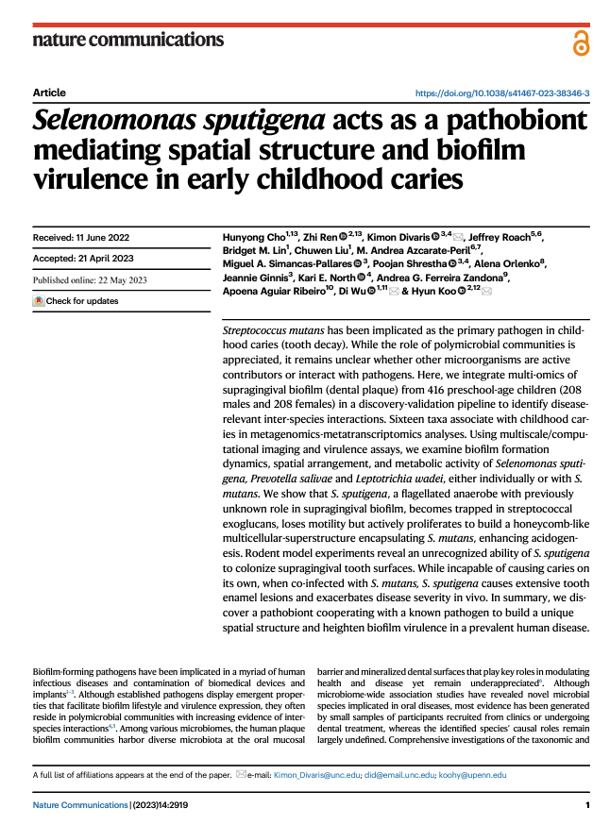
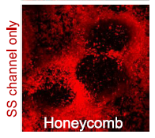
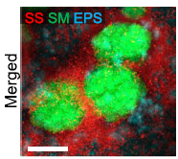
Discovery of a caries-promoting bacteria: Selenomonas sputigena
Plaque from 416 preschoolers
  Metagenomics-metatranscriptomics analyses
  Examined biofilm formation dynamics
S. Sputigena works in partnership with S. Mutans
  Forms honeycomb-like multicellular superstructure, protecting S. Mutans and enhancing acidogenesis.
Highlights potential future target for cavity prevention

Slide 6
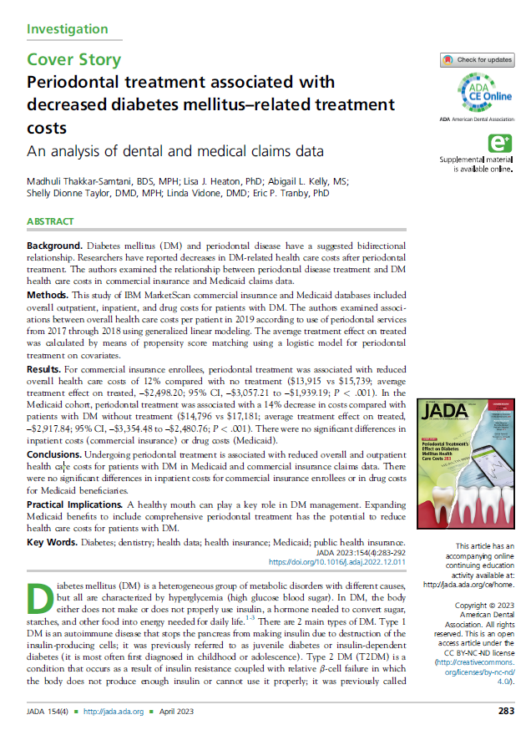
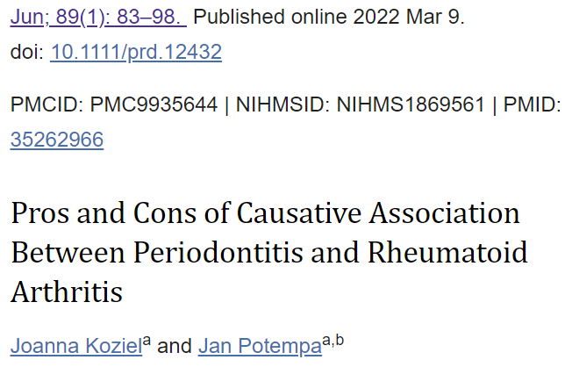
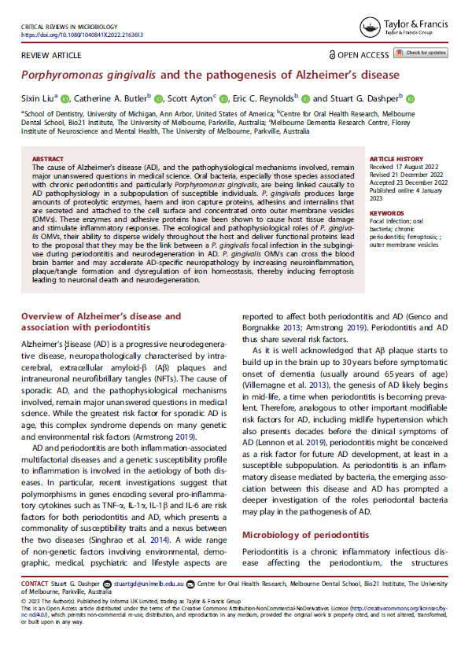
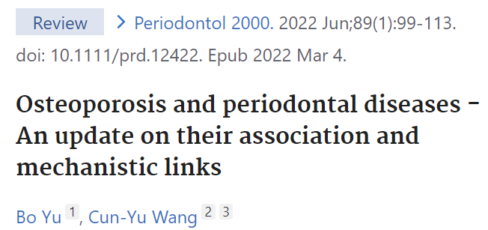
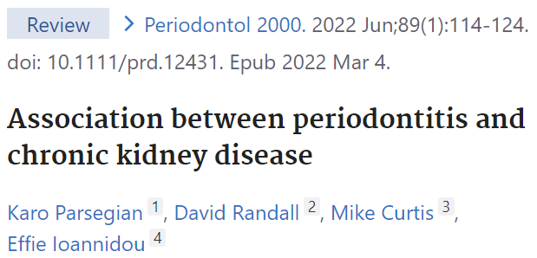
Medical-dental connections: more findings

Slide 7
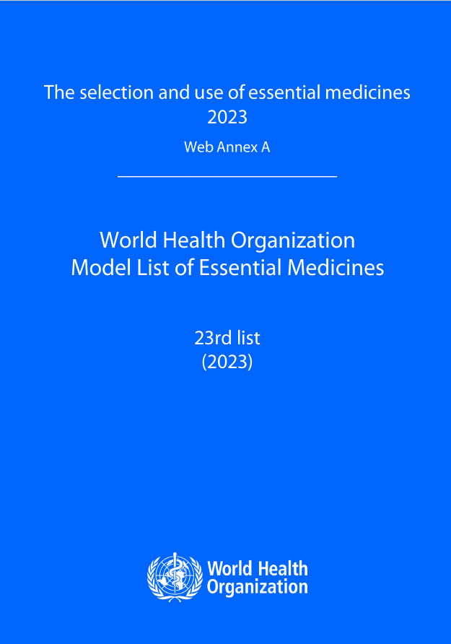
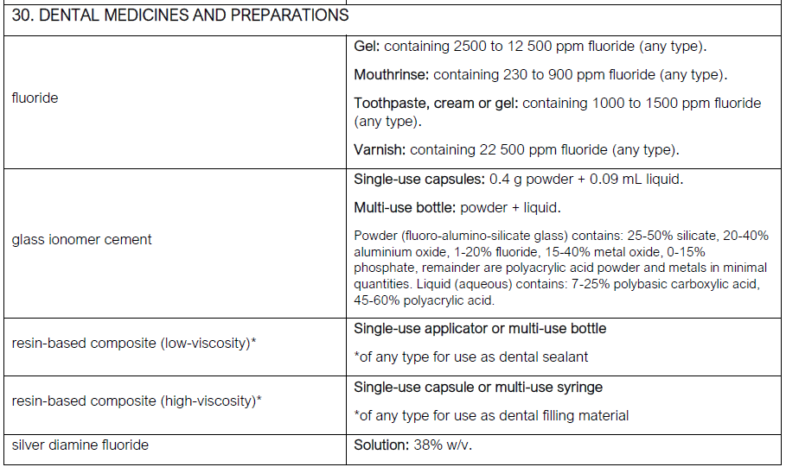
2023 WHO Essential Medicines: Dental

Slide 8
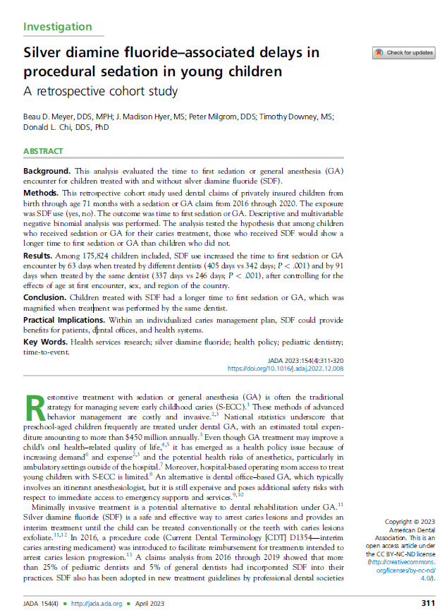
SDF delays GA/sedation
Among 175,824 children ages 0-5 who received GA/sedation, those who received SDF delayed GA/sedation encounter by 2-3 months
Effect increased if consistent dentist
New: SDF gel
https://www.elevateoralcare.com/products/AdvantageArrest/Advantage-Arrest-GEL

Slide 9
CariedAway Study: SDF for prevention
Conducted February 1, 2019 – June 1, 2023
2098 children across 47 NYC public primary schools, grades K-3
School criteria:
  > 80% of students receiving free or low=cost lunch
  > 50% of students reporting Hispanic or Latino/a ethnicity and/or Black race
Interventions:
  SDF on all pits/grooves of molars and premolars + all frank cavitated lesions
    Applied by RDH or trained medical nurses
    Applied 30 seconds, then air-dried 60 seconds
  GI sealants on all pits/grooves of molars and premolars + ART on all frank cavitated lesions
    Finger-sweep technique
  Portable equipment at schools, with dental assistants
Assessed using ICDAS-II for arrested caries and no new caries
What do you think they found?

Slide 10
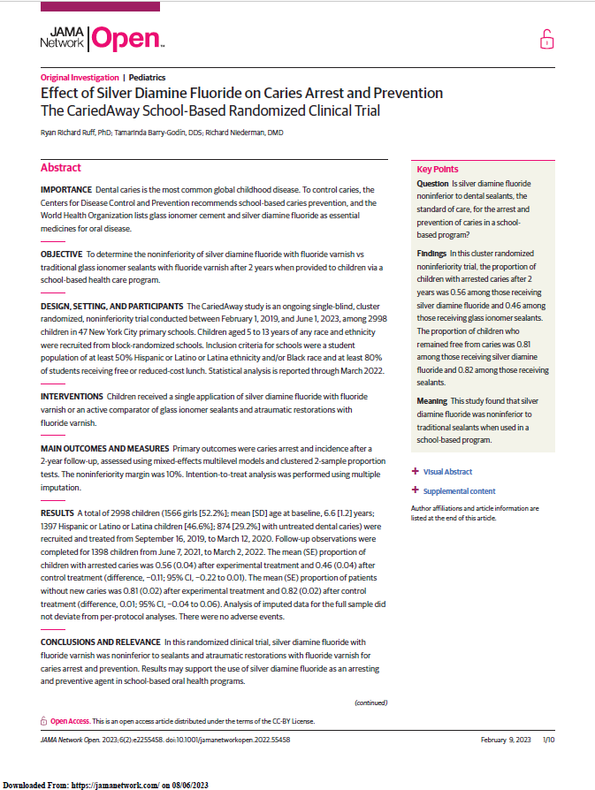
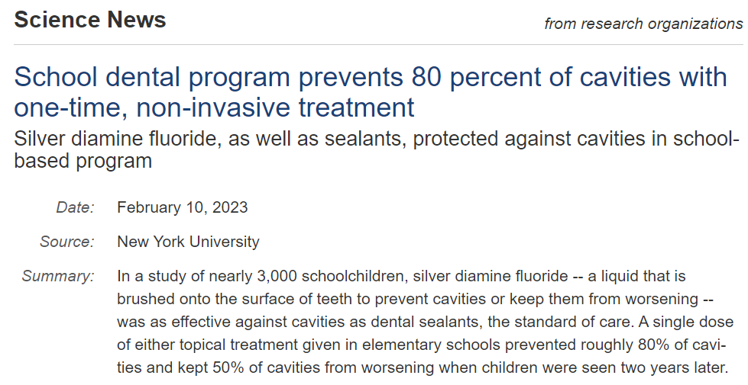
CariedAway Findings
2098 children ages 5-13 across 47 NYC primary schools
Treated once (2019), then followed up after 2+ years
Findings:
>80% caries prevented by 1x SDF or GI sealants
Noninferiority of 1x SDF vs sealants for caries prevention
Noninferiority of SDF application by trained RNs vs RDHs

Slide 11
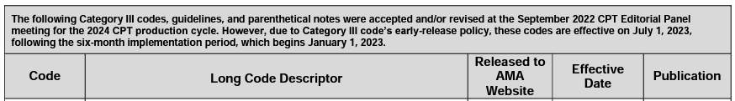
CPT Codes for Silver Diamine Fluoride
D1354: Caries arresting medicament – active caries present
D1355: Caries preventive medicament – no caries present
0792T: SDF treatment in medical practices
  Category III codes for new and emerging technologies, services, and procedures.
    Utility is evaluated after 5 years.
chrome-extension://efaidnbmnnnibpcajpcglclefindmkaj/https://www.ama-assn.org/system/files/cpt-category3-codes-long-descriptors.pdf

Slide 12
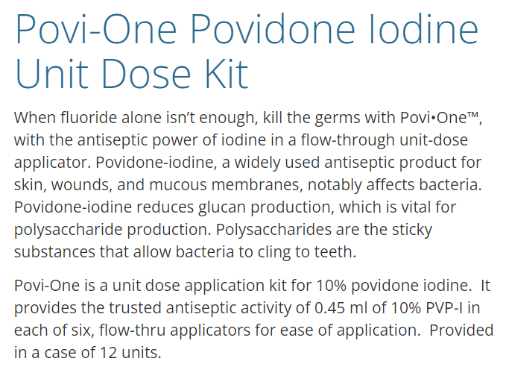
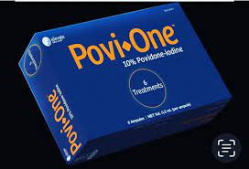
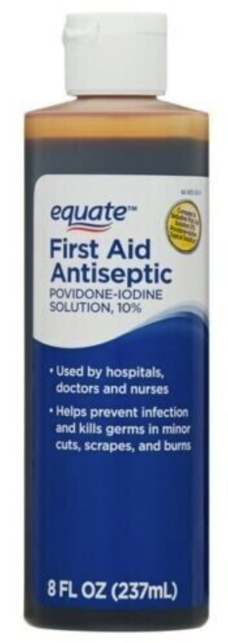
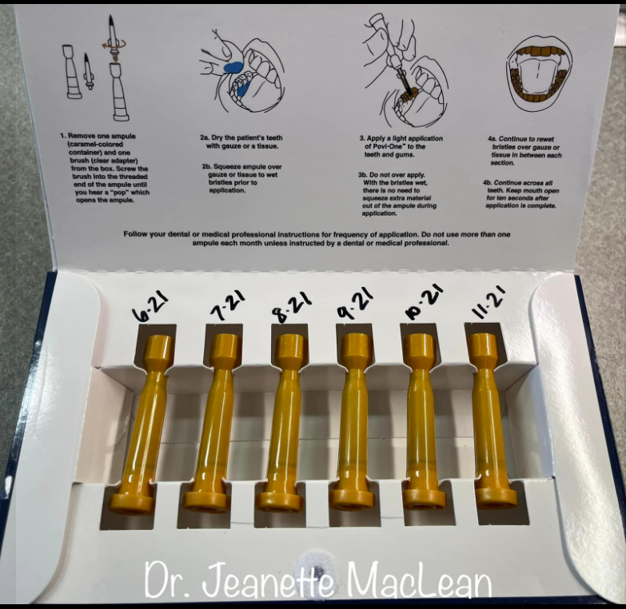
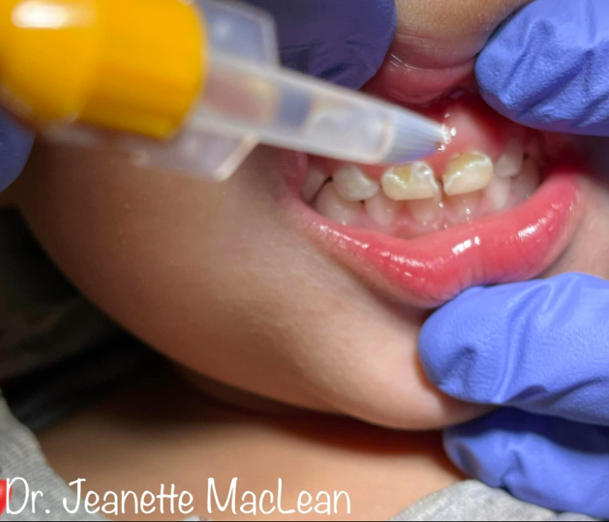

Povidone Iodine packaged for dental/home use
https://www.elevateoralcare.com/Povi-One
Free PI webinar by Dr. Jeremy Horst:
youtu.be/vPrkD1w6388
Free PI webinar by Dr. Sean Kelly:
ihs.gov/DentalCDE course DE0755

Slide 13
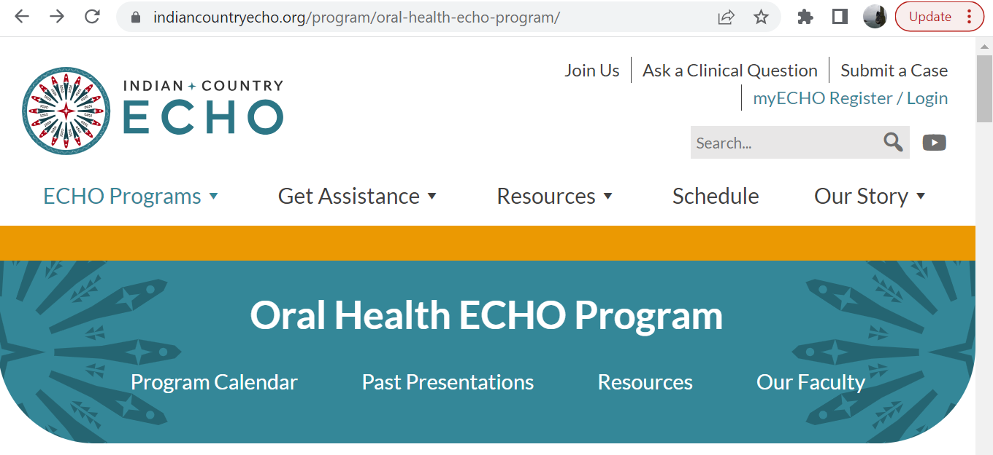
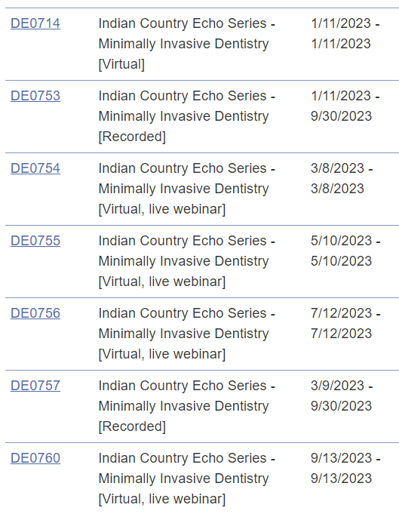
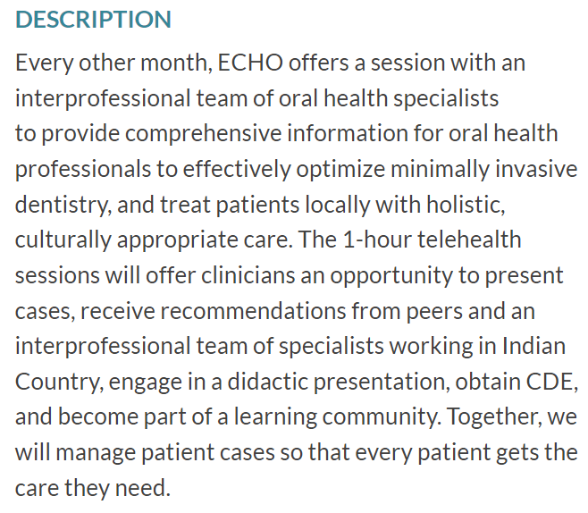
Indian Country ECHO: Extension for Community Health Outcomes
CDE at ihs.gov/dentalCDE
Prevention-focused
Case presentations
Didactic + Discussion

Slide 14
Presentation Outline:
Reinforcing 2022 concepts
  Caries-promoting bacteria
  Medical - dental connection
  World Health Organization – essential medicines
  CarriedAway study: description, findings
  SDF: CPT codes, gel option
  PVI packaged for dental home use
  ECHO
Trending in 2023
  Probiotics and postbiotics
  Artificial Intelligence
Looking to the future
  Different Kind: Patient Experience
  WHO Global Oral Health Status Report
  Representation matters in the workforce
  CareQuest White Paper
  Wy’East Dentistry

Slide 15
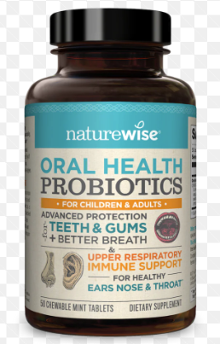
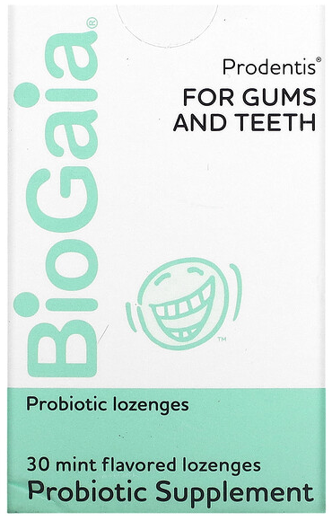
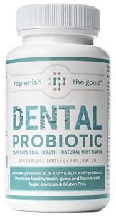
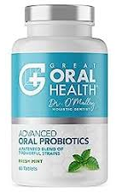
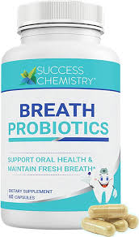
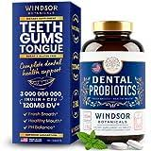
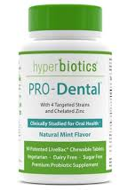
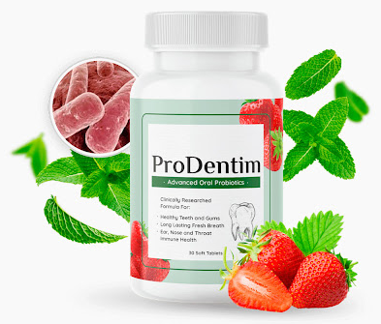
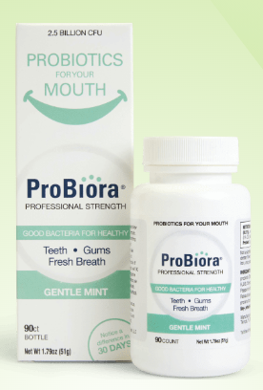
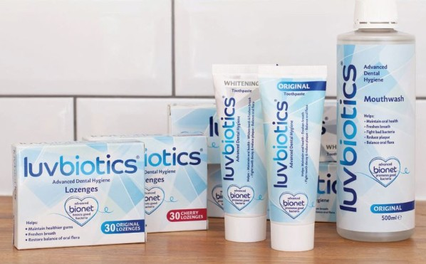
Probiotics?

Slide 16
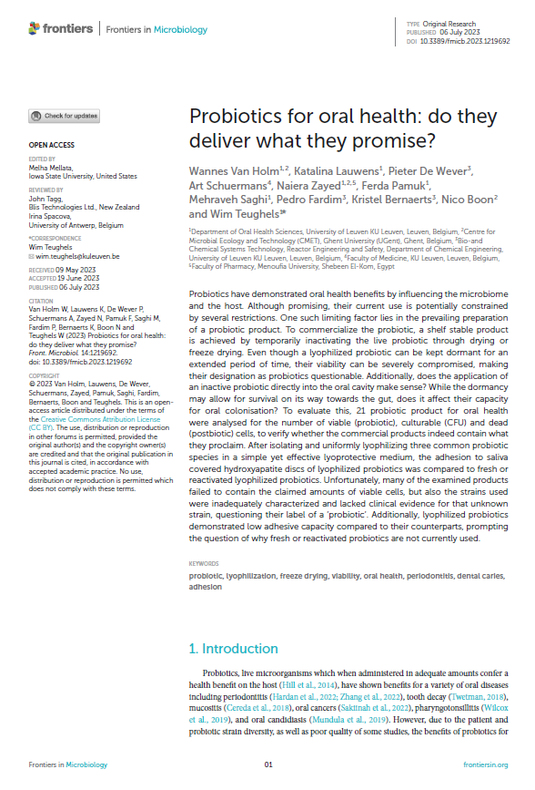
What’s in there?
Types tend to be present as advertised
Fewer remained alive (probiotic)
Potential health benefits of postbiotics are discussed

Slide 17
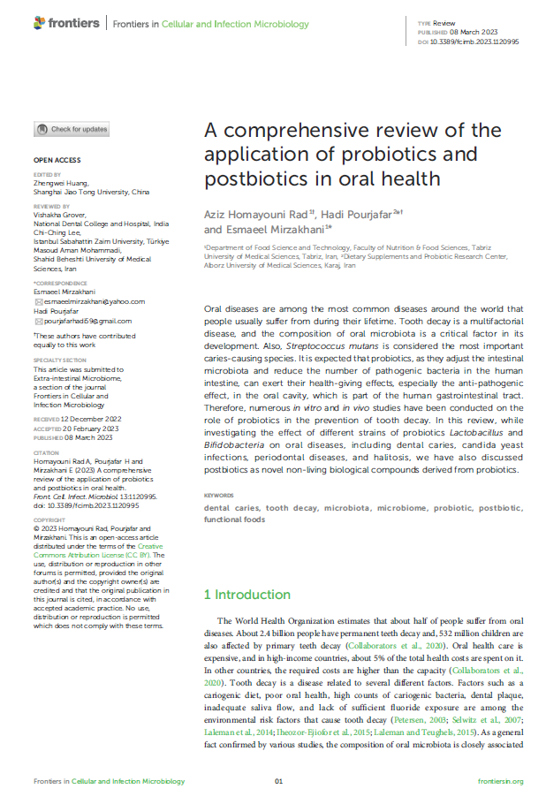
Probiotics
(and/or postbiotics) have been shown to improve oral health
Review of 54 studies between 2001 – 2020
Some showed little to no effect.
Many showed significant effects:
Decrease in S. Mutans
Antioxidant effect → reduced free radicals → less plaque
Increased pH (neutralizing acid)
Reduced caries and periodontal disease

Slide 18
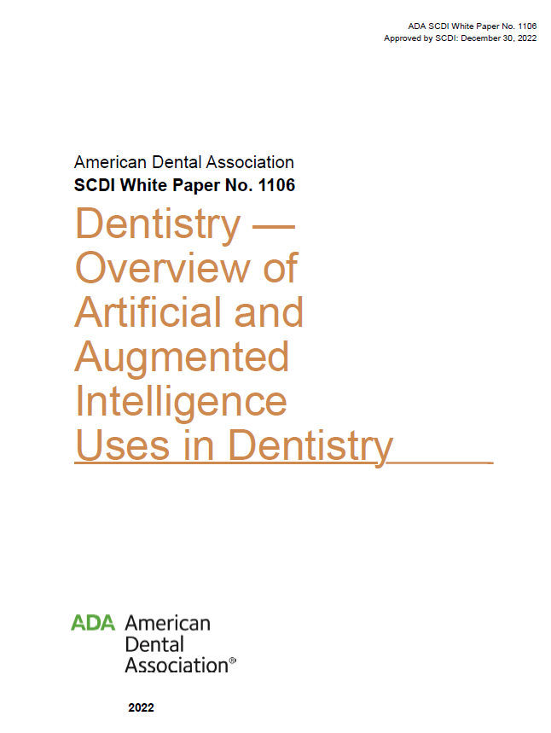
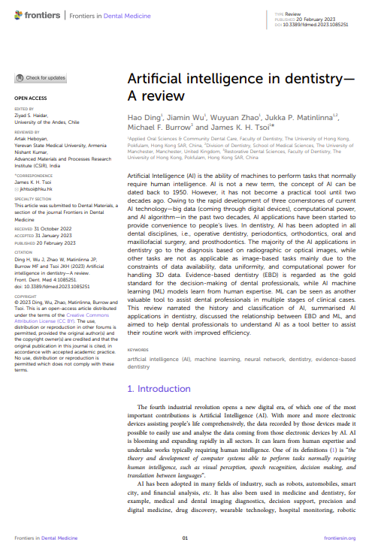

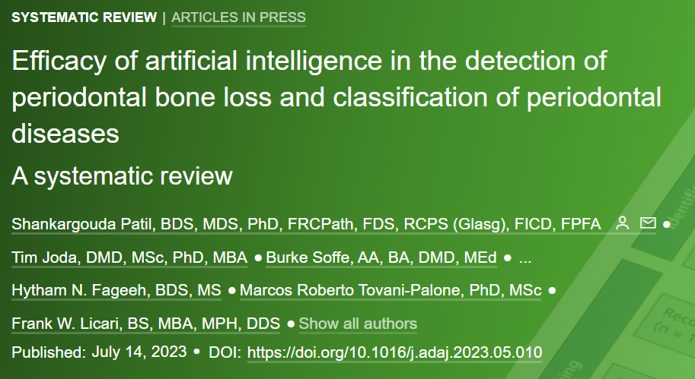

Slide 19
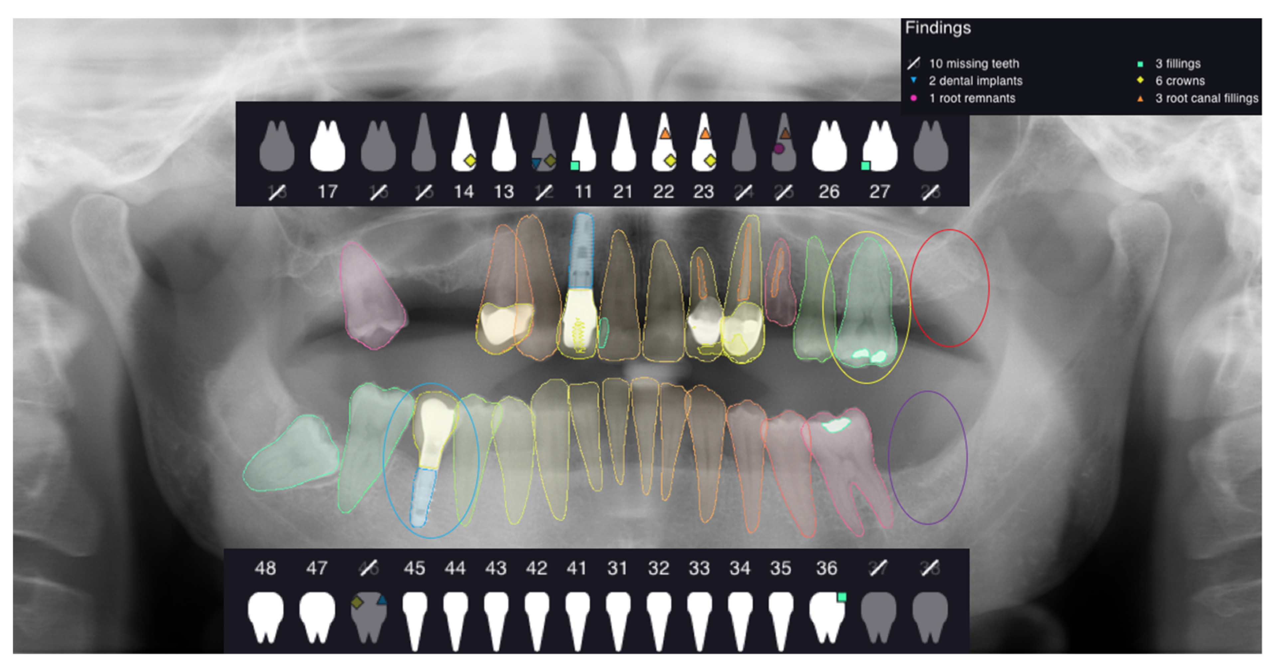
Artificial Intelligence: detecting disease
FDA-cleared to detect:
  Caries
  Calculus
  Bone level
Removes bias
Reduces error
Calibrates providers and payors
Can compare patient’s own data over time
Perio, endo, implant uses
Patient education

Slide 20
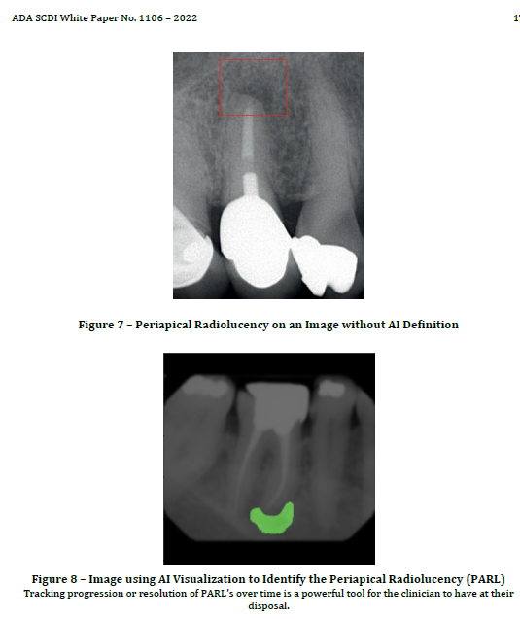

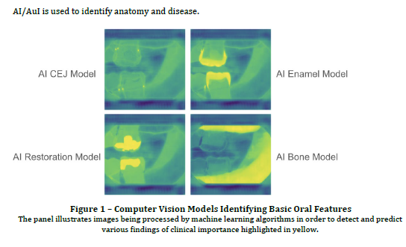
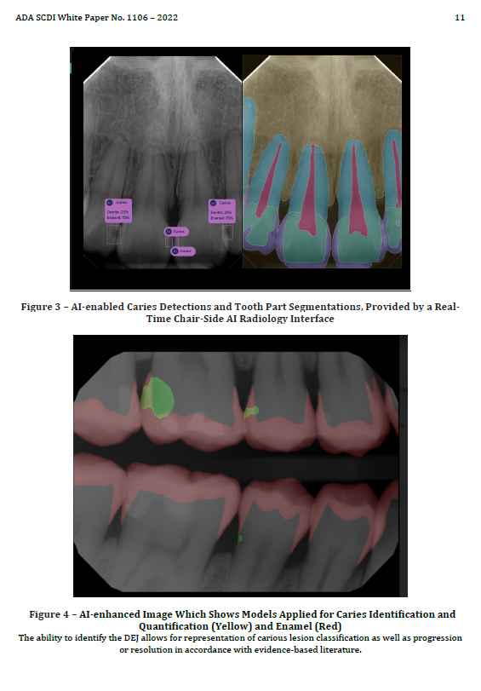
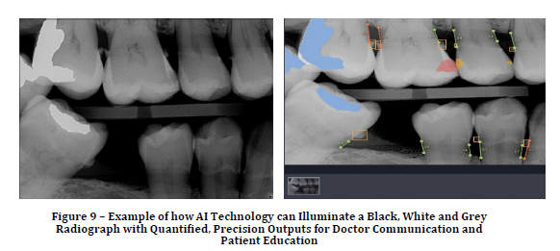

AI

Slide 21
Presentation Outline:
Reinforcing 2022 concepts
  Caries-promoting bacteria
  Medical - dental connection
  World Health Organization – essential medicines
  CarriedAway study: description, findings
  SDF: CPT codes, gel option
  PVI packaged for dental home use
  ECHO
Trending in 2023
  Probiotics and postbiotics
  Artificial Intelligence
Looking to the future
  Different Kind: Patient Experience
  WHO Global Oral Health Status Report
  Representation matters in the workforce
  CareQuest White Paper
  Wy’East Dentistry

Slide 22
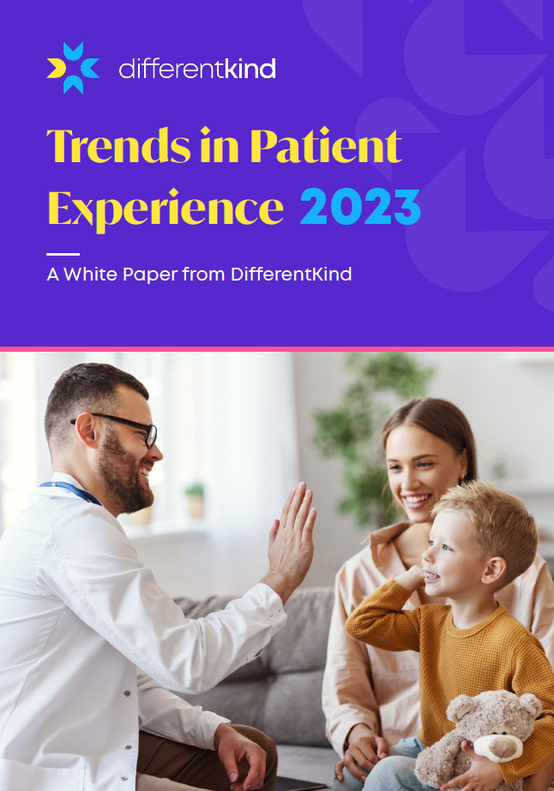
Different Kind: Trends in Patient Experience
Patient experience:
  What is it? What shapes it?
  Why do we care?
    Return on investment: the business perspective
  How do we measure patient experience?
    KPIs Across continuum of care
  What correlates most with positive patient experience?
    Cultivating skills for active listening, shared decision-making.

Slide 23
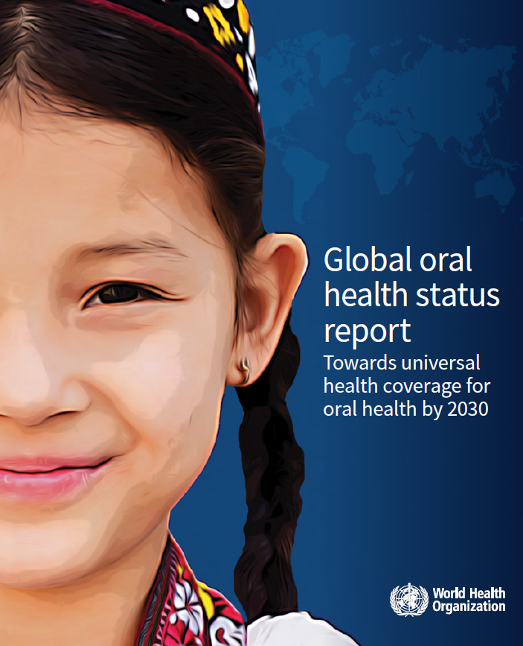
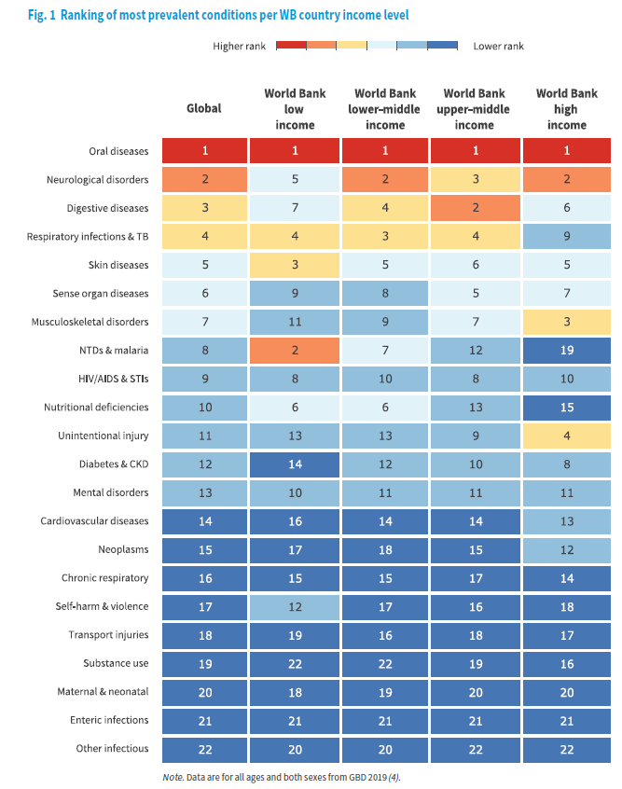
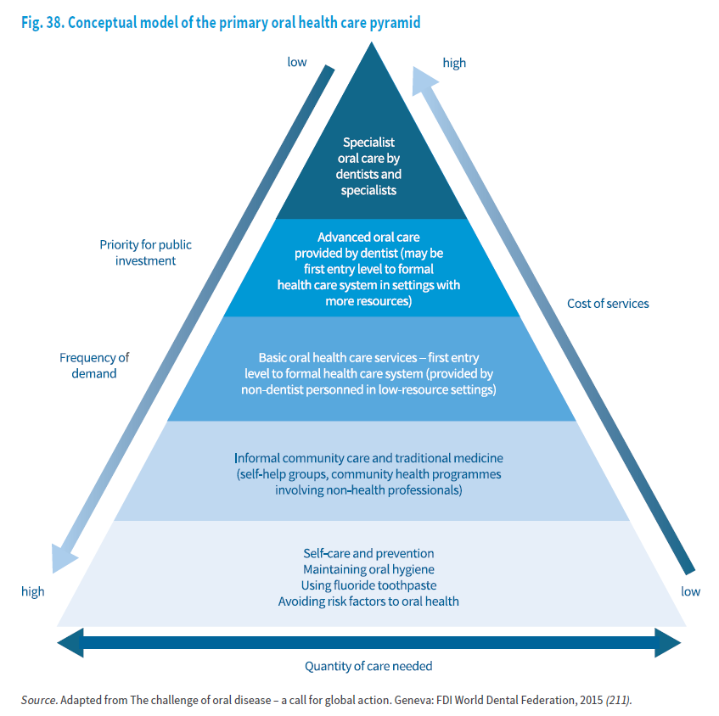
Foundation: protective behaviors and community
Published Nov 18, 2022

Slide 24
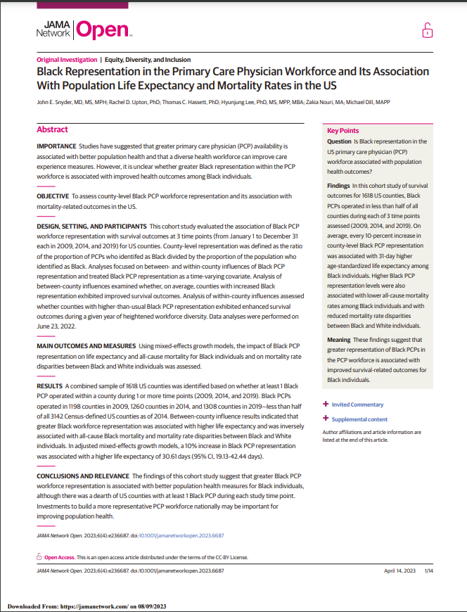
Representation matters: health effects of representation in the healthcare workforce
Increased black primary care physician workforce correlated with measurably better health outcomes at the population level.
Diversifying the workforce is a method of preventing disease.

Slide 25
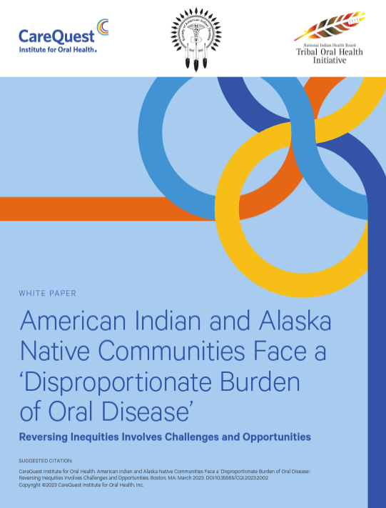
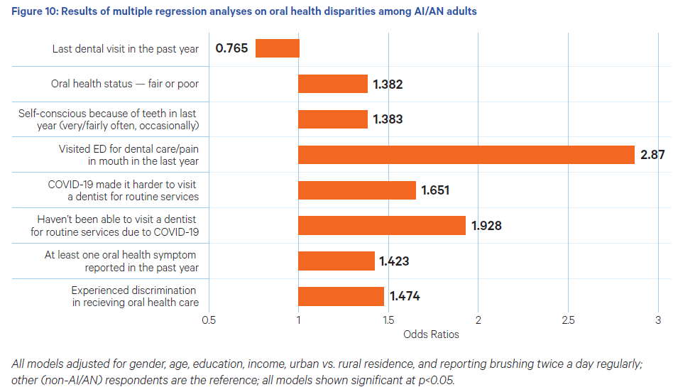
  State of OralHealth Equity in America (SOHEA)
    2022 Survey
    Designed by CareQuest Institute
    Conducted by NORC AmeriSpeak
  Discussion with and co-authored by AI/AN dentists and Native-led organizations
  Recommendations for:
    Research, Education, Workforce, Grantmaking, Policy

Slide 26
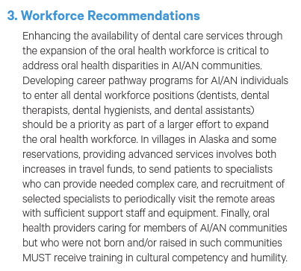

Slide 27
Representation matters:
Northwest AI/AN pathways into dental careers
Training in local clinics
  Tribal clinics employing community members
Dental Health Aide Program
  Northwest Portland Area Indian Health Board
    More information tomorrow!
Wy’East Dentistry
  Northwest Native American Center of Excellence (NNACOE)
  at Oregon Health Science University

Slide 28



Chloe Craig DMD, MPH
Cherokee
Wy’east Dentistry Pathway Program Manager

Slide 29

Notes:
Wy’East Academic Enhancement – NEW DAWN – (DECK CHAIRS ON TITANIC)
ONE SCHOOL – OHSU – increase number of AIAN matriculants by over 15% if trends hold
Collectively applied to over 100 medical schools – rejected from ALL OF THEM – now they are future health leaders!

Slide 30




NNACoE Affirmations
Native youth are curious & knowledgeable
Natives are drawn to STEMM fields
Natives are qualified applicants
Natives are the future health leaders

Slide 31



10 month pathway (September-June)
Cohort size:4-6 learners
Tuition free
Living stipend provided
EARN conditional acceptance at OHSU School of Dentistry
Application cycle opens Summer 2024

Slide 32


Slide 33

Notes:
Wy’East Academic Enhancement – NEW DAWN – (DECK CHAIRS ON TITANIC)
ONE SCHOOL – OHSU – increase number of AIAN matriculants by over 15% if trends hold
Collectively applied to over 100 medical schools – rejected from ALL OF THEM – now they are future health leaders!

Slide 34




Erik Brodt, MD (Ojibwe)
Anishinaabe / Minnesota Chippewa
Director, NNACoE

Slide 35



Allison Empey, MD
Confederated Tribes of Grand Ronde
Wy’east Faculty, Indigenous Health & Wellness
Notes:
To promote scholars’ sense of cultural connectedness and community through immersion in a rich Indigenous community, Indigenous coursework, and cultural activities

Slide 36




Cristi Pinela, MS, PhD
Rarámuri / Tarahumara
Wy’east Faculty, Academic Skills & Wellness
Notes:
Evidence based study methods

Slide 37


nnacoe.org

Slide 38

Questions?
https://www.nnacoe.org/wyeast-dentistry
craigch@ohsu.edu

