Slide 1





Northwest Dental Health Aide Program
Portland Area Dental Meeting-2023
Miranda Davis, Dental Health Aide Program Director
Pam Ready, Dental Health Aide Program Manager
Kari Ann Kuntzelman, Dental Health Aide Specialist
Notes:
1

Slide 2

Objectives
  History of the Northwest Dental Health Aide Program: Following Alaska's lead
  Organizational Infrastructure
  Learn the settings Dental Health Aides are authorized to work in
  Adapting to the Pacific Northwest
  Program updates
Notes:
2

Slide 3
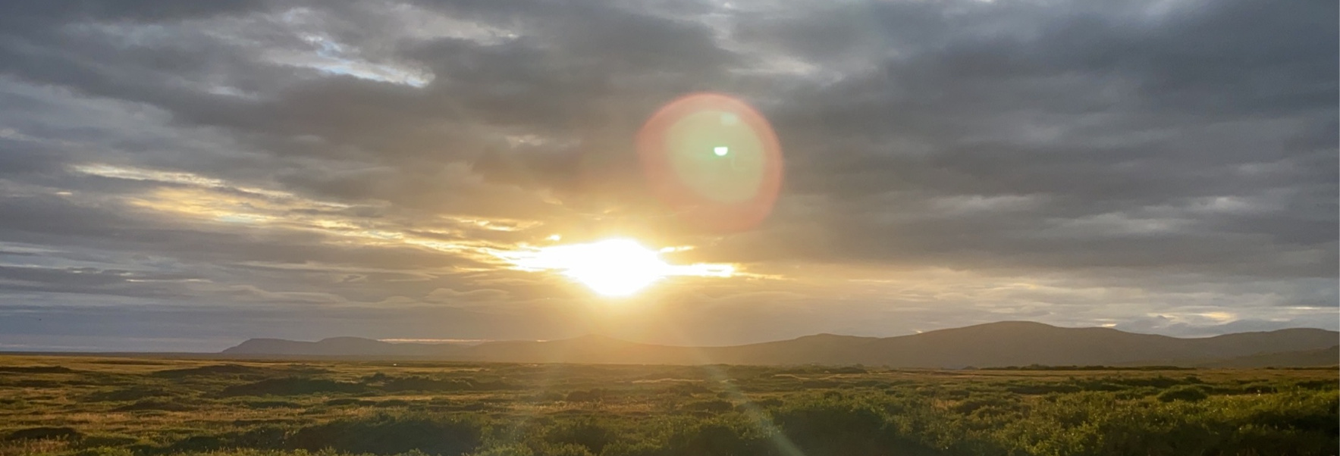
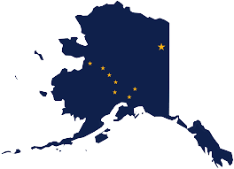
ALASKA
CHAP ORIGINS
Nome, AK Aug 2022
1950'S ORGINATED IN RESPONSE TO TB EPIDEMIC
1990'S ALASKA COMMUNITY HEALTH AIDE PROGRAM CERTIFICATION BOARD FORMALIZED
https://akchap.org/
1960'S INDIAN HEALTH SERVICE (IHS) ESTABLISHES THE COMMUNITY HEALTH AIDE PROGRAM (CHAP) IN ALASKA (THIS ONLY INCLUDED MID-LEVEL MEDICAL PROVIDERS WHO WERE COMMUNITY HEALTH AIDES).
2000'S DENTAL HEALTH AIDE AND BEHAVIORAL HEALTH AIDE PROGRAMS CREATED AND CERTIFIED
2010 : IN REAUTHORIZATION OF IHCIA, CONGRESS AUTHORIZES NATIONALIZATION OF CHAP
1970'S CONGRESS AMENDS THE INDIAN HEALTH CARE IMPROVEMENT ACT (IHCIA) TO AUTHORIZE THE Alaska CHAP (PL 94-437).
2020 IHS releases policy outlining nationalization of CHAP (Circular 20-06)
https://www.ihs.gov/chap/backgroun/

Slide 4
History of the NW DHAP
  Began in 2015 as the Native Dental Therapy Initiative (NDTI)
    Because Dental Health Aide Therapist (DHAT) is the only profession within CHAP that is noted in IHCIA as requiring authorization from the state
  NDTI focused on assessment and developing infrastructure for the profession of dental therapy in Portland Area
    Advisory Committees
    Oregon Dental Pilot Project #100 (2016-2023)
    Legislation in WA (2017, 2023), ID (2019), and OR (2021)
    State Plan Amendments
    Development of dental therapy education program
  Began work to plan and implement other DHA types in 2021
    Added title: Dental Health Aide Program, which oversees NDTI
Notes:
2

Slide 5
Dental Therapy Timeline in WA, OR, ID
2016
First Dental Therapist hired by Swinomish Tribe
Oregon Dental Pilot Project #100 approved
2017
Washington State passes Dental Therapy Legislation
2018
Dental Therapy Education Program Feasibility Study and Advisory Committee
2019
Idaho passes Dental Therapy Legislation
2021
Oregon passes Dental Therapy Legislation
2022
dəxʷx̌ayəbus DT Education Program receives CODA Accreditation, enrolls first class
Washington State passes state wide legislation
2023

Slide 6

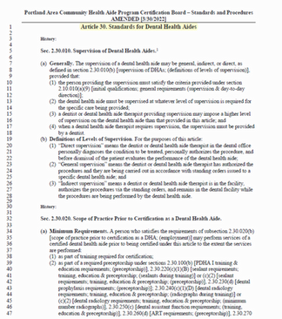
Dental Health Aide Program Infrastructure
5
4
Dental Health Aide Program Advisory Workgroup- 3.2023
Integrate your branding into your business.
3
Dental Accademic Review Committee-3.2022
2
Portland Area CHAP Certification Board- 2021
1
Resolution-all 43 tribes agree on CHAP-7.15.2020
Tribes- 43 Federally Recognized tribes in OR, WA and ID
Standards and Procedures

Slide 7



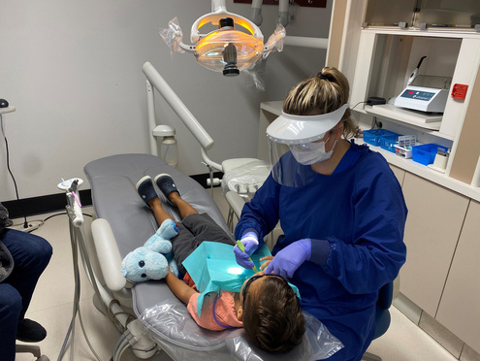
DHAs Increase Access and Efficiency
PDHA
      OHI, motivational interviewing
      Polish, antimicrobials, fluoride
      Dental Assisting
EFDHA
      Place Restorations
      PDHA services
DHAH
      RDH procedures including local anesthesia
      PDHA, EFDHA services
DHAT
      Exam, diagnose
      Prep, restore and finish
      Non-surgical extractions
Kari Kuntzelman, DHAT, LDT, Oregon, 2020
Dentist
      Complex services (RCT, crowns, surgery)
      Supervising Dental Health Aides

Slide 8

For more information please contact:
pready@npaihb.org
kkuntzelman@npaihb.org
mdavis@npaihb.org
Dental Health Aide Program
https://www.tchpp.org/about-dhas
Primary Dental Health Aide I PDHA I | Primary Dental Health Aide II PDHA II | Expanded Functions Dental Health Aide I EFDHA I | Expanded Function Dental Health Aide II EFDHA II | Dental Health Aide Hygienist DHAH | Dental Health Aide Therapist DHAT
Required Courses | Required Courses | Required Courses | Required Courses | Required training & education | Required training & education
 | PDHA I and: | PDHA II and: | EFDHA I and:
Core Curriculum | Advanced Dental Procedures | Basic Restorative Functions | Advanced Restorative Functions | Accredited DH Program or Board approved DHAH Program | Accredited DT Program or Board Approved DHAT Program
Primary Oral Health Promotion and Disease Prevention | Community Based Dental Practice | Prefabricated Crown Placement | Preceptorship - 6 months or 800 hrs | Accredited DH Program or Board approved DHAH Program | Accredited DT Program or Board Approved DHAT Program
 | One or more of the following: Dental Assistant Functions Sealants Dental Prophylaxis Radiology Atraumatic Restorative Treatment | Preceptorship - 6 months or 800 hrs | Preceptorship - 6 months or 800 hrs | Accredited DH Program or Board approved DHAH Program | Accredited DT Program or Board Approved DHAT Program
Preceptorship - specific # of procedures | Preceptorship (s) - specific # of procedures | Preceptorship - 6 months or 800 hrs | Preceptorship - 6 months or 800 hrs | Accredited DH Program or Board approved DHAH Program | Accredited DT Program or Board Approved DHAT Program
Preceptorship - specific # of procedures | Preceptorship (s) - specific # of procedures | Preceptorship - 6 months or 800 hrs | Preceptorship - 6 months or 800 hrs | Accredited DH Program or Board approved DHAH Program | Accredited DT Program or Board Approved DHAT Program

Slide 9
NW Tribes Guiding the Dental Health Aide Progam
  DHA CHAP Analysis:
    Outreach conducted with Area Tribes and clinics to explore familiarity with CHAP, offer information, and ensure that DHA Program development is meeting their needs
    Dental clinics interested in DHA program to enhance exiting DAs skills and train new DAs
  DHA Program Advisory Workgroup
    All tribes and staff welcome to participate
    Guiding development of DHA Program
    Next meeting: September 13, 12pm-1pm Pacific Time
Notes:
2

Slide 10
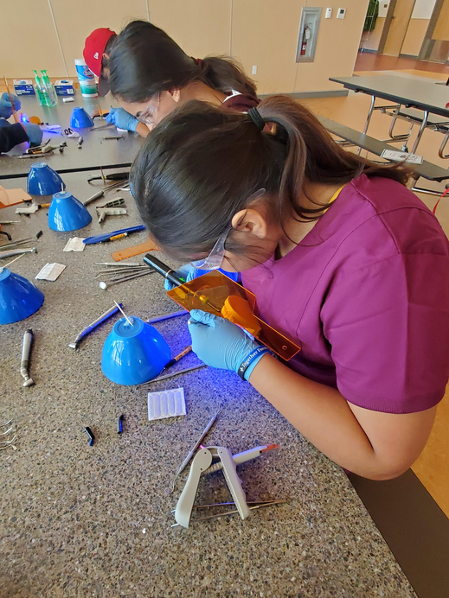
Outreach: Tribal Schools
  Nixya’awii Community School - CTUIR Charter School
    June 2022: Educational dental unit to capture interest in the core curriculum course
    August - November 2023: Core Curriculum course
  Chief Leschi Schools - Puyallup Tribe
    Dental careers information
      High School Career and Technical Ed
      Elementary STEM Enrichment
      2022 and 2023
***Please contact the DHAP if you are interested in adding these programs to your community.
Notes:
2

Slide 11
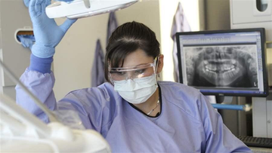
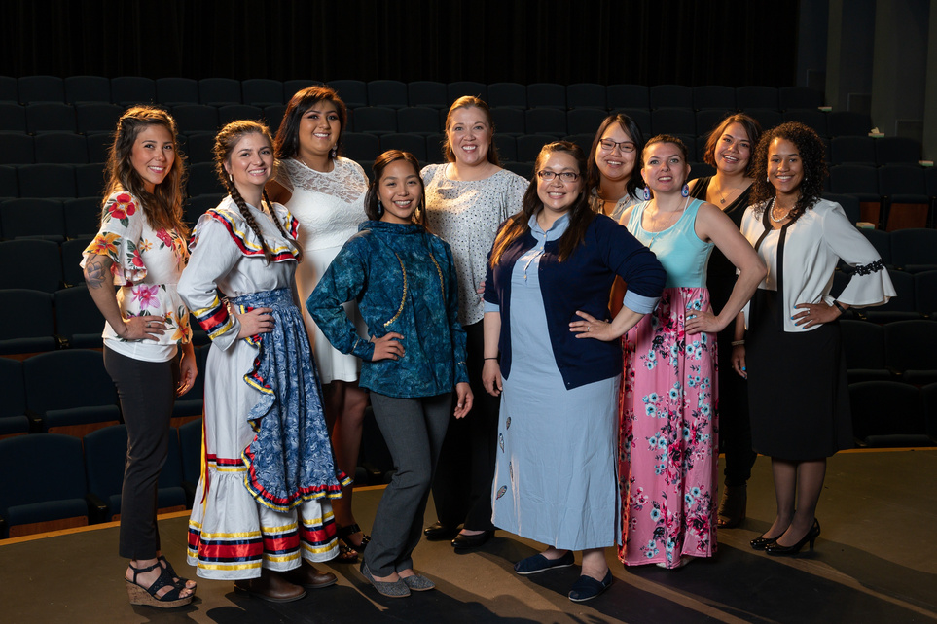
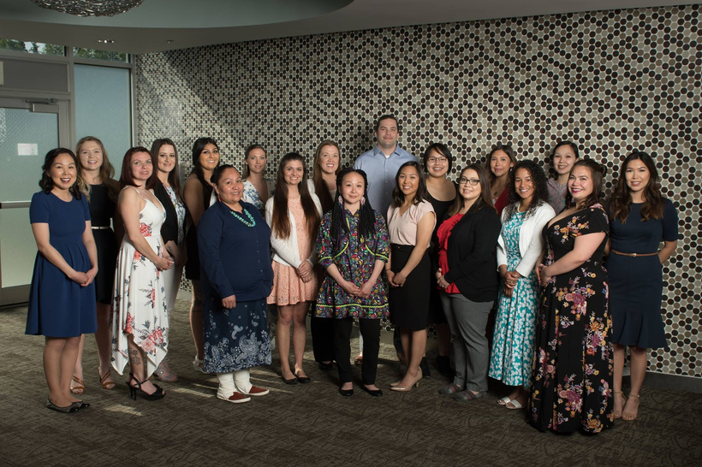
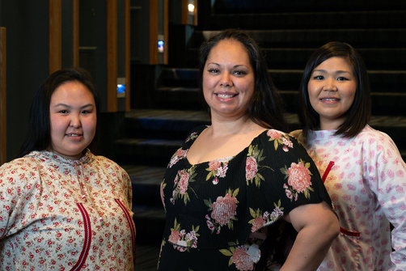
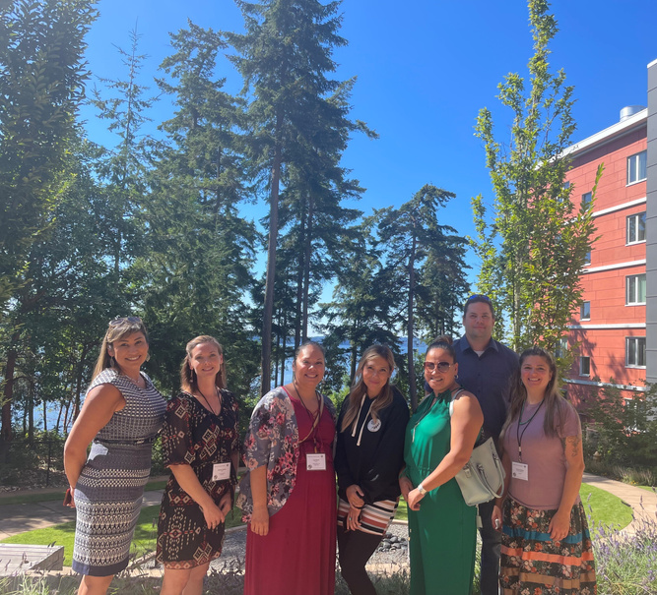
MENTORSHIP
  Elders recruitment
  Communication
  Portland Area CHAP CertificationCertification assistance
  Recruitment for AWG's/ARC's
Notes:
2

Slide 12
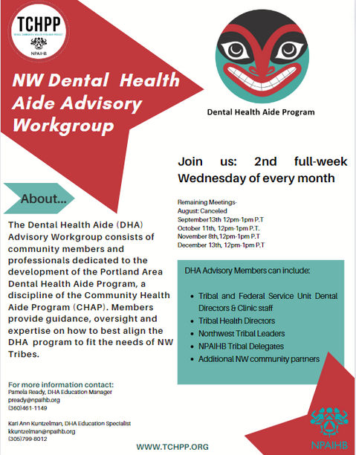

PROGRAM UPDATE
https://www.tchpp.org/-academic-review-committees
Notes:
2

Slide 13
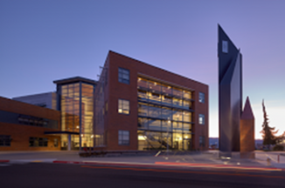

dəxʷxayəbus (Place of Smiles) Dental Therapy Program
Skagit Valley College, 2019
  2022: CODA Accreditation and enrolled first cohort
  Currently recruiting for 3rd cohort beginning September 2024
  5 students accepted for the 2023 cohort
  NPAIHB continues to coordinate advisory committee
Notes:
2

Slide 14
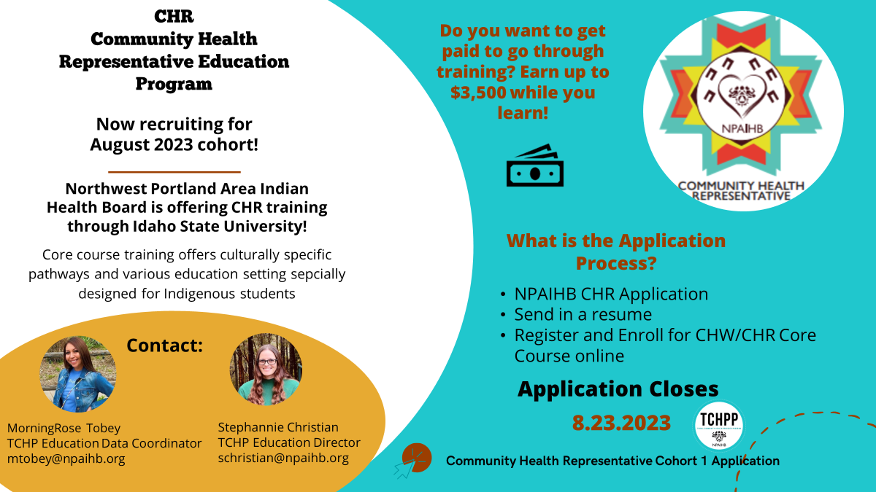

Slide 15

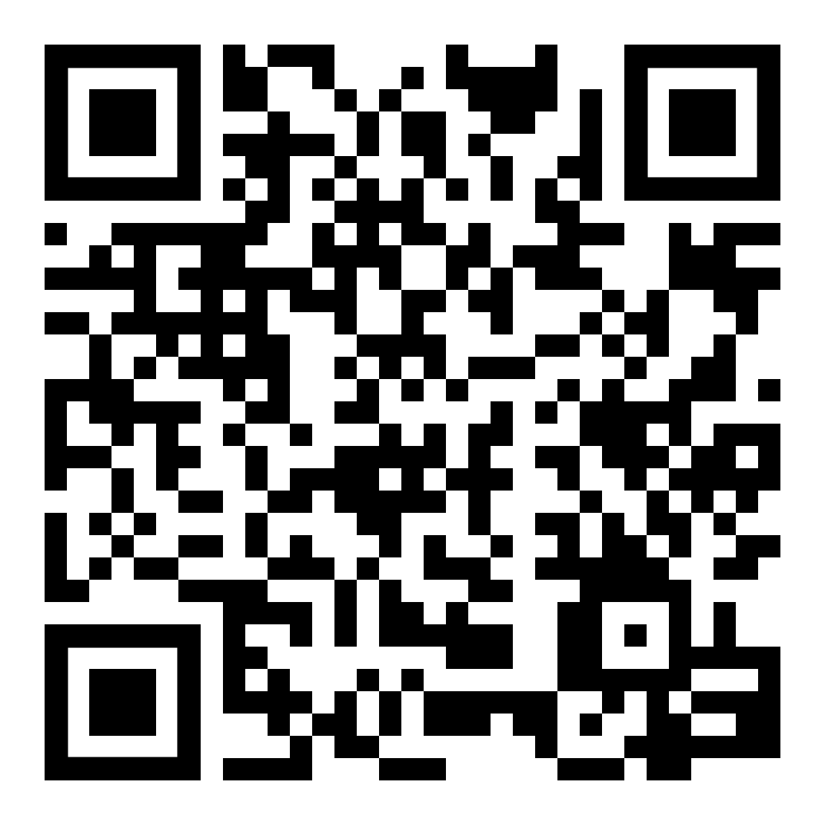

Slide 16

THANK YOU
www.tchpp.org
pready@npaihb.org
mdavis@npaihb.org
kkuntzelman@npaihb.org

