Slide 1
We Smile Collaborative:
Panel of Participants
Northwest Tribal Dental Support Center
Portland Area Dental Meeting
August 16, 2023

Slide 2
Course Objectives:
1. Describe three benefits We Smile participants experienced
2. List the three aims the Collaboratives hope to accomplish
3. Name the focus of the 2023 NTDSC-Arcora Collaborative

Slide 3


NTDSC – Arcora Collaboratives
2013 – 2019: Baby Teeth Matter
2018 – 2020: Elders’ Initiative
2021 – 2023: We Smile: MID Style
2023 – 20__: Wee Smile (ages 0-5)
Aims:
1. Increase access to care
2. Decrease disease / improve health
3. Improve patients’ experience

Slide 4
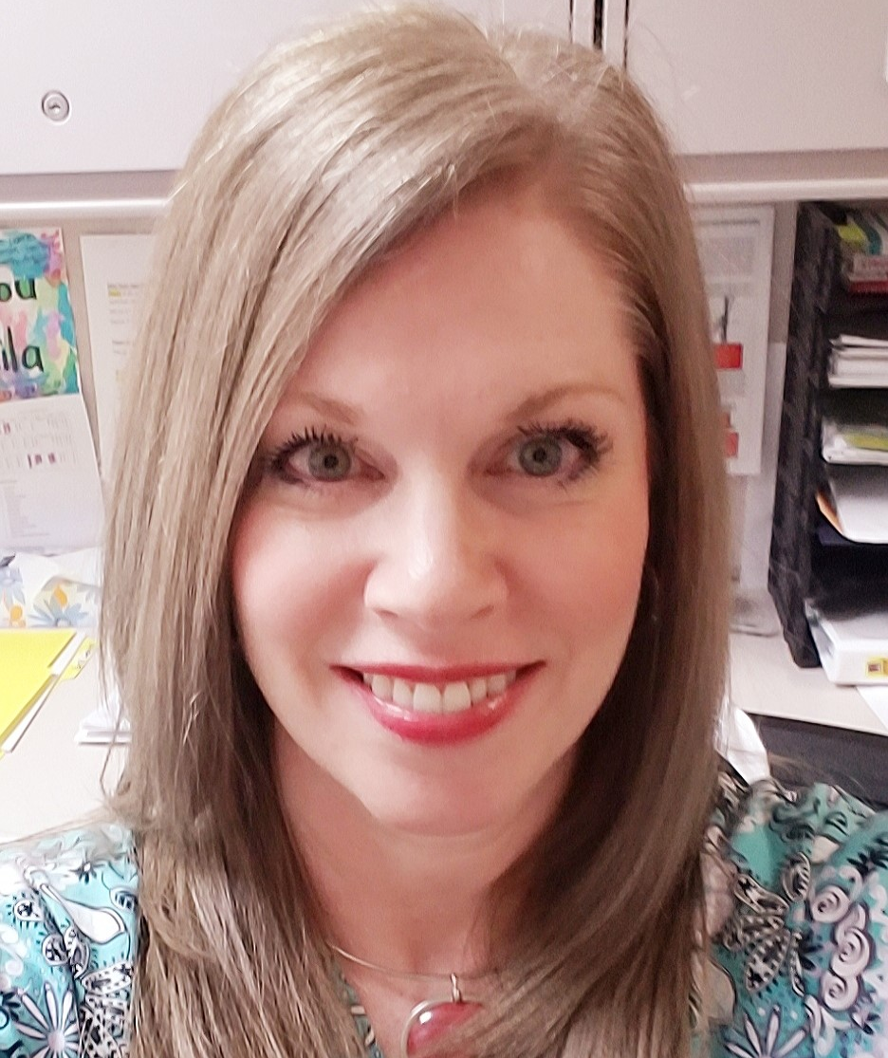
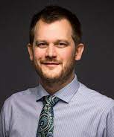
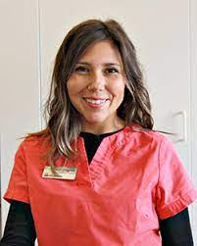
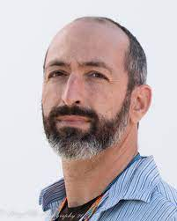
We Smile: MID Style – Panelists
Sheila Blacketer, RDH
Grand Ronde Tribe
Dental clinic Director
Dr. Taylor Wilkens
Coeur D’Alene Tribe
Dental clinic Director
Sarah Chagnon,
Swinomish Tribe
Dental Therapist
Dr. Joseph Churchill
Lower Elwha Klallam Tribe
Dental clinic Director

Slide 5
Why did your clinic decide to participate in the We Smile Collaborative?

Slide 6
Tell us about your experience participating in the We Smile Collaborative

Slide 7
Did anything change for your clinic as a result of participating in the We Smile Collaborative?

Slide 8
Did anything change for your community as a result of the We Smile Collaborative?

Slide 9
Did anything surprise you while participating in the We Smile Collaborative?

Slide 10
